Slide 1
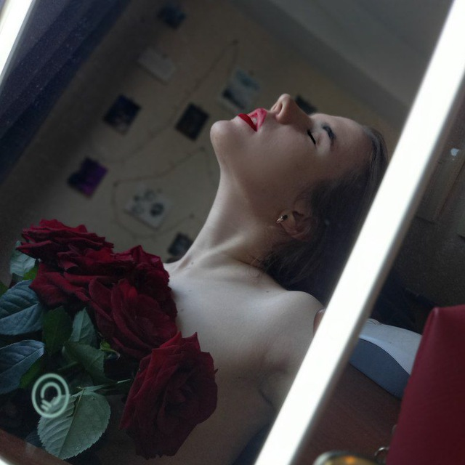
Пример изображения
Картинка 1
Картинка 1
Картинка 1

Slide 2
Таблица с результатами (Часть 1/5)
Product | Price | Description
Khinkali | 59 | To take a girl out to eat, but nothing more
Manti | 79 | For grated peppers, who really know what they want
Poses | 69 | For truly true connoisseurs of delicious food and good rest
Rolls | 200 | To feed a girl at home, an expensive thing made of rice and fish and a lot of fat, some people like it, I don't judge, but I need the text here to be as long as possible, so I'll write a few more words about it. The end
Product | Price | Description

Slide 3
Таблица с результатами (Часть 2/5)
Product | Price | Description
Khinkali | 205 | To take a girl out to eat, but nothing more
Manti | 246.3 | For grated peppers, who really know what they want
Poses | 287.6 | For truly true connoisseurs of delicious food and good rest
Rolls | 328.9 | To feed a girl at home, an expensive thing made of rice and fish and a lot of fat, some people like it, I don't judge, but I need the text here to be as long as possible, so I'll write a few more words about it. The end
Product | Price | Description

Slide 4
Таблица с результатами (Часть 3/5)
Product | Price | Description
Khinkali | 370.2 | To take a girl out to eat, but nothing more
Manti | 411.5 | For grated peppers, who really know what they want
Poses | 452.8 | For truly true connoisseurs of delicious food and good rest
Rolls | 494.1 | To feed a girl at home, an expensive thing made of rice and fish and a lot of fat, some people like it, I don't judge, but I need the text here to be as long as possible, so I'll write a few more words about it. The end
Product | Price | Description

Slide 5
Таблица с результатами (Часть 4/5)
Product | Price | Description
Khinkali | 535.4 | To take a girl out to eat, but nothing more
Manti | 576.7 | For grated peppers, who really know what they want
Poses | 618 | For truly true connoisseurs of delicious food and good rest
Rolls | 659.3 | To feed a girl at home, an expensive thing made of rice and fish and a lot of fat, some people like it, I don't judge, but I need the text here to be as long as possible, so I'll write a few more words about it. The end
Product | Price | Description

Slide 6
Таблица с результатами (Часть 5/5)
Product | Price | Description
Khinkali | 700.6 | To take a girl out to eat, but nothing more
Manti | 741.9 | For grated peppers, who really know what they want
Poses | 783.2 | For truly true connoisseurs of delicious food and good rest
Rolls | 824.5 | To feed a girl at home, an expensive thing made of rice and fish and a lot of fat, some people like it, I don't judge, but I need the text here to be as long as possible, so I'll write a few more words about it. The end
Product | Price | Description

Slide 7
Выводы
Резюме и рекомендации
Система работает как ожидалось...
Дополнительные выводы
Следующие шаги обсуждаются отдельно

