Slide 1
BYOC CAPSTONE / DATA ANALYTICS
Intelligent Credit Card
Fraud Detection
Explainable, cost-aware triage for rare fraudulent transactions
0.167%
0.786
81.1%
Model score is not a calibrated probability.
Fraud prevalence after dedup
XGBoost test average precision
Recall at score threshold 0.50
Prepared 11 Oct 2026 | Dataset: ULB / Kaggle anonymized benchmark

Slide 2
BYOC CAPSTONE
The business problem is a queue trade-off
Fraud is rare: the majority class dominates every simple metric.
False negatives can allow fraud; false positives create friction and investigator workload.
A useful system must expose score threshold, alert volume, fraud capture and missed cases together.
99.87%
0%
Test accuracy if all transactions called legitimate
Fraud recall of that baseline
Success question
How many frauds can be surfaced at a review volume that operations can tolerate?
INTELLIGENT CREDIT CARD FRAUD DETECTION • OFFLINE PROTOTYPE
2

Slide 3
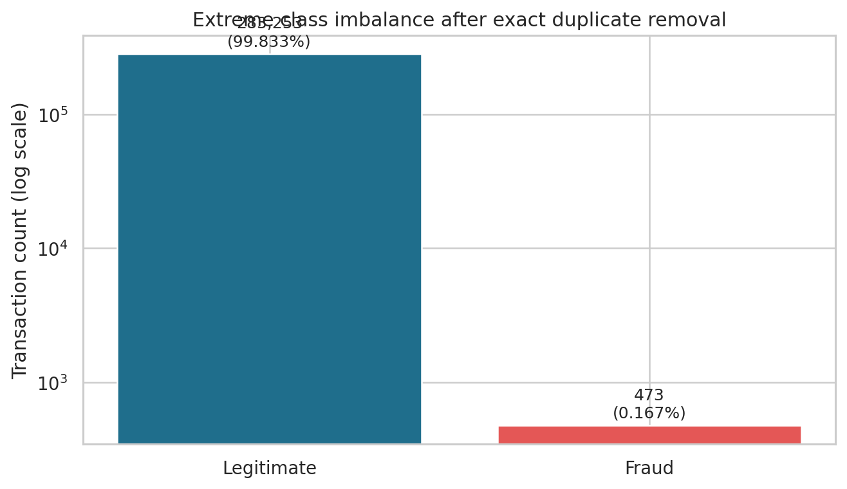
BYOC CAPSTONE
Data profile: usable benchmark, narrow context
284,807
31
1,081
0
2 days
Raw transactions
Columns
Exact duplicate rows identified
Missing cells
Observed window
V1–V28 are PCA-transformed, anonymized components.
No customer, merchant, device or account identifiers are provided.
Exact duplicates removed for the primary temporal model; 19 duplicate rows carry fraud labels.
INTELLIGENT CREDIT CARD FRAUD DETECTION • OFFLINE PROTOTYPE
3

Slide 4
BYOC CAPSTONE
Architecture: reproducible analytics to decision interface
01
02
03
04
05
06
DuckDB SQL
profile + dedup
→
Features +
chronological split
→
Logistic baseline
+ XGBoost
→
PR metrics +
statistical tests
→
TreeSHAP +
threshold analysis
→
Streamlit +
Power BI exports
Why it matters: SQL handles repeatable profiling/aggregates; the temporal holdout tests forward-in-time generalization; the UI exposes the alert trade-off to business stakeholders.
DuckDB source implementation is included; execution must be verified after installing the pinned dependency.
INTELLIGENT CREDIT CARD FRAUD DETECTION • OFFLINE PROTOTYPE
4

Slide 5
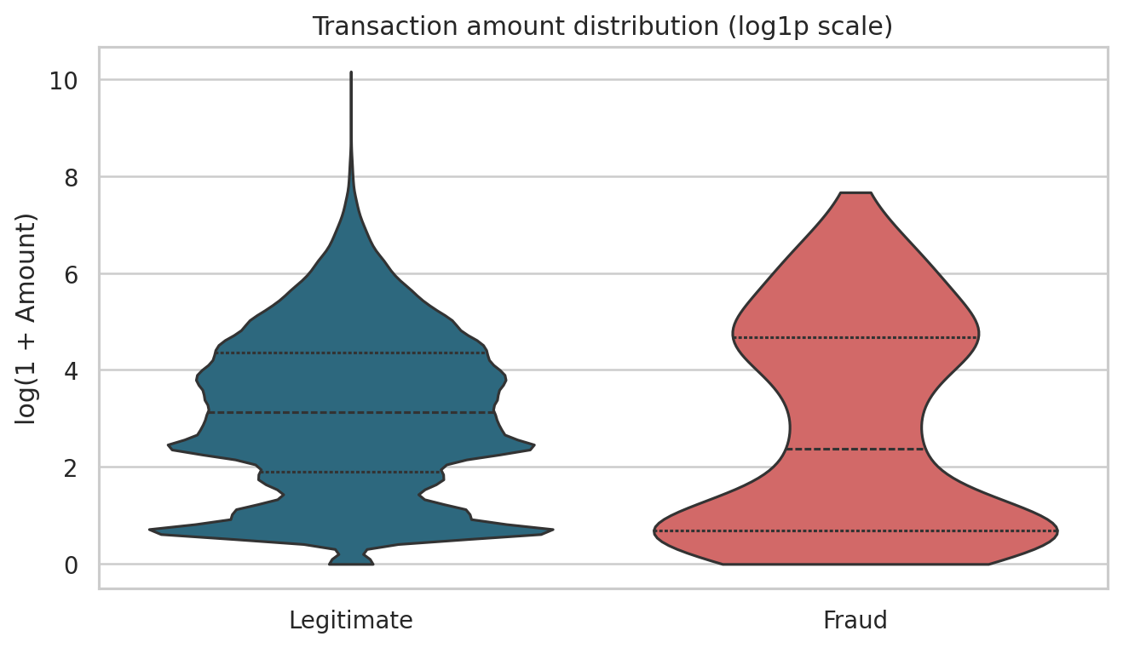
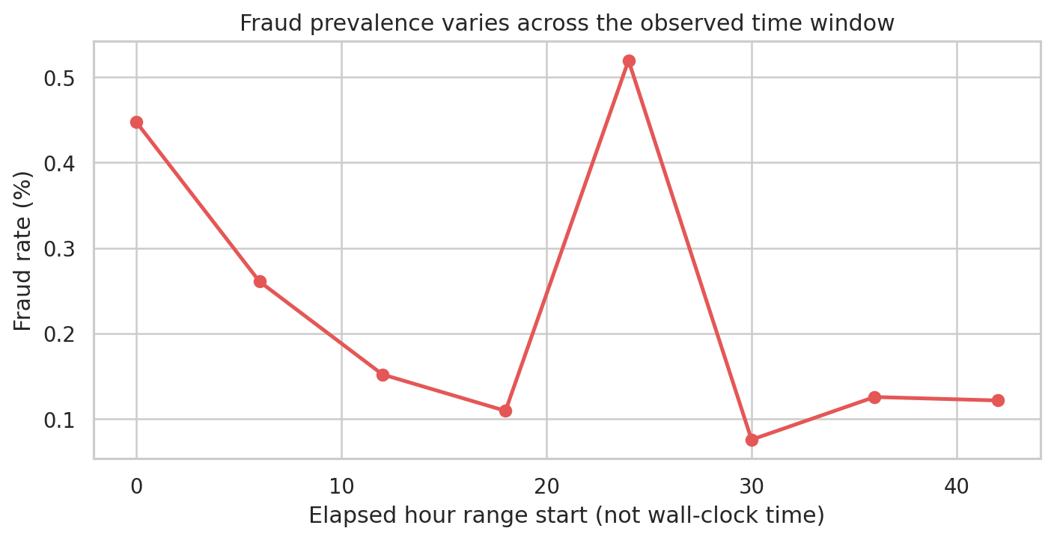
BYOC CAPSTONE
Statistical diagnostics reveal differences, not causes
Mann–Whitney amount test: p = 2.69e-05
Fraud median 9.82; legitimate median 22.00
Time-half fraud-rate test: p = 0.0189
0.1847% vs 0.1487%
INTELLIGENT CREDIT CARD FRAUD DETECTION • OFFLINE PROTOTYPE
5

Slide 6
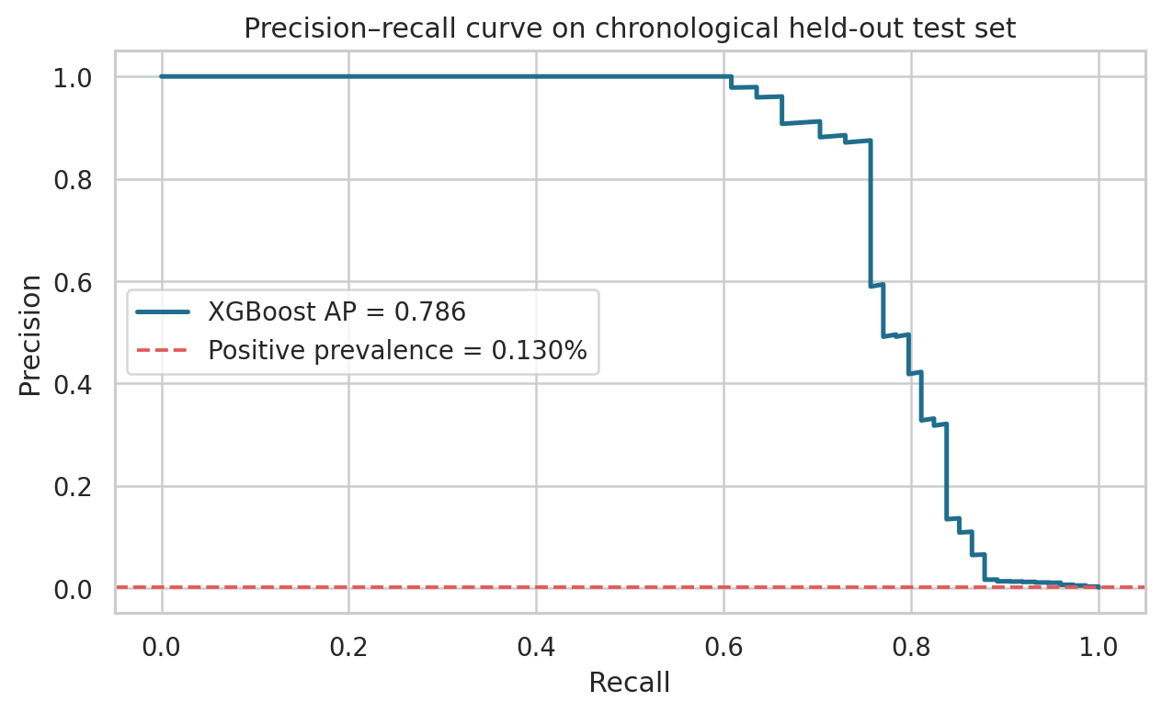
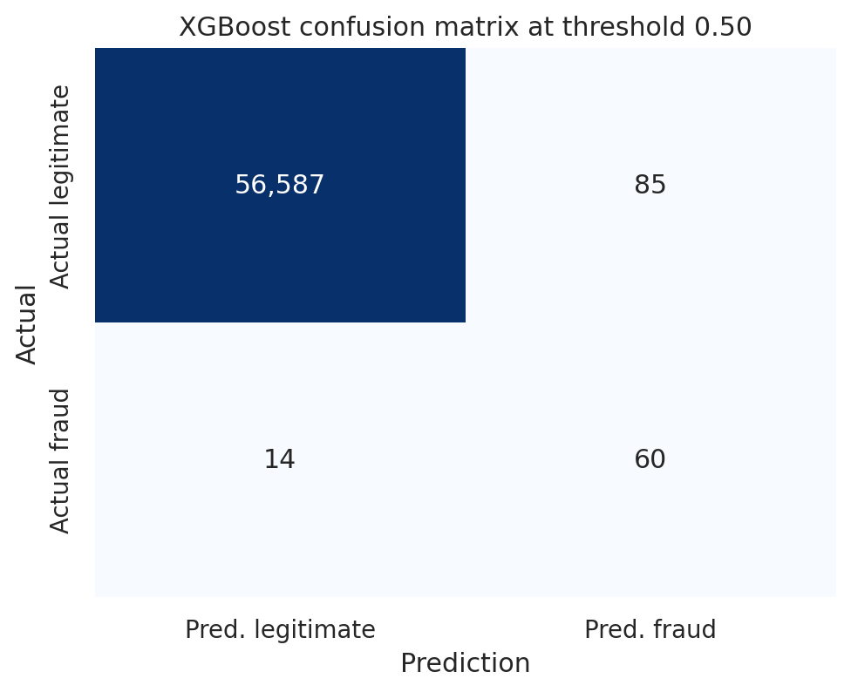
BYOC CAPSTONE
XGBoost ranks fraud cases well; the operating point matters
0.786
0.980
41.4%
81.1%
85
Average precision
ROC-AUC
Precision @ 0.50
Recall @ 0.50
False alerts @ 0.50
INTELLIGENT CREDIT CARD FRAUD DETECTION • OFFLINE PROTOTYPE
6

Slide 7
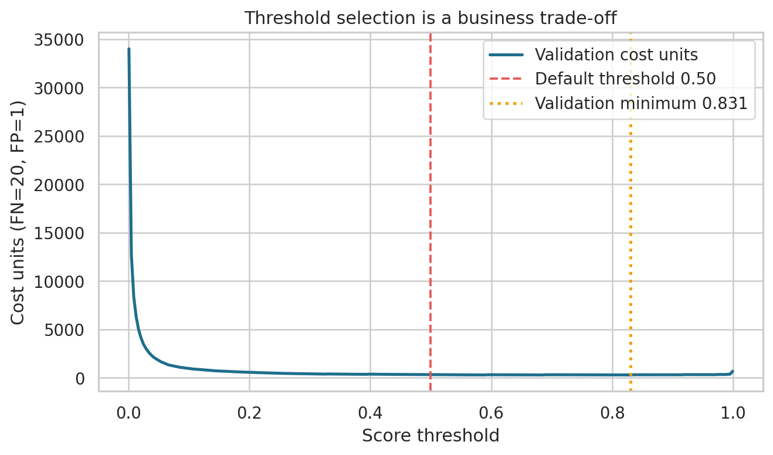
BYOC CAPSTONE
Threshold tuning must survive a later time window
Validation-selected threshold: 0.831.
Test cost at 0.50: 365 units (14 FN × 20 + 85 FP × 1).
Test cost at validation-selected threshold: 384 units.
Selected threshold failed to improve later-window cost; use more validation data and real cost estimates.
INTELLIGENT CREDIT CARD FRAUD DETECTION • OFFLINE PROTOTYPE
7

Slide 8
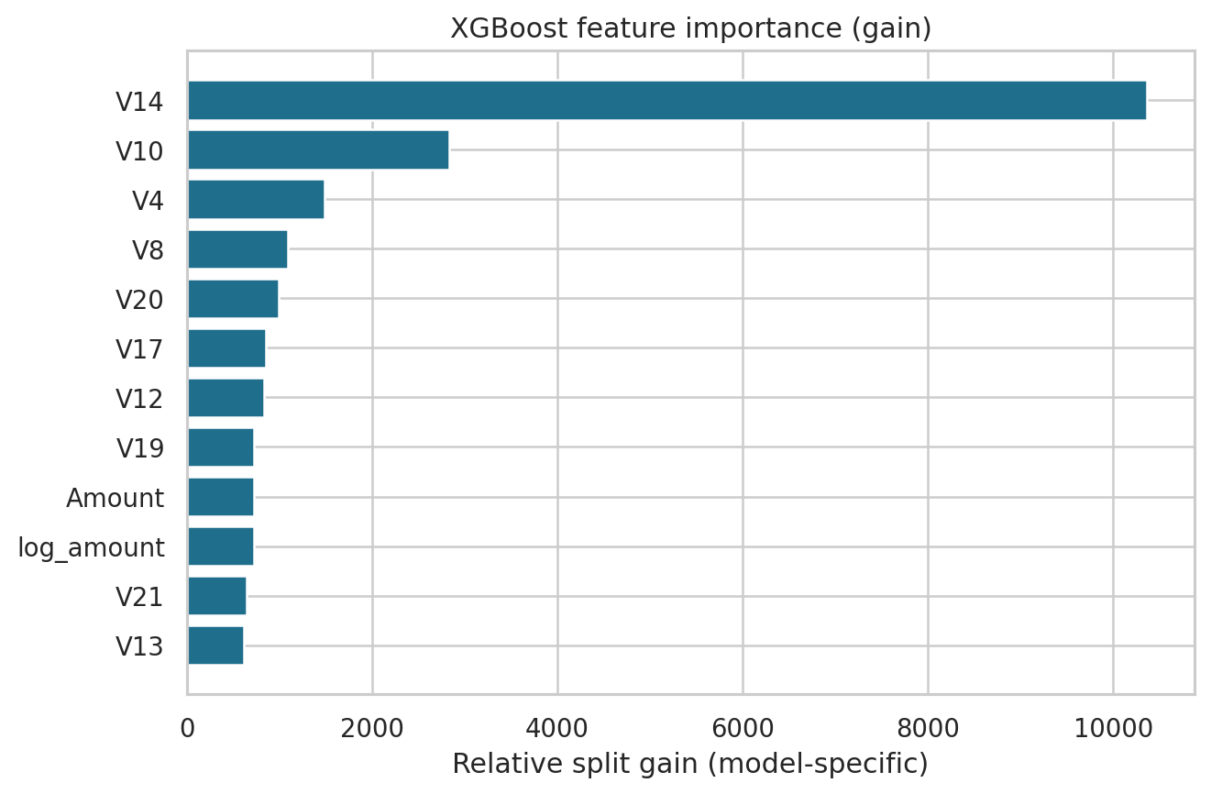
BYOC CAPSTONE
Explainability supports investigation, not causal claims
TreeSHAP contributions are available per scored row.
Show the top contributing component and its signed contribution.
V1–V28 are anonymized PCA components; do not invent meanings like location or device.
Streamlit provides filterable rows, risk tiers, a threshold slider and downloadable results.
INTELLIGENT CREDIT CARD FRAUD DETECTION • OFFLINE PROTOTYPE
8

Slide 9
BYOC CAPSTONE
Engineering choices and lessons learned
Choice | Benefit | Trade-off / caveat
Chronological split | More realistic for future scoring | Few frauds in the later holdout increases uncertainty
Exact deduplication | Reduces identical-row leakage risk | Could remove indistinguishable repeated events
Class-weighted XGBoost | High AP; handles class imbalance | Scores are not calibrated probabilities
Cost scenario | Makes trade-offs explicit | Costs are assumptions; validation optimum did not transfer
PCA anonymity | Protects original feature confidentiality | Limits business-readable explanations
INTELLIGENT CREDIT CARD FRAUD DETECTION • OFFLINE PROTOTYPE
9

Slide 10
CONCLUSIONS & NEXT STEPS
Move from benchmark to governed pilot
Collect recent, representative labeled transactions and validate with rolling temporal holdouts.
Calibrate scores on a dedicated time window and choose thresholds with fraud operations/finance.
Measure queue volume, false-alert costs, fraud loss avoided and reviewer capacity in shadow mode.
Add monitoring, delayed-label handling, audit logs, privacy/fairness review and human override.
Only add a policy-grounded GenAI analyst after governance review; LLM explains evidence, never authorizes payments.
Decision today: proceed as an offline analyst-triage prototype; do not auto-block real transactions.
INTELLIGENT CREDIT CARD FRAUD DETECTION • OFFLINE PROTOTYPE
10

Slide 11
BYOC CAPSTONE
Appendix: dataset, metrics and reproducibility
Source: https://www.kaggle.com/datasets/mlg-ulb/creditcardfraud — verify current ODbL/database terms before redistribution.
Schema: Time, V1–V28, Amount, Class (0 legitimate, 1 fraud).
Deduplicated data: 283,726 rows / 473 fraud labels; split 170,235 train, 37 validation, 56,746 test.
Run: install requirements; place CSV under data/raw; `PYTHONPATH=src python -m src.run_pipeline`; `streamlit run app/streamlit_app.py`; `pytest -q`.
Outputs: technical report, executive deck, README/GitHub guide, metrics CSVs and compact demo assets.
Reference docs: DuckDB, scikit-learn model evaluation, Streamlit, FastAPI, NIST AI RMF.
INTELLIGENT CREDIT CARD FRAUD DETECTION • OFFLINE PROTOTYPE
11

