Slide 1


Project Seminar
On
“AI-Based Smart Driver Monitoring & Accident Prevention System”
Partial fulfillment of Six Semester
Bachelor of Technology
In
COMPUTER ENGINEERING
Submitted By
Piyush Sondawale Sameer Meshram
Nayan Mandwalker
DEPARTMENT OF COMPUTER ENGINEERING
Under the Guidance of
PROF . K . SARODE
DEPARTMENT OF COMPUTER ENGINEERING
SMT. RADHIKATAI PANDAV COLLEGE OF ENGINEERING, NAGPUR
Rashtrasant Tukdoji Maharaj Nagpur University, Nagpur
2024-2025

Slide 2
INDEX TOPICS INTRODUCTION LITERATURE SURVEY EXITING WORK MODULES IMPLEMENTATION EXPERIMENTAL RESULT (OUTPUT & GRAPHS) CONCLUSION FUTURE SCOPE REFERENCES

Slide 3

ABSTRACT
We present a real-time, vision-based smart driver monitoring and accident prevention system that monitors:
Eye movements
Blink frequency (EAR)
Mouth opening (MOR)
Head orientation (NLR).
The system links visual fatigue indicators to an adaptive safety algorithm that issues
Graded alerts
Recommends breaks
Keywords: Real-Time Drowsiness Detection, Facial Recognition Monitoring, Driver Safety Enhancement, Fatigue Alert System.

Slide 4
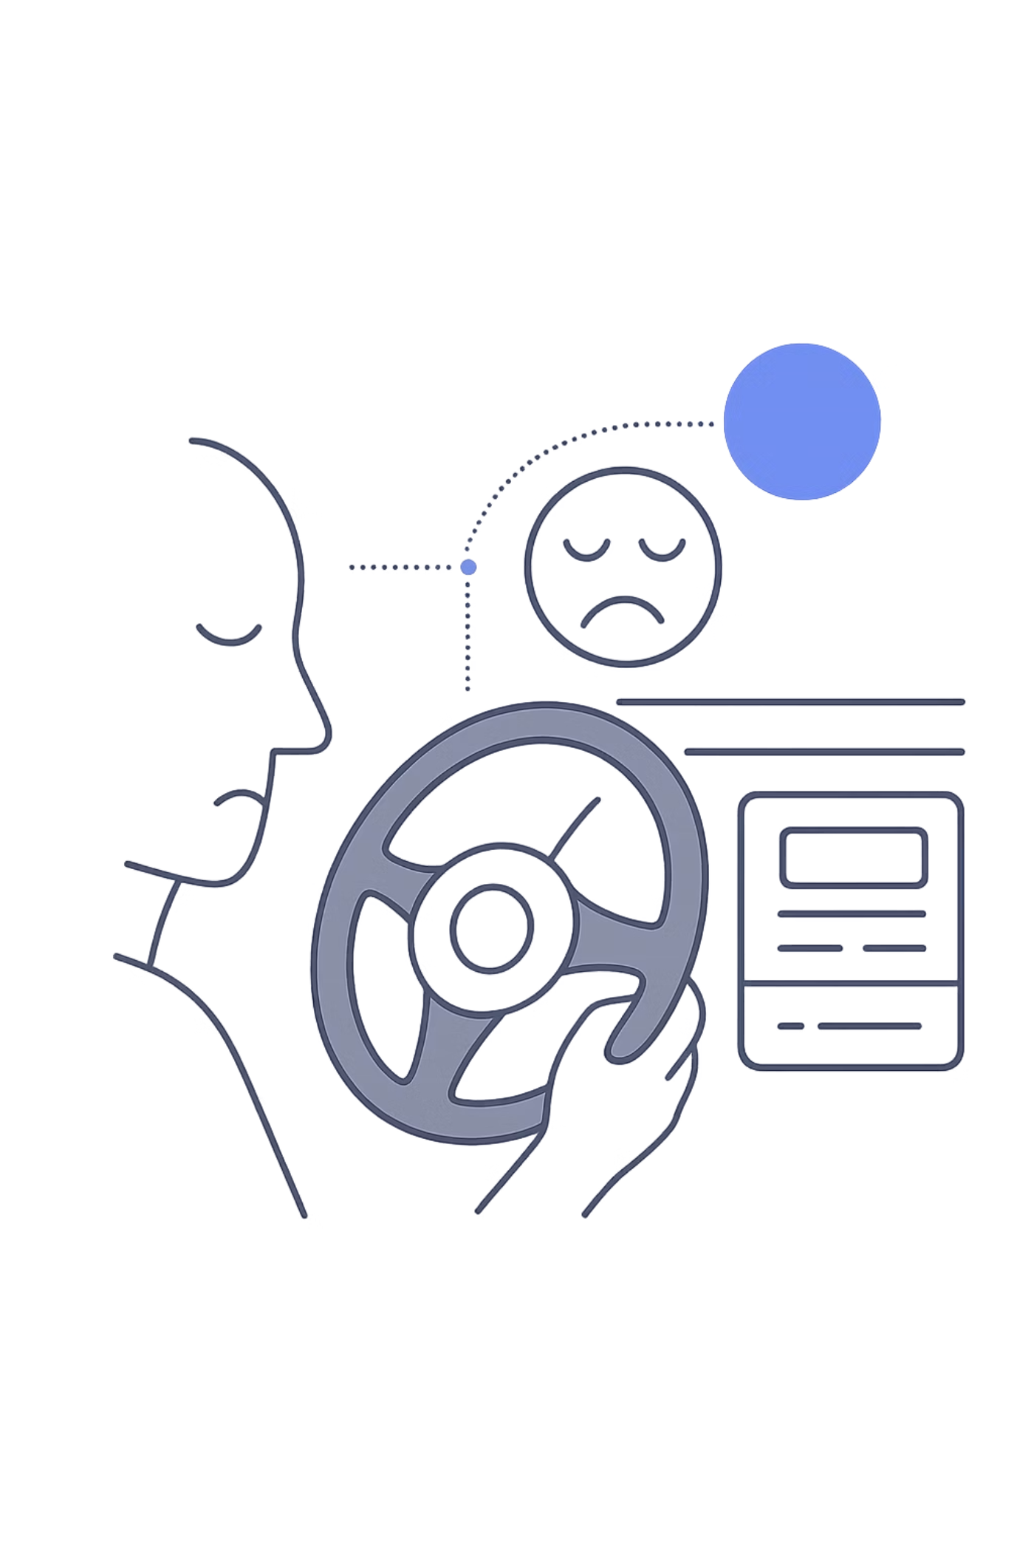

CHAPTER 1: INTRODUCTION
AI-Based Smart Driver Monitoring & Accident Prevention System
Drowsy driving causes 70,000–80,000 crashes and 1,000–2,000 deaths worldwide annually. This system uses facial recognition and deep learning to detect fatigue in real time — and alert drivers before disaster strikes.

Slide 5
CHAPTER 2: LITERATURE SURVEY
What Researchers Have Found
Dr. M. Ramya Devi
1
CNN + RNN for temporal eye/facial analysis — reduces false alarms in real-time fatigue detection.
Magán et al.
2
Deep learning on sequential image frames improves accuracy over single-frame detection.
Zambrano et al.
3
EAR + MAR with CNN detects fatigue, distraction & emotion under varied lighting conditions.
Krishna et al.
4
YOLO + Vision Transformers achieve ~96% accuracy — outperforming CNN-only models.
Kumar et al.
5
CNN-based blink rate & eye closure analysis optimized for real-time Indian road conditions.

Slide 6
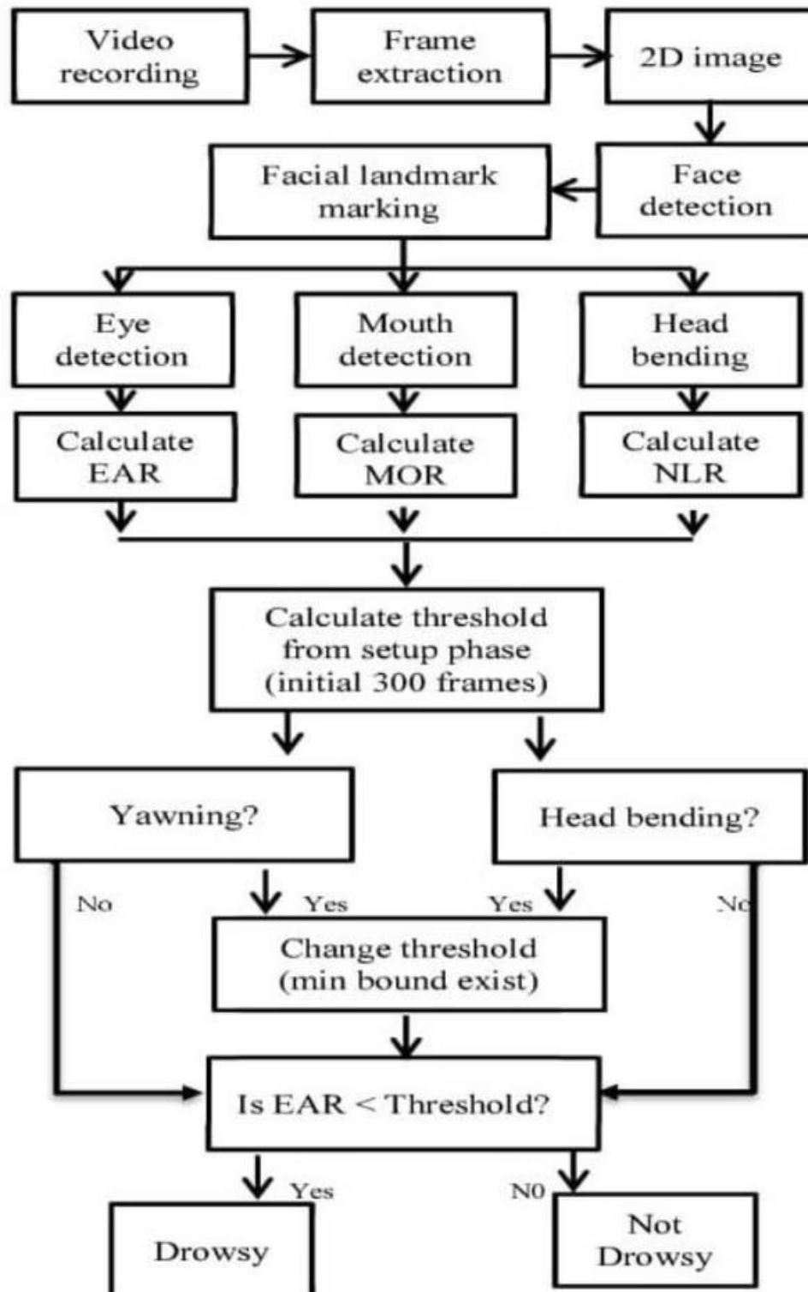
System Architecture
CHAPTER 3: EXISTING WORK
Three-Layer Design
Presentation Layer (UI)
Fatigue Detection Layer
Alert & Adaptation Layer
Front camera captures eye closure, head position, and yawning — analyzed by CNN models to generate live fatigue scores.
Dashboard showing real-time alertness status, session data, drowsiness alerts, and break reminders.
Dynamically adjusts alert intensity and assistance features based on detected fatigue level.
Fig 3.1 — EAR threshold decision flow: video input → facial landmarks → drowsy / not drowsy classification

Slide 7
CHAPTER 4: MODULES
System Modules
UI & Control
Video Acquisition & Face Detection
Start/stop monitoring, live camera feed, and dashboard showing Safe / Drowsy / Distracted status with visual warnings. Built with Python (Streamlit).
Captures real-time frames via webcam or IP camera using OpenCV, isolating the facial region for downstream analysis.
Fatigue Detection
Attention & Alert System
Calculates EAR (eye closure ≥ 2s = drowsy) and MAR (yawn detection) using facial landmark analysis.
3D head pose estimation detects distraction (looking left/right/down). Triggers audio alarms, voice warnings & visual alerts.

Slide 8
CHAPTER 5: IMPLEMENTATION
Core Code Highlights
Session Timer
WebRTC Camera Stream
sc = s.get("status_cls", "safe")
if sc == "safe":
st.success("
Tracks elapsed driving time and displays it live using datetime.now() and Streamlit metrics.
Live video via webrtc_streamer with DrowsinessProcessor for real-time frame analysis.
✅ DRIVER IS SAFE")elif sc == "drowsy": st.error("⚠️ DROWSY! WAKE UP!")elif sc == "distracted": st.warning("⚠️ DISTRACTED!")elif sc == "warning": st.warning("⚡ LOW BLINK RATE!")else: st.info("❌ NO FACE DETECTED")
Status Classification
Active Mode Display
Driver state (safe, drowsy, distracted, warning) drives color-coded UI alerts dynamically.
Shows Day/Night mode, yawn detection, face count, and CNN status in a live two-column panel.

Slide 9
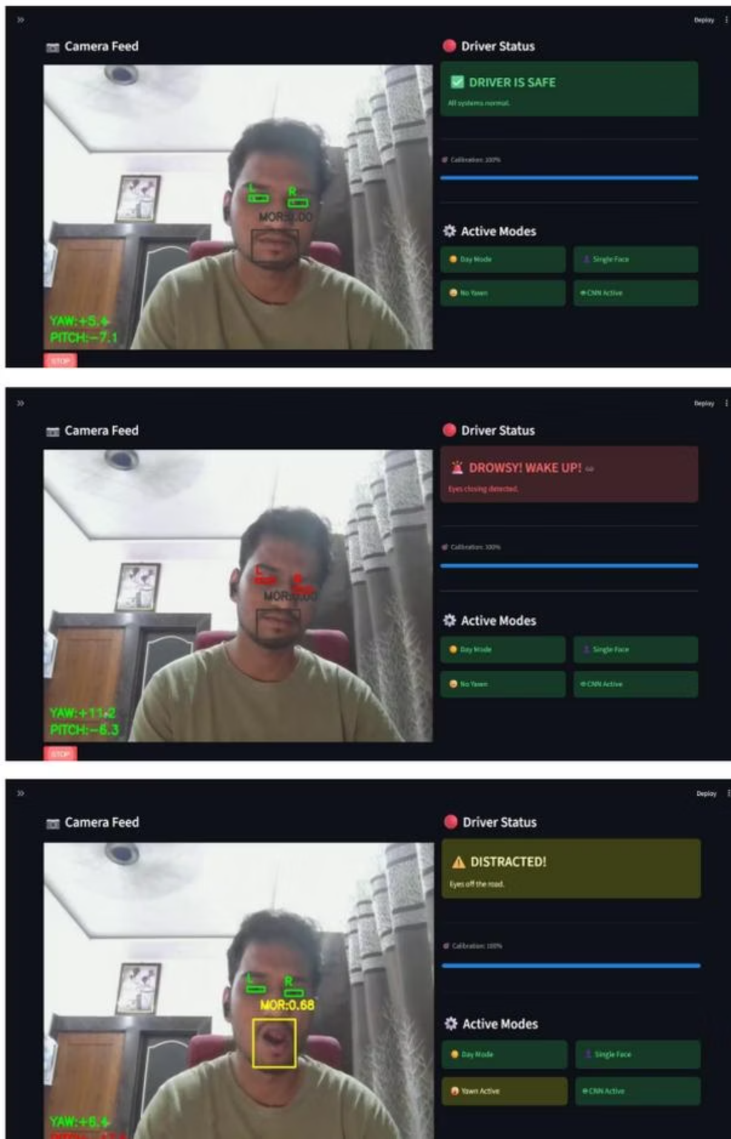
CHAPTER 6: EXPERIMENTAL RESULTS
System Output & Detection
Eyes open, head forward. Green status. EAR normal, calibration active
✅ Safe
0.336
EAR (Normal)
Threshold: 0.160 — eye closure triggers drowsy alert
15.6%
⚠️ Drowsy
Eyes closed detected. Red alert fires. EAR drops below threshold
PERCLOS
Eyes closed % in last 60s — alarm triggers at 20%
5/min
Blink Rate
Below 8/min triggers early drowsiness warning
⚡ Distracted
Yawning or gaze deviation. Yellow warning. MAR: 0.68 flagged
17%
CNN Eye Closed
MobileNetV2 probability — Eyes Open confirmed
Fig 6.2: Real-time detection — green (Safe), red (Drowsy, eyes closed), yellow (Distracted, MOR: 0.68 yawning detected).

Slide 10
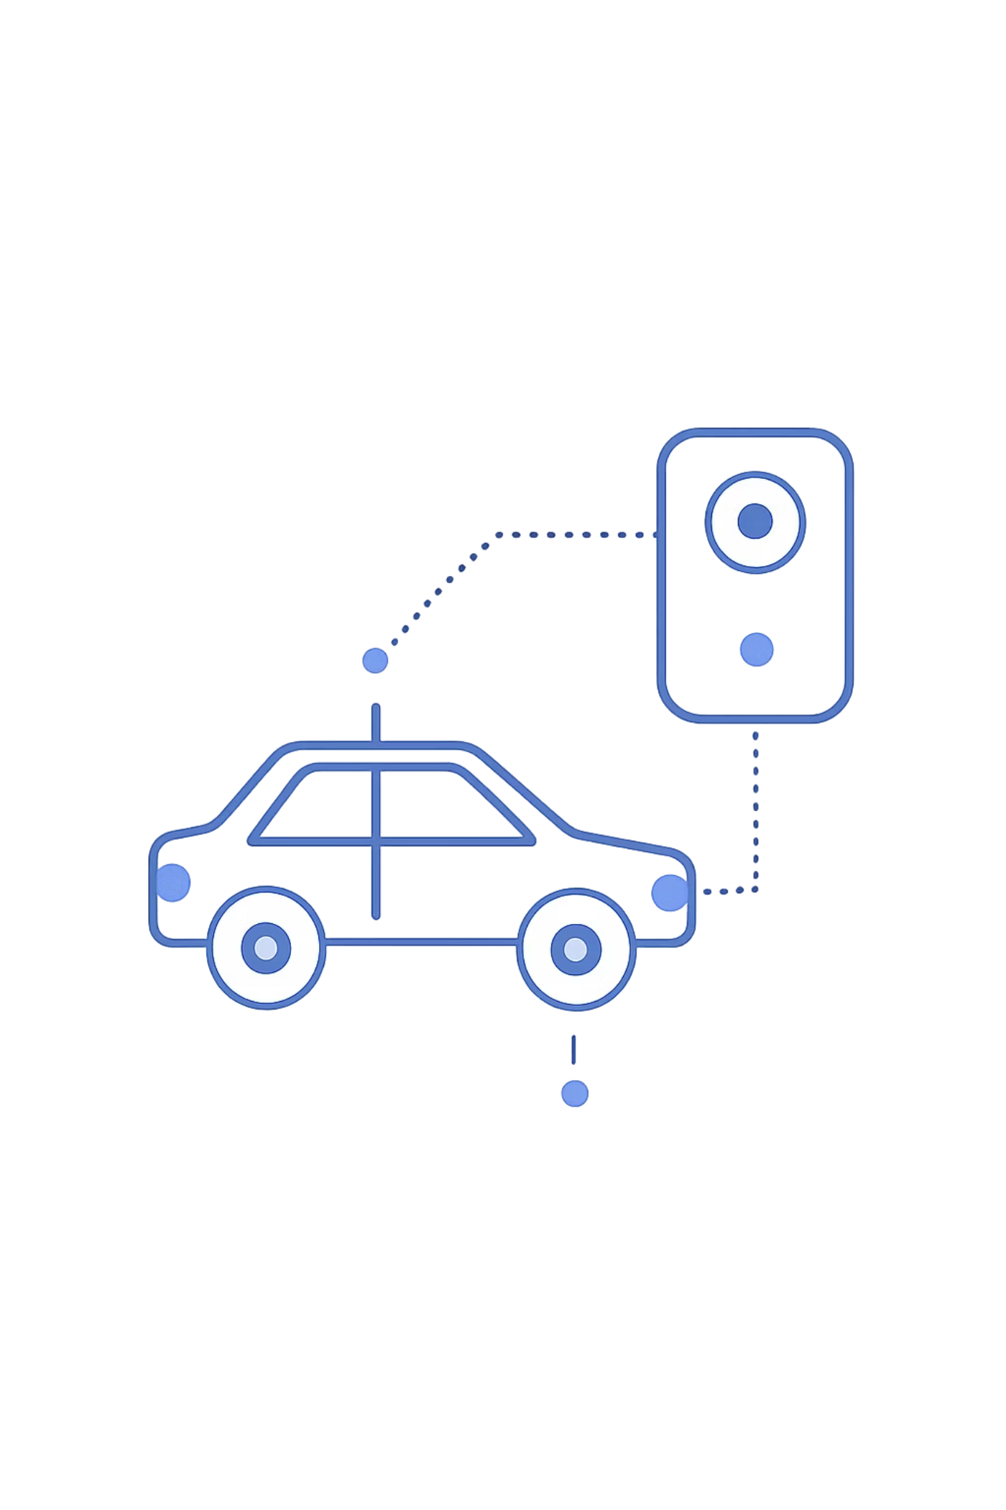
CHAPTER 7: CONCLUSION
Conclusion
Adaptive & Personalized Safety
Unlike traditional alerts, this system personalizes interventions — improving reaction time and reducing crash risk.
Real-Time Fatigue Interpretation
Detects eye closure, head movements, and yawning to provide timely alerts and recommend breaks.
Privacy-First, On-Device
Local implementation ensures offline functionality and secure biometric data management — no cloud dependency.

Slide 11
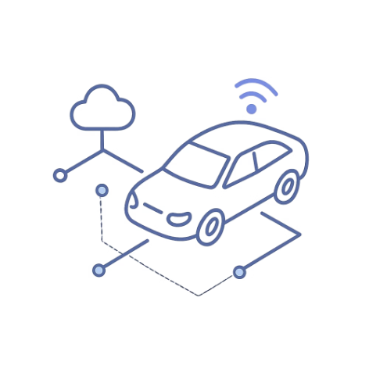
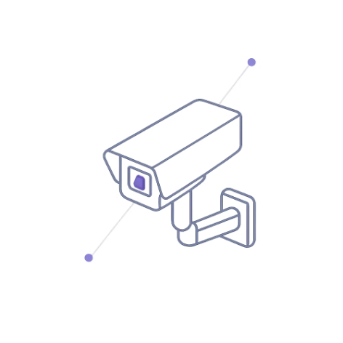

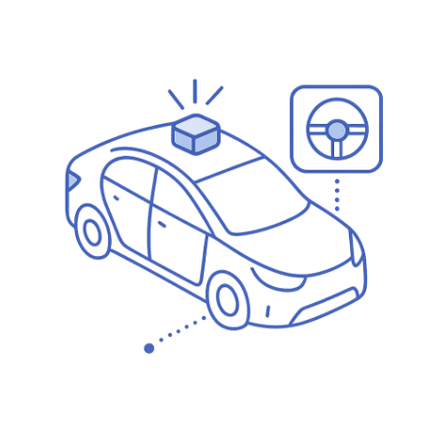
CHAPTER 8: FUTURE SCOPE
What's Next
IoT & Fleet Integration
Night Vision & Emotion AI
Wearables & GPS
Vehicle Control Integration
Heart rate monitoring via smart wearables; GPS tracking for emergency location alerts.
Send instant alerts to family, fleet managers, or vehicle owners. Support commercial transport and public fleets.
Infrared cameras for low-light monitoring; emotion and stress detection to prevent risky driver behavior.
Auto-reduce speed, apply brakes, or activate lane assist when critical drowsiness is detected.

Slide 12
REFERENCES
Dr. M. Ramya Devi
1
CNN + RNN for temporal eye/facial analysis — reduces false alarms in real-time fatigue detection.
Magán et al.
2
Deep learning on sequential image frames improves accuracy over single-frame detection.
Zambrano et al.
3
EAR + MAR with CNN detects fatigue, distraction & emotion under varied lighting conditions.
Krishna et al.
4
YOLO + Vision Transformers achieve ~96% accuracy — outperforming CNN-only models.
Kumar et al.
5
CNN-based blink rate & eye closure analysis optimized for real-time Indian road conditions.

Slide 13
Thank You

