Slide 1
Pacman 3D
Joc interactiv în OpenGL
Realizat de: Solomon Anastasia 1311B

Slide 2
CONTENTS OF THIS TEMPLATE
There’s what you’ll find in this Slidesgo template:
A slide structure based on a multi-purpose presentation, which you can easily adapt to your needs. For more info on how to edit the template, please visit Slidesgo School or read our FAQs.
An assortment of illustrations and pictures that are suitable for use in the presentation can be found in the alternative resources slide.
A thanks slide, which you must keep so that proper credits for our design are given.
A resources slide, where you’ll find links to all the elements used in the template.
Instructions for use.
Final slides with:
The fonts and colors used in the template.
More infographic resources, whose size and color can be edited.
Sets of customizable icons of the following themes: general, business, avatar, creative process, education, help & support, medical, nature, performing arts, SEO & marketing, and teamwork.
You can delete this slide when you’re done editing the presentation.

Slide 3
01
02
03
COMPANY
TARGET
SERVICES
Here you can describe the topic of the section
Here you can describe the topic of the section
Here you can describe the topic of the section

Slide 4
WHOA!
This could be the part of the presentation where you can introduce yourself, write your email...

Slide 5
“This is a quote, words full of wisdom that someone important said and can make the reader get inspired.”
—Someone Famous

Slide 6
COMPANY
01
You can enter a subtitle here if you need it

Slide 7
THE SLIDE TITLE GOES HERE!
Do you know what helps to make your point clear? Lists like this: one
They’re simple
You can organize your ideas clearly
You’ll never forget to buy milk!
And the most important thing: the audience won’t miss the point of your presentation

Slide 8
MAYBE YOU NEED TO DIVIDE THE CONTENT
MERCURY
VENUS
Mercury is the closest planet to the Sun and
the smallest one
Venus has a beautiful name and is the second planet from the Sun

Slide 9
YOU COULD USE THREE COLUMNS, WHY NOT?
MARS
JUPITER
VENUS
Despite being red, Mars is actually a cold place
It’s a gas giant and the biggest planet in the Solar System
Venus has a very poisonous atmosphere

Slide 10

AWESOME WORDS
Because key words are great for catching your audience’s attention

Slide 11
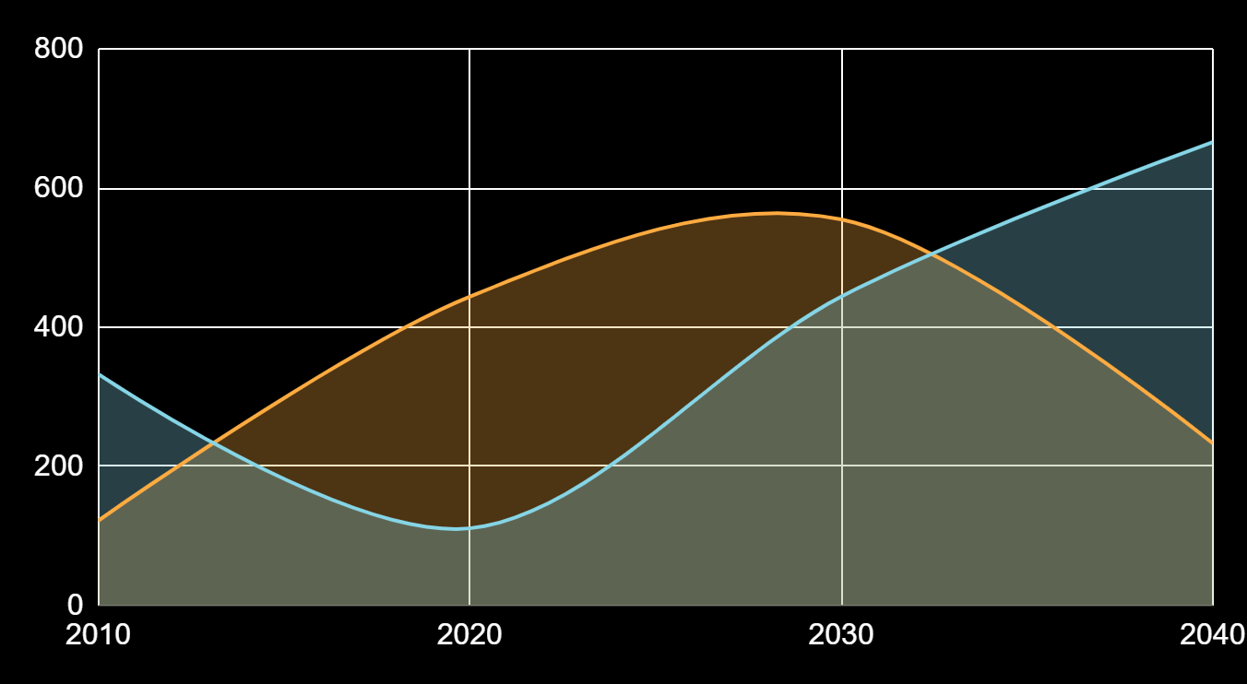
THIS IS A GRAPH!
Factor 1
Factor 2
To modify this graph, click on it, follow the link, change the data and paste the new graph here

Slide 12
… AND THE SAME GOES FOR TABLES
 | MASS | DIAMETER | GRAVITY
MERCURY | 0.06 | 0.38 | 0.38
MARS | 0.11 | 0.53 | 0.38
SATURN | 95.2 | 9.4 | 1.16

Slide 13
A TIMELINE ALWAYS WORKS WELL
DAY 1
DAY 3
DAY 2
DAY 4
Jupiter is the biggest planet
Venus has a nice name
Earth is where we live on
Mars is a cold place

Slide 14
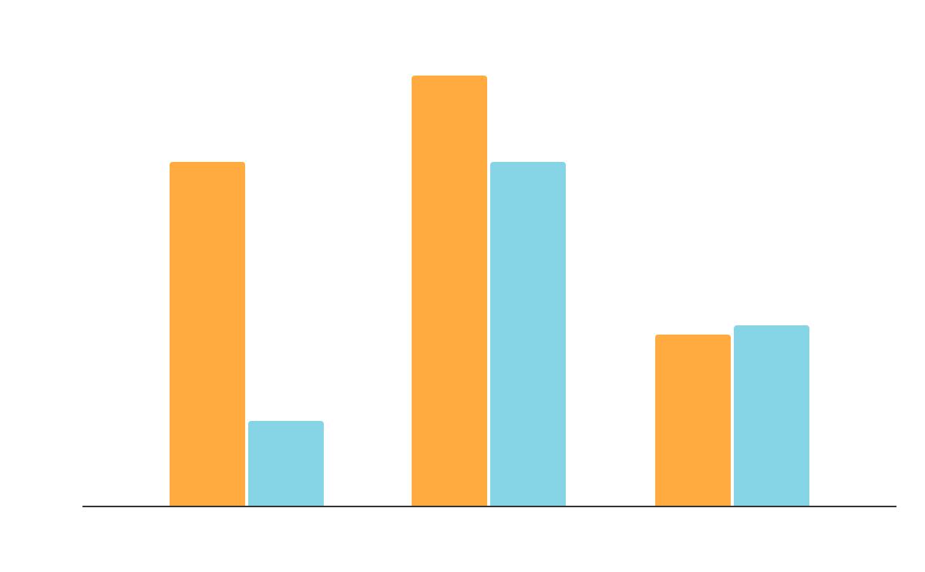
DO YOU PREFER THIS GRAPH?
Factor 1
Factor 2
To modify this graph, click on it, follow the link, change the data and replace it

Slide 15
300,000
Big numbers catch your audience’s attention

Slide 16
SOMETIMES, COMPARISONS ARE GOOD
CONCEPT 1
CONCEPT 2
You can define one of the concepts here
You can define one of the concepts here
You can define one of the concepts here
You can define one of the concepts here
You can define one of the concepts here
You can define one of the concepts here

Slide 17
DO YOU NEED FOUR COLUMNS?
MARS
MERCURY
JUPITER
VENUS
Despite being red, Mars is a cold place
Mercury is the closest planet to the Sun
It is the biggest planet in the Solar System
Venus has a beautiful name, but it’s hot

Slide 18
333,000
245,00
386,000
Mercury is the smallest planet
Jupiter is the biggest planet
Despite being red, Mars is cold

Slide 19
THESE ARE THE PERCENTAGES!
18%
48%
34%
Jupiter is the biggest one
Mercury is the smallest planet
Mars is a cold place

Slide 20
REVIEWING CONCEPTS IS A GOOD IDEA
MERCURY
VENUS
MARS
JUPITER
SATURN
NEPTUNE
Mercury is the smallest planet
Venus has a
beautiful name
Mars is actually a cold place
It’s a gas giant and the biggest one
Saturn is the ringed one and a gas giant
It’s the farthest planet from the Sun

Slide 21
A SUMMARY IS GOOD!
You can write about a concept here and talk about it a little
You can write about a concept here and talk about it a little
You can write about a concept here and talk about it a little
You can write about a concept here and talk about it a little
You can write about a concept here and talk about it a little
You can write about a concept here and talk about it a little
You can use bullet points to talk about the concepts. It is much more visual than a large text

Slide 22
WHAT THEY SAY ABOUT US?
—SARA BLACK, 19
—HELENA PATTERSON, 22
—JOHN DOE, 31
—WILL WHITMAN
“Mercury is the closest
planet to the Sun”
“Jupiter is the biggest
planet of them all”
“Despite being red, Mars is actually a cold place”
“Venus has a beautiful
name, but it’s hot”

Slide 23

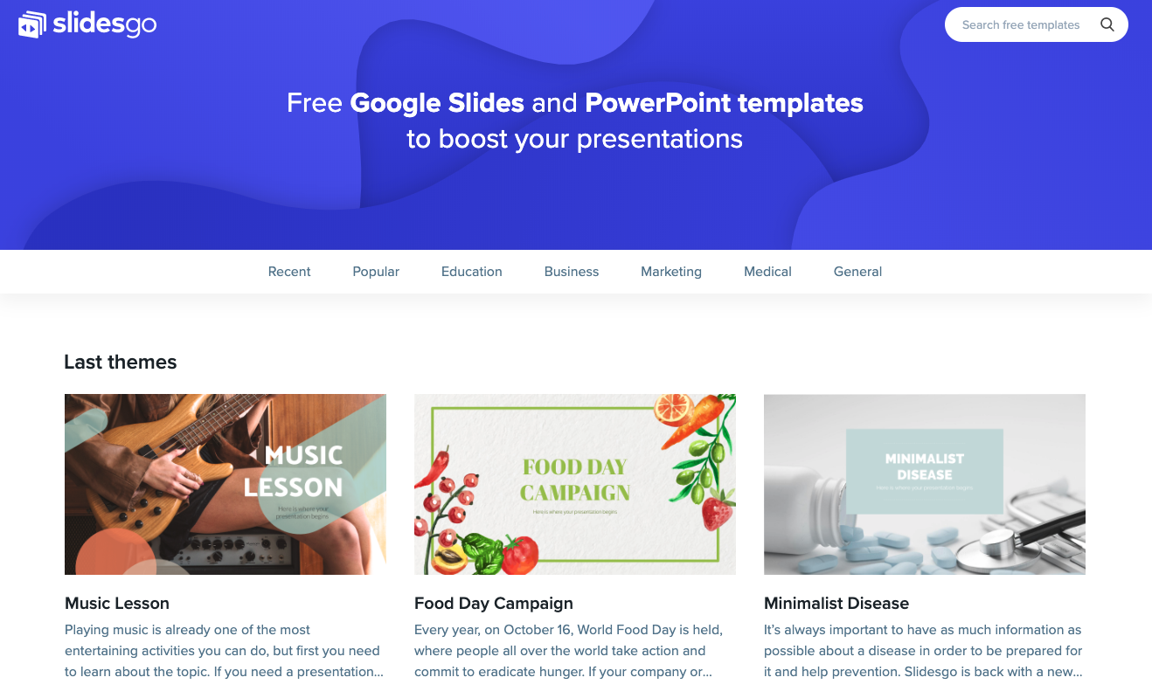
DESKTOP SOFTWARE
You can replace the image on the screen with your own work. Just delete this one, add yours and center it properly

Slide 24
A GOOD WAY TO END THE PRESENTATION
Mercury is the closest planet to the Sun and the smallest one in the Solar System—it’s only a bit larger than the Moon

Slide 25
Mulțumesc pentru atenție

Slide 26
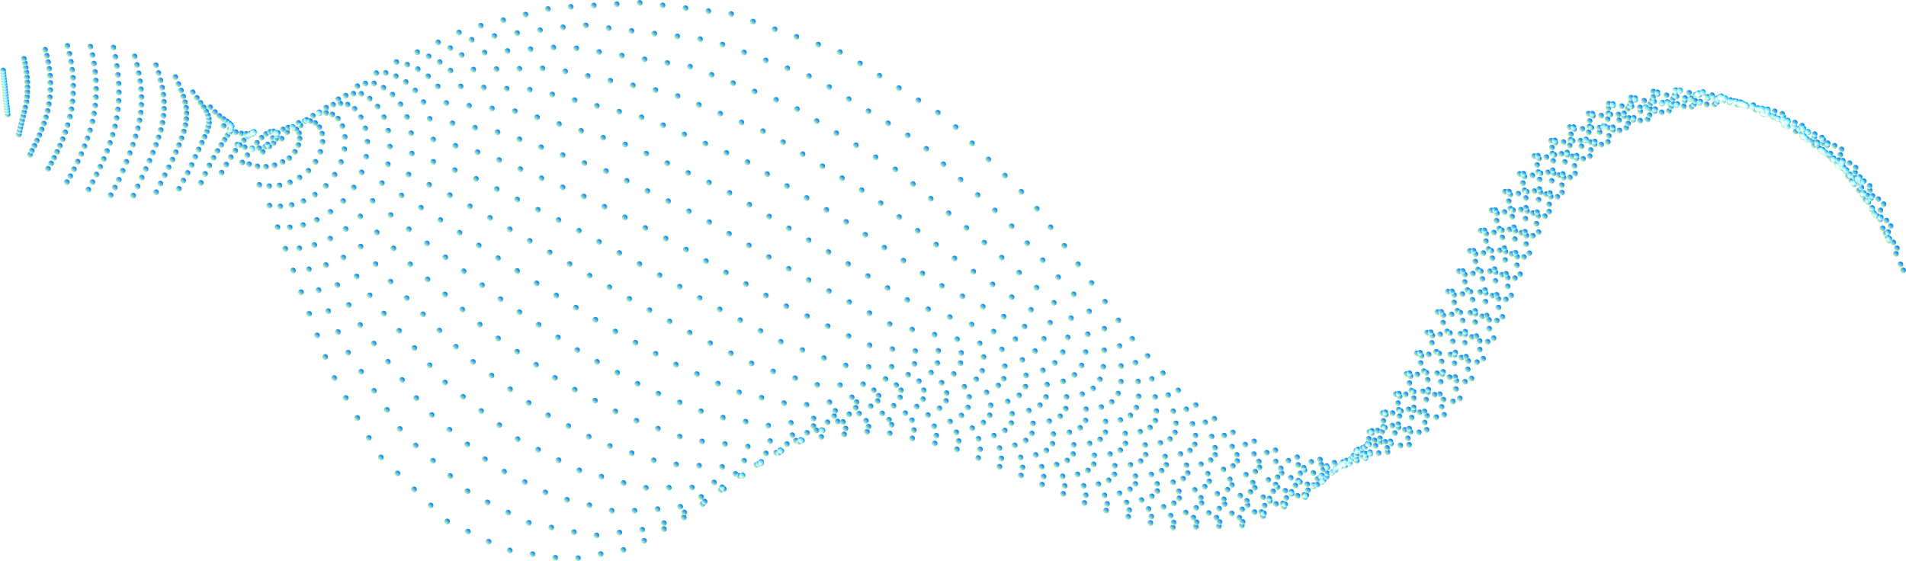



ALTERNATIVE RESOURCES
PHOTOS:
Low angle man with virtual reality simulator
Young man working on an ethernet switch medium shot
Motherboard with optical fiber cables
High speed optical fiber with blue light

