Slide 1



Insider Threat Detection Program
in AWS
“Trusted access with behavioral accountability”
Solomon Runzonza
MS Cybersecurity Capstone
Behavioral Analytics
Quinnipiac University May 2026
Notes:
This is based on a personal story and I can tell you later on if you are interested.

Slide 2







The Reality of Cybersecurity
Why Insider Threats Are Harder to Detect
Most breaches involve valid access
Insiders bypass traditional defenses
NSA Definition: An insider is any person with authorized access to any U.S. Government resource, including personnel, facilities, information, equipment, networks, or systems.
MALICIOUS
NEGLIGENT
COMPROMISED
Intentional misuse: deliberate theft, sabotage, or espionage using authorized access
Unintentional exposure: careless errors, misconfigurations, or policy violations without malicious intent
Hijacked credentials: external actors exploiting stolen or phished insider access keys
Unlike external attackers who must breach perimeters, insiders already have the keys—making detection a behavioral challenge, not a boundary problem.
Source: CNSSI 4009-2015 (NSA Definition)

Slide 3




Real-World Insider Threat Cases
Coinbase / Bribed Customer Support Agents MALICIOUS
2025
Impact
Detection Failure
Lesson Learned
Data theft via social engineering: 69,461 customer records stolen through insider collusion.
Overseas contractors were bribed to abuse legitimate customer support access.
Monitor privileged access patterns and implement insider threat detection for support systems.
Capital One / Paige Thompson NEGLIGENT
2019
Impact
Detection Failure
Lesson Learned
Unintentional public exposure of sensitive customer PII (100M+ users).
System viewed policy change as a standard, authorized API call.
Alert on boundary weakening & sensitive prefix targeting immediately.
Uber / Third-Party Contractor COMPROMISED
2016
Impact
Detection Failure
Lesson Learned
Unauthorized database access and massive infrastructure abuse.
Initial reconnaissance perfectly matched baseline user behavior.
Require cumulative sequence analytics for accurate detection.
Edward Snowden / NSA MALICIOUS
2013
Impact
Detection Failure
Lesson Learned
Mass exfiltration of highly classified intelligence data.
Exploited legitimate admin credentials; perimeter remained intact.
Must score actions, not assume trust based on role.

Slide 4





Industry Statistics: Why This Matters
1. Financial Impact
2. Threat Frequency
$19.5M +20%
76% report rising incidents
$16.2M (2023 Avg)
76%
$19.5M (2026 Avg)
What this means: The average cost equals ~130 senior engineer salaries. Insider risk is now a board-level financial exposure.
What this means: 3 out of 4 companies face more insider threats today than last year, driven by remote work and complex cloud permissions.
Source: Ponemon Institute, 2026
Source: Securonix Insider Threat Report, 2024
3. Detection Challenge
4. The Time Penalty
19% use internal actors
43% saved via fast response
1 in 5 breaches
$18.7M (>90 Days to contain)
$10.6M (<31 Days)
What this means: Traditional perimeter defenses (like firewalls) are completely blind to 20% of attacks because the actors already hold valid access keys.
What this means: Speed equals money. Containing an incident in under 31 days slashes the financial impact by $8.1M per incident.
Source: Verizon DBIR, 2025
Source: Ponemon Institute, 2025
Data Sources: Ponemon Institute (2025-2026), Verizon DBIR 2025, Securonix 2024

Slide 5





Problem Statement
Why Current Monitoring Approaches Fail
Noisy & Event-Centric Alerts
Traditional detections monitor isolated events, producing a high volume of noisy alerts without necessary behavioral context.
Ambiguity of Intent
Single-event rules struggle to distinguish careless errors and negligence from malicious intent or active account compromise.
Expanding Cloud Exposure
Cloud complexity (SaaS, APIs, remote work, AI tools) widens identity exposure significantly beyond traditional network perimeters.
Lack of Contextual Analytics
A critical need exists for action-sequence analytics, role-aware baselining, and automated risk score decay to prioritize real threats.

Slide 6





Project Goals
Key objectives for developing the AWS-native detection system:
01
02
03
04
Detect Threats Across Planes
Monitor Behavior & Baselines
Reduce False Positives
Provide Actionable Alerts
Monitor and detect suspicious activities natively across Amazon S3, IAM, and VPC resources.
Track and analyze user behavior using historical usage and role-specific persona baselines.
Minimize operational noise by employing alert cooldowns, threshold suppression, and risk decay.
Generate explainable, tiered notifications (Medium, High, Critical) ensuring rapid investigation.

Slide 7
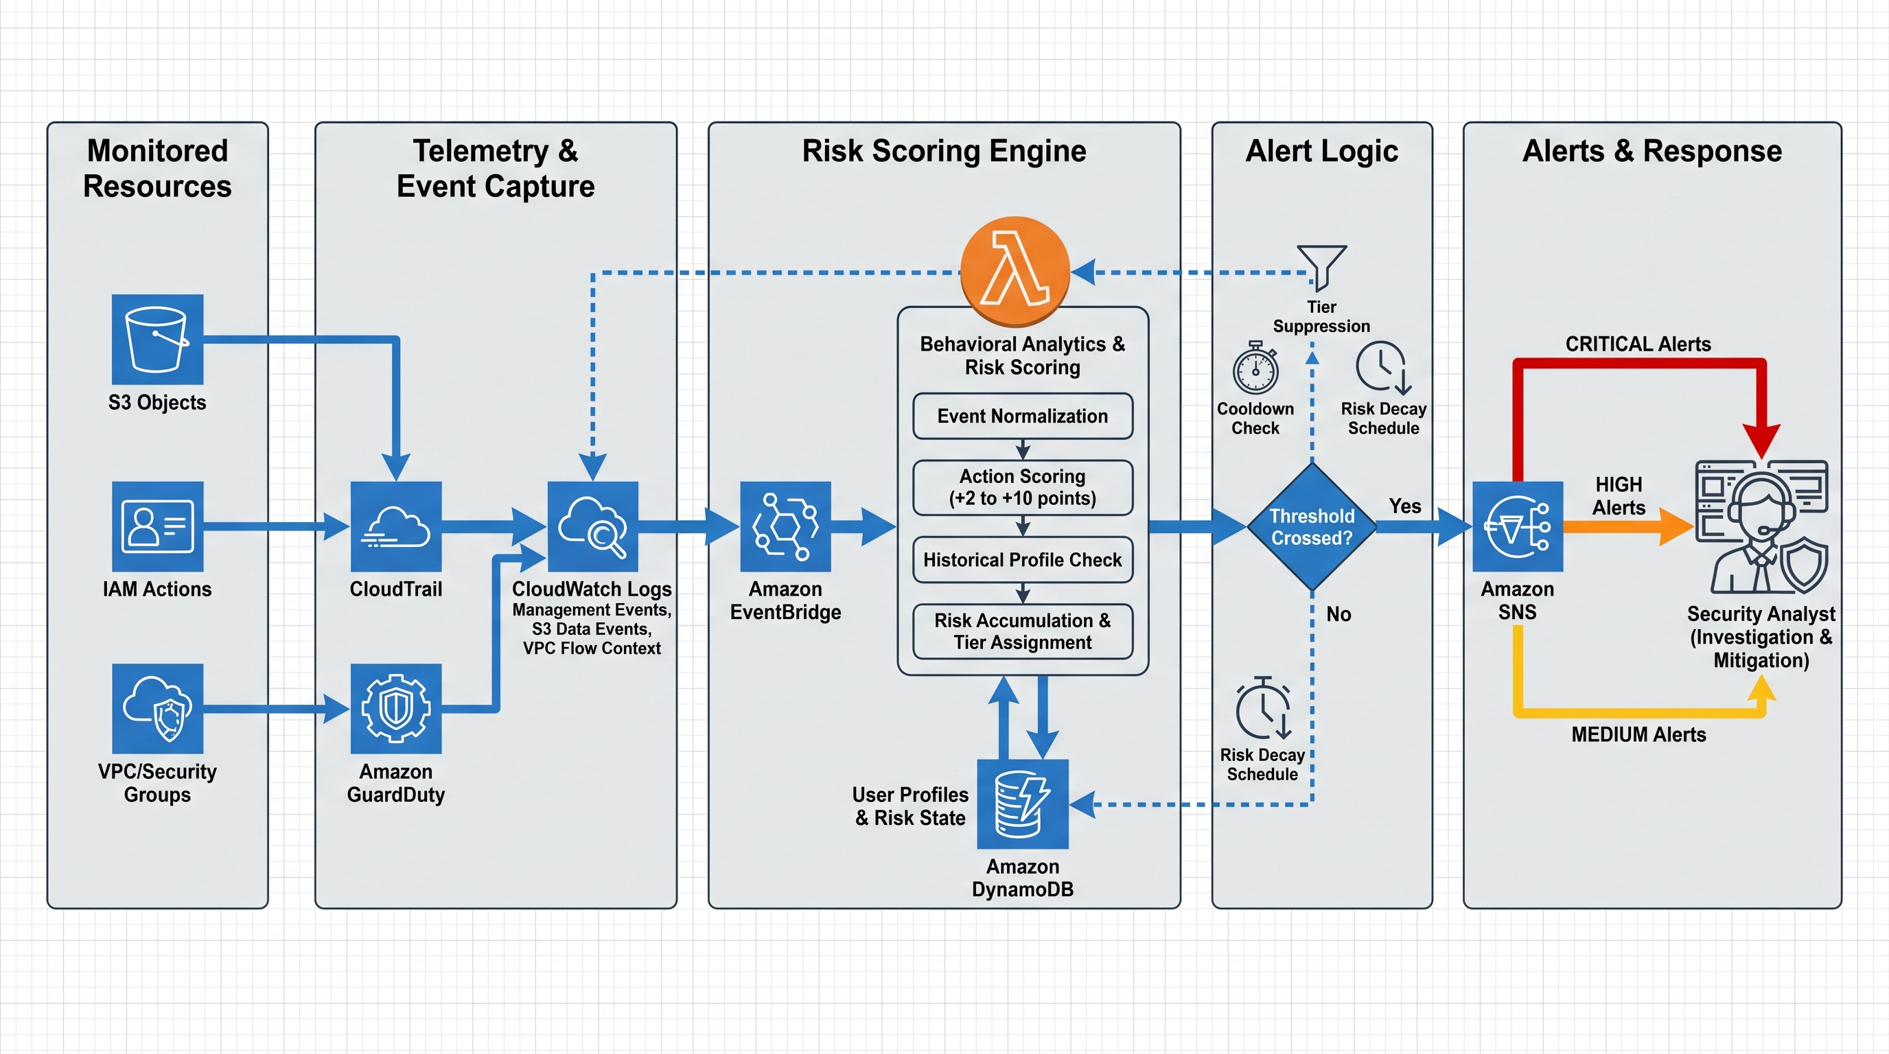
AWS-Native Solution Architecture
Monitored Planes: S3, IAM, VPC | Telemetry: CloudTrail, GuardDuty | Processing: CloudWatch, EventBridge, Lambda | State & Alerts: DynamoDB, SNS

Slide 8











Action-Centric Threat Model
Core Principles
Observe Actions
Score Deviations
Accumulate Risk
Explain Outcomes
Observable Action Classes
Boundary Crossing
Control Weakening
Persistence
Reconnaissance
Escalating Sequence
Denied object access
Security group abuse
Privilege escalation
Sensitive folder probing
Accumulating risk steps
Why Action-Centric?
Explainability
Role Reuse
Motive-Agnostic
Alerts tie directly to concrete, observable AWS actions.
One consistent logic engine evaluates multiple simulated personas.
Detects organizational risk regardless of internal intent.

Slide 9

Detection Criteria & Weighted Scoring
Action Category | Observable Evidence | Risk Points
Unauthorized S3 access | GetObject with AccessDenied | +2
Sensitive folder targeting | Executive/* or IT/* access attempts | +5
VPC/security group abuse | AuthorizeSecurityGroupIngress | +7
High-risk infrastructure change | DeleteSecurityGroup, CreateRoute | +10
IAM privilege escalation | CreateAccessKey, AttachUserPolicy | +10
GuardDuty managed finding | Recon / UnauthorizedAccess | +5 to +10
Historical Profiling Policy
To reduce false positives and operational noise, historical anomaly points (e.g., new IPs or unusual event types) are only awarded to amplify an already suspicious base event.
Source: Common Vulnerability Scoring System - CVSS

Slide 10





Monitored Personas
Simulated identities testing the system's ability to differentiate baseline activity, careless mistakes, deliberate misuse, and stolen credentials.
Developer
Negligent-User
Engineering Baseline
Careless Mistake Simulation
Scope: Engineering data access; normal reads
Scope: Engineering access + accidental out-of-bounds
Behavior: Expected usage within defined role boundaries
Behavior: Low volume, occasional mistakes, non-persistent
Outcome: Clean baseline preserved, generating 0 risk points
Outcome: Low/Medium tier isolated alert without escalation
MaliciousInsider
Compromised-User
Authorized Rogue Simulation
Stolen Credential Simulation
Scope: Authorized Finance data with intentional abuse
Scope: Unauthorized broad recon across varied resources
Behavior: Honeyfile targeting, VPC & IAM privilege abuse
Behavior: API-driven key validation, aggressive boundary probes
Outcome: Progressive sequence reaching High/Critical risk
Outcome: Spiky, high-velocity Critical alerts with abnormal IP

Slide 11











System Design: Event-to-Alert Flow
EventBridge
GuardDuty ingest
2. Risk Engine
4. SNS Output
1. Collection
Lambda normalizes events, applies scoring weights, and queries user baseline history
3. Alert Logic
CloudTrail mgmt + S3 data events routed to CloudWatch Logs
Tier evaluation, suppression filters, and cooldown enforcement
CRITICAL Alert
HIGH Alert
MEDIUM Alert
DynamoDB
Profiles & Scores
Design Rationale: Explainability Over Opacity
Separating action collection (CloudTrail/GuardDuty) from interpretation (Lambda) allows the program to evolve over time while maintaining transparent, explicit scoring rules for security analysts.

Slide 12






Demo Results: Test Methodology
Validating the action-centric threat detection model through controlled simulations and cumulative scoring logic.
4 Simulated
Personas
Cross-Plane
Monitoring
Conditional
Profiling
Validation &
Tiers
Implemented Developer, Negligent-User, MaliciousInsider, and Compromised-User with least-privilege boundaries.
Monitored and scored observable actions natively across Amazon S3 (data), IAM (identity), and VPC (infrastructure).
Applied historical anomaly scoring strictly to suspicious base events to prevent noise from benign console activity.
Validated alert escalation (Low, Med, High, Crit), noise suppression cooldowns, risk decay, and GuardDuty ingestion.

Slide 13

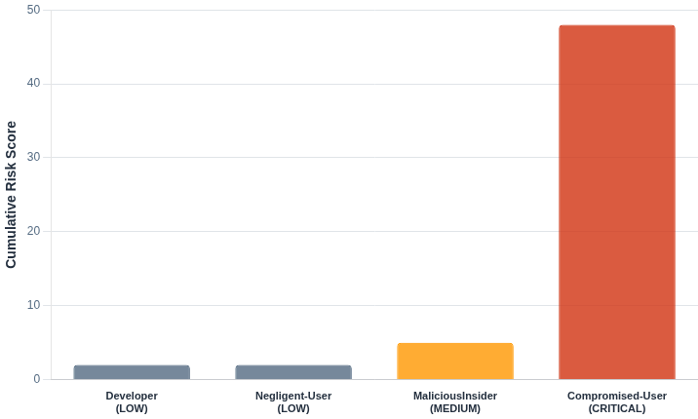



Demo Results: Risk Score Comparison
Cumulative scoring successfully differentiates baseline activities from suspicious, high-risk behaviors.
Escalation Drivers
Privilege Escalation
• MaliciousInsider: 3 attempts
• Compromised-User: 2 attempts
Access Denied Counts
High session denied counts highlight clear boundary-crossing probes during the compromised credential sequence.
Risk Tier Mapping
• CRITICAL: Score > 20
• HIGH: Score 11-20
• MEDIUM: Score 5-10
• LOW: Score < 5
Source: Risk tier mapping based on Common Vulnerability Scoring System (CVSS) severity levels

Slide 14
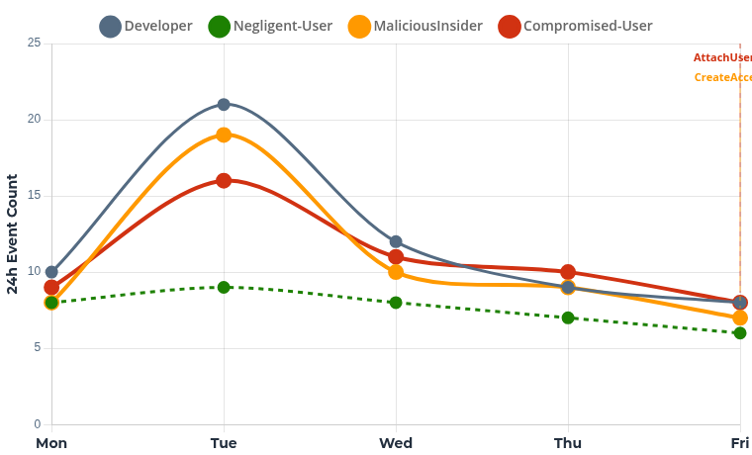



Suspicious Activity Trends Over Time
Tracking rolling event volume highlights structural differences between baseline operations and rapid escalation sequences.
Trend Analysis & Escalation
Compromised User
Sustained elevated volume resulting in AttachUserPolicy. Shows highest after-hours cross-department probes.
Malicious Insider
Mid-week spike aligns with infrastructure probing, culminating in CreateAccessKey persistence attempt.
Baseline & Negligent
Relatively flat trajectory. Despite isolated mistakes by the negligent user, structural event velocity remains stable.
*Markers indicate primary alert escalation thresholds where tier transitioned to HIGH/CRITICAL.

Slide 15



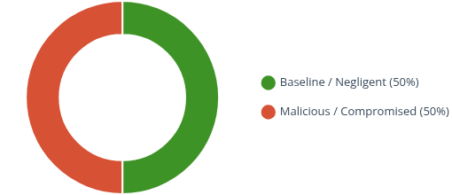
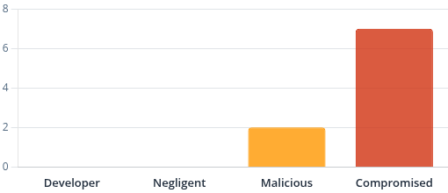

Demo Results: Executive Dashboard
Total Avg Events/Day
Avg Denied Actions/Day
Privilege Escalation Attempts
Developer: 12
Negligent: 6
Developer: 0
Negligent: 0
Developer: 0
Negligent: 0
Malicious: 12
Compromised: 6
Malicious: 6
Compromised: 3
Malicious: 3
Compromised: 2
Overall Behavior Classification
After-Hours Activity Breakdown
Key Insights & System Effectiveness
Clear Separation: Compromised persona shows the highest after-hours and cross-dept behaviors; Malicious shows distinct honey-resource targeting.
Zero Baseline Noise: Authorized users (Developer, Negligent) remain quiet across suspicious metrics, validating extremely low false-positive rates.
Explainable Results: Weighted scoring combined with suppression and decay produced predictable, tier-based escalations tied directly to business risk.

Slide 16
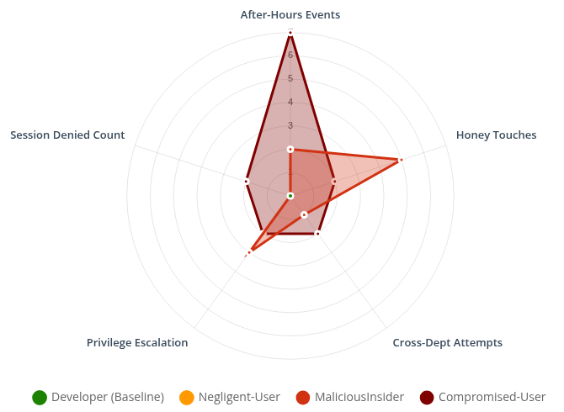

Demo Results: Behavior Radar
Behavioral Profiles
Measured Dimensions:
After-Hours Events: Time-of-day anomalies
Honey Touches: Targeting sensitive/decoy data
Cross-Dept: Lateral boundary probing
Privilege Escalation: IAM role/policy abuse
Session Denied: Burst of AccessDenied errors
Key Insight
The Compromised persona exhibits a broader, spikier profile across multiple vectors due to automated recon and boundary probing. The Malicious Insider shows deep, targeted spikes primarily around specific honeyfile and escalation attempts.

Slide 17








Detection Effectiveness: KPIs
Cumulative Escalation: Tiered alerts (Medium, High, Critical) triggered consistently as suspicious action sequences accumulated over time.
Noise Suppression: Alert storms were eliminated using cooldown logic and daily risk decay, reducing analyst fatigue.
Action Explainability: Clear mapping of S3, IAM, and VPC actions provided immediate, readable context for every score change.
Zero
Tiered
High
Additive
Baseline Noise
Risk Escalation
Noise Reduction
GuardDuty Signals
Developer expected activity generated no risk points, preserving perfectly clean behavioral profiles.
Alerts reliably escalated from Low to Critical threshold only as suspicious actions sequentially accumulated.
Alert suppression controls and risk-score decay algorithms successfully mitigated excessive notification volume.
AWS-managed threat intelligence and anomaly findings seamlessly integrated to corroborate custom context.

Slide 18


Key Achievements
Project outcomes demonstrated the viability and effectiveness of action-centric monitoring in cloud environments.
Successfully differentiated baseline activity from suspicious action sequences
Generated explainable scoring tied directly to concrete AWS actions
Maintained alert discipline via strategic cooldowns and noise suppression
Integrated GuardDuty successfully as managed corroborating telemetry
Delivered a practical, scalable prototype suitable for enterprise adaptation

Slide 19




Future Enhancements
Recommendations for maturing the prototype into an enterprise-scale security operation.
Longer Baselines
Geolocation & Session Analytics
Extend historical profiling windows (weeks to months) to establish stronger judgments about normal access times, expected service usage patterns, and API sequence behaviors before triggering anomaly scores.
Incorporate IP enrichment, approved network lists, and device reputation to raise confidence when access originates from unusual geographies or inconsistent infrastructure patterns.
Broader Workload Telemetry
SIEM & SOAR Integration
Expand visibility beyond S3/IAM/VPC by integrating VPC Flow Logs, host-level telemetry, container execution logs, and EDR sources to capture lateral movement post-exposure.
Connect natively-generated detections into broader enterprise case management platforms. Implement automated response playbooks for tier-critical thresholds (e.g., immediate credential revocation).

Slide 20








Cybersecurity Implications
Translating action-based telemetry into strategic enterprise risk management and governance outcomes.
Board-Level Exposure
Cost Mitigation
Insider risk is fundamentally an identity and access risk. It requires measurable, board-level metrics moving beyond perimeter security to focus on internal posture.
Faster containment materially lowers cost exposure. Early behavioral detection prevents prolonged breaches that can scale to average containment costs of $18.7M.
Regulatory Alignment
Continuous Governance
Aligns perfectly with NIST SP 800-30/53 frameworks and Zero Trust principles by enforcing continuous verification and tracking privilege deviation.
Underscores the operational necessity for rigorous access recertifications, strict handling of orphaned accounts, and comprehensive third-party oversight.

Slide 21


Action-based, AWS-native insider threat detection
Thank You
QUESTIONS & DISCUSSION
Solomon Runzonza | MS Cybersecurity Capstone

