Slide 1
Banking Customers Analysis

Slide 2
TABLE OF CONTENTS
01
02
03
04
PROBLEM STATEMENT
DATA ANALYSIS
FINDINGS
RECOMMENDATIONS

Slide 3
01
PROBLEM STATEMENT

Slide 4
THE PROBLEM
Who should we target/approve for Credit Cards?
How can we market promotions?
What additional info could we get to help in decision making?
Notes:
We are the marketing team / credit card approval team here at JBS Bank and would like to know who to target/approve for credit cards.
We have all of this info and would use it to identify potential customers and retarget existing customers
Feedback: good that I set the business goals upfront!!
Look at labelling in radar plot – tips can rename columns in actual df to shorten the name, also in plotly you can enable presentation mode to get better plots, also when comparing things we could have used bar charts or stacked radar charts.
i.e. we could have combined those radar charts to see all in one place
He said that the presentation was very clean

Slide 5
02
DATA ANALYSIS

Slide 6
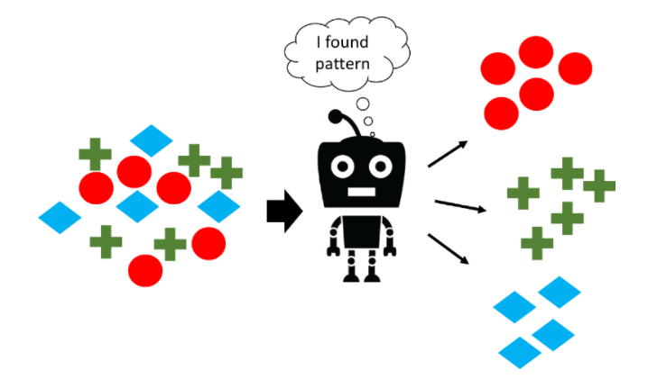
DATA
Notes:
Analysed demographic and financial behaviour combined for the respective customers and split them based on observed behaviour

Slide 7
03
FINDINGS

Slide 8
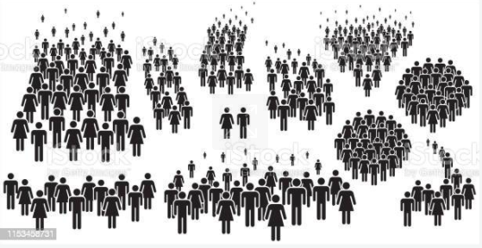
Results BREAKDOWN
5 Types of Customers:
2 Subgroups – Frugal
Not Sensible Spenders

Slide 9
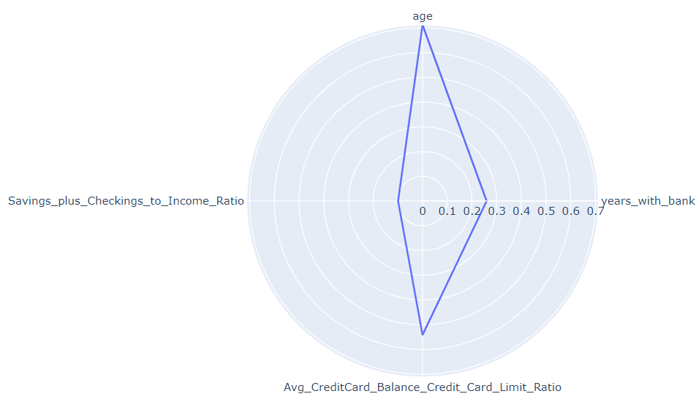
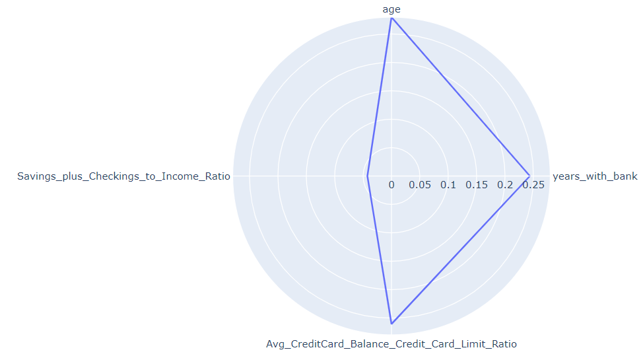
Results BREAKDOWN
Personas: Sensible Spenders
Older
Longer Term Clients
Strong Savings to Income Ratio
Rel High CC Bal to CC Limit Ratio
Older
Recent Clients
Strong Savings to Income Ratio
Lower CC Bal to CC Limit Ratio
Notes:
Approve those

Slide 10
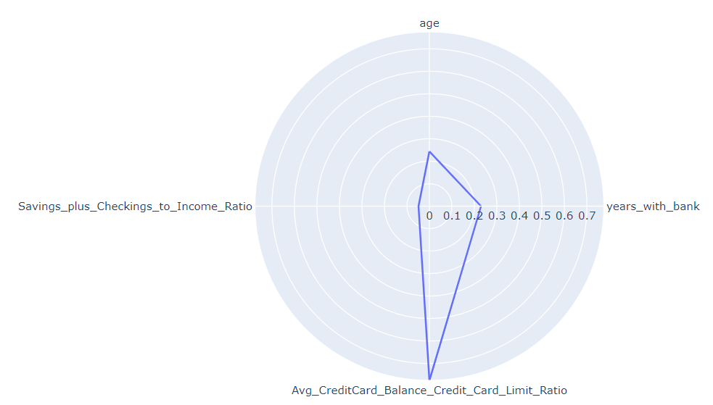
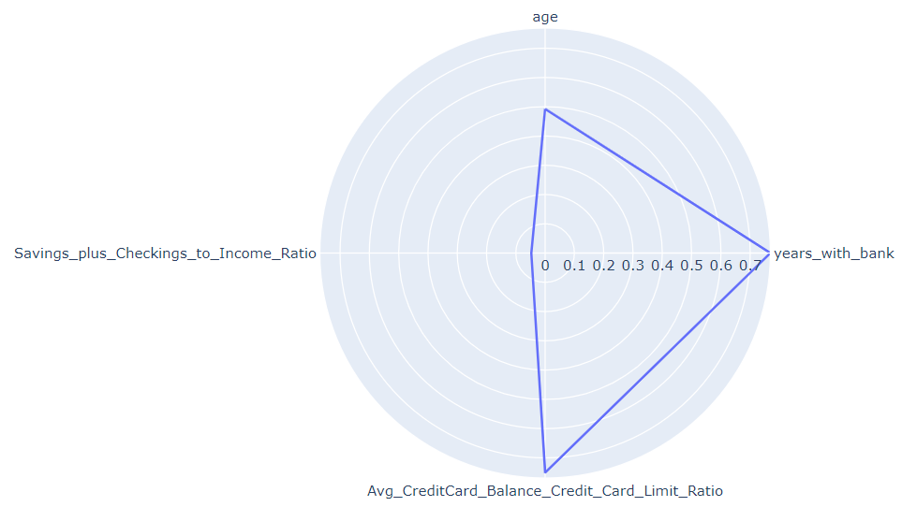
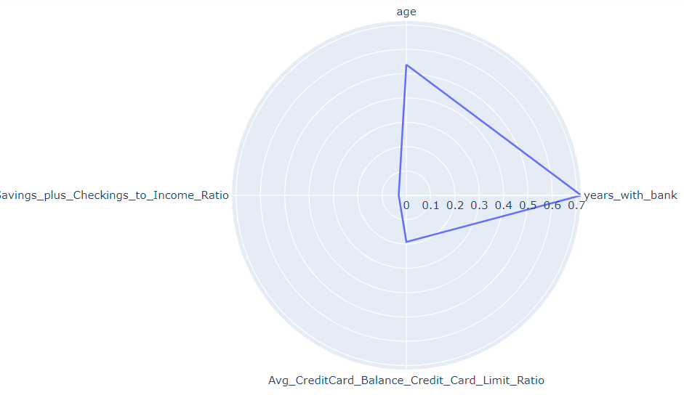
Results BREAKDOWN
Personas: Inactive Spenders
Young
Long Term Clients
Low Savings to Income Ratio
Low CC Bal to CC Limit Ratio
Personas: Careless Spenders
Young
Short and Long Term Clients
Low Savings to Income Ratio
High CC Bal to CC Limit Ratio
Notes:
Approve those

Slide 11
04
RECOMMENDATIONS

Slide 12


RECOMMENDATIONS
Have separate dimension tables for Savings + Checking Accounts’ Credit and Debit Transactions
Age doesn’t seem to be a separating factor for those in Approve list so experiment with other demographic features to be able to tailor marketing schemes
Notes:
Have separate dimension tables for Savings + Checking Accounts Credit and Debit Transactions – doing this would enable features related to spending habits could be garnered. As it is right now it’s not that clear.

