Slide 1


YeneQR
The All-in-One Restaurant Management Platform
A comprehensive platform to digitize and streamline daily restaurant operations — menus, orders, reservations, kitchen workflow, staff, CRM, analytics, and multi-branch management from one centralized system.
Vision: Empower restaurants with technology that improves efficiency, customer experience, and business growth.
Ethiopia's leading restaurant technology platform

Slide 2
THE CHALLENGE
Common Challenges in Restaurant Operations
While global restaurants digitize, most Ethiopian restaurants still rely on manual processes.
Printed Menus
Manual Orders
Kitchen Chaos
Manual Reservations
Costly to print, hard to update
Slow, errors, illegible to kitchen
No ticket system, missed orders
No-shows, double-bookings
No Analytics
No CRM
Multi-Branch Chaos
Limited Payments
No data on bestsellers or revenue
Cannot track customers or loyalty
Cannot manage locations centrally
No Telebirr, Chapa, CBE Birr
YeneQR solves all of this

Slide 3
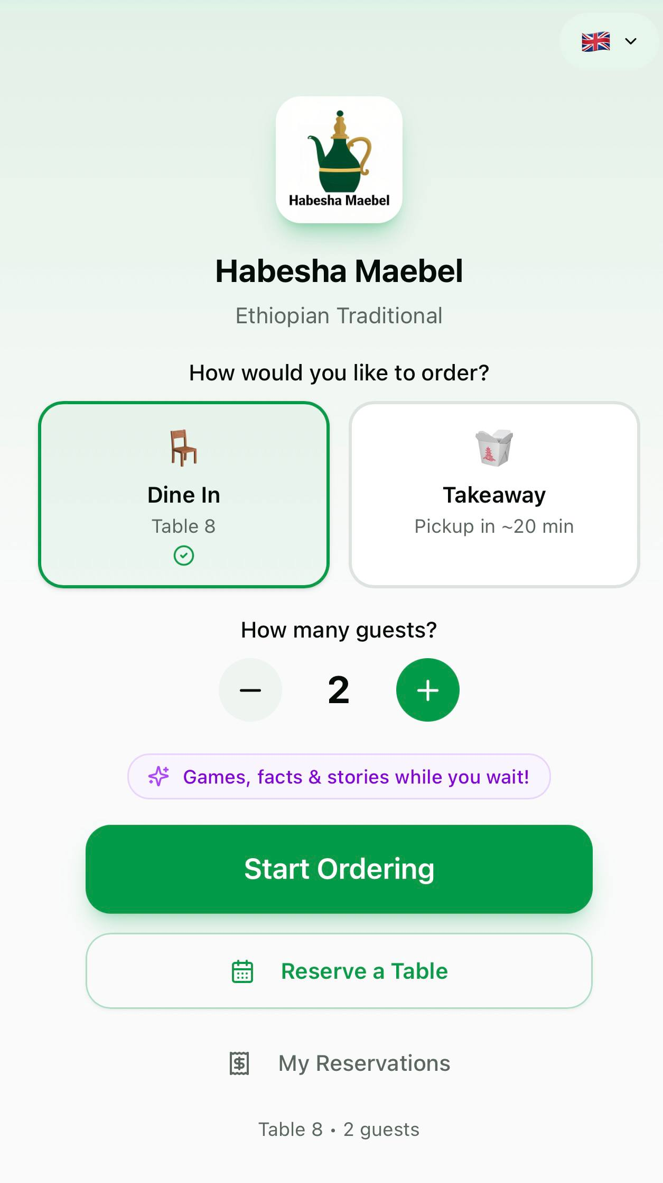
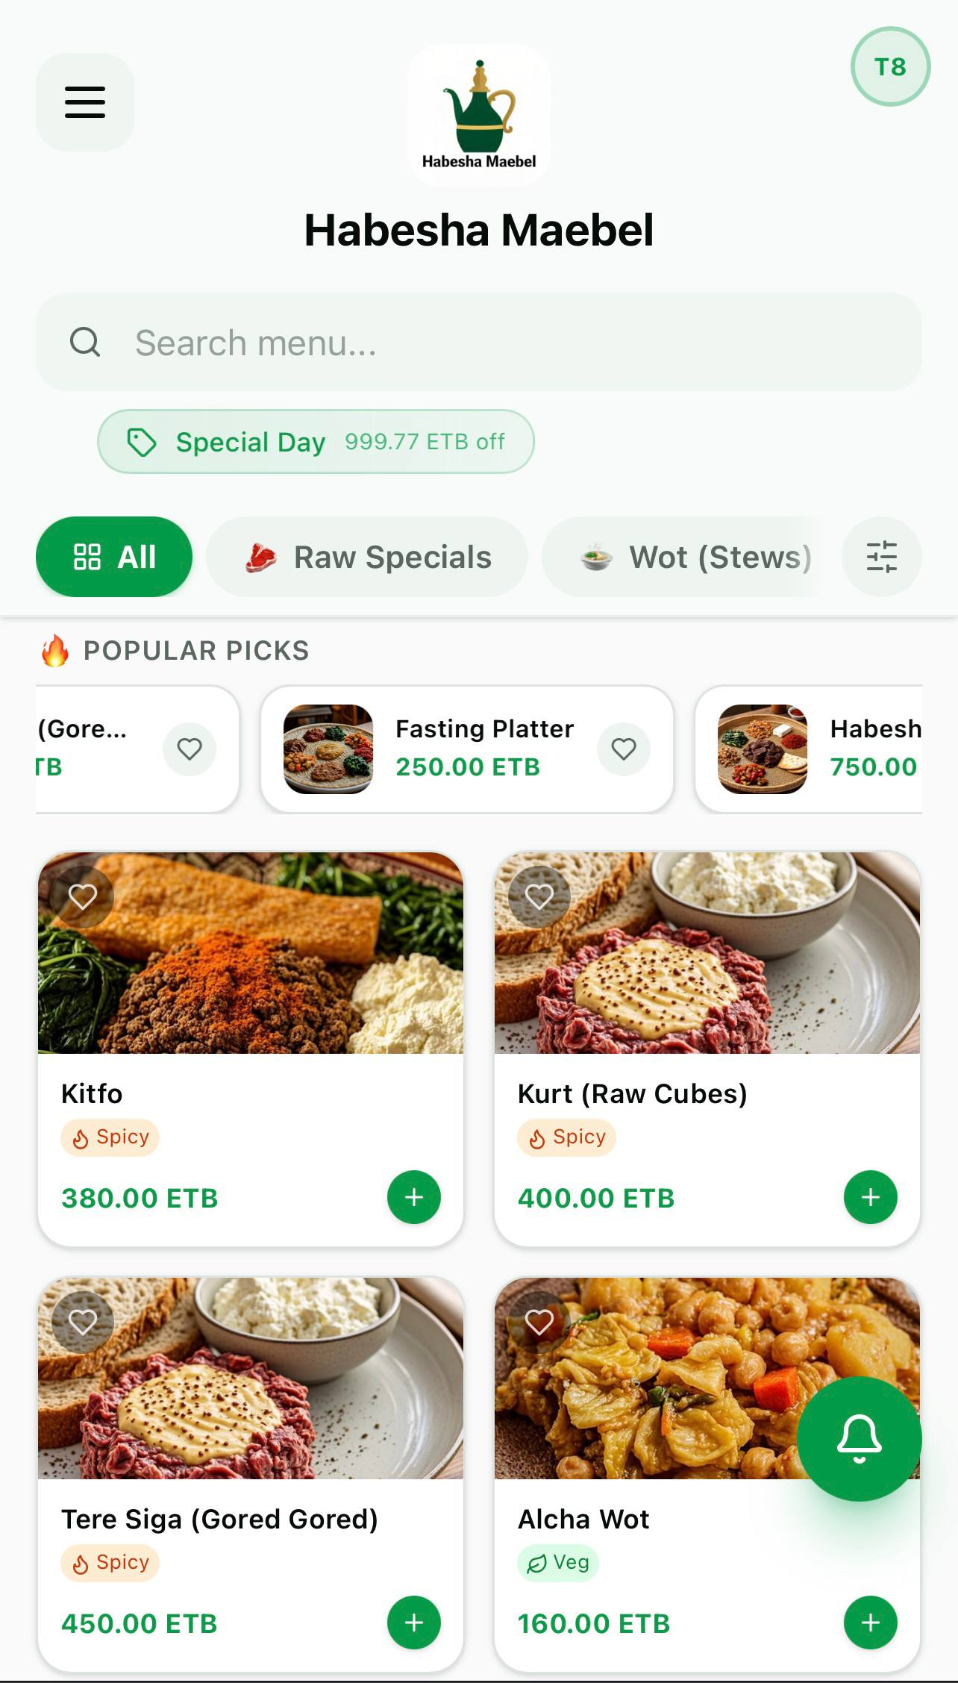
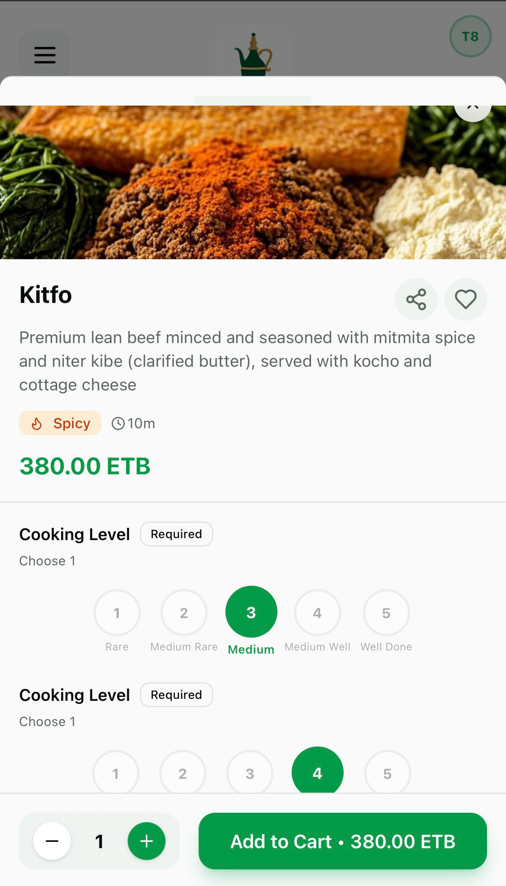
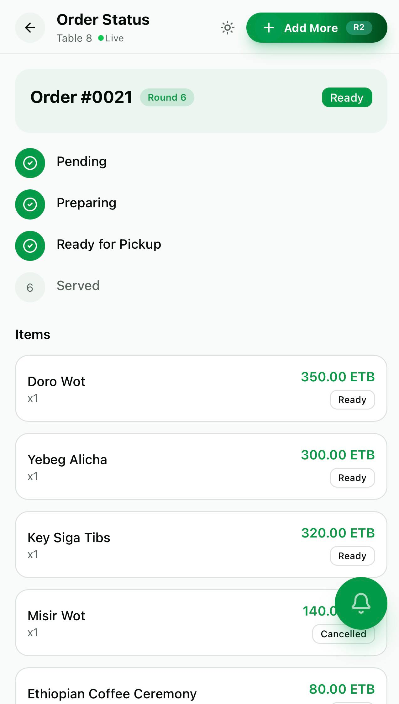
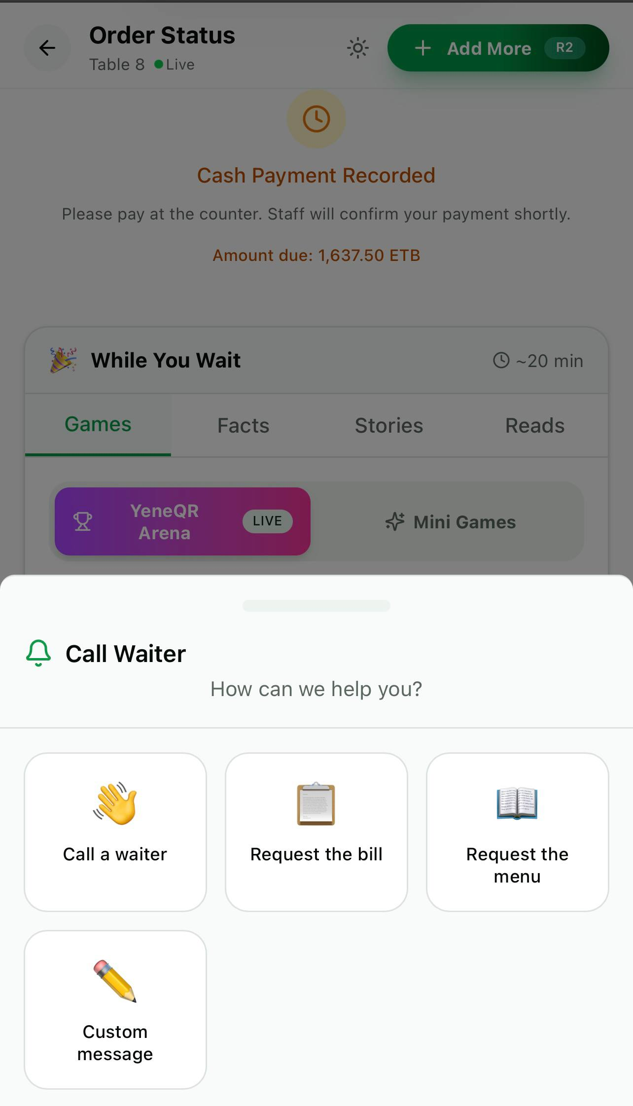
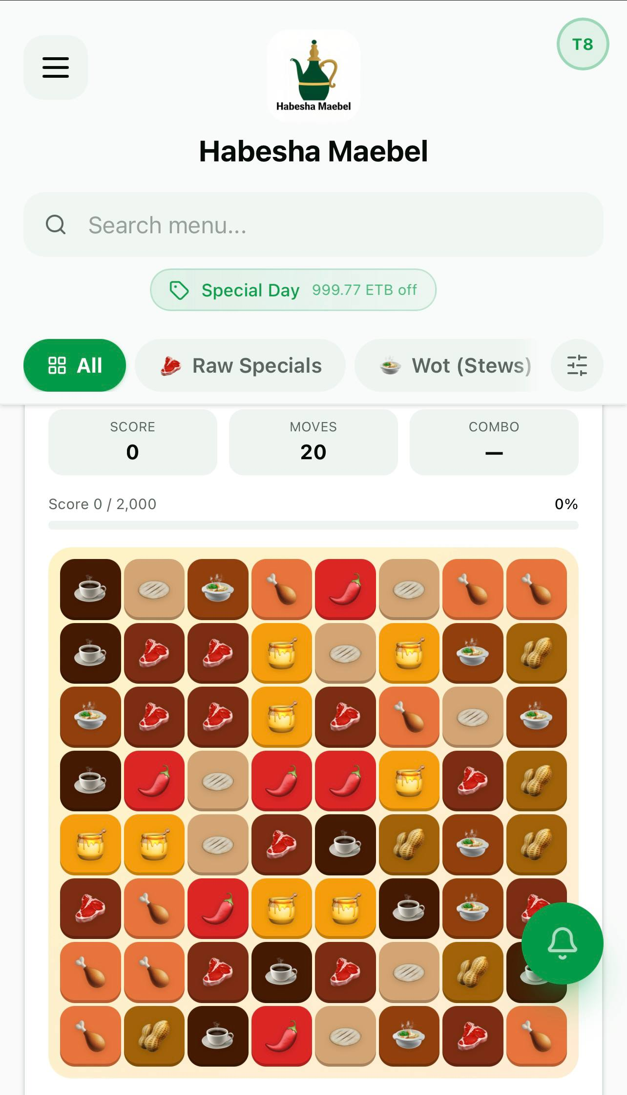
GUEST EXPERIENCE
End-to-End Guest Journey — From Scan to Pay
Scan QR → browse menu → customize order → track status → pay → play games.
1
2
3
4
5
6
→
→
→
→
→
1. Scan QR &
Choose Dine In
2. Browse Menu
& Categories
3. Customize &
Add to Order
4. Track Order
Status Live
5. Pay: Cash,
Telebirr, Chapa
6. Play Games
While Waiting
Multilingual · Telebirr · Chapa · CBE Birr · StarPay · Cash

Slide 4
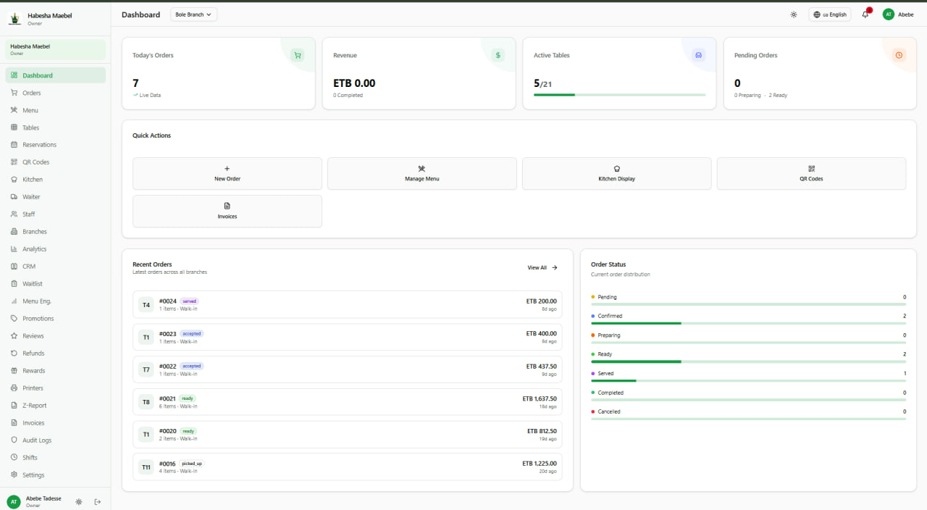
OPERATIONS
Complete Operational Control From One Dashboard
QR Menus, Online Ordering, Kitchen Mgmt, Waiter Mgmt, Tables, Staff, Multi-Branch, CRM, Analytics, Waitlist.
✓
Live Orders Dashboard
✓
Menu & Category Mgmt
✓
Kitchen Display System
✓
Staff & Role Management
✓
Table & Floor Plan
✓
Analytics & Reports
✓
Multi-Branch Management
✓
CRM, Promotions & Loyalty
Admin Dashboard — Real-time orders, revenue, table status
One platform replaces 5+ tools
No more switching between POS, spreadsheets, and paper tickets. Real-time from one login.
Kitchen Tracking

Slide 5
COMPETITIVE LANDSCAPE
How YeneQR Compares to Global Leaders
Same operational power as Toast and Lightspeed — with a revenue model built for emerging markets.
Feature
Toast
Shopify
Square
Lightspeed
YeneQR
POS & Order Mgmt
✓
—
✓
✓
✓
Kitchen Display
✓
—
—
✓
✓
QR Menu Ordering
—
—
—
—
✓
Multi-Branch
✓
✓
—
✓
✓
CRM & Loyalty
✓
✓
—
✓
✓
Reservations
✓
—
—
✓
✓
Games & Entertainment
—
—
—
—
✓
Telebirr/Chapa/CBE
—
—
—
—
✓
Amharic/Multilingual
—
Partial
—
Partial
✓
Revenue Model
Sub+Tx
Sub+Tx
Free+Tx
Sub+Tx
Decoupled
Key difference: Global platforms couple subscription to transaction fees. YeneQR decouples them — fee rate is negotiated per-restaurant, independent of the subscription plan.

Slide 6
BUSINESS MODEL
A Revenue Model Built for Emerging Markets
PER-TRANSACTION FEE
MISSION
0.5% — 3%
Become Ethiopia's leading restaurant technology platform by delivering modern digital solutions for the hospitality industry.
Charged on every captured payment. Rate set per-restaurant — negotiable. Excludes tips and tax.
WHY DECOUPLED?
Default: 3%
Enterprise: 1%
Charity: 0%
Fee rate and subscription are independent. Set any fee rate for any restaurant without changing their plan. Lower barrier. Higher conversion.
VOLUNTARY SUBSCRIPTION
BENEFITS
0 — 5,000 ETB/mo
Reduce printing · Speed up service · Minimize errors · Better CX · Real-time insights · Multi-branch
Optional monthly subscription for advanced features. No hard limits — all get full access.
No hard limits. No feature gating. Pure value.
Basic: Free
Pro: 2K
Premium: 5K
Custom

Slide 7
OUR VISION
Become Ethiopia's Leading
Restaurant Technology Platform
Delivering modern digital solutions for the hospitality industry — from QR menus to full operational intelligence.
All-in-One Platform
Local Payment Integration
Unique Guest Engagement
Menu, orders, kitchen, CRM, analytics
Telebirr, Chapa, CBE Birr, StarPay, cash
Games, loyalty, multilingual, waiter call
Repux Technologies PLC
repuxt@gmail.com

