Slide 1
CDF
CONTENT DELIVERY FRAMEWORK

Slide 2
What is CDF?
Content Delivery Framework (CDF) is a framework for delivering JSON content from disparate sources via HTTP REST architecture.
Joint effort between Solutia Consulting and Screwtop Media
CDF is really 2 things:
Retrieval of data from different REST sources (aka Data Island)
Packaged web components for displaying content (Web Component Architecture)

Slide 3
Benefits of CDF
Standard approach for front-end applications interacting with different REST APIS
CDF handles authentication and storage of access tokens
Simplifies data integration from multiple endpoints across different domains
Increases productivity
Affords ability to quickly surface content to client
Easy to create mashups of content from multiple sources
OAUTH2 Best Practices

Slide 4








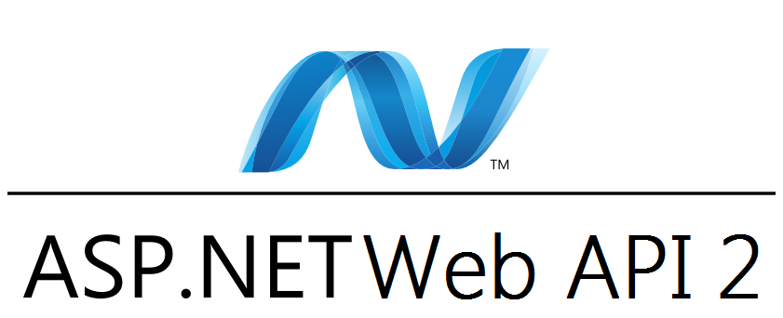

HOW CDF WORKS
custom
CDF combines multiple REST calls on client into a single unit.
HTTP
HTTP
HTTP
HTTP
HTTP
<cdf/>
HTTP
HTTP
HTTP
Web and Mobile Apps
HTTP
HTTP
HTTP
HTTP
CLIENT SIDE
SERVER SIDE

Slide 5
HOW IS CDF USED
Developer configures client application for each REST Web API needed for app
Developer constructs REST GET/POST requests
Multiple requests are bundled together and treated as a unit
CDF returns results for all requests as an array
Client app processes JSON results as needed
This is handled via CDF Data Islands

Slide 6
CDF DATA ISLAND EXAMPLE
JAVASCRIPT CODE
HTML CODE
<script>
let requestModel = new CdfRequestModel();
//LIST OF GETS FOR DATA ISLAND
requestModel.GetList =
[
'http://your-domain.com/something/something/1',
'http://some-domain.com/something/something/2',
'http://your-domain.com/something/something/5'
];
function onContentReceived(rawJson:any)
{
console.log('CONTENT RECEIVED:', rawJson);
//NOW PROCESS rawJSON INTO DATA NEEDED FOR UI…
};
</script>
<cdf-data-island
[RequestData]= "requestModel" (onContentReceived)="onContentReceived()">
</cdf-data-island>
<section>
/* DISPLAY HTML HERE CONSUMING JSON RESULTS FROM CDF-DATA-ISLAND */
</section>

Slide 7
CDF REQUIREMENTS
Angular2
Credentials for each REST API

Slide 8
CDF TO DATE
CDF is being used in these apps:
Screwtopmedia.com redesign
WinStar prototype app
DFW SportsBeat Progressive Web App
CDF Web Components
Media Web Component showing video or image
Slider Web Component showing a collection of media components. If media component is a video, then slides out to play video
Twitter Web Component showing a tweet as styled by Twitter
CDF is distributed via NPM package

Slide 9
CDF MODELS
CDF is shipped with models describing content
CDF web components are built to consume these models
Developer can use CDF web components by mapping incoming JSON data from REST calls to CDF models
CDF Models:
Root Model
Media Model

Slide 10
CDF Root Model
This is the base model that all subsequent models extend
Consists of the following data elements:
Type
Id
Title
Description

Slide 11
CDF Media Model
This model extends root model
Is used to handle different types of media (images or YouTube videos)
Consists of the following data elements (in addition to the ones in root model):
Image URL
YouTubeId
If YouTubeId is supplied, then CDF Media Web Component will load the video via JWPlayer
If Image URL is supplied with YouTubeId, the image will serve as poster for video
If Image URL is supplied with NO YouTubeId, then image is displayed

Slide 12
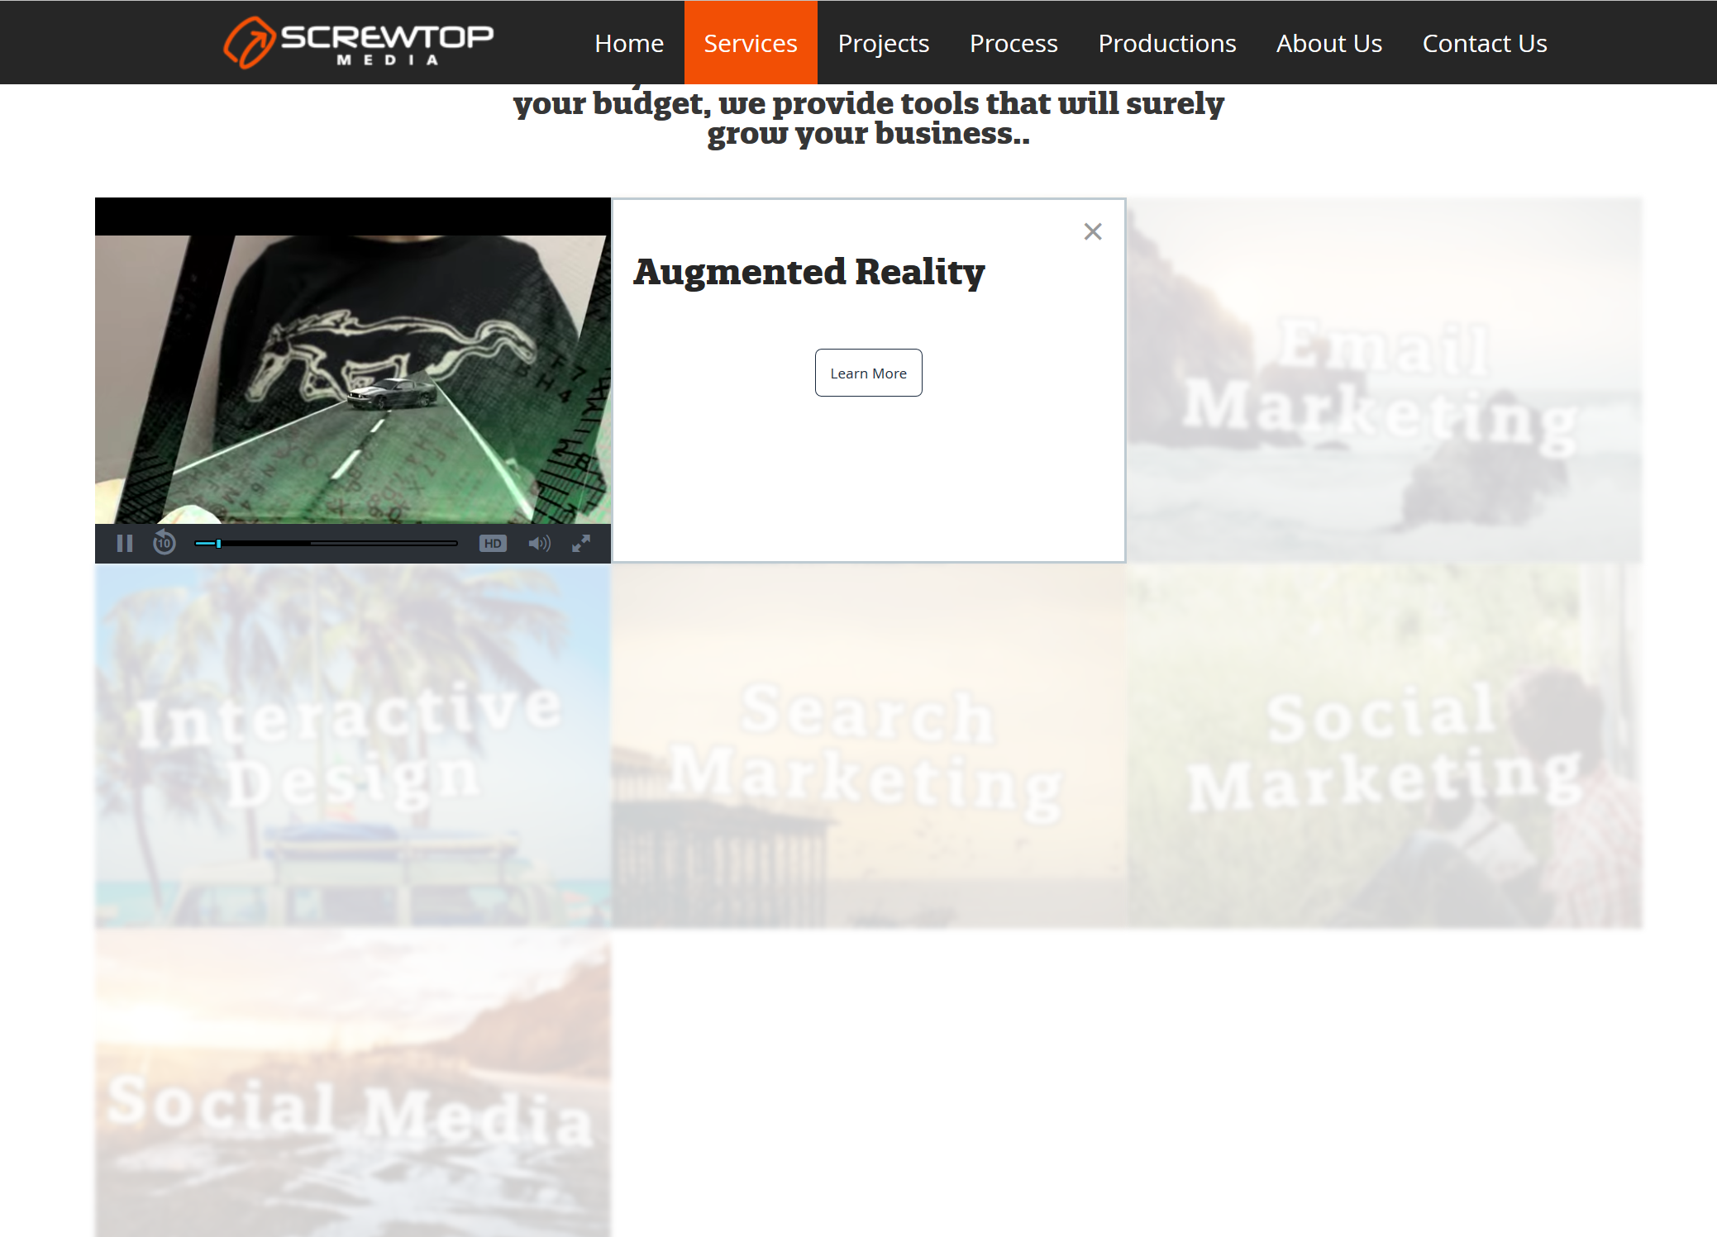
CDF Web Components
YouTube Video Component
Media Slider
Component
Image Component

Slide 13
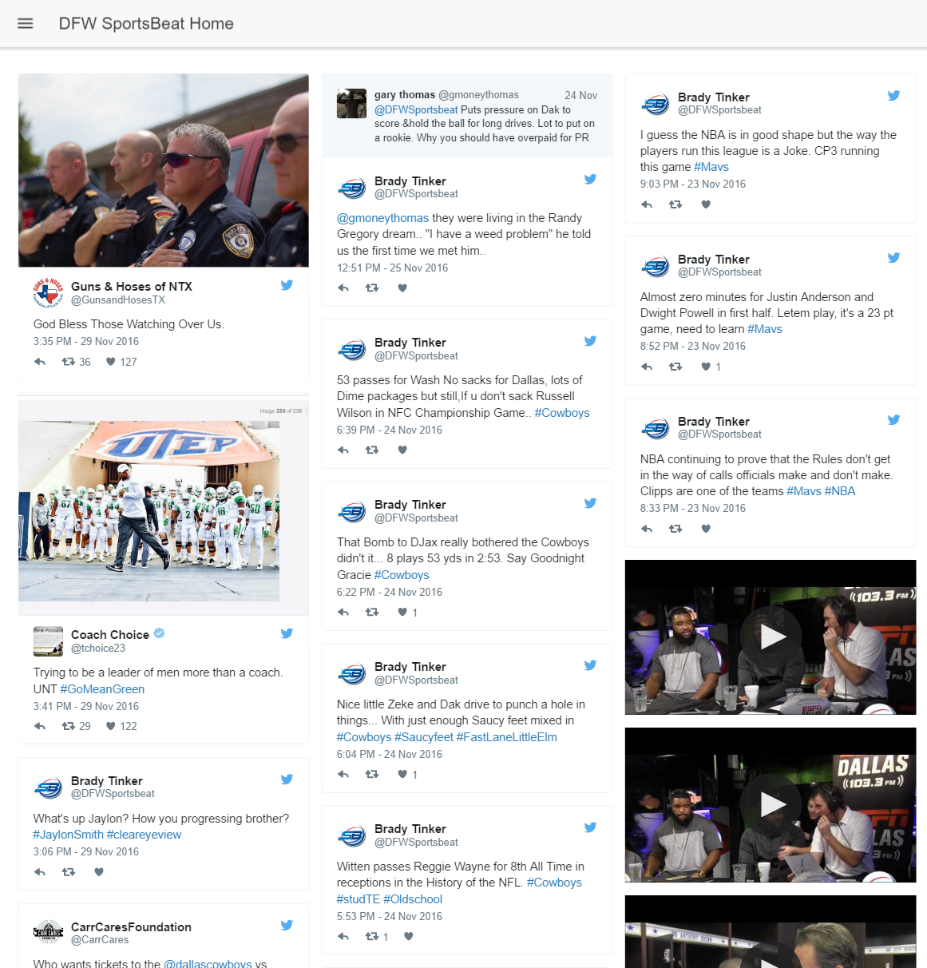
CDF Web Components
Twitter Component
YouTube Component

