Slide 1
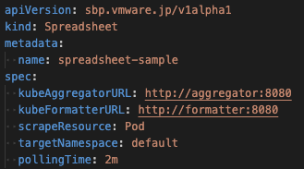
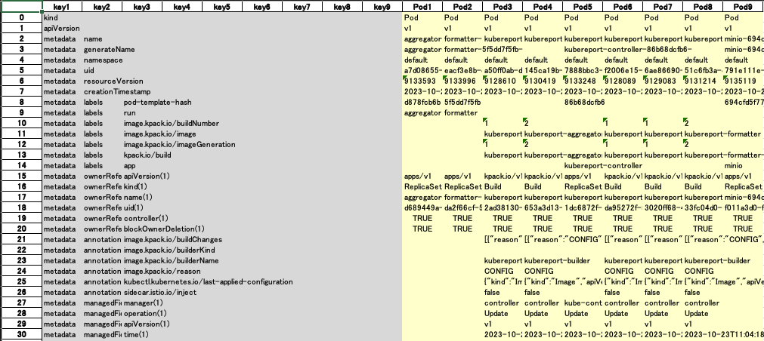
kubereport
Excel
Creates
kubereport formatter
Rest API(Post)
kubectl
kubereport controller
Saves
Rest API(Post)
kubereport aggregator
Rest API(Get)
minio
kubernetes
kubernetes
Persistent Volume
kubernetes

