Slide 1
Anatomy of a Web App
MVC Architecture
REST
Introduction to Web frameworks
SYSC4806
Notes:
1/16/17
1
1

Slide 2
Anatomy of a Web App
Server
Web App
SYSC4806
Notes:
1/16/17
2
2

Slide 3

Anatomy of a Web App
Server
Web App
request
port
response
Internet:
HTTP
TCP/IP
Routing
client
SYSC4806
Notes:
1/16/17
3
3

Slide 4
Anatomy of a Web App
(1990's)
site
Server
Web App
HTML
request
port
HTML
response
client
SYSC4806
Notes:
1/16/17
4
4

Slide 5
Anatomy of a Web App
(1990's)
site
Server
Web App
HTML
request
port
HTML
response
client
1 – Get index.html
=> index.html contains links:
2 – user sends: [get page2.html]
=> page2 has new links...
<a href=”page1.html”>click here</a>
<a href=”page2.html”>or here</a>
<a href=”page3.html”>or here !</a>
SYSC4806
Notes:
1/16/17
5
5

Slide 6
Anatomy of a Web App
Server
Web App
HTML
request
port
code
+js
response
HTML
XML
JSON
...
DB
client
generate
SYSC4806
Notes:
1/16/17
6
6

Slide 7
Anatomy of a Web App
Server
Web App
request
port
code
response
DB
client
SYSC4806
Notes:
1/16/17
7
7

Slide 8
The Problem: how to organize the code?
Need to handle complex logic in a maintainable way
Patterns to the rescue again!
Martin Fowler’s (remember him?) Patterns of Enterprise Application Architecture has become the reference (though some of it is now dated)

Slide 9
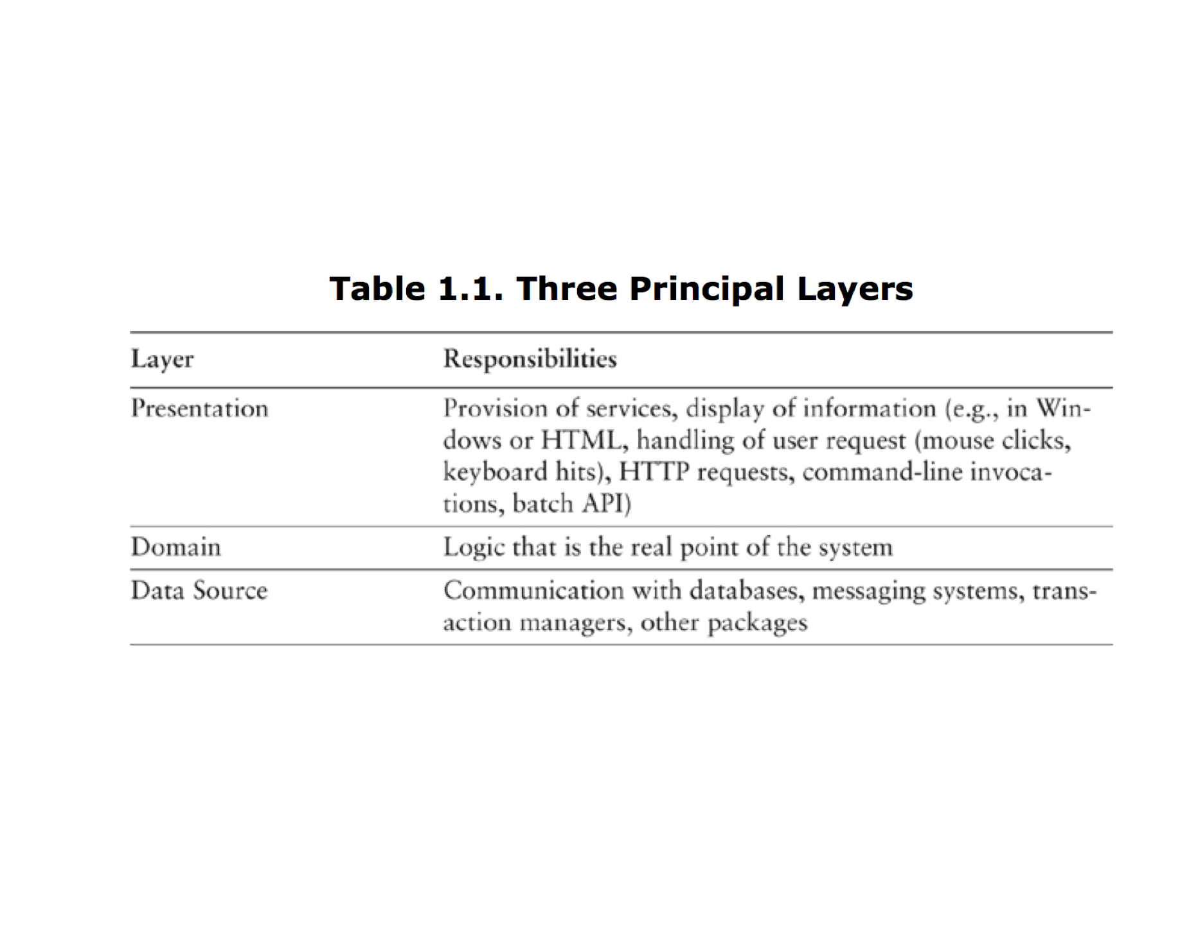
Three-tiered architecture
Fowler relies on the traditional three-tiered architecture:
separation between presentation layer, domain layer, data source layer
where does each live?

Slide 10
Organizing Domain Logic: “Transaction Script” vs “Domain Model”
in “Transaction Script” pattern, a single procedure processes the input, validates it, makes calculations, queries/updates the database, and formats the response
early CGI perl scripts, Java servlets, were written this way
that’s great until:
the calculations become more and more complex (coherence pb!)
there are increasing overlaps between various scripts (not DRY!)
the object-oriented alternative is to come up with a “Domain Model”
domain logic is organized by classes and relationships

Slide 11
“Service Layer”
A “Service layer” can be seen as an intermediary between the presentation layer and Domain Model
it provides a Façade with a clear API
this is where cross-cutting concerns such as authentication, transaction management, security can be applied
in modern web frameworks, this is where the Controller is
Domain Model logic can sometimes creep into the Service Layer, but you should resist it
keep your controller “thin”

Slide 12
“MVC”
Web App
Controller
Model
request
response
View
client
DB
SYSC4806
Notes:
1/16/17
12
12

Slide 13
MVC example: My Blog
Web App
Controller
Model
This is my first post!!
Dec. 31St, 2015
1 Comment:
Anonymous: Yay!
Post
+id
+title
+date
+text
Comment
+ author
+ text
Here is an entry in my blog. I'm
so excited to have a blog.
request
response
View
DB
client
SYSC4806
Notes:
1/16/17
13
13

Slide 14
MVC example: My Blog
Web App
Controller
Actions:
- view posts
- view post (id)
- new post
- delete post (id)
- add comment
Model
This is my first post!!
Dec. 31St, 2015
1 Comment:
Anonymous: Yay!
Post
+id
+title
+date
+text
Comment
+text
Here is an entry in my blog. I'm
so excited to have a blog.
request
response
View
DB
client
SYSC4806
Notes:
1/16/17
14
14

Slide 15
MVC example: My Blog
Web App
Controller
Actions:
- view posts
- view post (id)
- new post
- delete post (id)
- add comment
Model
This is my first post!!
Dec. 31St, 2015
1 Comment:
Anonymous: Yay!
Post
+id
+title
+date
+text
Comment
+text
Here is an entry in my blog. I'm
so excited to have a blog.
request
response
View
[HTML templates]
DB
client
SYSC4806
Notes:
1/16/17
15
15

Slide 16
MVC
GET [uri]
DELETE [uri]
PUT [uri][content]
POST [uri][content]
PATCH [uri][content]
Web App
Controller
Model
request
GET /blogposts/20151231
response
View
client
DB
SYSC4806
Notes:
1/16/17
16
16

Slide 17
MVC
Web App
Controller
def view(post_id):
p=posts.get(postid)
def delete (post_id):
Model
request
GET /blogposts/20151231
response
View
client
DB
SYSC4806
Notes:
1/16/17
17
17

Slide 18
MVC
Web App
Route Mapping
Controller
def view(post_id):
p=posts.get(postid)
def delete (post_id):
Model
request
GET /blogposts/20151231
response
View
client
DB
SYSC4806
Notes:
1/16/17
18
18

Slide 19
MVC
Web App
Controller
def view(post_id):
p=posts.get(postid)
def delete (post_id):
Model
request
Post
Comment
GET /blogposts/20151231
response
View
SQL
client
DB
SYSC4806
Notes:
1/16/17
19
19

Slide 20
MVC
Web App
Controller
def view(post_id):
p=posts.get(postid)
def delete (post_id):
Model
request
Post
Comment
GET /blogposts/20151231
Object-Relational Mapping
response
View
SQL
client
DB
SYSC4806
Notes:
1/16/17
20
20

Slide 21
MVC
Web App
Controller
def view(post_id):
p=posts.get(postid)
def delete (post_id):
Model
request
Post
Comment
GET /blogposts/20151231
response
View
client
DB
<HTML>
<H1> <%=p.title %><H1>
<p><%=p.date%></p>
<p><%=p.text%></p>
<div id=”comments”>
...
SYSC4806
Notes:
1/16/17
21
21

Slide 22
MVC
Web App
Controller
def view(post_id):
p=posts.get(postid)
def delete (post_id):
Model
request
Post
Comment
GET /blogposts/20151231
response
View
client
DB
<HTML>
<H1> <%=p.title %><H1>
<p><%=p.date%></p>
<p><%=p.text%></p>
<div id=”comments”>
...
Template w. Embedded code
SYSC4806
Notes:
1/16/17
22
22

Slide 23
MVC
Web App
Controller
def view(post_id):
p=posts.get(postid)
def delete (post_id):
Model
request
Post
Comment
GET /blogposts/20151231
Client-side code (js) processes json (/xml/etc.)
response
View
client
DB
(JSON)
{ “title”: p.title,
“date”: p.date
“text”: p.text,
“comments”: {
...}
Template w. Embedded code
SYSC4806
Notes:
1/16/17
23
23

Slide 24
Anatomy of a Web App: Summary
request
Controller
Model
Architecture:
Languages:
Request: HTTP: verb + URI [+content]
Controller: [Some programming language]
Model to DB: SQL
Response: HTML (or JSON, XML, etc.)
Patterns:
Route Mapping, Service Layer
Object-relational Mapping (ORM): Data Mapper, ActiveRecord
Presentation Layer: Templating
response
View
DB
SYSC4806
Notes:
1/16/17
24
24

Slide 25
REST (REpresentational State Transfer)
Architectural Style defined by Roy Fielding (2000) defined by a set of constraints:
Client-Server
Stateless Server
Layered Architecture
Uniform Interface:
identification of resources;
manipulation of resources through representations;
self-descriptive messages;
hypermedia as the engine of application state
Cacheable
Code on demand
SYSC4806
Notes:
1/16/17
25
25

Slide 26
REST
Server
Resources
client
client
client
Clients Manipulate Resources Managed by App
(products, photos, maps, blog posts, emails, ...)
SYSC4806
Notes:
1/16/17
26
26

Slide 27
REST
Server
Resources
Request: GET x
“What is the state of resource x?”
Response:
[A representation of x]
client
SYSC4806
Notes:
1/16/17
27
27

Slide 28
REST
URI identifies resource: e.g.
http://acme.com/products/bhz-2000
Server
Resources
Request: GET x
“What is the state of resource x?”
Response:
[A representation of x]
(HTML, JPG, JSON, XML...)
client
SYSC4806
Notes:
1/16/17
28
28

Slide 29
REST
Server
Resources
Request: PUT x [repr]
“Replace x with [repr]”
client
SYSC4806
Notes:
1/16/17
29
29

Slide 30
REST
GET x
“What is the state of resource x?”
PUT x [repr]
“Change x to [repr]”
POST x [repr]
(or PATCH x [repr])
“Change state of x”
(e.g. add to collection)
DELETE x
“Delete x”
Server
Resources
client
Create / Retrieve / Update / Delete (CRUD)
SYSC4806
Notes:
1/16/17
30
30

Slide 31
REST and MVC
request
Controller
Actions:
- Create
- Retrieve
- Update
- Delete
Model:
Resources
DB
response
View
SYSC4806
Notes:
1/16/17
31
31

Slide 32
REST and MVC and Web Framework
request
Controller
Actions:
- Create
- Retrieve
- Update
- Delete
Model:
Resources
Post
Comment
1 – Define Resources
DB
response
View
SYSC4806
Notes:
1/16/17
32
32

Slide 33
REST and MVC and Web Framework
request
Controller
Actions:
- Create
- Retrieve
- Update
- Delete
Model:
Resources
Post
Comment
1 – Define Resources
2 – Generate the rest.
(skeleton + mapping)
DB
response
View
SYSC4806
Notes:
1/16/17
33
33

