Slide 1
Charity Website
Jason Perez

Slide 2
Charity Website Outline
Wireframes
Wide Screen Format
Medium Screen Format
Mobile Format

Slide 3
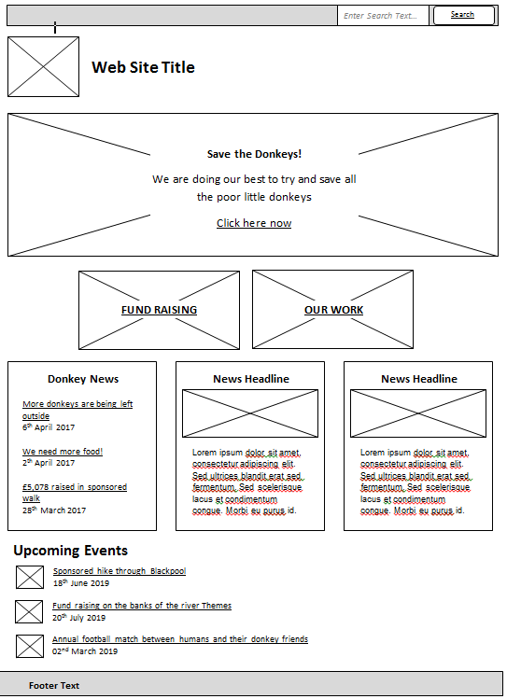
Wireframe Original

Slide 4
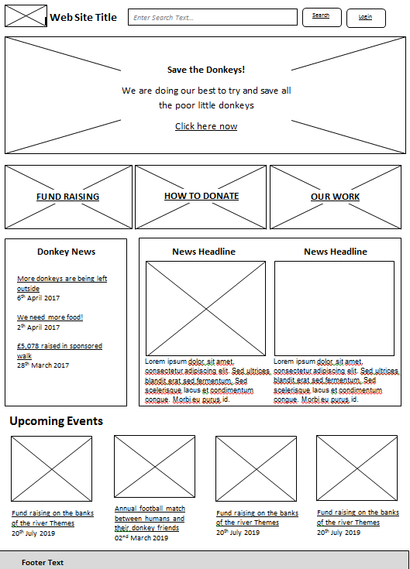
Wireframe Updated

Slide 5
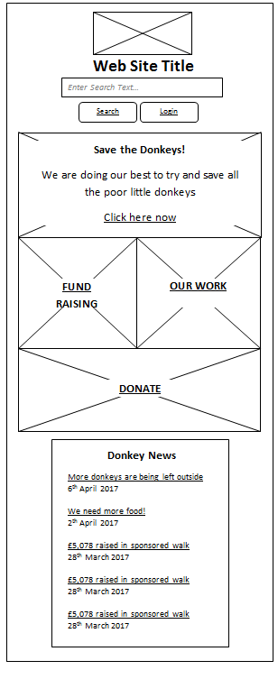
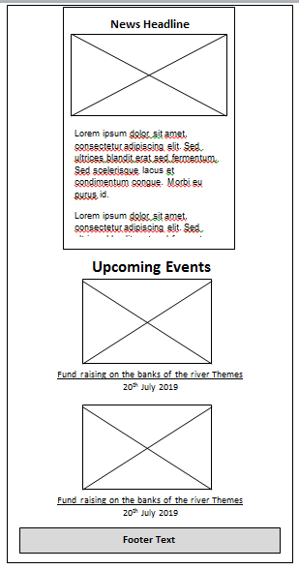
Wireframe Mobile

Slide 6
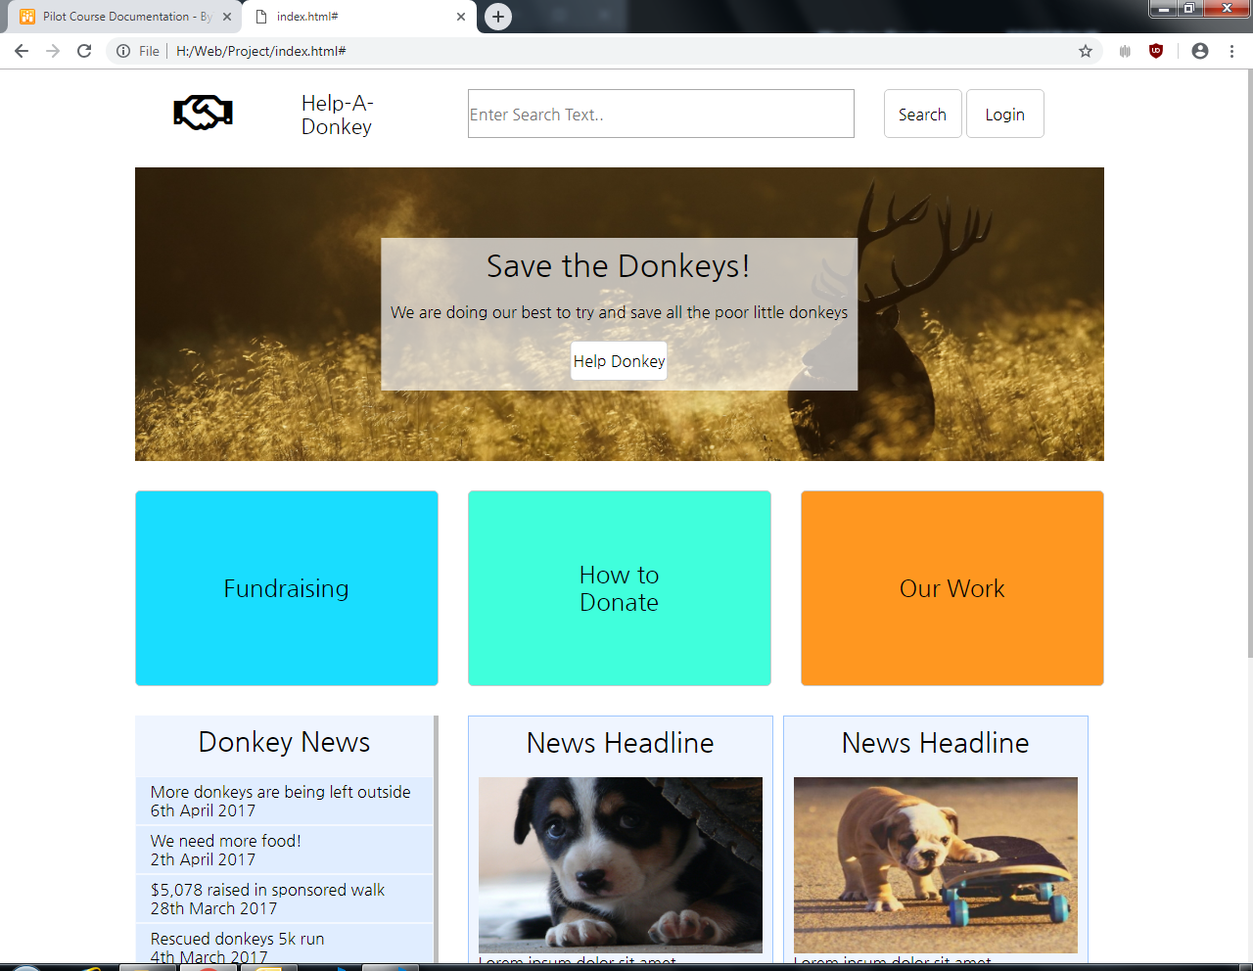
Wide Screen Format

Slide 7
Wide Screen Format

Slide 8
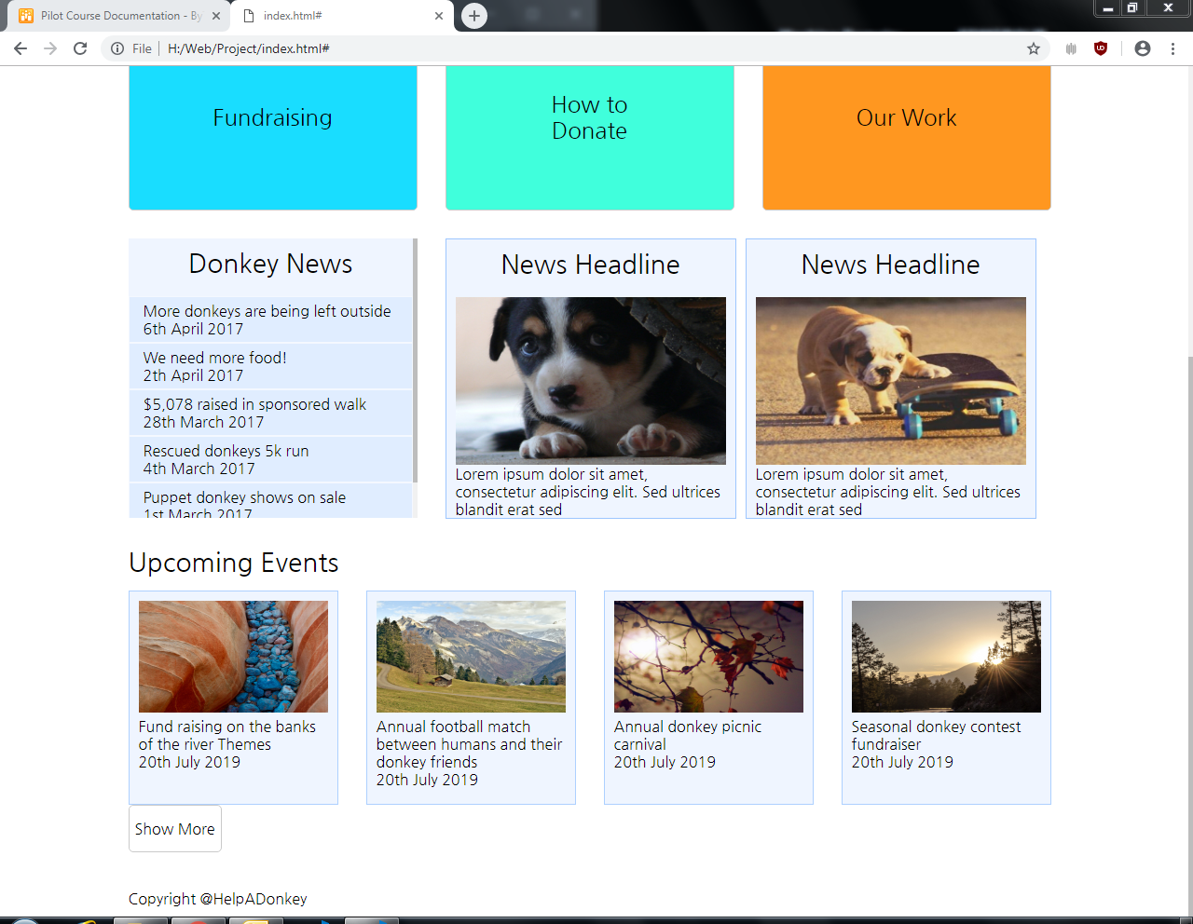
Wide Screen Format

Slide 9
Wide Screen Format

Slide 10
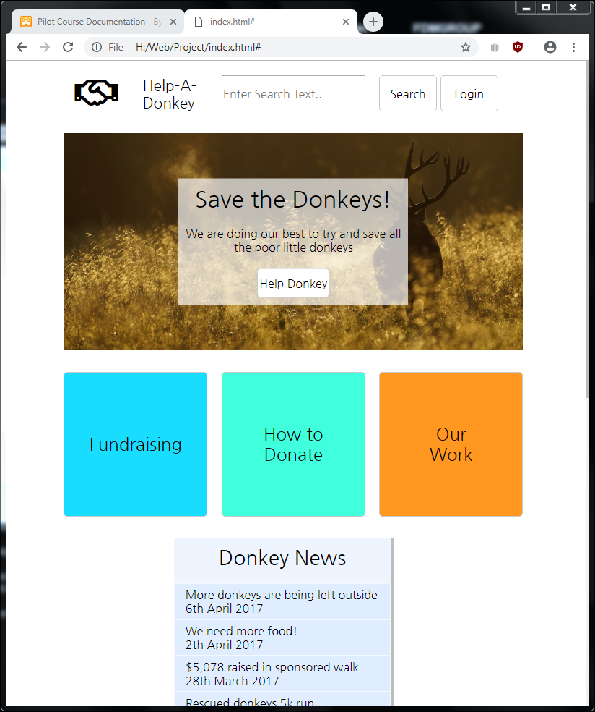
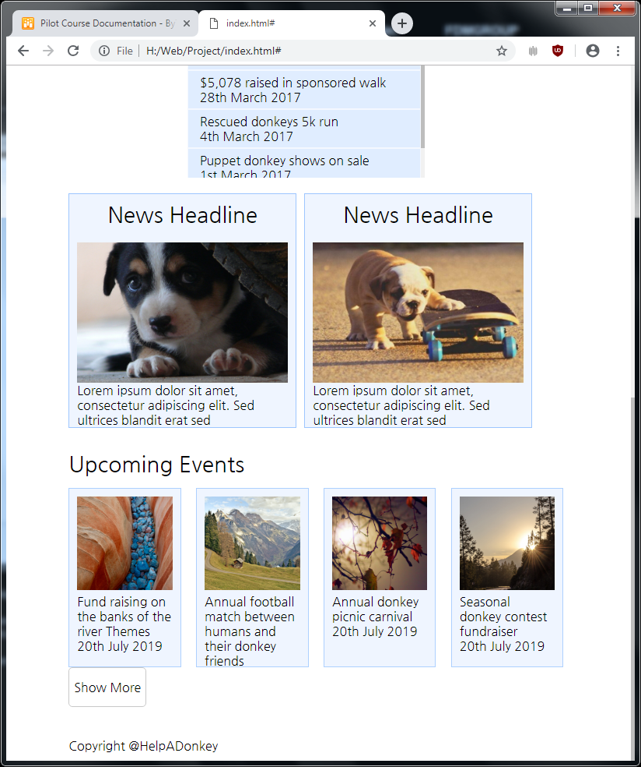
Medium Screen Format

Slide 11
Medium Screen Format

Slide 12
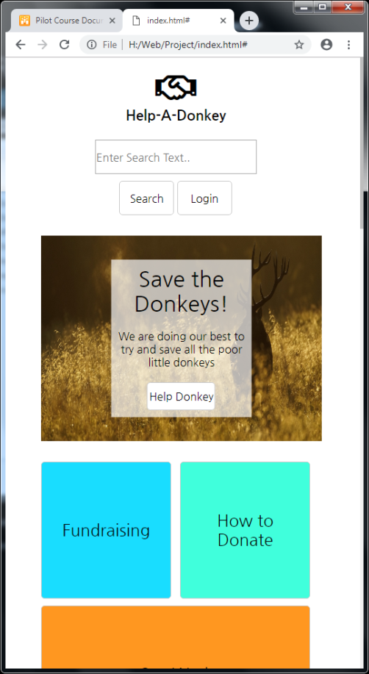
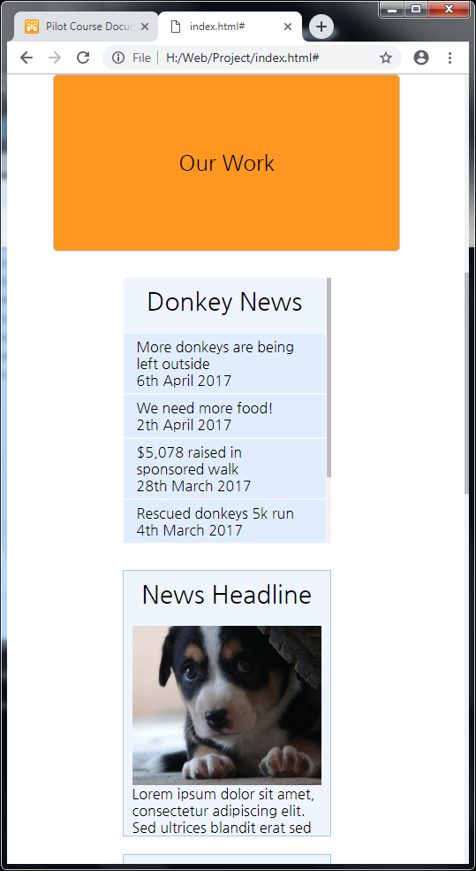
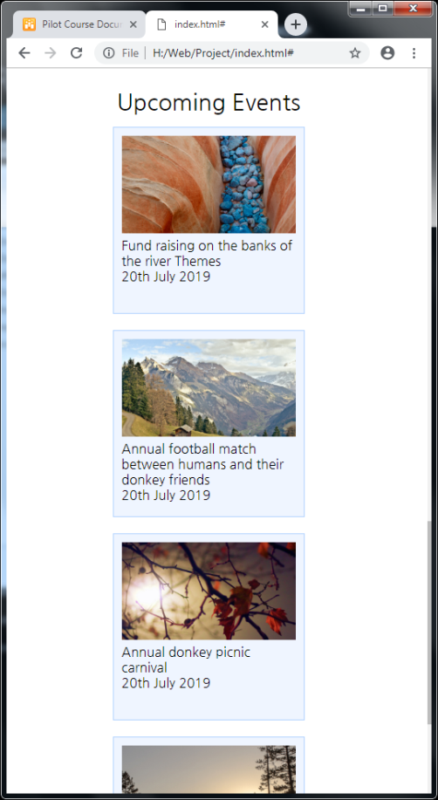
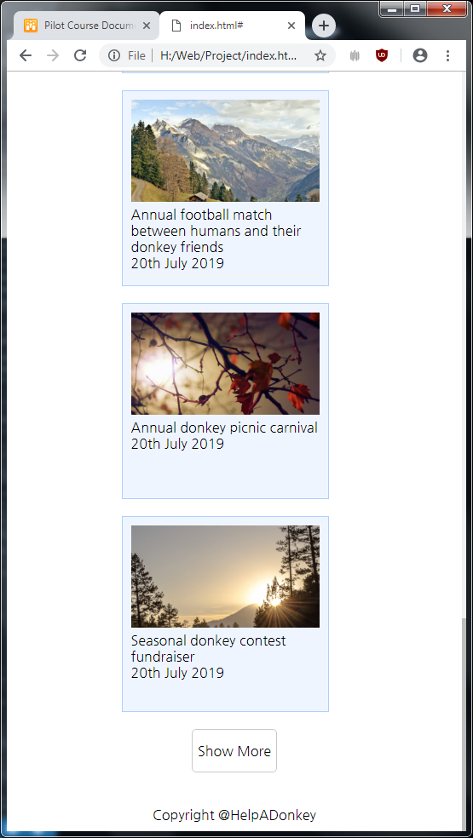
Mobile Screen Format

Slide 13
Mobile Screen Format

Slide 14
Questions?

