Slide 1
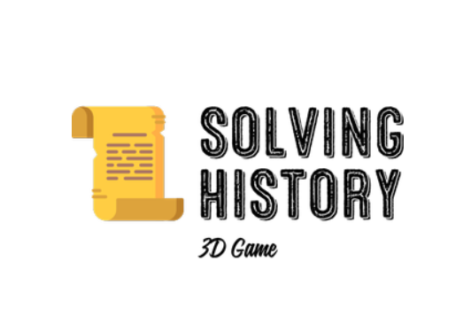
NAMES:
MARIOS KOUNDOURIS
PRODROMOS PIERI
FILIPPOS SAVVA

Slide 2
Content
Our team
Our idea
The Challenge
The Way Forward
The Solution
Tools

Slide 3
Our team
Marios Koundouris
Prodromos Pieri
Filippos Savva
4th year students at Cyprus University of Technology on Computer Engineering branch.

Slide 4
Our idea
Adventure and Puzzle solving video game
Riddles based on historical facts
Riddles and solutions providing information
Getting to know historical and archeological areas and monuments

Slide 5
The Challenge
Place: Choirokoitia
Riddle: Do you know how people here used to ensure their necessary goods to survive? But be careful, the solution is fluffy, pointy and try not to cut yourself.

Slide 6
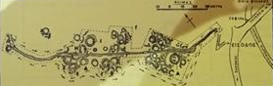
The Way Forward
The player will have to navigate through the map to find and solve the riddle given to him by interacting with specific objects.

Slide 7
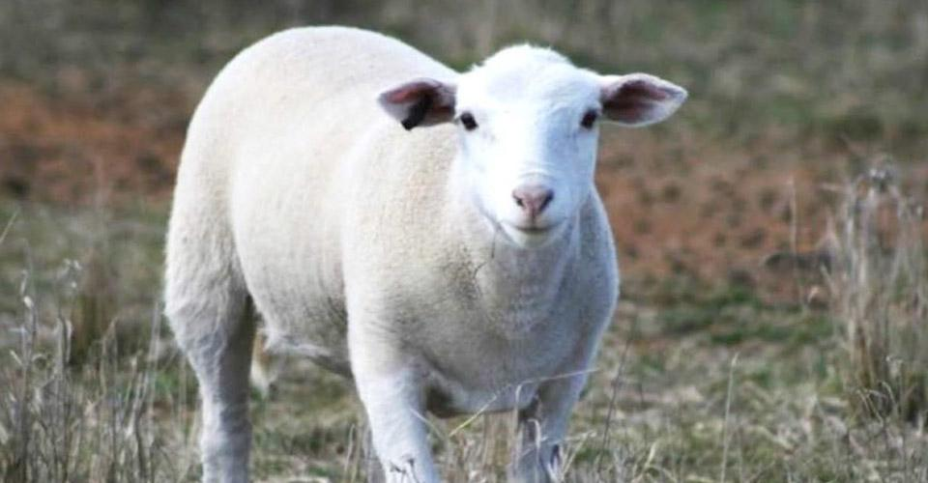
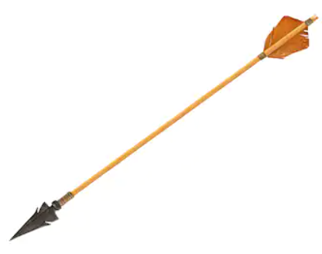
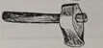
The Solution
Fluffy
Pointy
Don’t cut yourself!

Slide 8




Tools

Slide 9
Our progress with the tools
We have installed Unity and 3DS Max
We purchased a course for Unity using C# in Udemy
We purchased a course for 3DS Max in Udemy
We created a shared project in Plot for the storyboard
We created a repository in GitHub to share our code

Slide 10
Storyboard Final Areas
Sites:
Neolithic Era:
Choirokitia
Start of 12th Century:
Panagia tis Asinou
2 castles:
Kolossi
Palaipafos

Slide 11
Our progress with the tools before August
We learned how to create some environments and some movements of the character as we reached in a good section of the course (Unity and C#)
We completed the course for 3DS Max so we can start designing our character and some objects that character will interact with
We are ready to get into Plot for the storyboard and start creating the scenes. We are still looking for some information for some of the areas

Slide 12
Our progress until 4/8/2020
Added movement and animation to the character and added third person camera rotation and experimented with the colliders but there are still some bugs(still trying to perfect it)
Experimented with the terrain and the game environment
Started adding color to the castle
Started experimenting with in game lighting

Slide 13
Progress of Marios Kountouris
This week I was involved with the design part, I tried to format the terrain, to create mountains but also a small sample of the game environment(sky), experimenting with the colors in the castle in all its parts.

Slide 14
Progress of Filippos Savva
This week I worked on the movement of the character, the lighting and tried to figure out the colliders in Unity. Basic movement with animation has been established but I’m still working on the castles colliders and perfecting the movement. We found ways to add light in the game but we are still working on the right angles to make it more sufficient.

Slide 15
Progress of Prodromos Pieri
This week I worked on finding the sources for the movement of the character after I created the character in 3Ds Max Generator which is very helpful for creating custom characters. I also found the source to download the specific folder with the animations of the character(walking ,running, forward, left, right) and I added it into our files. Finally, I found some textures for the terrain and the sky(environment) to help Marios with the process and I helped Filippos with the first steps of the movement of the character.

Slide 16
Our progress until 20/8/2020
We added real terrain
We tried different movement for the character
We organized our files
We added more scenes

Slide 17
Progress of Marios Kountouris
This week I found the way to make a terrain looks exactly like ours in Cyprus using the terrain party and some tools like height mapper that I added into unity to make it.

Slide 18
Progress of Filippos Savva
This week I worked on finding a way to create a transition between the scenes. There are still major bugs.

Slide 19
Progress of Prodromos Pieri
This week I worked on finding some new characters and especially a character who looks like a tourist. I still looking for the NPC model that will look like an ancient human who will guide the main character. I discussed with Filippos some of our scenarios about the gameplay of each area and we decided some specific ways we want to make it in real. We faced a big problem while trying to find the best way to collaborate without limits with my team and finally we got into solution. Suddenly, it took me 3 4 days to solve this problem. I also worked on creating the main menu scene using the canvas in unity and I tried to put some functionality but it’s not finished yet.

Slide 20
Our progress until 27/8/2020
We added texture on Pangia of Asinou and the surrounding terrain
We added light in Panagia of Asinou
We added a new character
We tried different movement for the character and added animation
We finished our door scene

Slide 21
Progress of Marios Kountouris

Slide 22
Progress of Filippos Savva
This week i focused on the door scene and the lights in Panagia of Asinou. The door scene is finished and fully functional. I tried to add the sense of been on an alternate dimension in a planetarium. I have also added light in the church.

Slide 23
Progress of Prodromos Pieri

Slide 24

Thank you for your attention!

