Slide 1
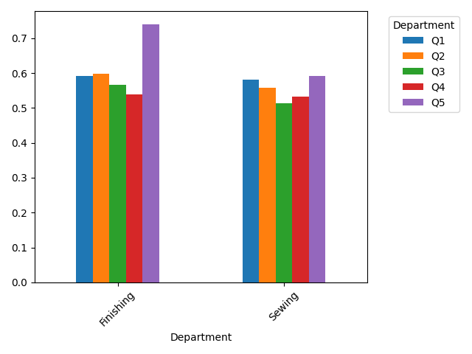
Departmental Value Brought in Various Quarters

Slide 2
Allocation Strategy
Finishing: 51.38%
Sewing: 48.62%

