Slide 1
AI Project MAZE Application
Team Members:
Mohamed Ismail Elsayed 32020246
Mohamed Samy Abdul Azim 32020265
Yasmine Ahmed Mohamed 32020165
Shaymaa Abdelbadea Hanafy 32020098
Salwa Ahmed Mohmed 32021012
Dr/Kareem Badawi ENG: Alaa Ayman

Slide 2
Informed and Uniformed Search
An uninformed search is a searching technique that has no additional information about the distance from the current state to the goal.
Informed Search is another technique that has additional information about the estimate distance from the current state to the goal.

Slide 3
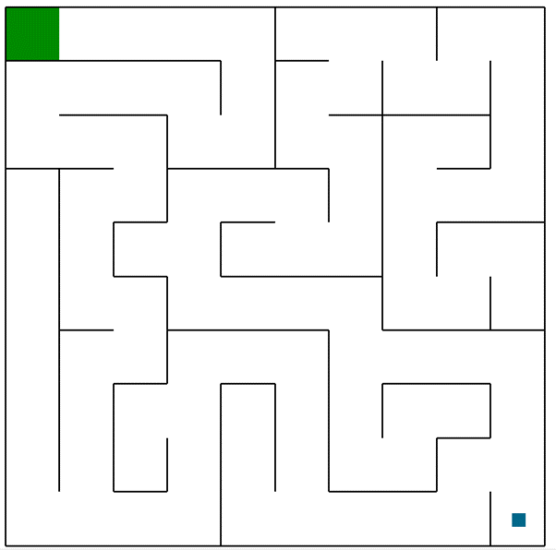
Python-Maze-world-pyamaze
The module pyamaze is created for the easy generation of random maze and apply different search algorithm efficiently.

Slide 4
Search Algorithm
Depth-first Search Algorithm (DFS)
Breadth-First Search Algorithm (BFS)
Uniform-cost Search Algorithm (UCS)
A* Search Algorithm

Slide 5
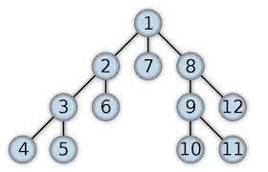
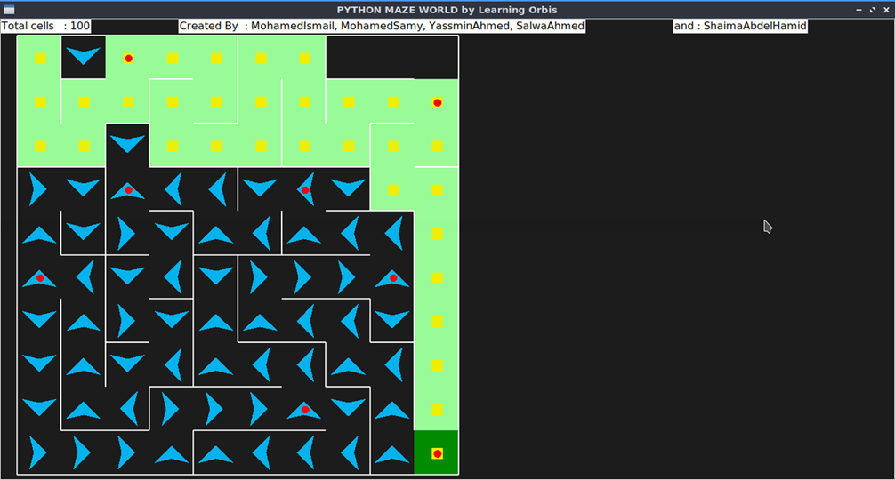
Depth-First search Algorithm (DFS)
The Depth-First Search is a recursive algorithm that uses the concept of backtracking.

Slide 6
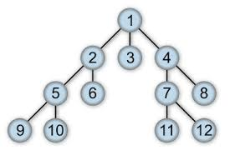
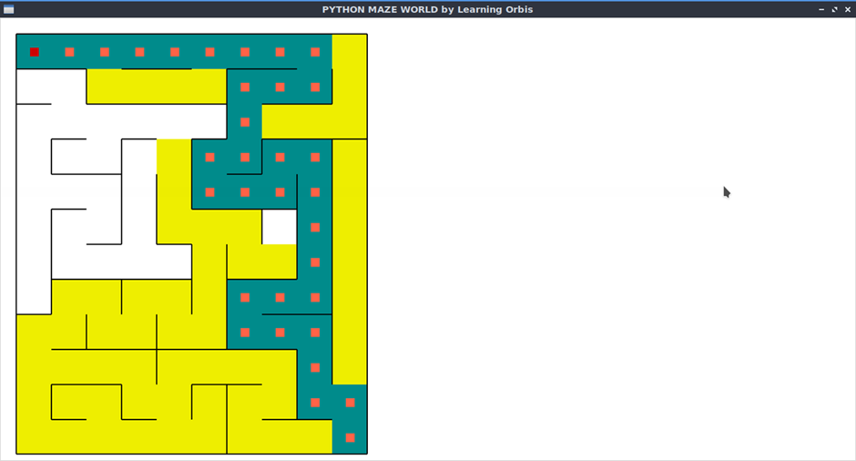
Breadth-Frist Search Algorithm (BFS)
Breadth-First Search is a recursive algorithm to search all the vertices of a graph or a tree

Slide 7
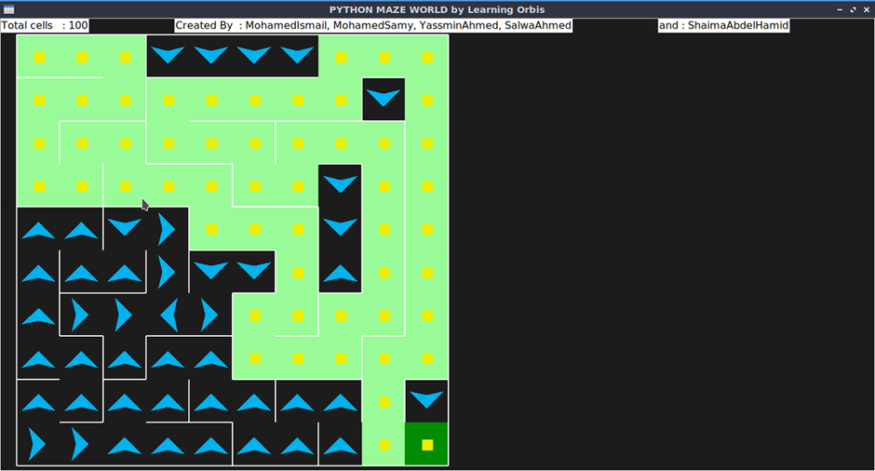
Uniform-cost Search Algorithm (UCS)
Uniform Cost Search is an algorithm used to move around a directed weighted search space to go from a start node to one of the ending nodes with a minimum cumulative cost.

Slide 8
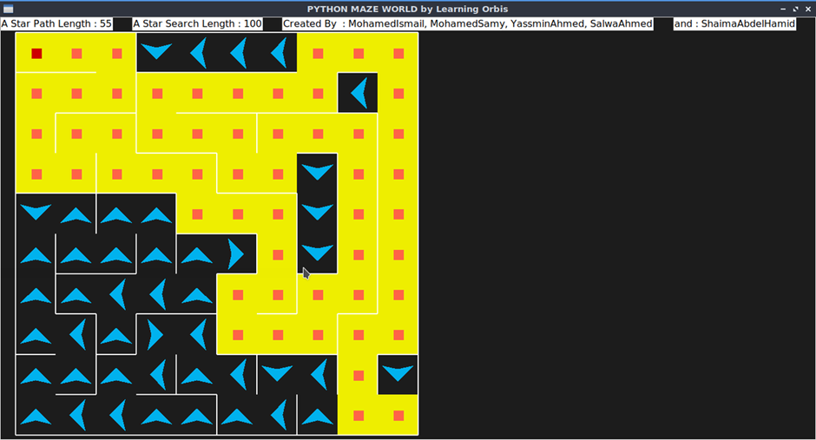
A* Search Algorithm
A* Search
Combining UCS and Greedy,
A* is based on using heuristic methods to achieve optimality and completeness, and is a variant of the best-first algorithm.

Slide 9
Thank you

