Slide 1



BizBoost AI
Find out what's holding your website back, in under 2 minutes.
Free SEO audit. No account. No SEO knowledge needed.
Soma Majumder
Erick Marcatoma

Slide 2
BizBoost AI
One job, six kinds of work. Too big for a small business.
What B&H's Senior SEO Specialist is paid to do, full-time:
The gap
Audits
Monitoring
$129/mo
Recurring technical and on-page audits
Crawlability, speed, XML sitemaps, canonicals, metadata, redirects
Entry plan for an SEO suite (Semrush). Built for marketers, so owners can't turn the output into action.
Keywords
Content
Keyword research and knowing the ranking factors
Requesting new or refreshed content and landing-page changes
So owners guess, pay an agency, or do nothing.
Links
Priorities
Example: a vegan restaurant with no page titles, summaries or photo descriptions never shows up for "vegan food near me", and the owner doesn't know.
Link building and interlinking
Choosing projects from data and reporting status
2
Notes:
Start from the job description. Six recurring kinds of work bundled into one full-time role at B&H. A small business can't afford it. Semrush entry plans are about $129/month and still need an expert to act on the output. Priya, the vegan restaurant owner, is the human example.

Slide 3
BizBoost AI
So we built it: five areas, one score each.
Each area scores out of 100. The overall score is a weighted average.
25
20
20
25
10
weight
weight
weight
weight
weight
Keywords
Content quality
Local presence
Technical health
Credibility
Do your pages use the words customers search for?
Is your writing useful and complete?
Can Google find your address, phone and hours? It matters for "near me" searches.
Are there broken pieces? Is the site fast?
Do other websites link to you and vouch for you?
Replaces: Keyword research and ranking factors
Replaces: Content and landing-page requests
Replaces: Added for small businesses
Replaces: Audits and monitoring
Replaces: Link building and interlinking
The weights are a first guess, tuned after our 10 test sites. Checks the tool can't reach are dropped and the other weights rescale to 100, so no one is penalized for missing data.
3
Notes:
Prioritizing from data and reporting status is handled by the scoring engine, the AI recommendations and the dashboard. Deferred from the job description: ongoing alerts, ranking tracking and cross-department coordination.

Slide 4
BizBoost AI
How it works: code decides, AI explains.
1 Input
2 Gather evidence
3 Explain and check
4 Result
Streamlit interface
Owner pastes a public URL
Website crawler
Up to 10 pages
Scoring engine
Score out of 100
Results dashboard
Overall score
5 category scores
Top 3 fixes
Evidence for each
5 SEO analyzers
Keywords, Content, Local
Technical, Credibility
AI reasoning agent
Explains the evidence
Picks the top 3 fixes
URL validator
Public and safe sites only
retry once
Output validator
Every fix cites its check
pass
Audit orchestrator
Crawl and PageSpeed run together
Google PageSpeed
Homepage speed
fails twice
Backlinks (optional)
Inbound links
Rule-based text
Backup
4
Notes:
One AI agent supported by five deterministic analyzers. Single pass, no tool-calling loop, which keeps it easy to build, test and explain.

Slide 5
BizBoost AI
The small loop: the AI can't make things up.
Scores + findings
the only thing the AI sees
AI agent
writes fix per finding
Output validator
every fix names its check?
Report
shown to the owner
pass
The rules
fails: retry once
Explain only what the evidence shows
Every recommendation names its check
No invented metrics, rankings or traffic
Goal: 0 unsupported recommendations
Rule-based fallback text
if it fails twice or the AI is down
5
Notes:
This is a validate-and-retry loop, not a tool-calling agent loop. The AI runs in a single pass. The output validator rejects anything that does not cite a check from the evidence. One retry, then rule-based text, so the report always renders.

Slide 6
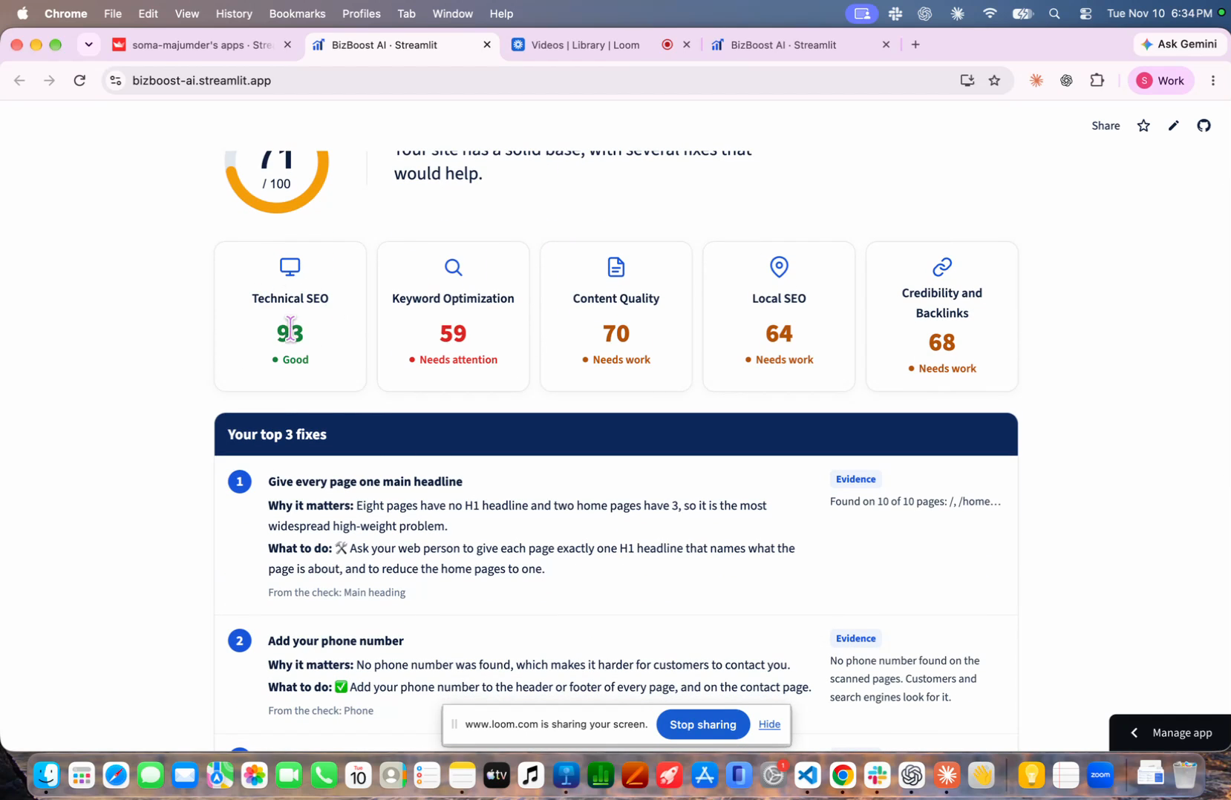
Notes:
Screen recording of bizboost-ai.streamlit.app (click to play). Not built yet, from the job description: ongoing alerts, ranking tracking and cross-department coordination.

