Slide 1

Security analysis of autonomous cyber physical systems using deep learning
Under The Supervision of Dr. K. Kranthi Kumar Professor
Presented By
Yamani Kavya Sri - 22BQ1A12H2
Soma Indu - 22BQ1A12F1
Sankuri Sravani - 22BQ1A12E1
Tadiboyina Pranavi - 22BQ1A12F5
DEPARTMENT OF INFORMATION TECHNOLOGY VASIREDDY VENKATADRI INSTITUTE OF TECHNOLOGY
PADAKAKANI MANDAL, NAMBURU, GUNTURU-522508

Slide 2
AGENDA
Abstract
Introduction
Problem Statement
Existing System 5.Literature Survey
Proposed System
Methodology

Slide 3
1.Abstract
  Secure and autonomous cyber–physical systems (CPS) are increasingly deployed in critical domains such as industrial automation, smart infrastructure, and intelligent transportation systems. However, the growing connectivity of CPS exposes them to sophisticated cyber-attacks, making reliable intrusion detection essential for ensuring system safety and resilience. This project presents a deep learning–based intrusion detection framework for CPS security using a hybrid CNN–LSTM architecture evaluated on the Edge-IIoT dataset. Convolutional Neural Network (CNN) layers are employed to extract spatial and protocol-level features from network traffic, while Long Short- Term Memory (LSTM) layers capture temporal dependencies and sequential attack behaviors. To enhance robustness against data imbalance and unseen attack patterns, a Generative Adversarial Network (GAN)–based data augmentation approach is incorporated to generate realistic synthetic attack samples. Additionally, explainable AI (XAI) techniques based on layer-wise activation analysis are used to improve interpretability and trust in model decisions. Experimental results demonstrate that the proposed CNN–LSTM framework, augmented with GAN-generated data, achieves improved detection performance compared to conventional deep learning approaches, making it suitable for security monitoring in autonomous CPS environments.

Slide 4
2.Introduction
Autonomous Cyber-Physical Systems (CPS) are an integral part of modern digital infrastructure, as they seamlessly combine physical processes with computation, communication, and intelligent control mechanisms. These systems rely on sensors to collect data from the physical environment, controllers to process this data, and actuators to perform appropriate actions in real time. CPS are extensively used in critical sectors such as industrial automation, autonomous transportation, smart manufacturing, smart grids, and healthcare monitoring systems, where timely and accurate decision-making is essential. In many of these applications, even minor delays or errors can result in severe safety issues, system downtime, or financial losses. The rapid advancement of technologies such as the Internet of Things (IoT), edge computing, cloud platforms, and high-speed communication networks has further increased the autonomy and intelligence of CPS, enabling them to operate in highly dynamic and distributed environments. However, this increased reliance on interconnected components also introduces greater system complexity, making CPS more difficult to manage and secure.

Slide 5
While the interconnected nature of CPS improves efficiency and functionality, it also significantly expands the attack surface, exposing these systems to a wide range of cyber threats. Modern cyberattacks are no longer limited to software-based intrusions but can directly influence physical processes by manipulating sensor readings, control commands, or communication protocols. Such attacks may cause incorrect system behavior, unsafe operating conditions, or even catastrophic physical damage. Securing CPS is particularly challenging because these systems continuously generate massive volumes of heterogeneous data from sensors, networks, and control units, all of which must be analyzed in real time. Traditional security approaches that depend on static rules, predefined attack signatures, or threshold-based anomaly detection are insufficient to handle the evolving and sophisticated nature of modern cyberattacks. Many attacks are designed to closely mimic normal system behavior, making them difficult to distinguish from legitimate operations. As a result, classical detection techniques often suffer from high false alarm rates, delayed detection, and limited adaptability, highlighting the need for more intelligent and data-driven security solutions.

Slide 6
3.Problem Statement
Autonomous Cyber-Physical Systems (CPS) are increasingly vulnerable to sophisticated cyberattacks due to their reliance on real-time communication, distributed control, and interconnected network infrastructures. Cyber intrusions in such systems can directly affect physical processes, leading to safety risks, operational disruptions, and significant economic losses. Traditional intrusion detection methods based on static rules or signature matching are inadequate for identifying complex, evolving, and stealthy attacks that often mimic normal system behavior. In addition, CPS network traffic is highly heterogeneous, high-dimensional, and class-imbalanced, which limits the effectiveness of conventional and existing deep learning-based detection approaches that struggle to capture both spatial protocol features and temporal attack patterns. The limited availability of diverse attack data further reduces the ability of detection models to generalize to unseen and zero-day threats, highlighting the need for an adaptive and accurate intrusion detection framework for securing autonomous CPS environments.

Slide 7
4.Existing System
Unable to effectively capture both communication patterns and time-dependent attack behavior in CPS environments.
Limited capability to handle imbalanced network traffic, leading to poor detection of rare but critical cyberattacks.
Weak performance against unseen or evolving attacks, as most systems rely heavily on known patterns.
High computational complexity and detection latency, making them unsuitable for real-time autonomous CPS operation.
Lack of model transparency, making it difficult to understand and trust detection decisions in security-critical systems.

Slide 8
5.Literature Survey
No. | Author & Year | Method | Dataset | Advantage | Disadvantage | Research Gap | Reference (Link)
1 | Anita (2024) | GAN | Public space dataset | Detection of zero-day attacks | High cost & system complexity | Realistic AI-generated attack data | https://doi.org/10.1016/j.cose.2021.102305
2 | Unitil et al. (2024) | AI-based Anomaly Detection | MW Data | Improved efficiency & optimization | High implementation complexity | Real-time robust CPS protection | https://doi.org/10.1109/TII.2020.2977438
3 | MIM Saeed et al. (2023) | FS-Tech | NSL-KDD & KDD-CUP 1999 | Improved detection accuracy | Time-consuming | Efficient anomaly detection for CPS | https://doi.org/10.1016/j.future.2022.01.018
4 | Akinola et al. (2024) | AI / ML | Healthcare CPS data | Efficiency improvement | Increasing security risks | Vulnerability-aware CPS models | https://doi.org/10.1016/j.adhoc.2023.103450
5 | Chen et al. (2021) | GAN | ICS Dataset | Strong attack recognition | High computational cost | Multi-attack generalization | https://doi.org/10.1109/TII.2020.3036044
6 | Alsoadk (2022) | MCC-SubSVDD | CPS Dataset | High accuracy & reliability | Real-time maintenance difficulty | Lightweight AI models for CPS | https://doi.org/10.1016/j.ins.2022.03.042

Slide 9
6. Proposed System
Proposed Methodology Overview
Autonomous Cyber-Physical Systems (CPS) operate by continuously sensing physical processes, exchanging data over communication networks, and executing control actions in real time. These systems generate large volumes of heterogeneous, high-dimensional sensor and network traffic data that must be continuously monitored to ensure secure and reliable operation. Due to the tight coupling between cyber and physical components, any successful cyber intrusion can propagate rapidly and cause physical damage, safety hazards, or system downtime. To address these challenges, the proposed methodology introduces a comprehensive deep learning–based intrusion detection framework specifically designed for autonomous CPS environments. The framework follows a structured pipeline that includes realistic CPS data acquisition, preprocessing and normalization, data balancing through augmentation, spatial–temporal feature learning, real-time intrusion detection, and result interpretation, ensuring accurate, robust, and timely identification of cyber threats.

Slide 10
Hybrid CNN–LSTM Intrusion Detection Module
The hybrid CNN–LSTM detection module forms the analytical core of the proposed system and is designed to jointly model spatial and temporal characteristics of CPS network traffic. The Convolutional Neural Network (CNN) component automatically extracts spatial features such as protocol-level patterns, packet structures, flow characteristics, and communication signatures from the Edge-IIoT dataset, enabling the detection of anomalies associated with malicious payloads and abnormal protocol usage. In parallel, the Long Short-Term Memory (LSTM) component processes sequential traffic data to learn temporal dependencies and long-term behavioral patterns, which are essential for identifying slow-rate attacks, coordinated intrusions, and multi-stage cyberattacks that evolve over time. By integrating CNN and LSTM layers into a unified architecture, the model captures complementary spatial–temporal representations, significantly improving detection accuracy, stability, and generalization in dynamic and real-world CPS environments.

Slide 11
GAN-Based Data Augmentation Module
To address the inherent class imbalance present in CPS intrusion datasets, where normal traffic dominates and certain attack types appear infrequently, the proposed methodology incorporates a Generative Adversarial Network (GAN) for data augmentation. The GAN consists of a generator that learns to produce realistic synthetic attack samples and a discriminator that distinguishes between real and generated data, enabling the generation of high-quality attack traffic through adversarial training. These synthetic samples are combined with original training data to enrich minority attack classes and increase dataset diversity. As a result, the intrusion detection model gains improved exposure to rare, unseen, and zero-day attack patterns, leading to reduced overfitting, enhanced robustness, and more balanced detection performance across different attack categories in autonomous CPS environments.

Slide 12
Detection, Evaluation, and Explainability
Once trained, the CNN–LSTM model is deployed to perform real-time intrusion detection by classifying incoming CPS traffic as normal or malicious with minimal latency. The system’s effectiveness is evaluated using standard performance metrics such as accuracy, precision, recall, F1-score, and confusion matrix analysis to ensure reliable detection across all attack classes. In addition to performance evaluation, explainable artificial intelligence (XAI) techniques are incorporated to interpret model decisions by identifying influential features and temporal patterns that contribute to attack classification. This explainability enhances transparency, improves user trust, and supports informed decision-making, which is essential for deploying intrusion detection systems in safety-critical and security-sensitive CPS applications.

Slide 13
Key Advantages and Research Gap Addressed
The proposed system provides a comprehensive and effective solution for securing autonomous Cyber-Physical Systems by integrating deep learning, data augmentation, and explainable intelligence within a unified framework. The hybrid CNN–LSTM architecture enables robust spatial–temporal learning by simultaneously capturing protocol-level traffic characteristics and time-dependent attack behaviors, leading to improved detection accuracy for complex and evolving intrusions. GAN-based data augmentation addresses the critical challenge of dataset imbalance by generating realistic synthetic attack samples, thereby enhancing model exposure to rare, unseen, and zero-day threats. Furthermore, the incorporation of explainable AI enhances transparency by providing meaningful insights into model decisions, increasing trust and usability in safety-critical applications. By addressing key research gaps such as limited sequential attack detection, insufficient dataset diversity, and poor adaptability to evolving cyber threats, the proposed system advances the state of CPS security beyond existing solutions.

Slide 14
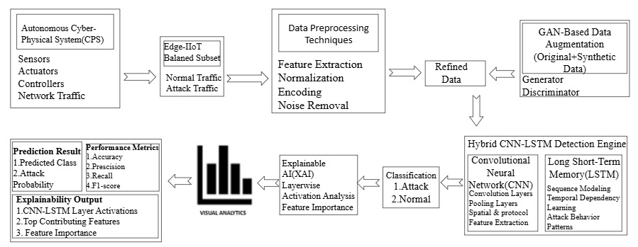
System Architecture

Slide 15
Software Requirements
Python Libraries: TensorFlow / PyTorch, Keras, NumPy, Pandas, Scikit-learn, Matplotlib, Seaborn, Gradient-based Explainable AI (XAI), Layer-wise Activation Analysis
Python: The proposed intrusion detection system is implemented using Python, so Python must be installed on the system. It is recommended to use the latest stable version such as Python 3.9 or above for better compatibility with deep learning frameworks.
Deep Learning Libraries: TensorFlow or PyTorch is used for building and training thehybrid CNN-LSTM model and GAN-based data augmentation framework.
Data Processing Libraries: NumPy and Pandas are used for preprocessing CPS network traffic data, feature handling, and dataset manipulation.
Machine Learning Library: Scikit-learn is used for dataset splitting, normalization, performance evaluation metrics, and confusion matrix generation.

Slide 16
Hardware Requirements
CPU:
• Minimum: Quad-core processor clocked at 2.5 GHz
• Maximum: Octa-core processor clocked at 3.5 GHz or higher
RAM:
• Minimum: 8GB DDR4 RAM
• Maximum: 32GB DDR4 RAM or more for efficient deep learning training
STORAGE:
• Minimum: SSD storage with at least 256GB capacity15
• Maximum: SSD with 1TB or higher for faster dataset access and model
GPU:
• Minimum: Integrated GPU or entry-level dedicated GPU
• Maximum: NVIDIA mid to high-end GPU with CUDA support for accelerated deep learning

Slide 17
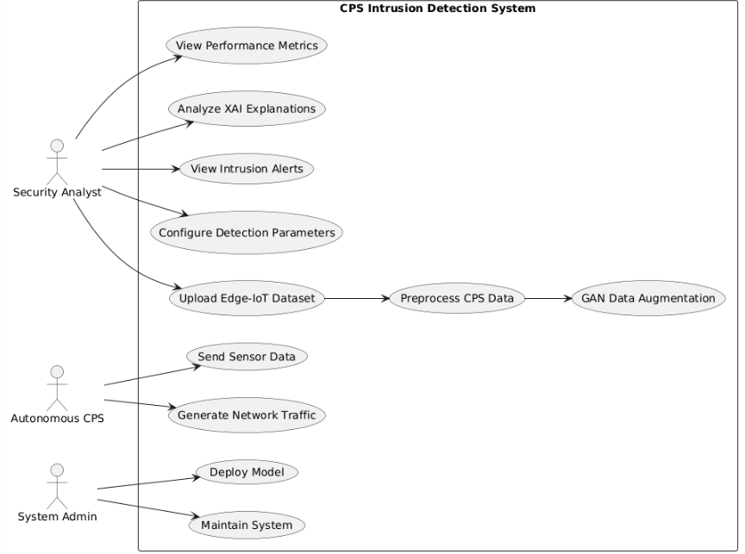
Methodology
Usecase Diagram

Slide 18
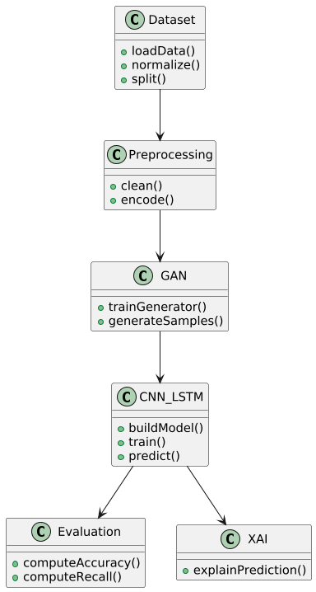
Class Diagram

Slide 19
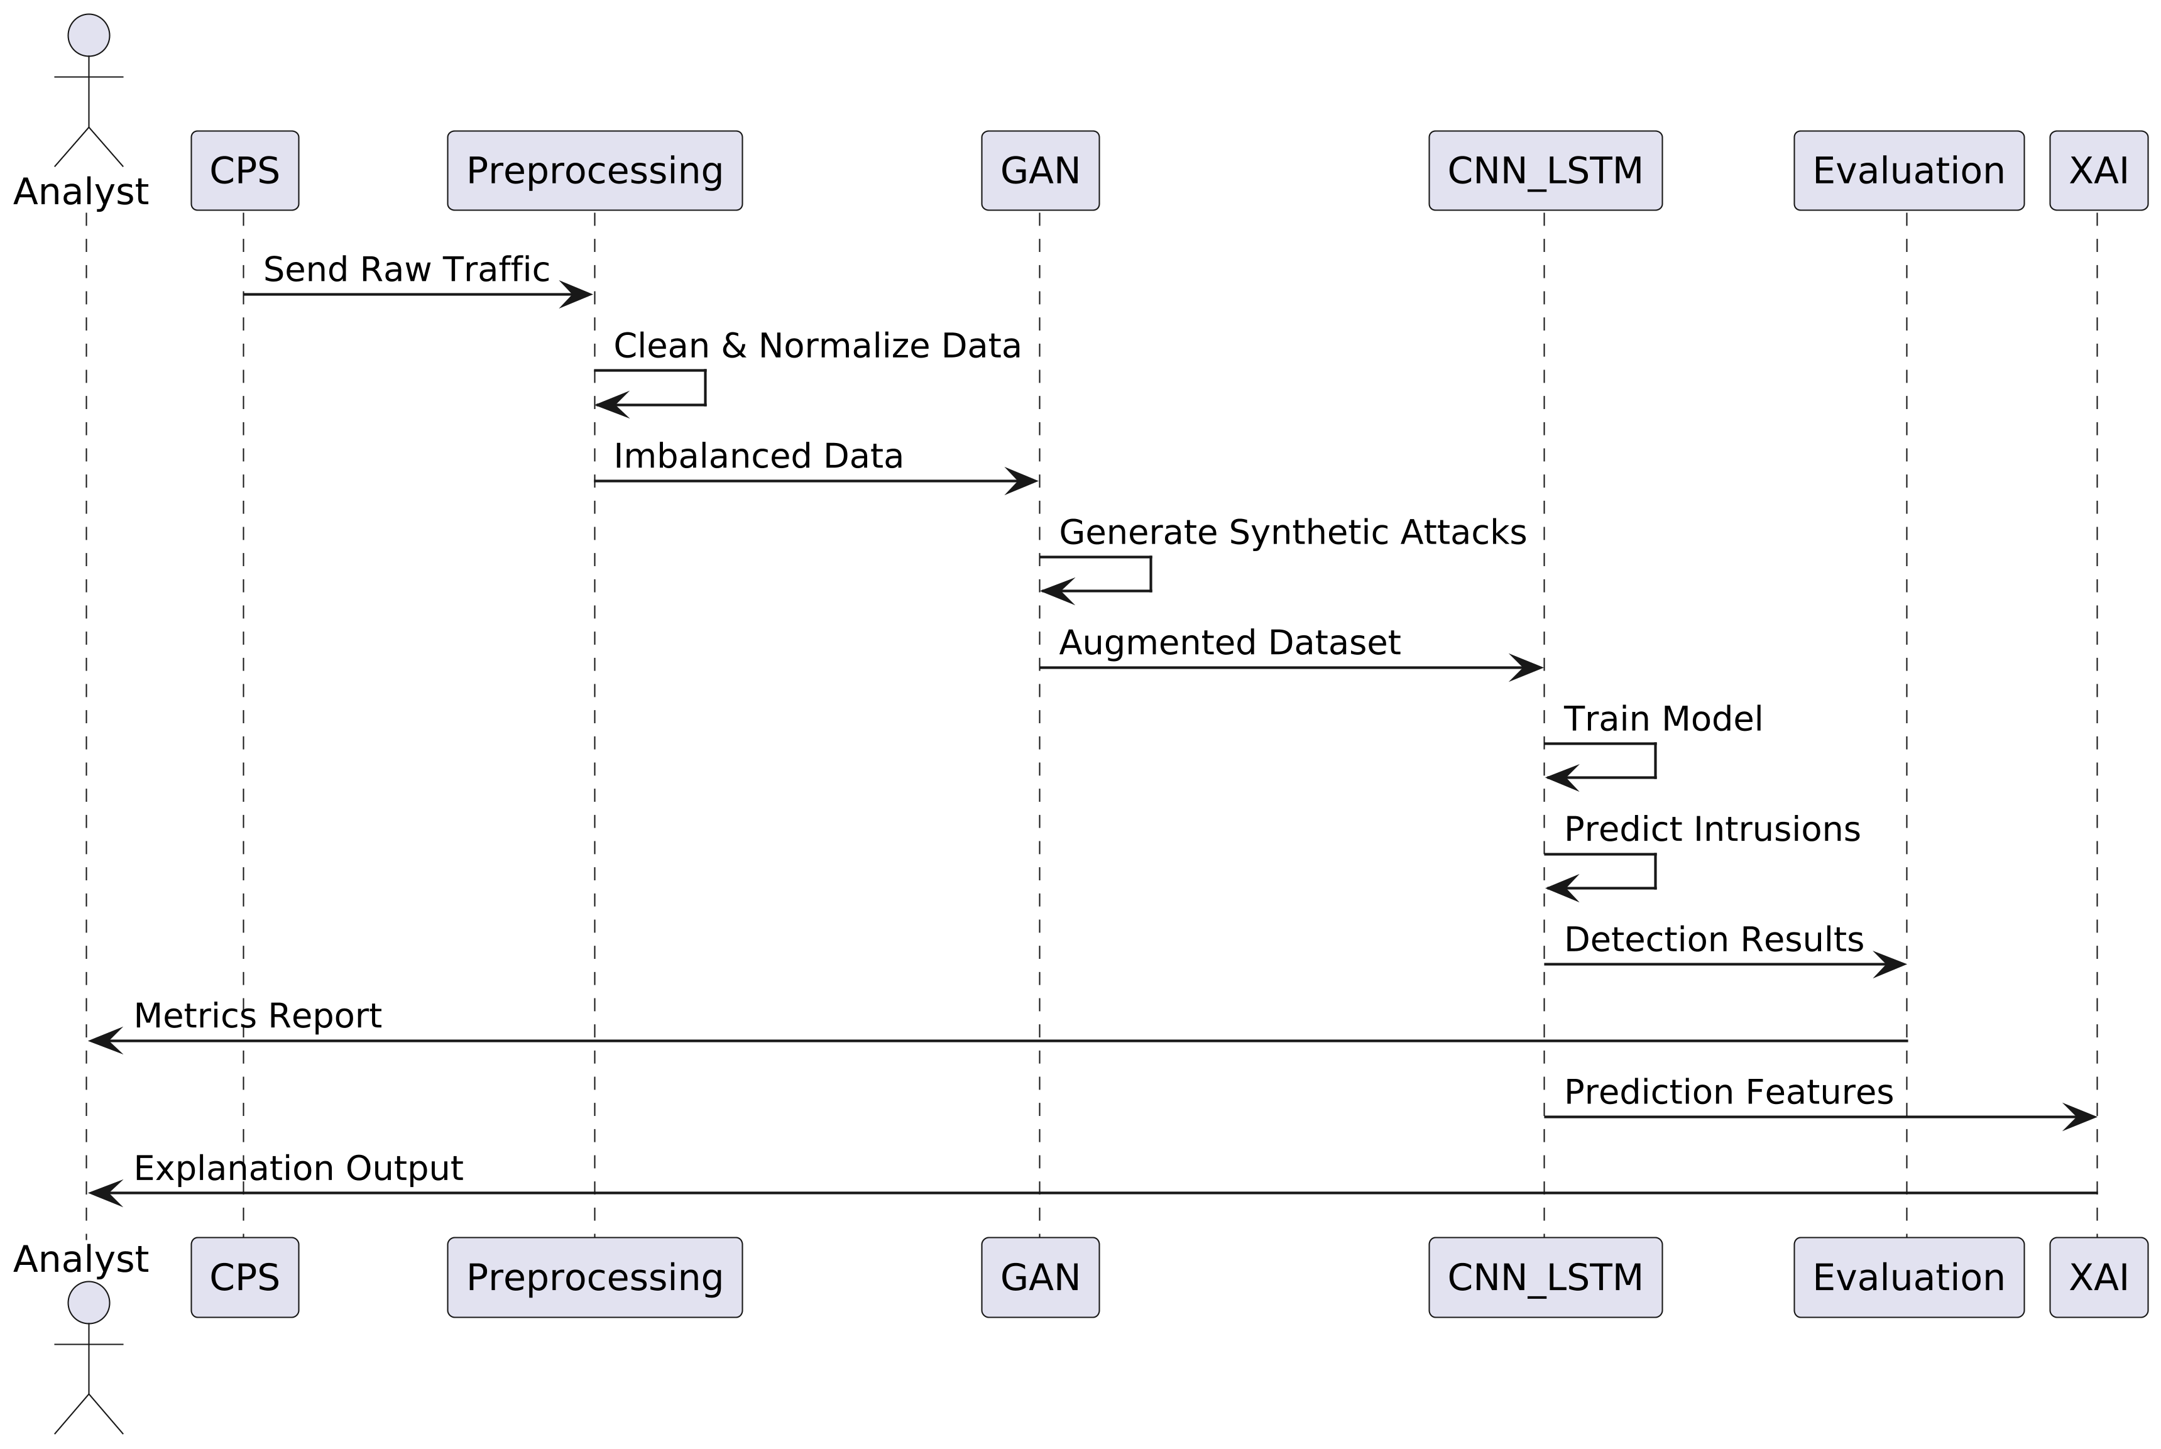
Sequence Diagram

Slide 20
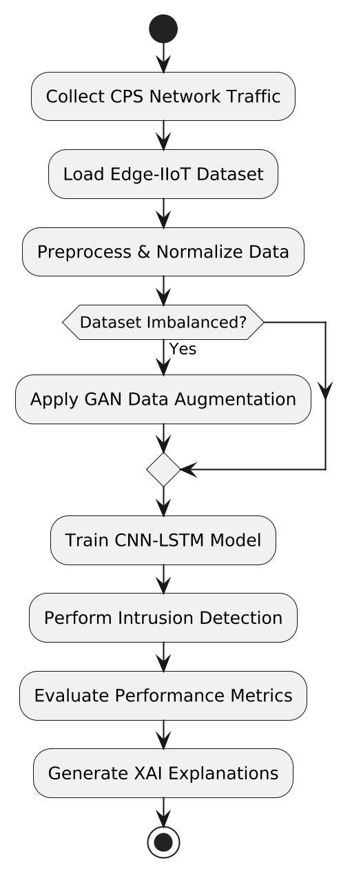
Activity Diagram

Slide 21
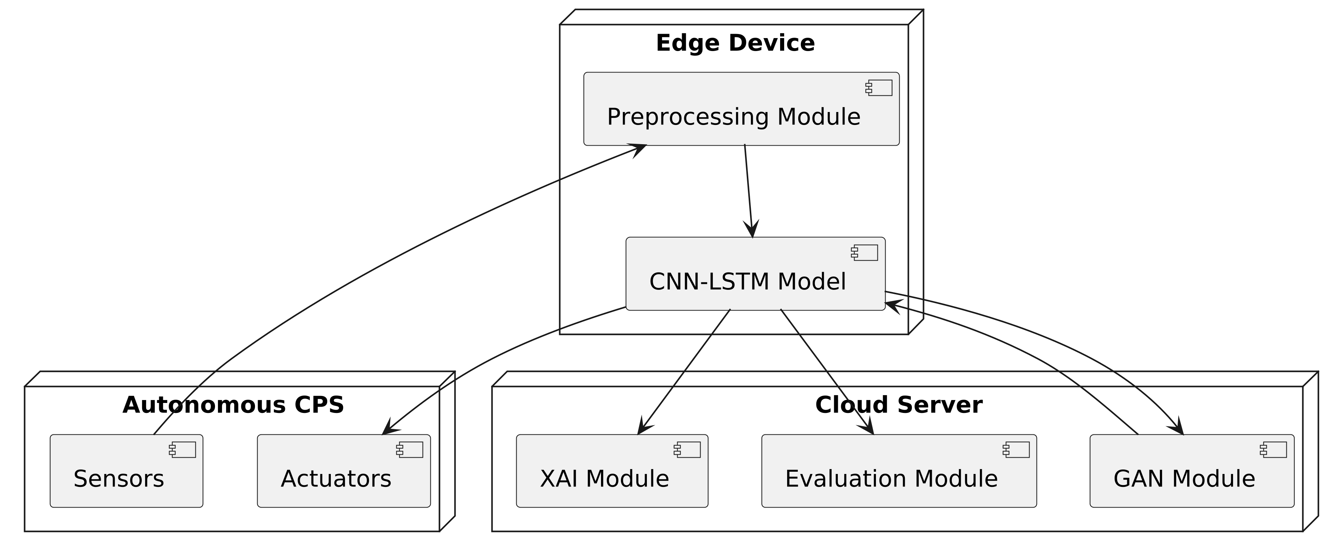
Deployment Diagram

Slide 22
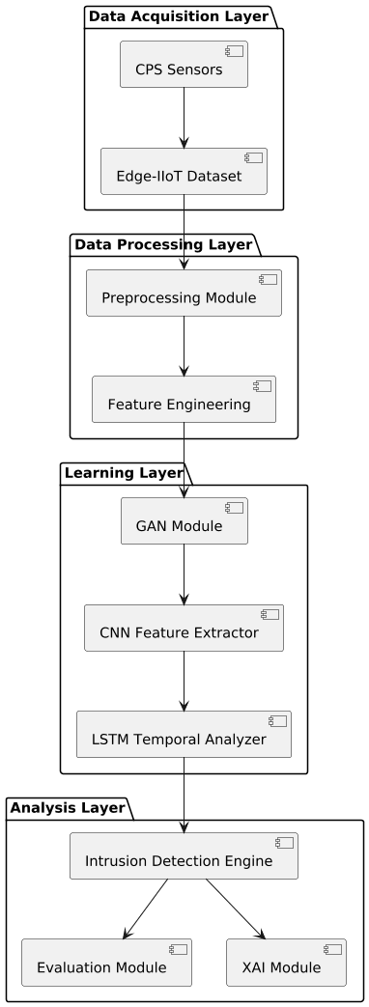
Component Diagram

Slide 23
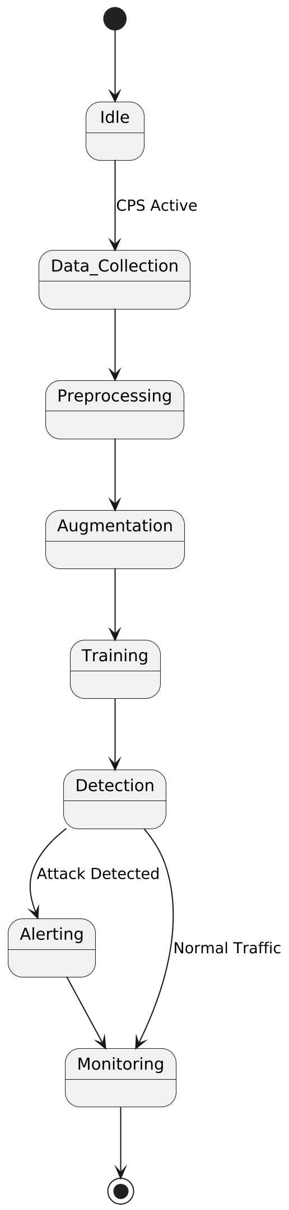
State Machine

Slide 24
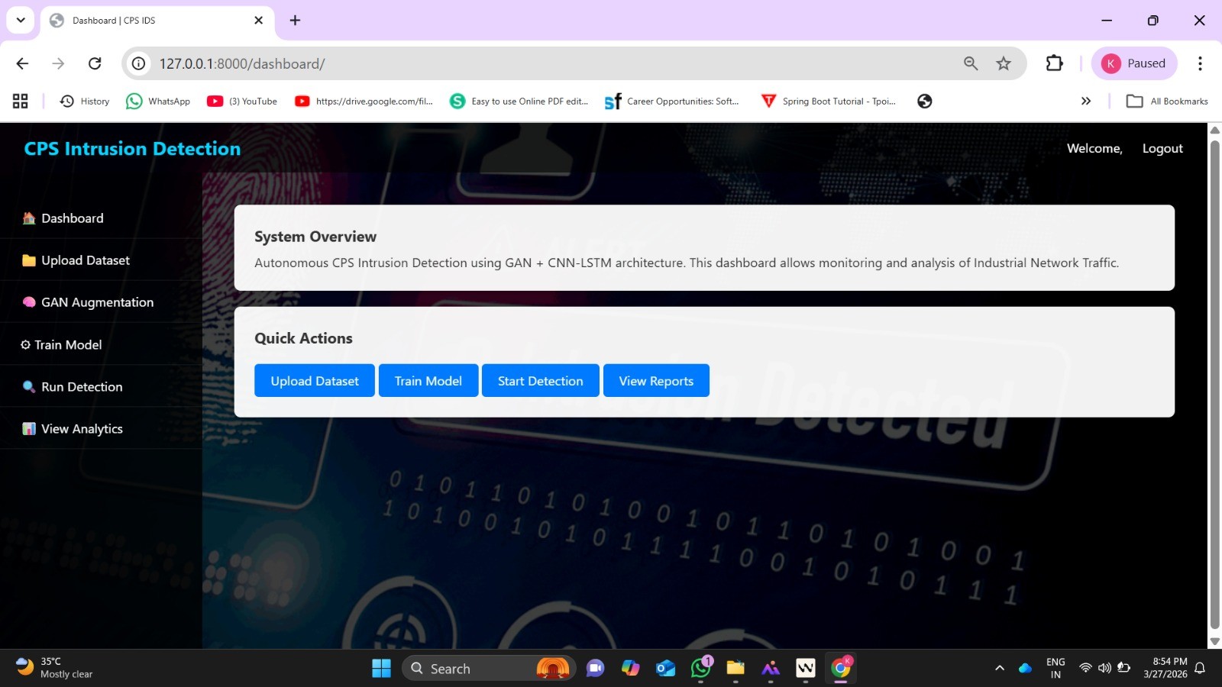
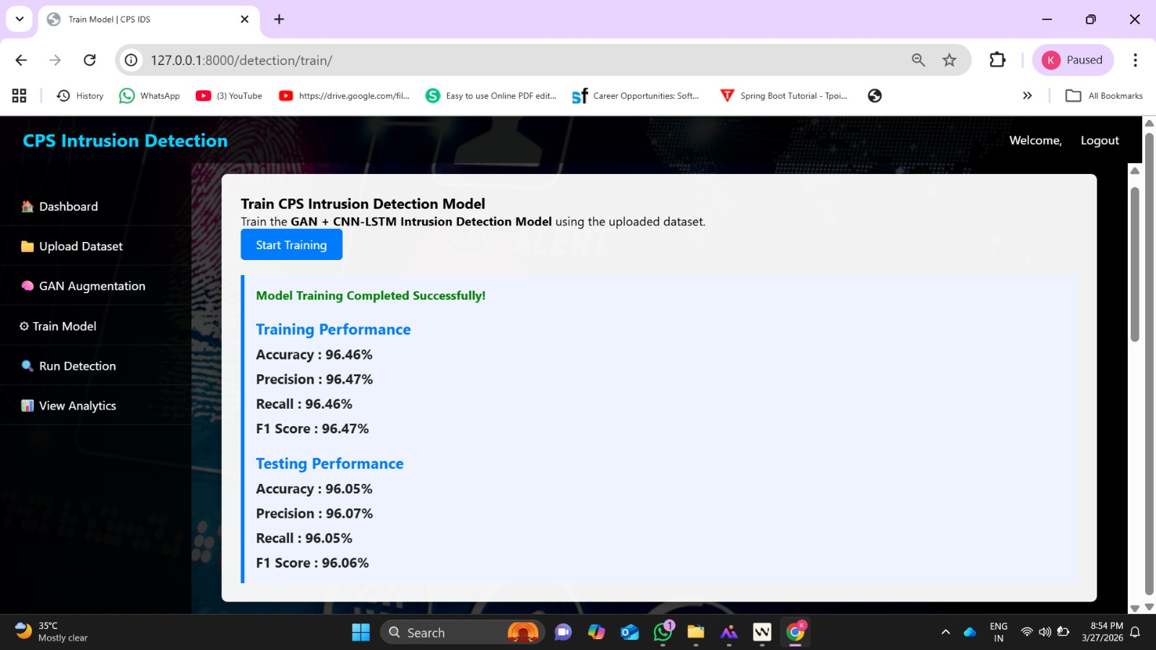
Performance Analysis

Slide 25
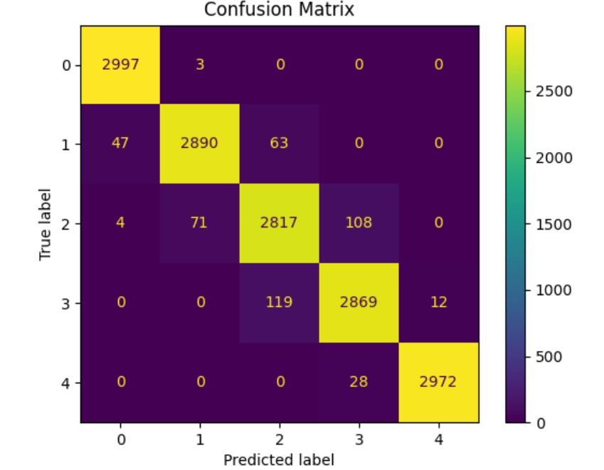
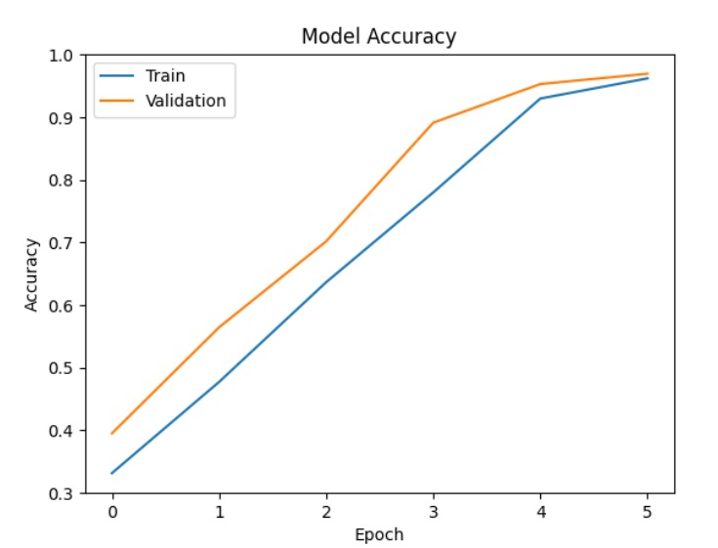

Slide 26
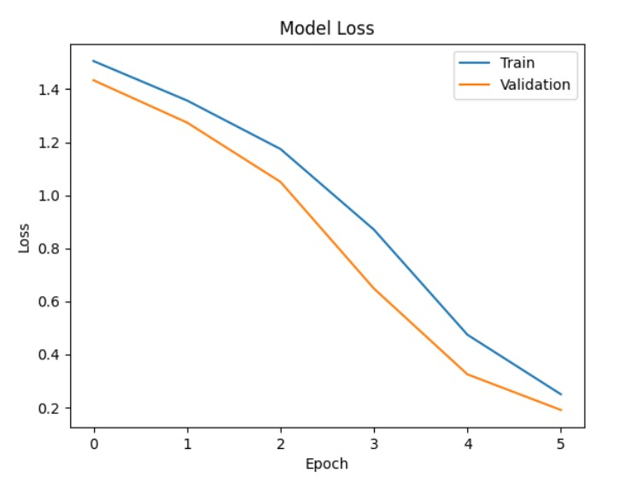

Slide 27
References:
[1] G. Lampropoulos and K. Siakas, “Enhancing and securing cyber-physical systems and Industry 4.0 through digital twins: A critical review,” Journal of software: evolution and process, vol. 35, no. 7, p. e2494, 2023.
[2] B. A. Salau, A. Rawal, and D. B. Rawat, “Recent advances in artificial intelligence for wireless internet of things and cyber–physical systems: A comprehensive survey,” IEEE Internet Things J, vol. 9, no. 15, pp. 12916–12930, 2022.
[3] P. Marwedel, Embedded system design: embedded systems foundations of cyber-physical systems, and the internet of things. Springer Nature, 2021.
[4] P. Malhotra, Y. Singh, P. Anand, D. K. Bangotra, P. K. Singh, and W.-C. Hong, “Internet of things: Evolution, concerns and security challenges,” Sensors, vol. 21, no. 5, p. 1809, 2021.
[5] A. J. Cartwright, “The elephant in the room: cybersecurity in healthcare,” J Clin Monit Comput, vol. 37, no. 5, pp. 1123–1132, 2023.
[6] G. Belgioioso et al., “Online feedback equilibrium seeking,” IEEE Trans Automat Contr, 2024.
[7] A. A. Jamal, A.-A. M. Majid, A. Konev, T. Kosachenko, and A. Shelupanov, “A review on security analysis of cyber physical systems using Machine learning,” Mater Today Proc, vol. 80, pp. 2302–2306, 2023.
[8] O. E. Oluyisola, S. Bhalla, F. Sgarbossa, and J. O. Strandhagen, “Designing and developing smart production planning and control systems in the industry 4.0 era: a methodology and case study,” J Intell Manuf, vol. 33, no. 1, pp. 311–332, 2022.

Slide 28
Thank You…
&
Any Questions…

