Slide 1

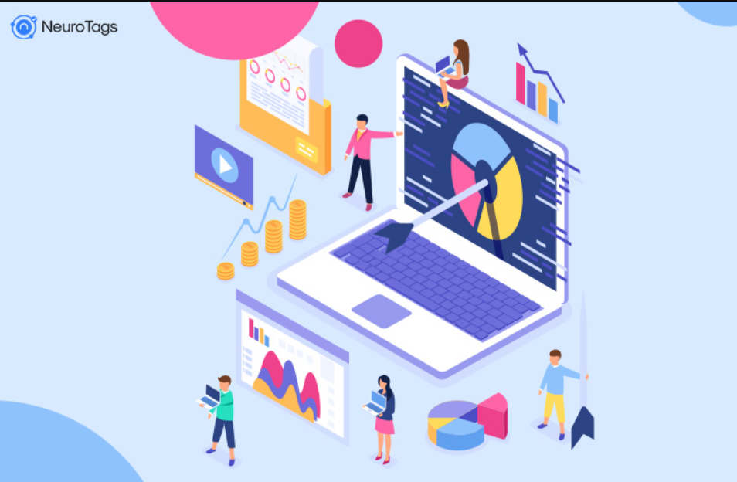
Customer Segmentation

Slide 2
GROUP_4
ABOUT
Hawar Dzaee
Team Leader, Application developer
Divya Soma
Data Scientist
Anjali Yadagiri
Data Modeling
Kaja Mohan Manikanta Reddy
Data visualization
Pitch deck title
2

Slide 3
Problem
PROBLEM STATEMENT
The company wants to identify the different customer segments within its customer base and create targeted marketing strategies to cater to the specific needs and preferences of each segment.
The goal is to increase customer satisfaction, retention, and loyalty by tailoring the company's offerings to the unique needs of each group.
Identifying target customers according to their product is not an easy task and creating or inventing new products or technology for a business based on Customer’s needs in this
day-to-day updating generation. Hence, Marketers must need to know their customer’s preferences.
Though after achieving a good number of customers the further goal of the Business is to
maintain the customers loyal to their business, this can be established by choosing the profitable customers

Slide 4

BUSINESS UNDERSTANDING
CUSTOMER SEGMENTATION
In order to have a better Marketer-Customer relationship, every organization needs to perform Customer Segmentation.
Analyze customer data to identify the most profitable customer groups based on factors such as purchase history, lifetime value, and profitability. Use this information to target acquisition efforts on those groups and develop acquisition strategies that align with their needs and preferences.
Hence better Customer Segmentation can lead to a better Marketer-Customer relationship, which is the main criterion for marketers present out there.

Slide 5
Main features of the project
In this project, K-means clustering is used to divide the customer data into four different categories based on the features available in the data.
Each time we use the application the input data used for prediction is stored in a database which allows the model to train irrespective of the timeline.
CRISP-DM methodology is used in this project to follow industry standards.
BENEFITS

Slide 6
DATA UNDERSTANDING
SOURCE
We will take the customer data sets out of UCI Data Inventory for this project. It is a collection of data generators and databases that can be utilized for data analysis.
CLEANING
Primary Data Sets are unstructured and contain many unwanted columns . The data will be organized and cleaned using the Python pandas module.
ANALYSIS
Basic data analysis will be performed on the structured data to find the hidden patterns in the data.

Slide 7
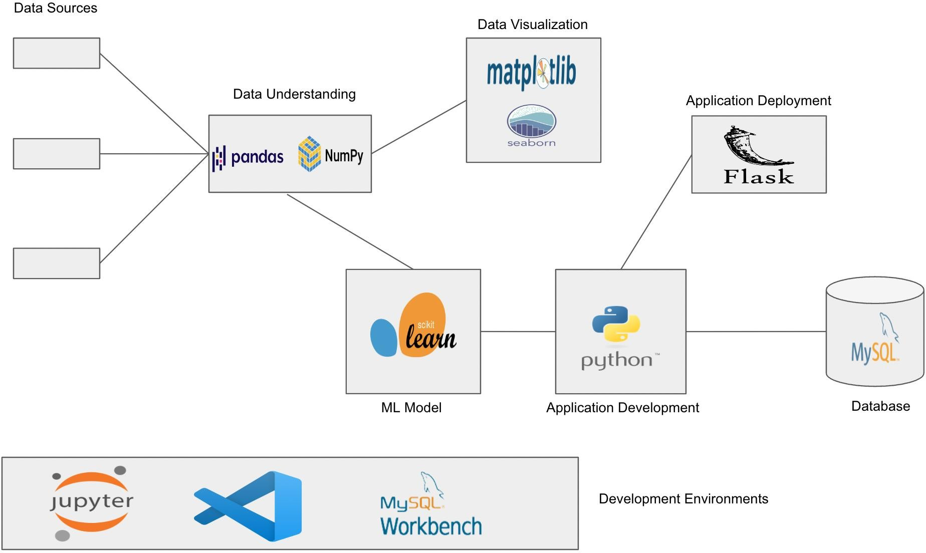

ETL Development

Slide 8
REQUIREMENTS
Python :
Python is used for Application Development.
Python libraries:
Pandas, and NumPy are used for Data Cleaning, Data Wrangling. Matplotlib, and Seaborn are used for Data Visualization.
Sklearn is used for Machine learning Models.
MySQL:
MYSQL is used for performing CRUD operations on the given data and used for data storage
FLASK:
The Flask library is used for the application deployment of the developed application.
AWS:
Amazon web services are used to host the application on the Web.
Development Environments:
Visual Studio Code, Jupyter Notebook.

Slide 9


