Slide 1

Sarcasm Detection
By Srilakshmi Pyarsani Soma Sudheer Puppala
Team D

Slide 2

Sarcasm is a form of verbal irony that is intended to mock or convey contempt. It's characterized by the use of tone, exaggerated expressions, or clear discrepancies between what is said and what is meant. Unlike straightforward statements, sarcasm often involves a contrast between literal and intended meaning, where the speaker says something but means another, often the opposite. This can be used for humor, criticism, or just playful teasing.

Slide 3
Problem Statement
In this digital communications era, There is lot of textual data that gets processed in the automated systems for sentimental analysis, content moderation, and customer feedback. These systems often ignore the inherent sarcasm present in the text data, which can lead to misinterpretations.
Objective
Main objective is to create an ML model that solve the above problem by detecting the inherent sarcasm present in the textual data.

Slide 4
Literature Review
Early Approaches
Rule-based Techniques: Initial methods relied on manually crafted rules to identify sarcasm based on linguistic cues such as hyperbole, punctuation, and sentiment contradictions.
Examples: Tepperman et al. (2006) employed prosodic features from speech for sarcasm detection, demonstrating the complexity of detecting sarcasm without contextual cues.
(Teppermanetal06.pdf (columbia.edu)
Machine Learning Approaches
Feature-based Models: Researchers experimented with various linguistic features (lexical, syntactic, semantic) using traditional classifiers like SVMs and logistic regression.
Significant Study: Davidov et al. (2010) used a combination of n-grams, emoticons, and punctuation as features to train SVMs, achieving promising results on Twitter datasets.
W10-2914.pdf (aclanthology.org)

Slide 5
Dataset Information:
Source: Kaggle(Tweets with Sarcasm and Irony (kaggle.com)
Team Github link: SarcasticDataset_TeamD
Content: The dataset comprises two sets of tweets intended for training and testing a machine learning model for sarcasm detection. Each tweet is categorized, allowing models to learn and predict sarcastic versus non-sarcastic content.
Volume and Structure:
Training Dataset: Contains 81,408 entries.
Columns:
tweets: Text of the tweet.
class: Categorization of the tweet
Irony
Sarcasm
Regular
Figurative (both irony and sarcasm)
Testing Dataset: Contains 8,128 entries with a small number of missing values.
Columns:
tweets: Text of the tweet.
class: Categorization of the tweet.
Usage: This dataset is used to train and validate models that can automatically detect sarcasm in textual content, which is a common challenge in the field of Natural Language Processing (NLP). The ability to accurately detect sarcasm can enhance the performance of systems involved in sentiment analysis, social media monitoring, and interactive assistants.

Slide 6
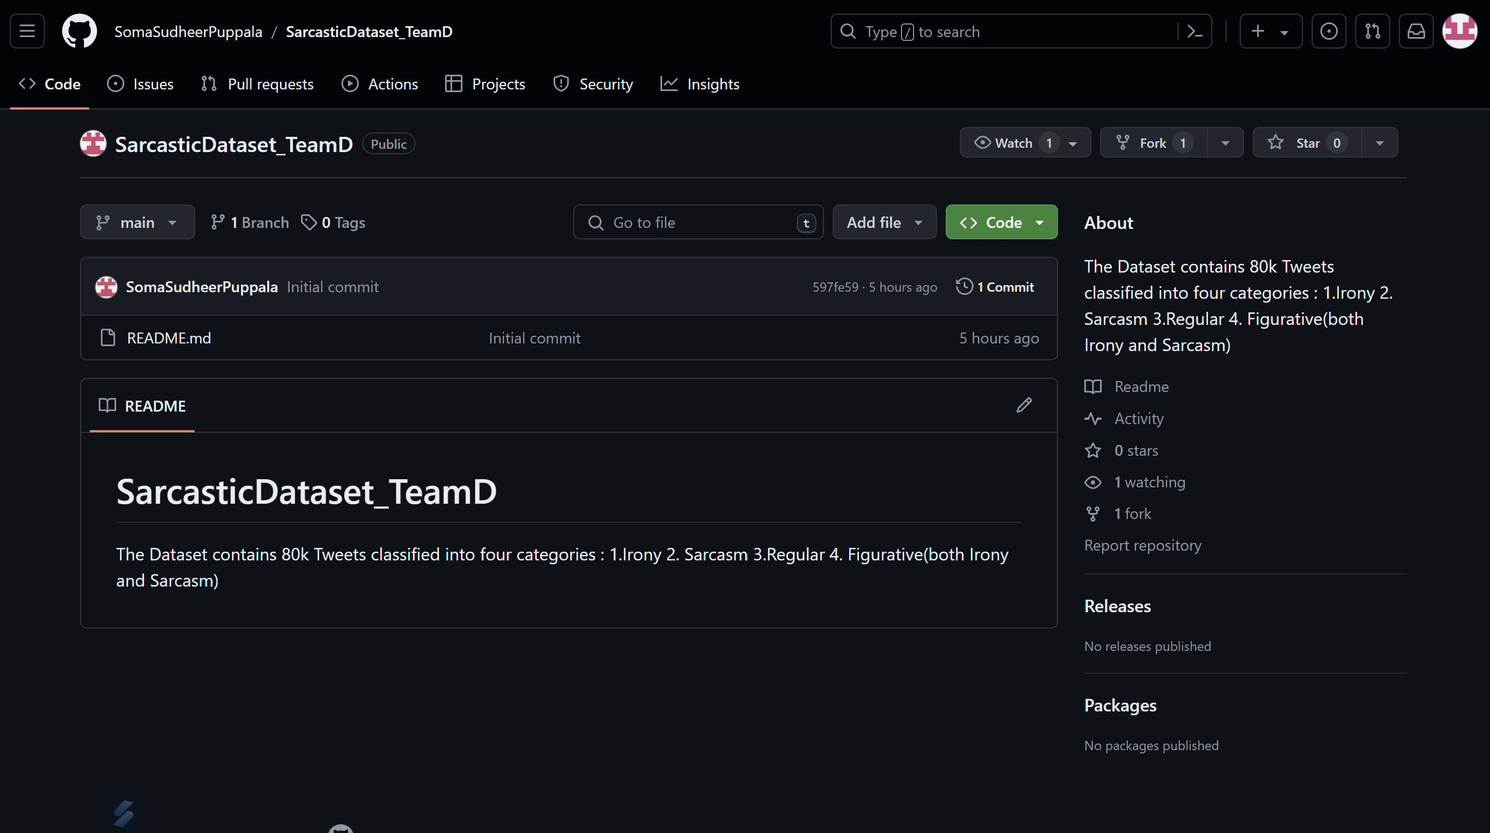

Slide 7
Preprocessing
Data Cleaning Steps:
Noise Removal – #Hashtags
Handling Missing Values:
Normalizing Text:
Expanding Contractions
Data Preprocessing Steps:
Tokenization
Removing Stop Words
Stemming
Feature Engineering:
Text length
Word count

Slide 8
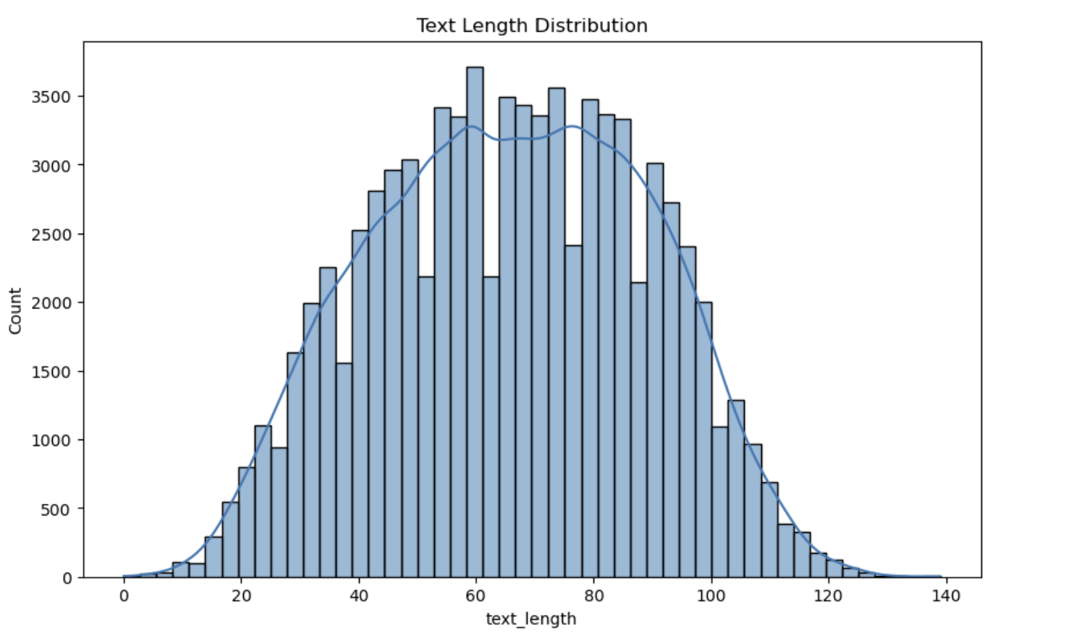
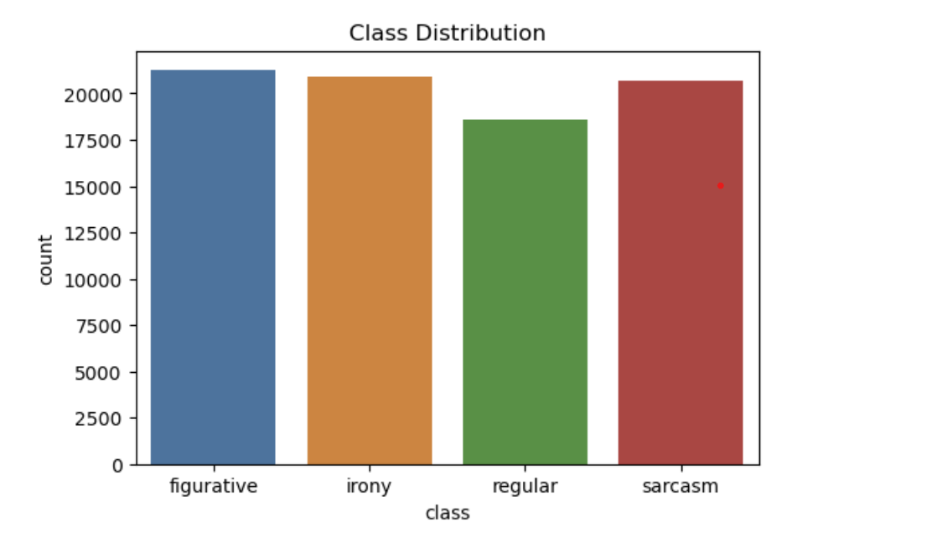
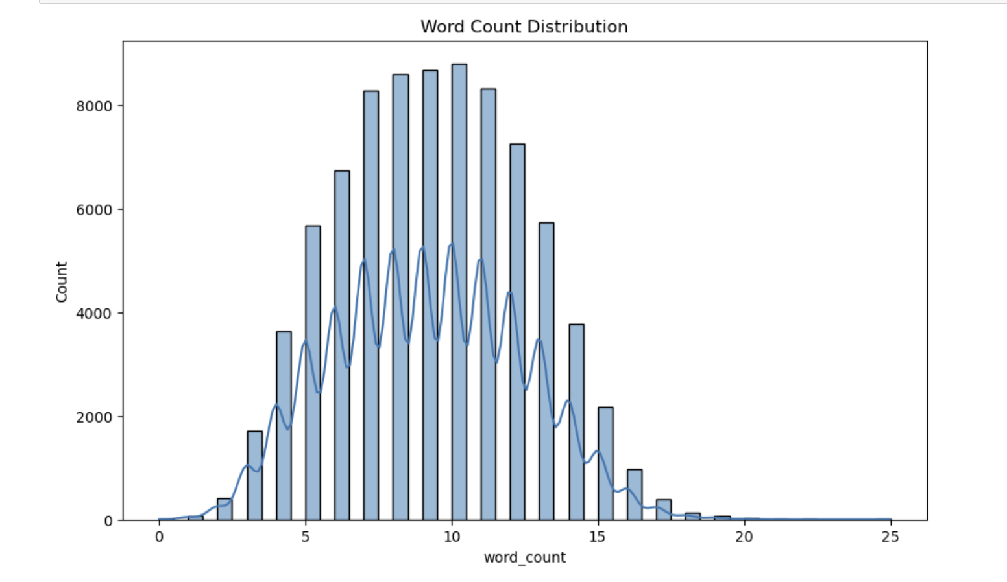
EDA

Slide 9
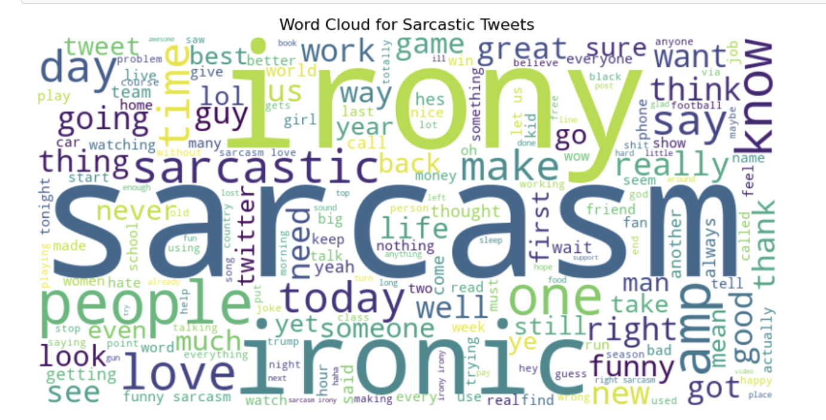
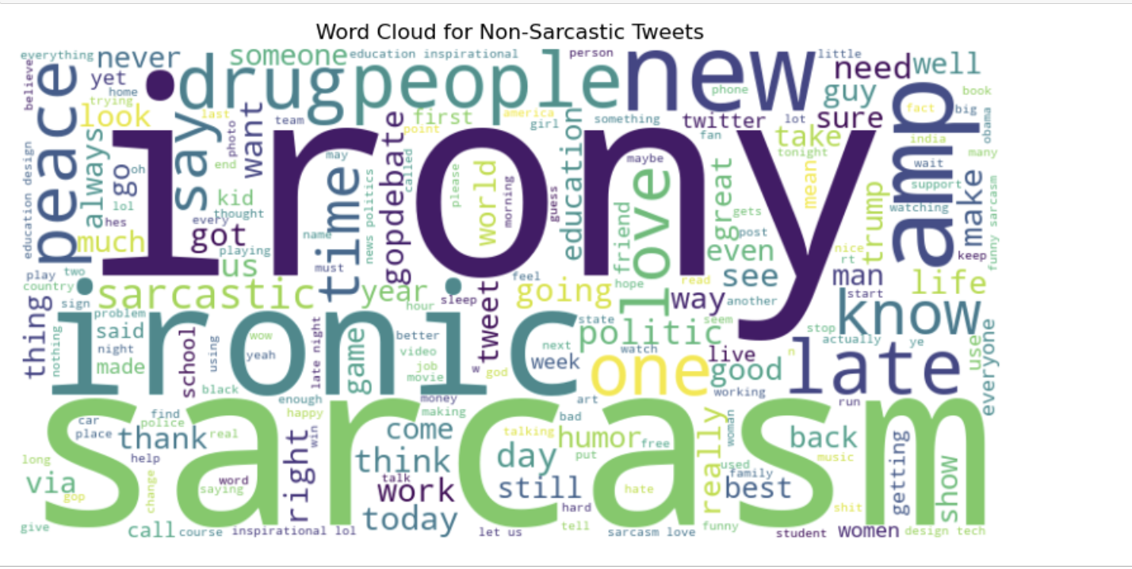
EDA

Slide 10
Our Approach
Use Natural language Inference. NLI is aimed at understanding relationships between premise and hypothesis.
All previous research approaches involved using ML algorithms such as SVM, Logistic Regression. Deep Learning models such as RNNs, LSTMs.
There are also some instances where individual researchers have used BERT.
We are using pretrained model RoBERTa in our project as this framework is relatively new.

Slide 11
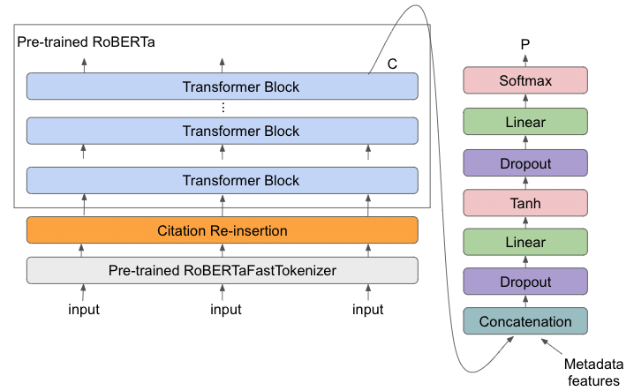
RoBERTa Architecture
RoBERTa is derived from BERT which is used in understanding context in language.
More optimized than BERT, RoBERTa stands for Robustly Optimized Bidirectional Transformers approach.

Slide 12

Conclusion
"Sarcasm Detection" project effectively tackles the challenge of identifying sarcasm in text, a key issue in digital communication that can lead to misunderstandings. Utilizing a comprehensive dataset from Kaggle. This research not only advances the field of natural language processing but also improves the functionality of systems in sentiment analysis and social media monitoring, highlighting the importance of contextual awareness in artificial intelligence.

Slide 13

References:
(Teppermanetal06.pdf (columbia.edu)
W10-2914.pdf (aclanthology.org)
Evolving with BERT: Introduction to RoBERTa | by Aastha Singh | Analytics Vidhya | Medium

Slide 14

Questions?

Slide 15

Thank you

