Slide 1
Welcome to Presentation
By Somaiya Jannat

Slide 2
Data Quality
Refers to the state of
Qualitative or
Quantitative piece of information.
Data is generally considered high quality if :
fit for its intended uses in operations.

Slide 3
Why Data Quality is Important
Increased productivity.
Informed decision-making.
Improved customer relations.
Easier implementation of data.
Effective content and better audience targeting.
Increased profitability.

Slide 4
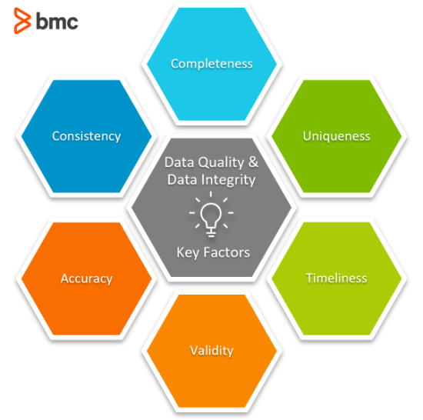
How do we ensure data quality?
There are Six Dimensions for measure the data quality.
1.Accuracy
2.Completeness
3.Consistency
4.Uniqueness
5.Timeliness
6.Validity

Slide 5

Accuracy
The term “accuracy” refers to the degree to which information accurately reflects an event or object described. For example, if a customer’s age is 32, but the system says she’s 34, that information is inaccurate.

Slide 6
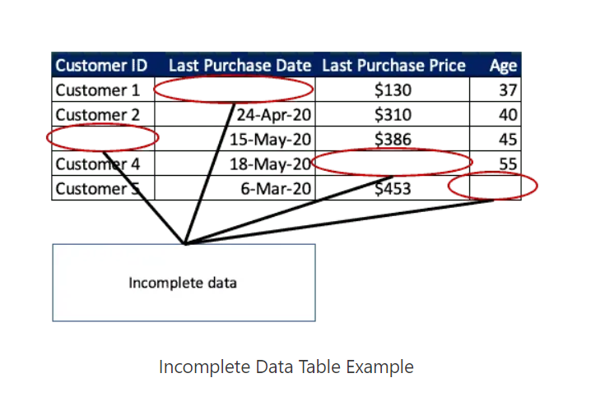
Completeness
Data is considered “complete” when it fulfills expectations of comprehensiveness

Slide 7
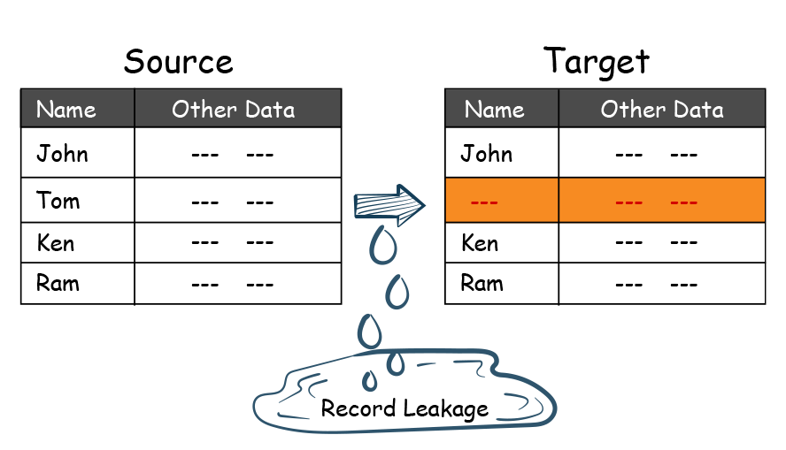
Consistency
The same information may be stored in more than one place. If that information matches, it’s considered “consistent.”
For example, if your human resources information systems say an employee doesn’t work there anymore, yet your payroll says he’s still receiving a check, that’s inconsistent.

Slide 8
Different Types Of Consistency
Record Level Data Consistency Across Source and Target

Slide 9
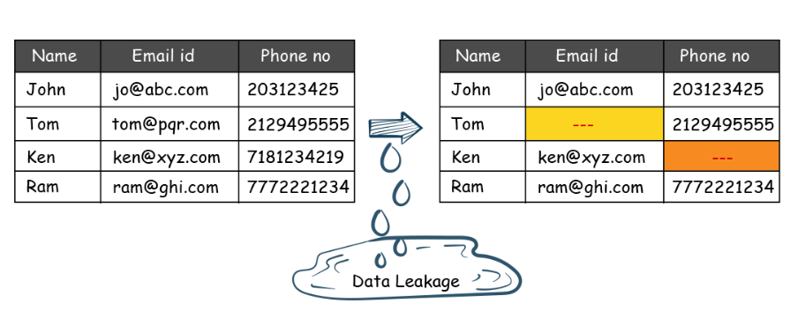
Different Types Of Consistency
Attribute Consistency Across Source And Target

Slide 10
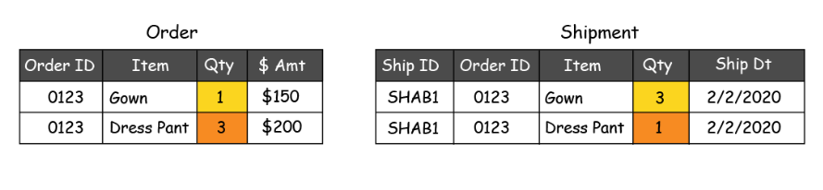
Different Types Of Consistency
Data Consistency Between Two Subject Areas

Slide 11
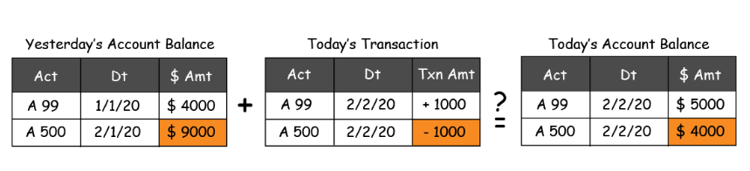
Different Types Of Consistency
Transaction Data Consistency

Slide 12
Timeliness
Is your information available right when it’s needed? That data quality dimension is called “timeliness.” Let’s say that you need financial information every quarter; if the data is ready when it’s supposed to be, it’s timely.
The data quality dimension of timeliness is a user expectation. If your information isn’t ready exactly when you need it, it doesn’t fulfill that dimension.

Slide 13
Validity
Validity is a data quality dimension that refers to information that doesn’t conform to a specific format or doesn’t follow business rules. A popular example is birthdays – many systems ask you to enter your birthday in a specific format, and if you don’t, it’s invalid.
To meet this data quality dimension, you must check if all of your information follows a specific format or business rules. Validity dimensions are:
1.Based on Rules or Calculation
2.Range of Values
3.Based on Sequence of events

Slide 14
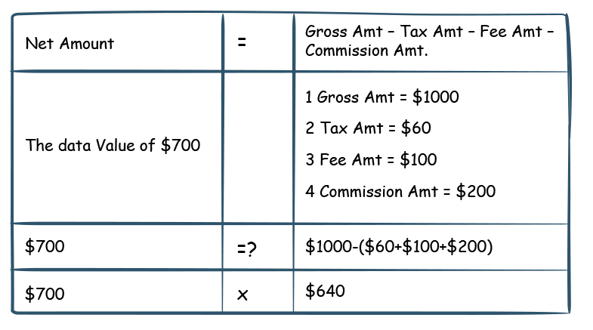
Based On Calculations

Slide 15
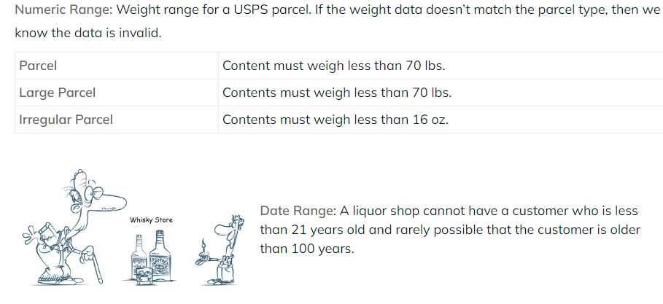
Data Validity for Range of Values

Slide 16
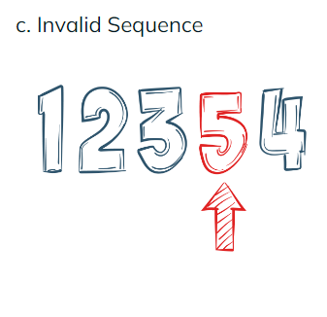
Invalid Sequence

Slide 17
Uniqueness
“Unique” information means that there’s only one instance of it appearing in a database. As we know, data duplication is a frequent occurrence. “Daniel A. Robertson” and “Dan A. Robertson” may well be the same person.
Meeting this data quality dimension involves reviewing your information to ensure that none of it is duplicated.

Slide 18
Four More Dimensions
1.Currency
2.Conformity
3.Integrity
4.Precision

Slide 19
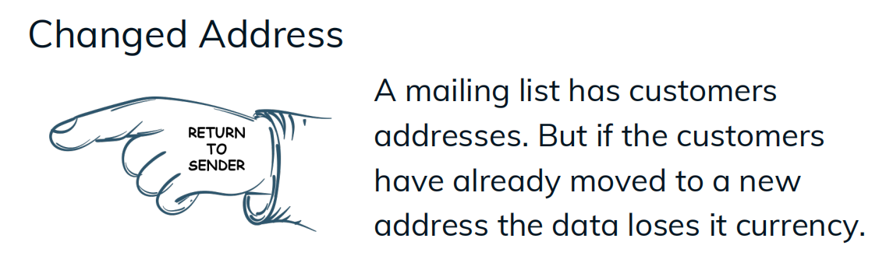
Currency
Reflection the real world state vs.state captured in dataset

Slide 20
Conformity
Data values of the same attributes must be represented in a uniform format and data type.
There are two types Conformity.
1.Format Conformity
2.Data Type Conformity

Slide 21
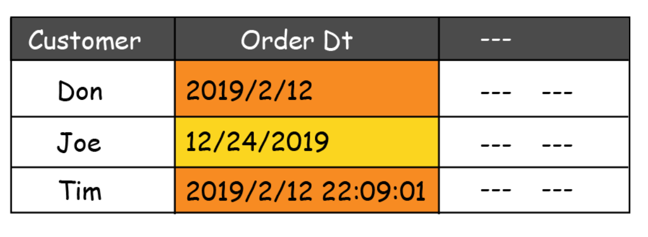
Format Conformity

Slide 22
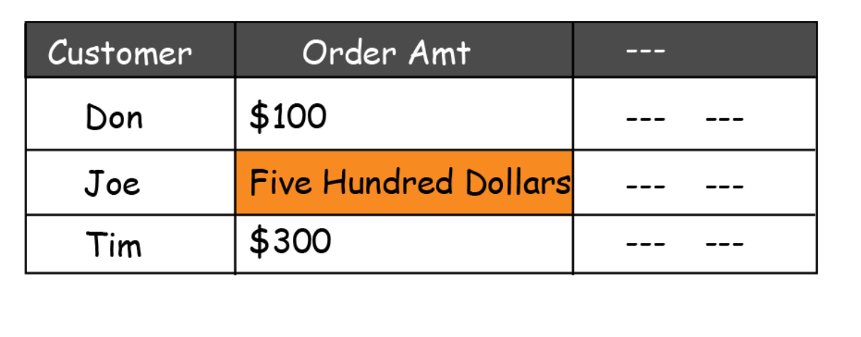
Data Type Conformity
Example:

Slide 23
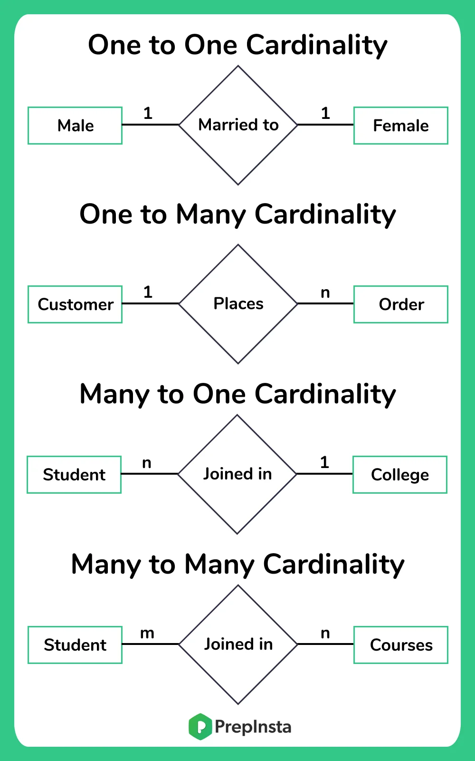
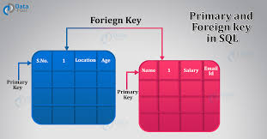
Integrity
The main characteristic for integrity data quality dimension is the relationship between two data set. Relational Constraint is implemented between in two data set.
Ex: 1.Referential Integrity Or
Foreign Keys
2. Cardinality Integrity

Slide 24
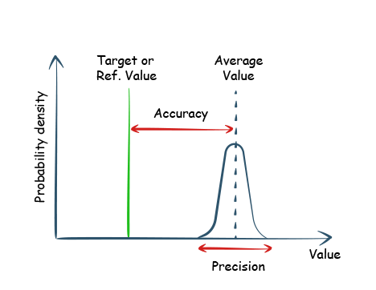
Precision
The degree to which the data has been
Rounded or
Aggregated.
Below are some of the examples of precision errors
Numerical Precisions
Time precision
Granularity precision

Slide 25
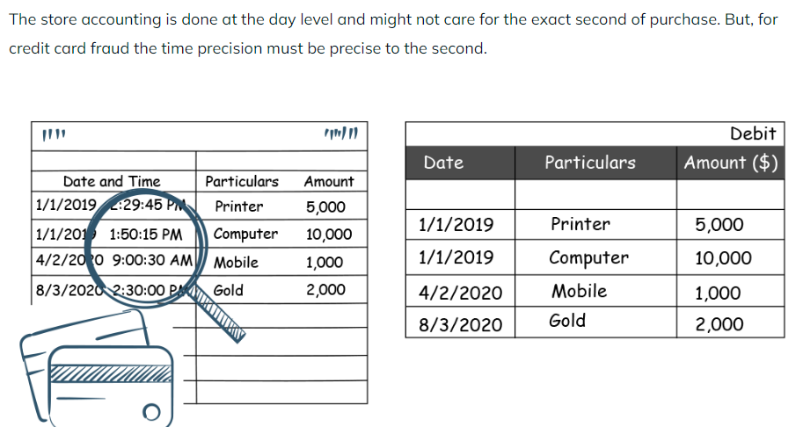
Time Precision
Example:

Slide 26
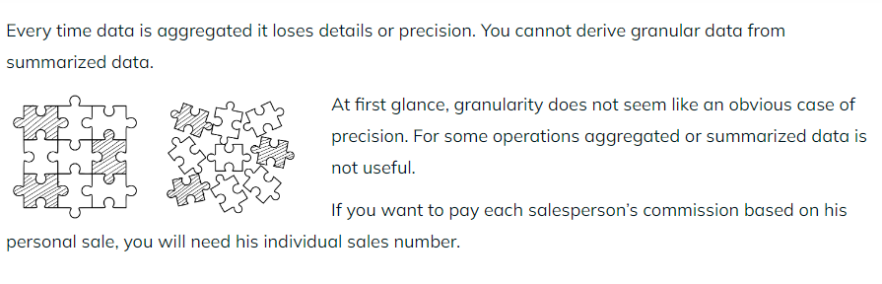
Granularity Precision
Example:

