Slide 1
Data Warehouse

Slide 2
Topics
Data Warehouse
Characteristics of Data warehouse
Goals of Data Warehouse
Difference between Database and Data Warehouse
Terminologies
Data Warehouse Architecture
Process Flow
Testing
Backup

Slide 3
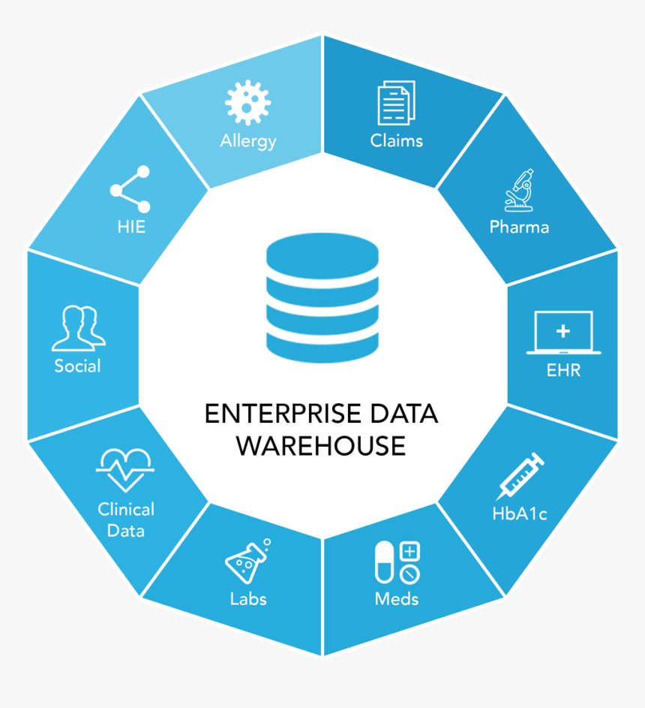
Data Warehouse
Central repository of data
Collected from multiple sources
Helps the business to make management decisions.

Slide 4
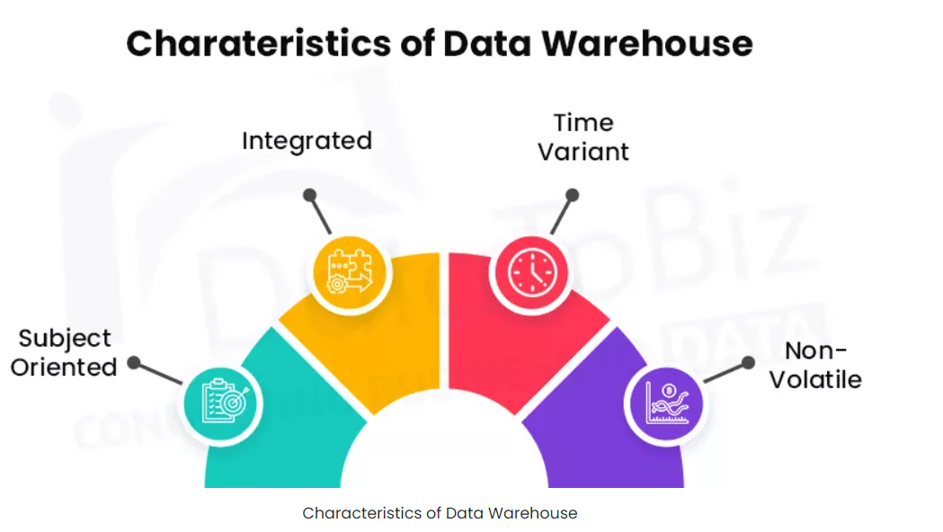
Characteristics
Collects data from multiple sources
Integrated those data then stored
Subject wise data are stored .ex: Sales, Product,Items etc.
New data loaded at intervals
Existing data does not change while new data is inserted.

Slide 5
Benefits Of Data Warehouse
Save time
Improve data quality
Improve Business Intelligence
Leads to data consistency
Increase data Security
Make organization information easily accessible
Helps to make important decisions

Slide 6
Database Vs Data warehouse
Parameter | Database | Data Warehouse
Purpose | Record | Analysis
Uses | OLTP | OLAP
Orientation | Perform Fundamental Operation | Analyze business
Data Summary | Detailed data | Highly summarized data
Design Model | ER Model | Data Modeling Technique
Performance | Low performance for analytical queries | High performance for analytical queries

Slide 7
Terminologies The most commonly used terms in data warehousing.
Metadata
Road map to a data warehouse
Acts as a directory
Helps the decision support system to locate the contents of a data warehouse
Why is metadata necessary in a data warehouses?
acts as the glue that links all parts of the data warehouses
provides information about the contents and structures to the developers.

Slide 8
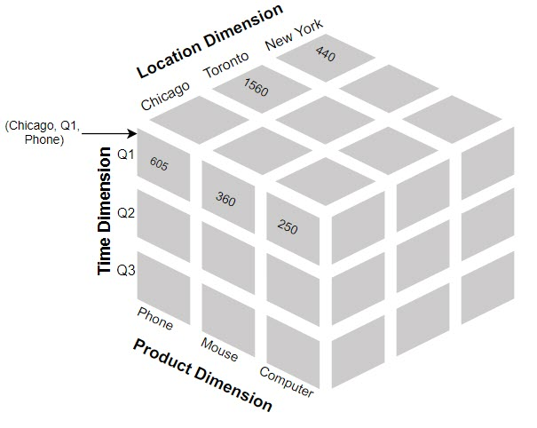
Terminologies
DataCube
Multidimensional structure
Represent data in multiple dimensions

Slide 9
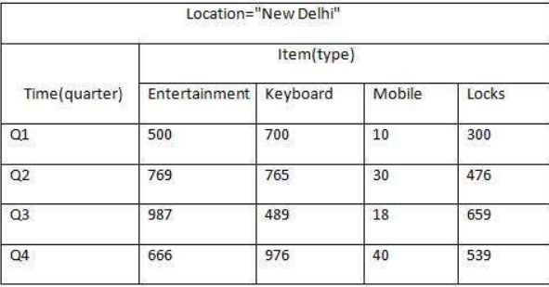
2-D Data Cube Example

Slide 10
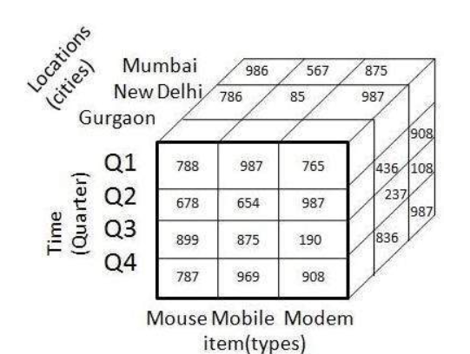
3-D Data Cube
Dimension:
1.Location
2.Time
3.Items

Slide 11
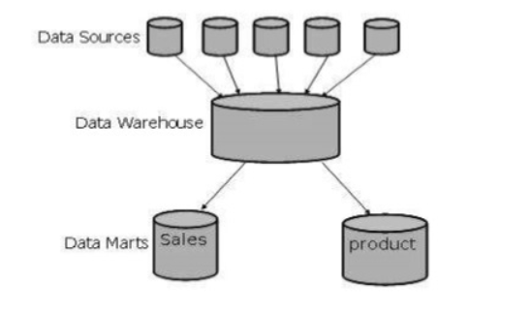
Data Mart
Contain subset of organization wide data
Valuable to specific group of people
Confined to subjects
Example: Marketing data may contains Sales, Items,Customers information

Slide 12
Data Warehouse Architecture
Bottom Tier (Data Warehouse Server)
Middle Tier (OLAP Server)
Top Tier (Front end Tools).

Slide 13
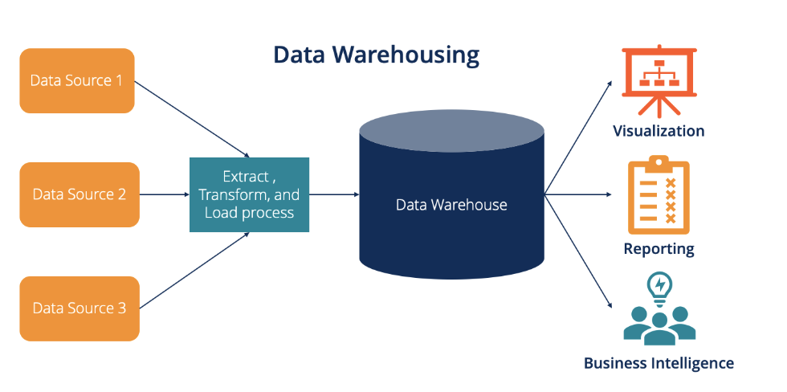
Process Flow

Slide 14
Process Flow In Data Warehouse
Extract and load the data.
Cleaning and transforming the data.
Backup and archive the data.
Managing queries and directing them to the appropriate data sources.

Slide 15
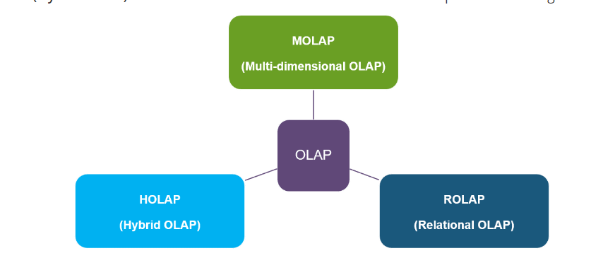
OLAP Servers
Online Analytical Processing (OLAP)

Slide 16
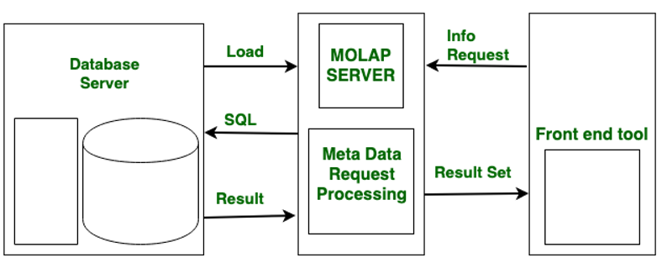
ROLAP
Placed between Relational back end server and Front end tool
Uses Extended RDBMS

Slide 17
MOLAP
Array based Storage Engine
Used for Multidimensional view of data

Slide 18
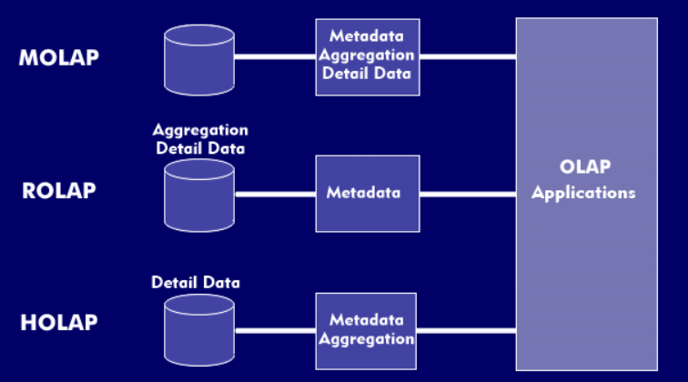
Hybrid OLAP
ROLAP
MOLAP
Offers Higher Scalability Of ROLAP
Faster Computation of MLOAP

Slide 19
Specialized SQL Servers
Advance Query Language
Query process Support

Slide 20

Backup Data
Complete Backup (Entire db)
Partial Backup (Does not Create Complete)
Cold Backup ( Shutdown)
Hot Backup (Running and up)

Slide 21


Slide 22
Data Warehouse Testing
Unit testing
Each component ex:Procedure, program,sql script
Performed by developer
Integration testing
Performed after integration
System testing
Whole DataWarehouse

