Slide 1
Master Data Management
Presented by Somaiya Jannat

Slide 2
"Why do BI projects fail ?"

Slide 3
"Why do BI projects fail ?"
Reason:
Master data quality
Topics Cover:
Types Of Data
What is master data?
Why these data set causing problems?
MDM Architecture
Basic Difference Of MDM Architecture

Slide 4
Organizational Data
3 types of data are being captured
Transactional Data
-> Generated by applications in supporting business processes
Analytical Data
-> Calculated and/or derived from transactional information
Master Data
-> Describes business core entities

Slide 5
What is master Data?
Unique Information
Describes business core entities
Essential to operations in a specific business or business unit.
Varies from one industry to another and even from one company to another within the same industry

Slide 6

Master Data
"Customer XYZ placed an order for 5 Product ABC on August 8th 2014 for a total of 250.
Master data: Customer, product
Transactional data: The invoice number, the total amount, the VAT amount
Analytical data: Average Order value,
the average quantity ordered

Slide 7
Master Data Management
A technology-enabled discipline
In which business and information technology work together
To ensure the uniformity, accuracy and accountability of the enterprise's official shared master data assets
Organize data according to business marketing and operations

Slide 8
Why Master Data Management Is Important?
Reduce work loads
Improve Data Quality
Promotes business agility(Speed)
Avoids duplication and increases data accuracy
Reduces security risk and ensures better data compliance
Improve Decision Making

Slide 9
MDM Implementation Style
There are four Implementation Style
1.Consolidation Style
2.Registry Style
3.Coexistence Style
4.Centralized Style

Slide 10
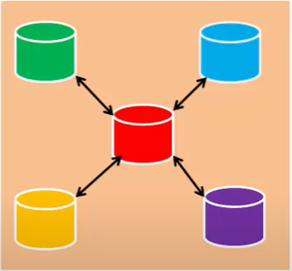
Coexistence Style
Used primarily to support business intelligence (BI) or data warehousing initiatives.
Master Data stored at various locations
Whenever practical, this style can contain master data
If not practical, style contains links to other master data sources
It allows incremental growth
Big risk of synchronization issue
Also called Synchronization issue

Slide 11
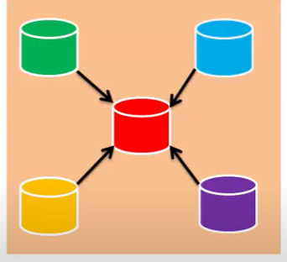
Registry Style
Provides Read only view to master data
Not possible to modify
Useful for remove duplicate
Provide a consistent way to master data

Slide 12
Registry Style
In operational style, master data is stored in one system and other system has pointers to master data system
Contains less number of record identifier
Data quality depends on the quality of master data in the source system
The registry selects “best version” of data dynamically via matching at the hub
Easy to implement
Performance issue due to multiple connection to system

Slide 13

Advantage
Usually quick to deploy and with lower cost compared to the other architectures
Fast integration with the profit of minimal intrusion into your application systems.
This framework is beneficial in finding redundancies.

Slide 14
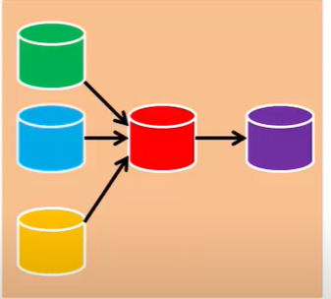
Consolidation style
Used primarily where master data authoring is distributed
A "golden copy" is maintained centrally in a hub.
The central system publishes the golden copy master data to subscribing systems.

Slide 15
Consolidation Style
Business data from different source is merged into a single record called golden record
Data quality is taken care separately before entering into master data system
Suitable for enterprise wide implementation both for operational as well as analytical process
For operational purpose this style can be illustrated by Operational data Store
For Analytical data this style can be illustrated by Data warehouse

Slide 16
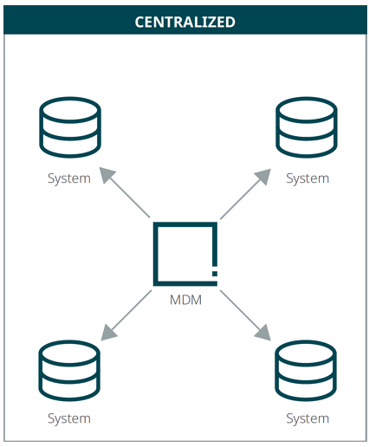
Centralized Style
A given set of data is selected as a system of record and update is happend directly in this system of record
Only one system becomes source of master data
Updated records are distributed to consuming system
Costly and complex to implement
Also Called Repository MDM

Slide 17

Parameters | Consolidation | Registry | Centralized | Coexistence
Authorship Vs Hub | Author is separate from hub | Author is separate from hub | Authorship in hub | Author EveryWhere
Validation | Hub is system of reference | Hub is system of reference | Hub is system of record | Mixed system of record/reference
Primary Consumer | Downstream and Reporting | Both Operational and Analytical | Upstream Operation | Upstream Operation
Search Complexity | Relatively light | Very Complex | Relatively light | Reasonably Complex

Slide 18
Which style should we choose?
For operational system ->Operational MDM System
For inconsistency data ->Enterprise MDM Style

