Slide 1
Normalization
Slide Developed By Somaiya Janant

Slide 2
Normalization
Normalization is the process of organizing data in a database.
Purpose:
Reduces data redundancy(Unnecessary)
Eliminates undesirable characteristics
Like Insertion,Updation Deletion Anomalies

Slide 3
Rules
Divides larger tables into smaller tables
Linkes them using relationship

Slide 4
1 Normal Form
Conditions to be 1NF
Contains Atomic value
An attribute can not hold multiple values
Each table has a primary key
There are no repeating groups

Slide 5
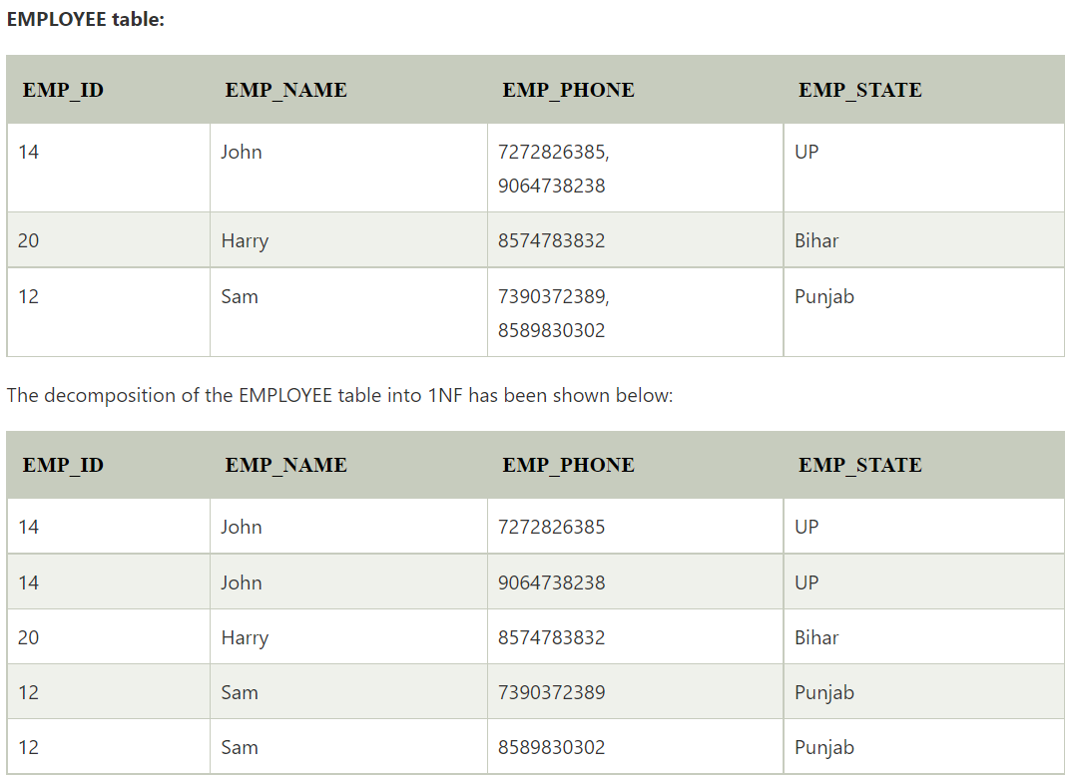
Example of 1 Normal Form

Slide 6
2nd Normal Form
A relation is in 1st Normal form and its all conditions
Every non key(prime) attribute is fully dependent on Prime Attribute

Slide 7
Prime And Non Prime Attribute
Prime Attribute: Define the Uniqueness
A primary key is a column in a table whose values uniquely identify the raw in a table
Non Prime Attribute: Attribute of a relation which are not uniquely identifies.Like Age, Cgpa, Product Price

Slide 8
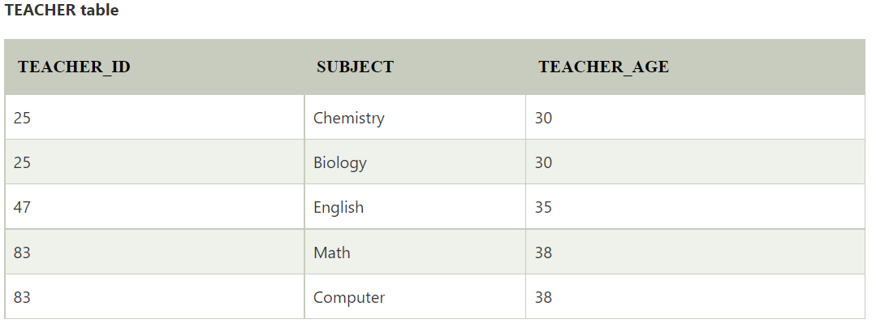
Example : 2nd Normal Form
Teacher_Age Non Prime Attribute
Totally dependent on Teacher_id
Prime Attribute

Slide 9
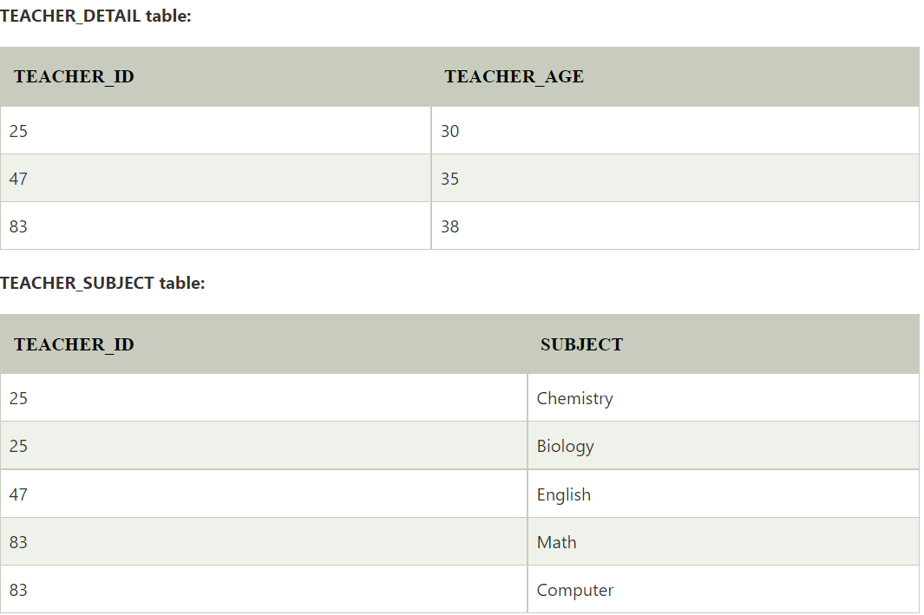
Solution

Slide 10
3rd Normal Form
Condition:
A relation will be in 2NF
Does not contain any Transitive Partial Dependency
Used to reduce data duplication for non prime attribute
Transitive Dependency: When non prime attribute depends on other non prime attribute
Score_id | Student_id | Subject-id | Marks | Exam_name | Total_marks
 | 101 | CSE-101 | 87 | CSE | 100
 | 102 | EEE-102 | 67 | EEE | 100

Slide 11
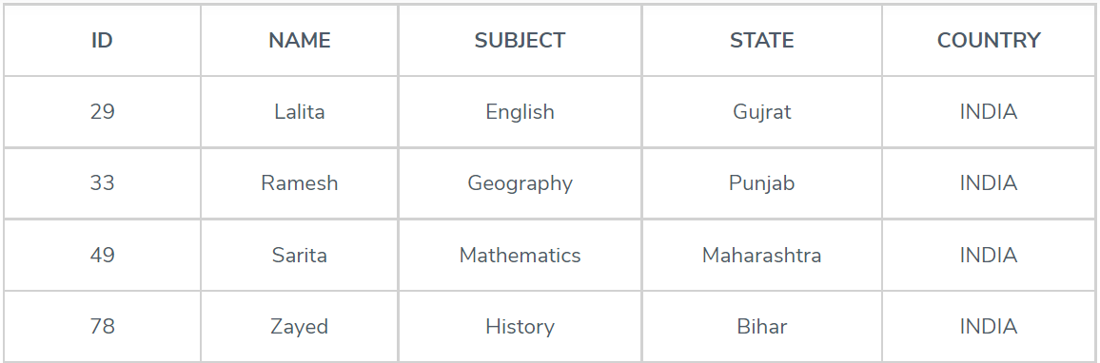
Problem

Slide 12
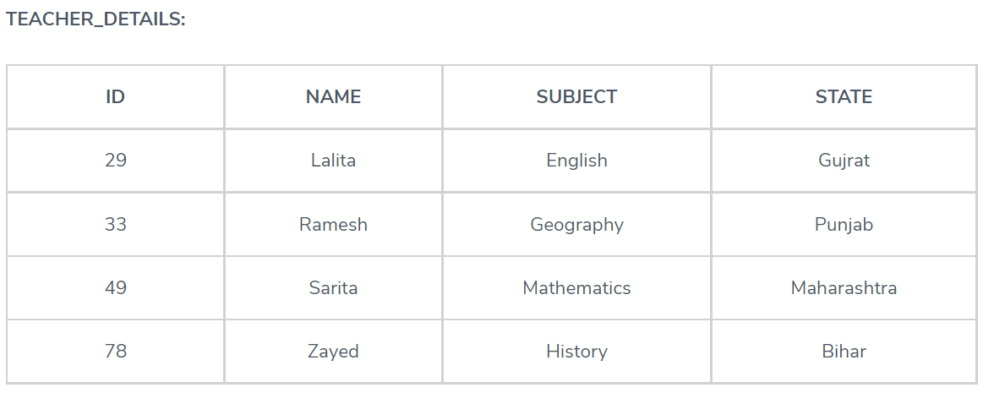
3rd Normal Form Solution

Slide 13
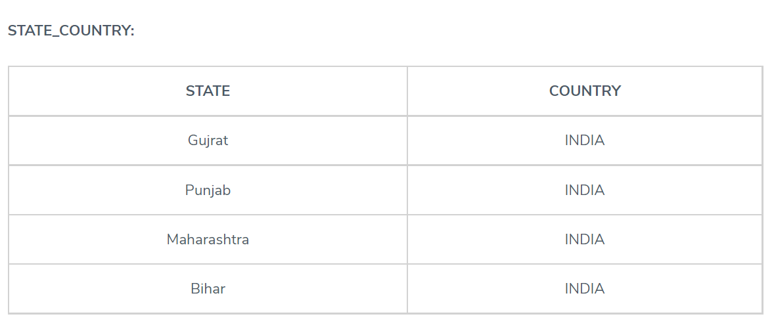
3rd Normal Form Solution

Slide 14
Boyce Codd Normal Form
BCNF is the advance version of 3NF. It is stricter than 3NF.
A table is in BCNF if every functional dependency X → Y, X is the super key of the table.
If prime attribute dependent on non prime attribute then
Non prime attribute must be in Super key

Slide 15
Super Key
A super key or simply key is a combination of all possible attribute which can uniquely identify the rows(tuples) in a table. This means that a superkey may have some extra attribute which isn't necessary for uniquely identifying the rows in the table

Slide 16
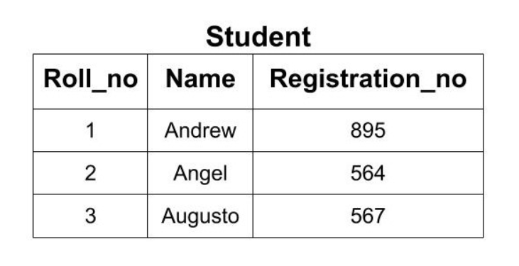
Super Key

Slide 17
Super Key
{Roll_no}
{Registration_no}
{Roll_no, Registration_no},
{Roll_no, Name}
{Name, Registration_no}
{Roll_no, Name, Registration_no}

Slide 18
Boyce Codd Normalization
For a table to satisfy the Boyce-Codd Normal Form, it should satisfy the following two conditions:
It should be in the Third Normal Form.
And, for any dependency A → B, A should be a super key.
Student_id | Subject | Professor
101 | DBMS | Titu
102 | DBMS | Tomal
103 | Computer Networking | LILI

Slide 19
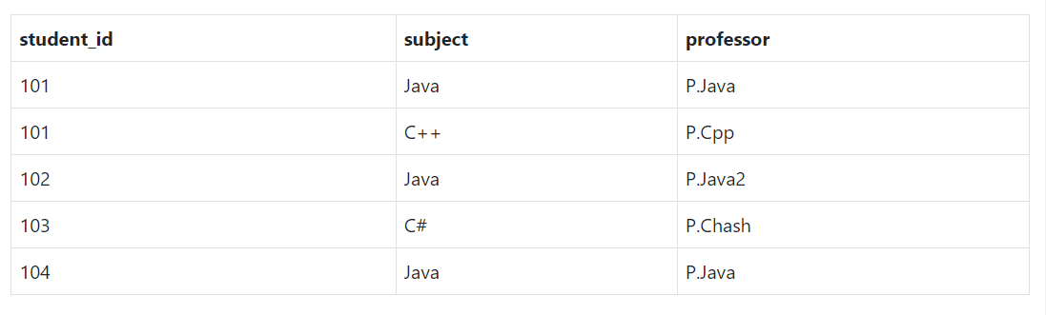
Boyce Codd Normalization Example

Slide 20
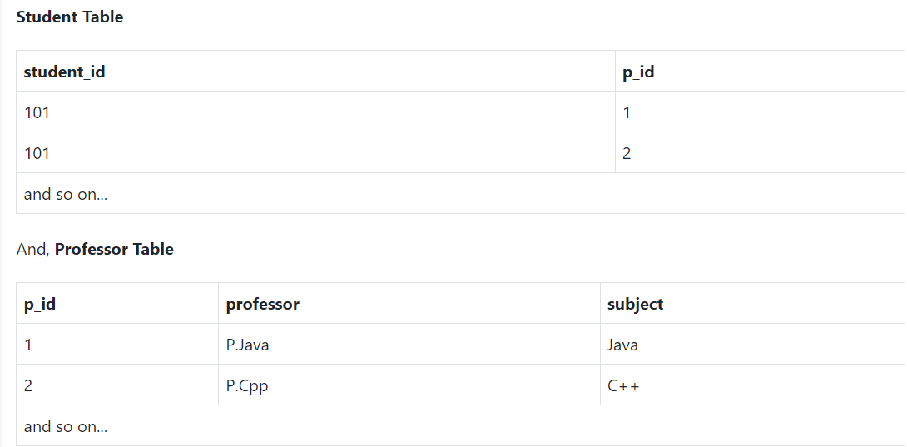
Boyce Codd Normalization

