Slide 1

Computing Review
Script (algorithm): A sequence of instructions where the order of instructions is important
Variable: is a storage location that holds a value
Arithmetic expression: A recipe (formula) that produces a numeric result
Numerical assignment (=): Statement where a variable is assigned a value

Slide 2
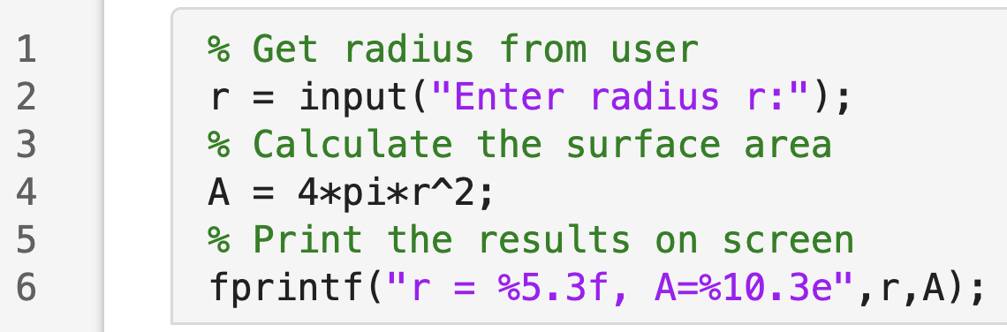
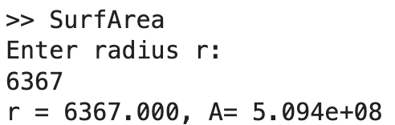
Recall: From last time
Comments begin with the percent % symbol and helps us remember our steps
The input statement is an effective way to prompt the user for data. A sequence of characters delimited by single quotes is called a string (text)
The script can be run from command line
fprintf command displays formatted output
Output in command line

Slide 3


MATLAB commands
Comments (%): Everything after the
Semicolon (;): If missing, a value is displayed on screen
Strings: Characters enclosed by single quotes:
Format: Decimal (5 or 15 digits) or scientific notation (5 or 15 digits)
Input function: to request a keyboard input
variable = input(‘string’)
Output functions: disp, fprintf
disp(‘string’)
fprintf(‘string with format’, variable)

Slide 4
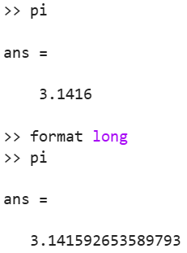
MATLAB commands
format short
default, decimal notation, 5 digits
format long
decimal notation, 15 digits
format short e
default, scientific notation, 5 digits
format long e
scientific notation, 15 digits
Notes:
The right image shows the differences for the default format (short) and how how to tell MATLAB to show the 15 digits using format long

Slide 5
MATLAB commands
clc: Clears the command window (lowercase)
clear all: Clears the Workspace (lowercase)
pi: MATLAB uses 3.14159265358979, by default shows 3.1416
Math functions: There are others built in functions:
  sqrt() for the square root, the hat ^ for exponents as x^2
  exp() for the exponential, log and log 10 for natural log and base-10 logarithms
  sin(), cos(), and tan() use radians
  sind(), cosd(), and tand() use radians
  asin(), acos(), and atan() return the inverse trig functions

Slide 6
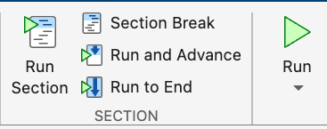
Create new sections in MLX script
Execute the current section
Create a new section from the current position of the cursor
Execute the whole script file with all sections in it

Slide 7
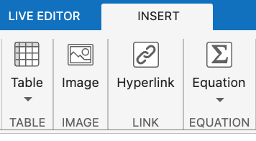
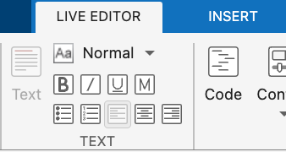
Add text or images to your MLX file
We can add text inside our live script.
The live script allows us to have text and code fused together in one file.
There are different kinds of text formating available for the live script.
We can insert image files from the INSERT tab.
Play around with the other options available under INSERT.

Slide 8
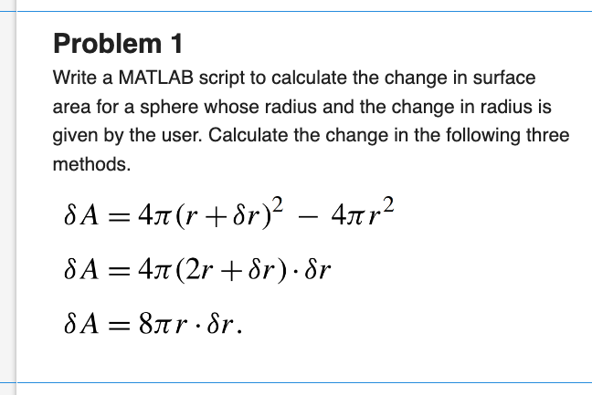
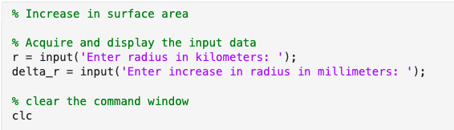
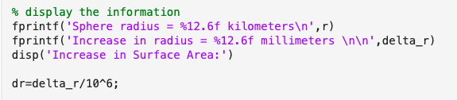

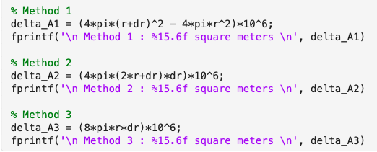
Back to Problem 1: Add it as a section to existing SurfArea.mlx

Slide 9
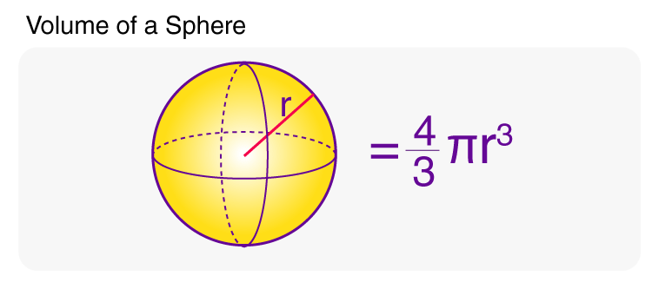
In-Class Activity
Create a script that request a radius input and calculates the volume of a sphere

