Slide 1


IDS 1721
Computing and Problem Solving for STEM
Chapter 02
Examples on For Loop

Slide 2
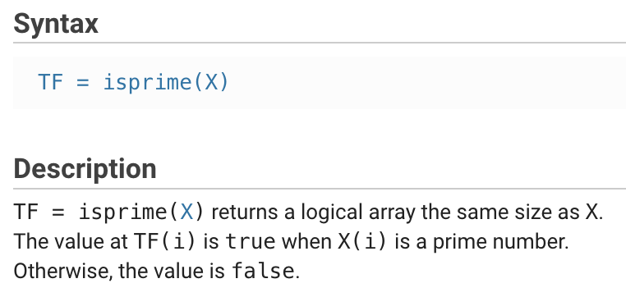
Function isprime( )
This function can check if a number is prime
Try the following in your command line
  isprime(4)
  isprime(17)

Slide 3
Exercise : Find prime numbers
Write a MATLAB script that takes a positive integer M as input and display all prime numbers between 1 and M.
Example:
Input: M = 10
Output: 2, 3, 5, 7
Pseudocode:
  Get M
  For k from 1 to M
    If k is prime
    Display k
    end if
    End for

Slide 4
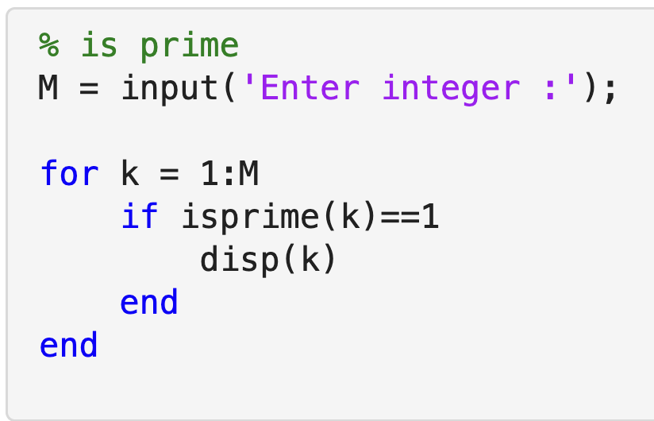
CODE

Slide 5
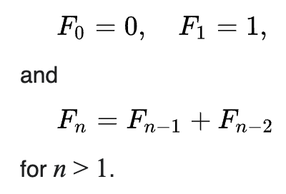
Fibonacci sequence
The sequence of numbers:
0 1 1 2 3 5 8 13 21 34 …
The sequence can be described by the following recurrence relation

Slide 6
Exercise : Fibonacci sequence
Pseudocode:
Get N
Set F0 = 0, F1 = 1
Display F0, F1
For k from 1 to N
F = F0 + F1
Display F
F0 = F1
F1 = F
End for
Write a MATLAB script that takes a positive integer N as input to generate the first N terms of the Fibonacci sequence.
Example:
  N=6
  Output:
  0 1 1 2 3 5

Slide 7
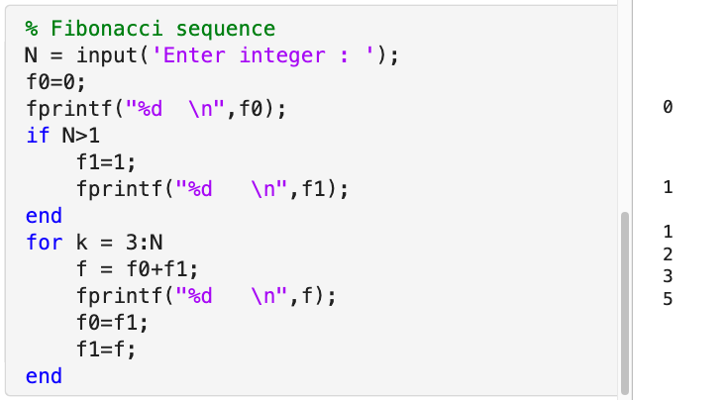
CODE N=6

Slide 8
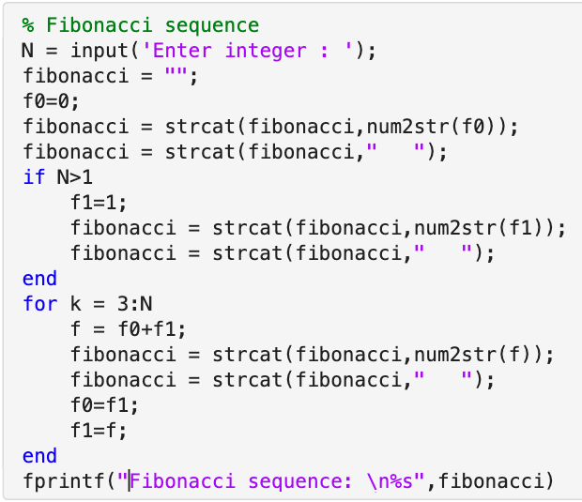

The output can be made to look nicer when we learn more about strings
N = 10

Slide 9
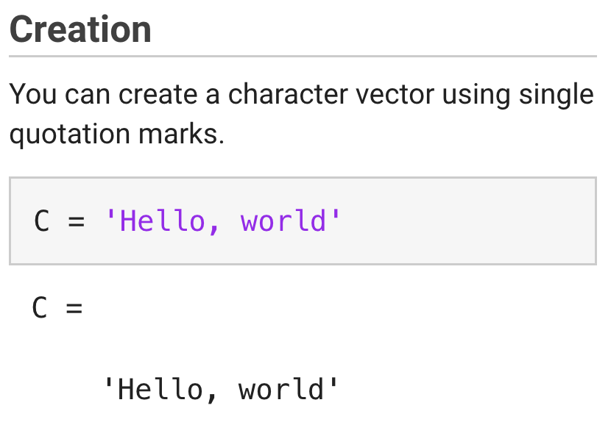
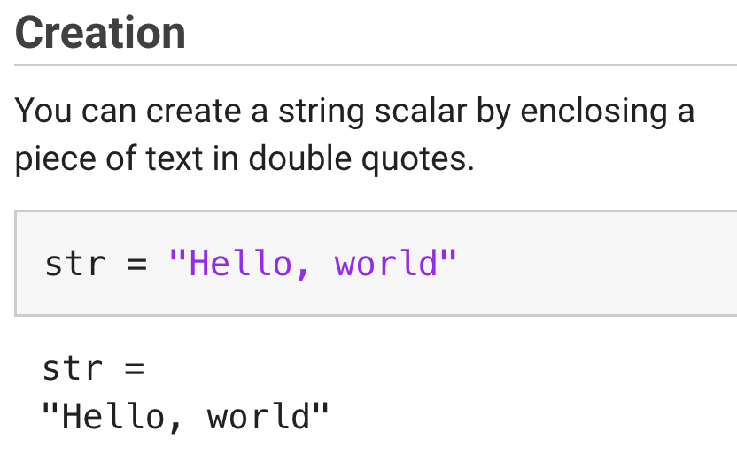
Strings and Characters
Texts can be also stored as character arrays
Texts in MATLAB is classified as strings
It is stored as a sequence of characters.
Character array
Strings
Do you see any difference between the two?
Look at the size of each variable in the workspace.

Slide 10
Try the following in command line
>> str(2)
>> C(2)
>> str(1)
>> C(10)
>> C(14)
A string is a single entity whereas a character arrays is a sequence of characters.
Both types of representation are useful
Let us focus on strings now

Slide 11
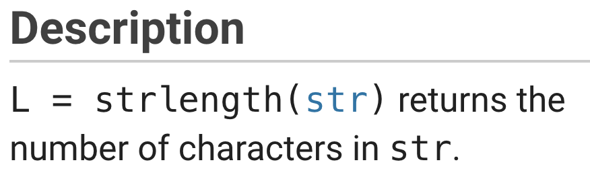
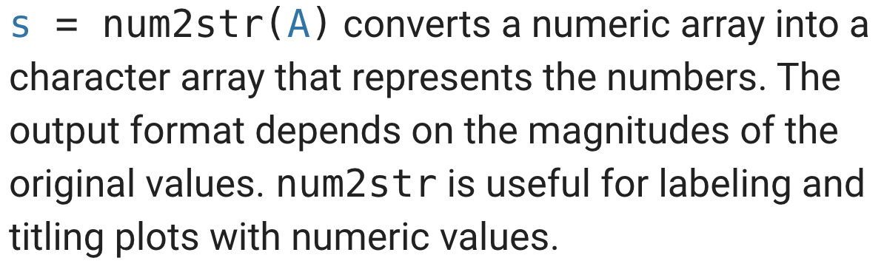
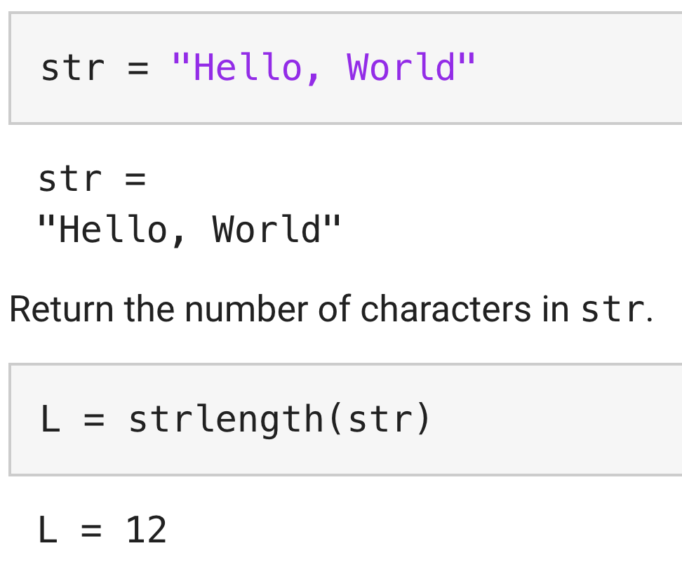
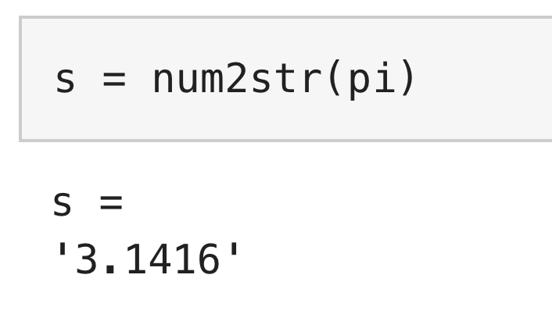
Functions
strlength
num2str
We can use a combination of these two functions to determine the length of a decimal number.
It is one of the ways.
Try the following in your command line
strlength(num2str(pi))
strlength works for both strings and character arrays!

Slide 12
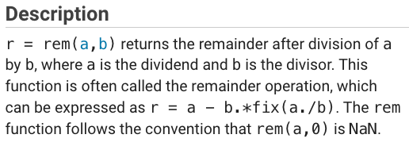


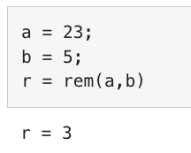
Functions

Slide 13
Exercise :
Sum of the digits
Example:
Find the sum of the digits of the number 1234.
Start Sum=0.
Extract the last digit:
rem(1234, 10) = 4
Sum = 4
Remove the last digit:
floor(1234 / 10) = 123
Extract the next digit:
rem(123, 10) = 3
Sum = 4 + 3 = 7
Remove the last digit:
floor(123 / 10) = 12
Extract the next digit:
rem(12, 10) = 2
Sum = 7 + 2 = 9
Remove the last digit:
floor(12 / 10) = 1
Extract the final digit:
rem(1, 10) = 1
Sum = 9 + 1 = 10
Thus, the sum of the digits of 1234 is 10.
Write a MATLAB script to input a non-negative integer N from the user
  Check to make sure that the number is positive
  Check to make sure that the number is integer
  Prompt the user that if the above checks fail
  If the number passes the checks, find the sum of the digits

Slide 14
Psuedocode
Get N
If N is negative
Prompt the user
Else if N is not integer
Prompt the user
Else
Set L as length of N
Set sum = 0
For I from 1 to L
Obtain digit of N in units place
sum = sum + digit
N = floor(N/10)
end for
Display the sum
End if-else-if

Slide 15
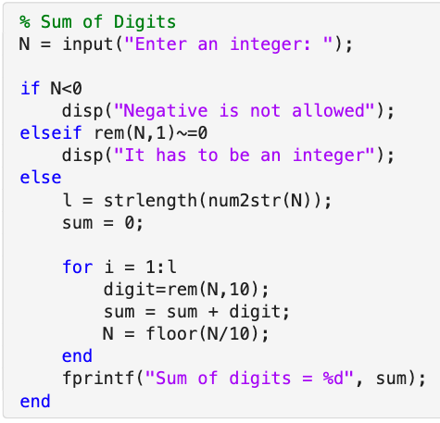
Code
Run the code for
N = -10
N= 0
N = 123.5
N = 234

Slide 16
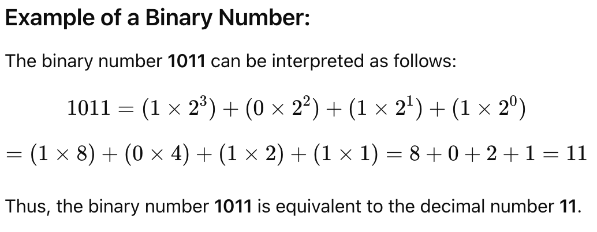
Binary numeral system
A binary number is a number expressed in base-2 or binary numeral system
It is a method for representing numbers that uses 0 and 1
Computers store numbers using the binary system

Slide 17
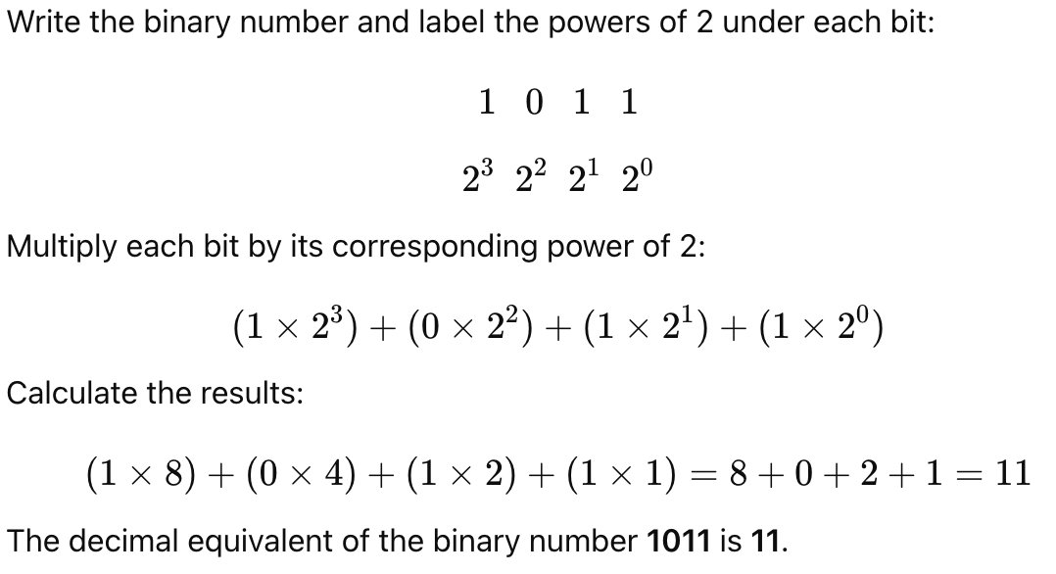

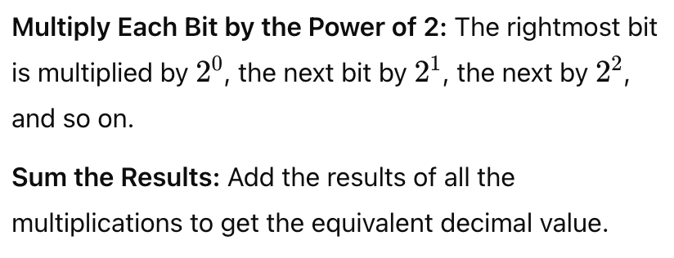
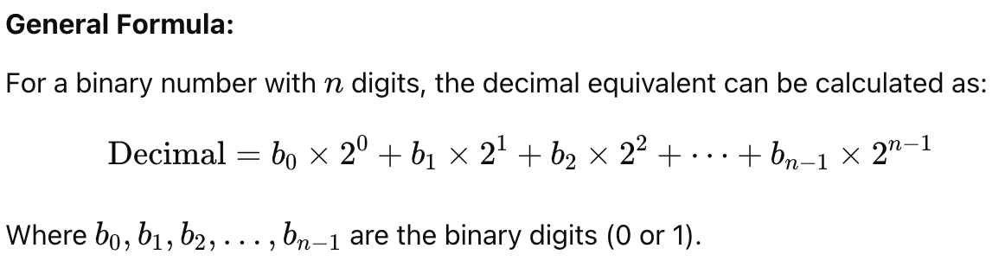
Binary to Decimal conversion

Slide 18
Exercise: Binary to Decimal
Write a MATLAB script to convert a binary number into its decimal equivalent.
Your script should carry out the following tasks:
Takes a binary number as input.
Converts the binary number into its decimal equivalent.
Outputs the decimal equivalent of the given binary number.

Slide 19
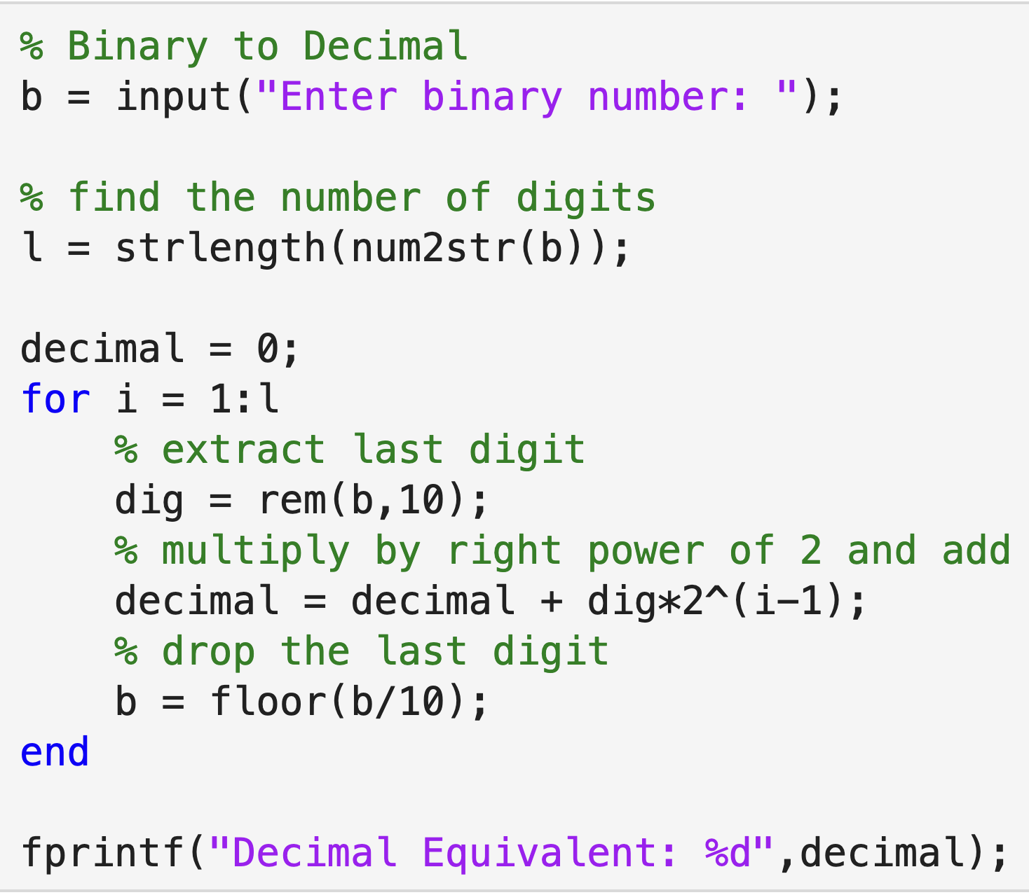
Code
Run the code for input 1011

