Slide 1


IDS 1721
Computing and Problem Solving for STEM
While loop

Slide 2
While loop
While loop is another important iteration process in MATLAB.
A while loop is useful when you don't know beforehand how many times the loop should execute.
Example:
MATLAB script that continues to ask the user for a positive integer until the correct input is entered.
Note that in the about example getting the input from the user may need to be repeated, but we do not know how many times!

Slide 3
While-Loop
As with a for-loop, a while-loop has a loop body.
If the boolean expression is true, then the loop body is executed.
If the boolean expression is false, then the loop terminates.
Syntax:
while <boolean expression>
statements
end
Notes:
As with a for-loop, a while-loop has a loop body. If the boolean expression is true, then the loop body is executed. This check-and-execute ritual is repeated as long as the boolean expression is true. If a check of the boolean expression reveals that it is false, then the loop terminates and control passes to the next statement after the end.
In a for-loop, the loop variable controls the iteration and it is automatically initialized to the first value in the set of possible loop variable values. In a while-loop, the boolean expression controls the iteration, and the variables that participate in the expression must be initialized before the loop is entered.

Slide 4
Exercise: Check for correct input
Write a MATLAB script that,
  Asks the user for a positive integer as input
  If the entry is positive integer the program prompts that "The input satisfies the criteria"
  If the input is not a positive integer the program should repeat asking for the correct input

Slide 5
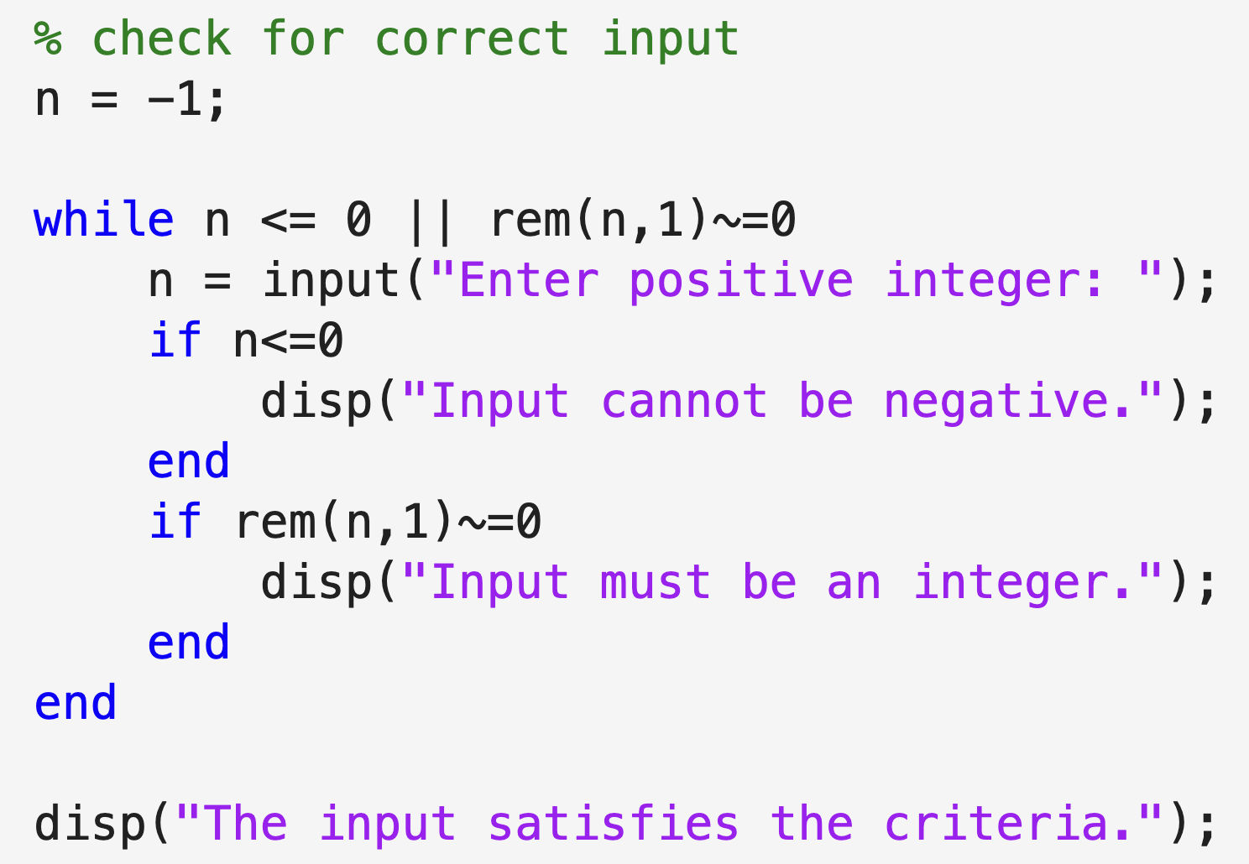
Code
Try the code for inputs
-2
4.5
-5.6
3

Slide 6
Exercise: Summing Positive Numbers
Write a MATLAB script to calculate the sum of positive numbers entered by the user, stopping when a negative number is entered.
The loop asks the user for a number.
If the number entered is non-negative, the loop adds it to a sum.
When the user enters a negative number, the loop stops.
The program then displays the sum of all positive numbers entered.
The program should display the number of entries.

Slide 7
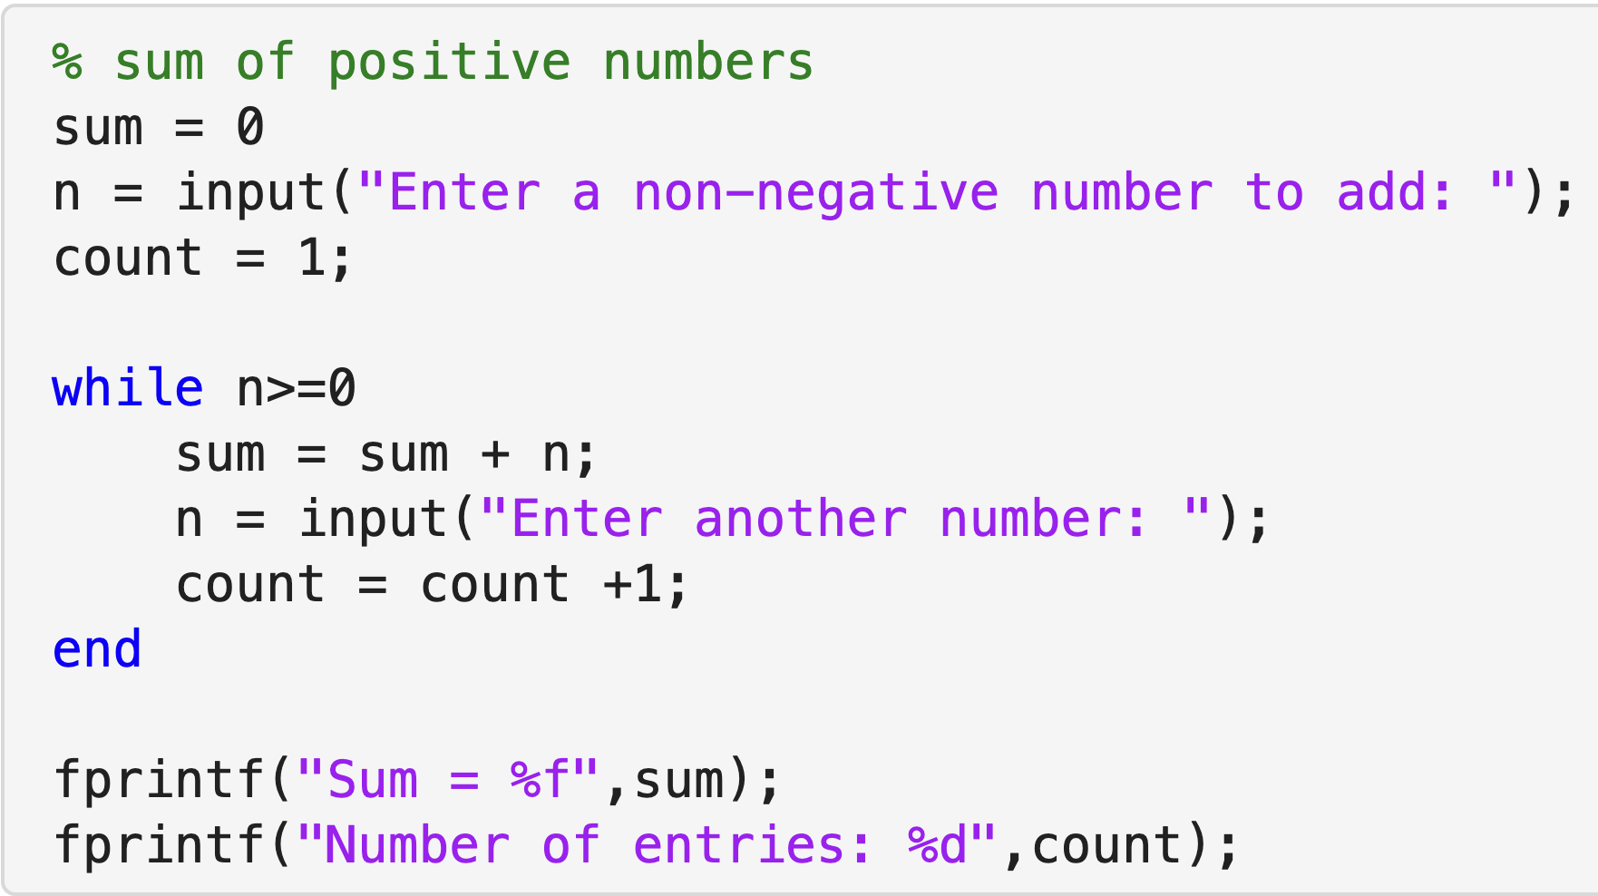
Code

Slide 8
Exercise: Fibonacci sequence with upper limit
Write a MATLAB script that generates the Fibonacci sequence with an upper limit N.
The script should:
Ask the user to input a positive integer N as the upper limit.
Generate the sequence until the term exceeds or equals N.
Displays all the terms in the Fibonacci sequence upto N.

Slide 9
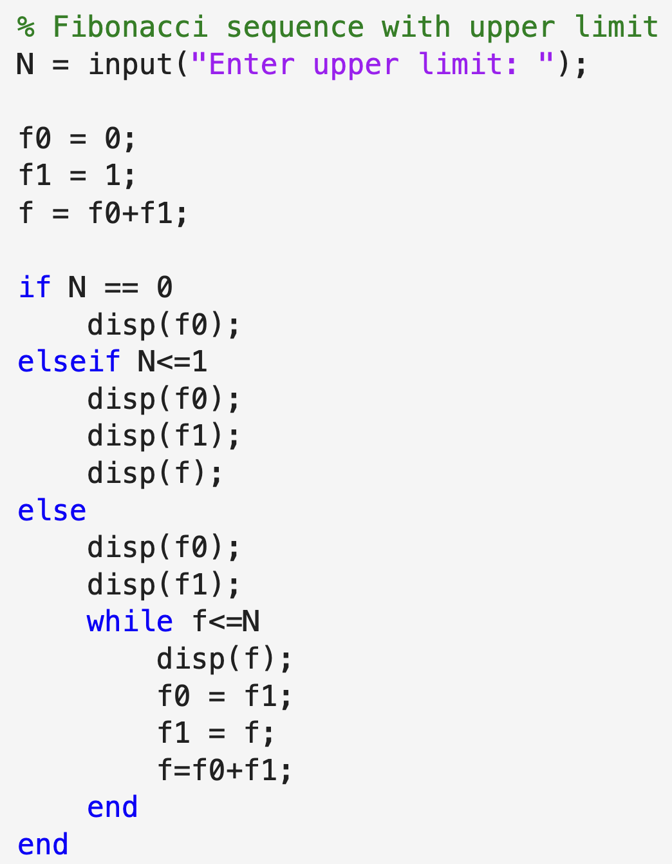
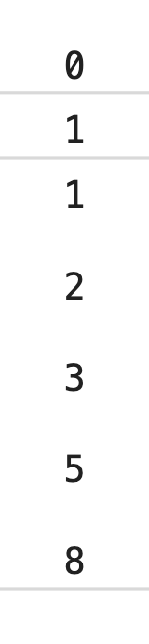
Code
N = 10
Run the code for
N = 0
N = 1
N = 5
N = 10

Slide 10
Decimal to Binary conversion
Write a MATLAB script that:
Prompts the user to input a positive integer.
Checks to ensure that the input is a positive integer.
Converts the decimal number to its binary equivalent.
Displays the binary representation of the number.

Slide 11
Conversion process:
Divide 13 by 2:
  Quotient = 6, Remainder = 1
Divide 6 by 2:
  Quotient = 3, Remainder = 0
Divide 3 by 2:
  Quotient = 1, Remainder = 1
Divide 1 by 2:
  Quotient = 0, Remainder = 1
Thus, the binary equivalent of decimal 13 is 1101.
Stop when Quotient is 0.
Read the remainders from bottom to top: 1101.

Slide 12
Conversion process:
How do put the numbers together backward?
1101 = 1X10³+1X10²+0X10¹+1X10⁰
If we count the number of iterations, then,
1101 = (remainder #1)X10⁰+
(remainder #2)X10¹+
(remainder #3)X10²+
(remainder #4)X10³
Divide 13 by 2:
  Quotient = 6, Remainder = 1
Divide 6 by 2:
  Quotient = 3, Remainder = 0
Divide 3 by 2:
  Quotient = 1, Remainder = 1
Divide 1 by 2:
  Quotient = 0, Remainder = 1
Thus, the binary equivalent of decimal 13 is 1101.

Slide 13
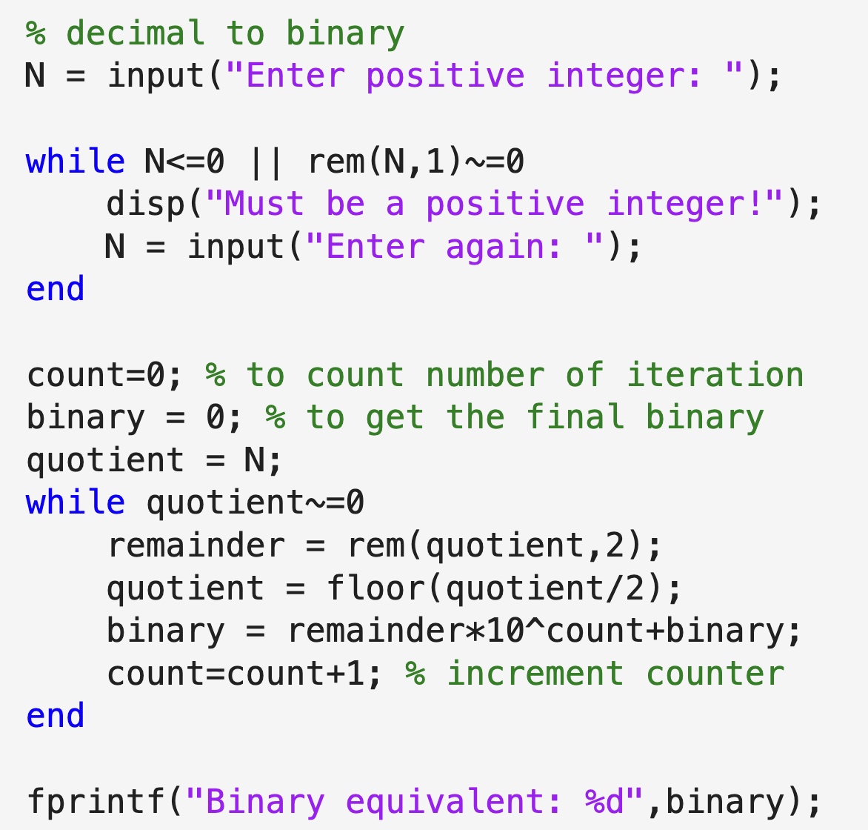
Code
Run the code for the inputs
N = -5
N = 0
N = 13

