Slide 1


IDS 1721
Computing and Problem Solving for STEM
More While loop
Method 2: Approximating PI

Slide 2
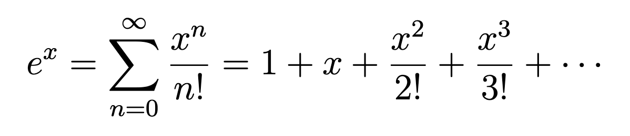
Sum of series
The Maclaurin series expansion of e^{x} is given by the following infinite series:
⁡
Where:
x is the input value (in radians),
n is the index of the series,
Factorial:
The series converges as more terms are added. For practical purposes, we compute the series up to a certain number of terms, say N.

Slide 3
Exercise: Series expansion of exp⁡(x)
Write a MATLAB script to approximate exp⁡(x) using its series expansion.
The script should:
Take an input x (in radians) from the user.
Compute the series sum until the absolute value of the terms get smaller than the tolerance value 10⁻⁵
Display the approximate value of exp(x)
Compare it to MATLAB’s built-in function exp(x).

Slide 4
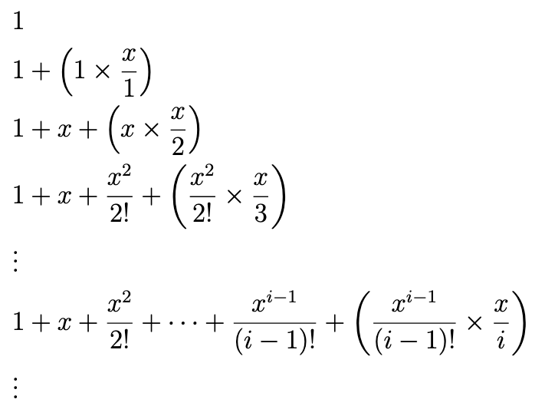
With that idea we can write our pseudocode,
Get x
Set tol = 10^(-5)
Set sum = 0
Set term = 1
Set i = 1
While abs(term)>tol
sum = sum + term
term = term * (x/i)
i = i+1
End while
Display sum
Note how we can break down this sum in steps
The i-th term in the sum is
[(i-1)-th term] × [x/i]
Stop when abs(term) smaller than tolerance

Slide 5
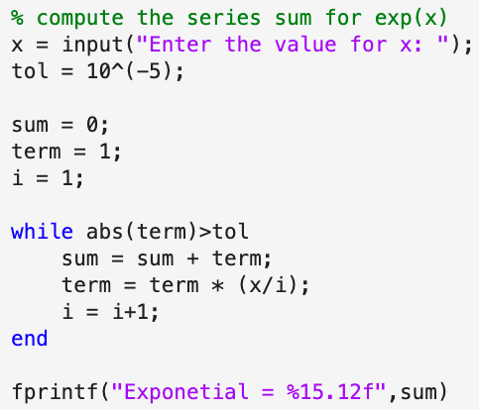
CODE

Slide 6
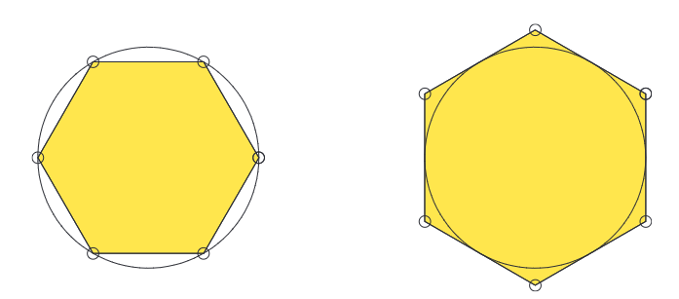
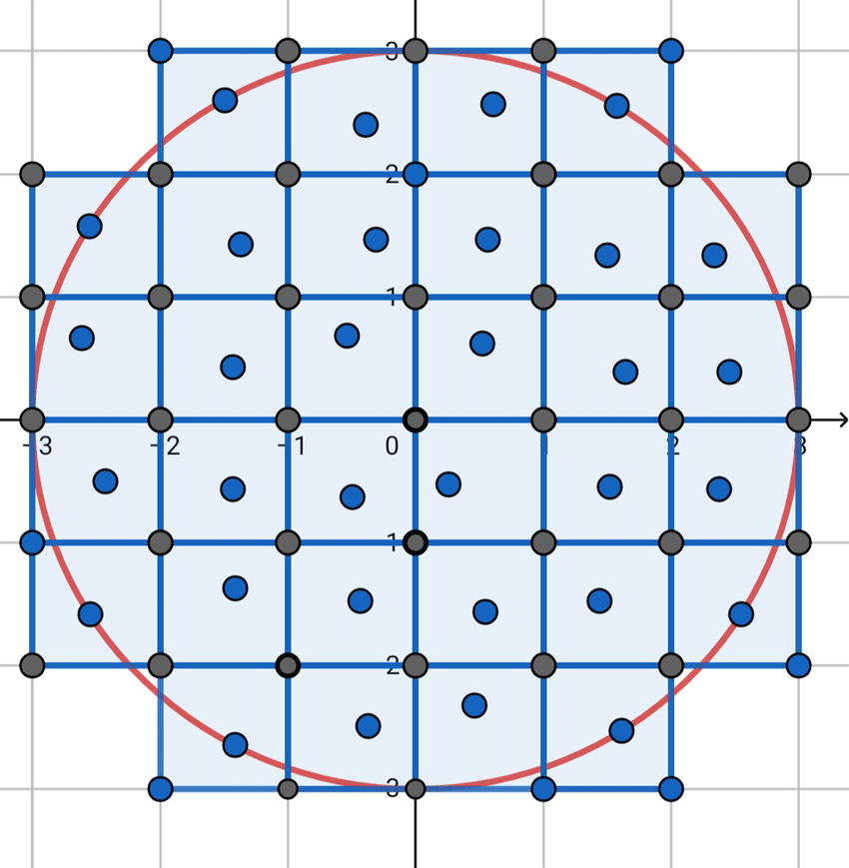
Method 2: Fitting Polygons
Previously, we counted uncut tiles to estimate π
We used the iterative method of for-loop
Now, we will estimate π by finding the average area of inscribed and circumscribed polygons
We will use another form of iteration.
Polygons
Inscribed Hexagon
An
Circumscribed Hexagon
Bn
Notes:
The polygons problem
The circle area is pi, one area is smaller, the inscribed figure and the other area is larger, the circumscribed figure
So the area of the circle sits in between both areas An < pi < Bn

Slide 7
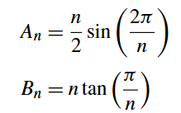
Fitting Polygon to estimate π
Suppose we have n equally spaced points around the unit circle (area is π).
If we connect these points in order, we obtain a regular inscribed polygon with n sides.
If we connect the tangent lines at those points, then we obtain a regular circumscribed polygon with n sides.
Figure on the right shows the cases for n = 6.
The polygon areas are given by
So, the average area should be close to π?
Polygons
Inscribed Hexagon
An
Circumscribed Hexagon
Bn
< π <
Notes:
The polygons problem
The circle area is pi, one area is smaller, the inscribed figure and the other area is larger, the circumscribed figure
So the area of the circle sits in between both areas An < pi < Bn

Slide 8
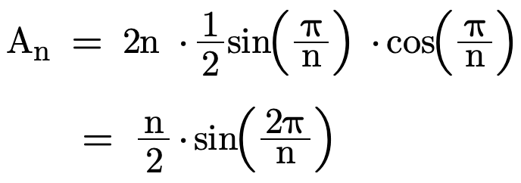

Trigonometry Alert!!!
tan(π/n)
sin(π/n)
1
1
π/n
cos(π/n)
π/n
< π <
Notes:
The polygons problem
The circle area is pi, one area is smaller, the inscribed figure and the other area is larger, the circumscribed figure
So the area of the circle sits in between both areas An < pi < Bn

Slide 9
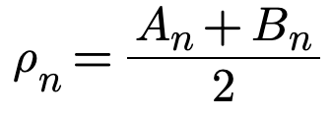

Problem Statement
Polygons
Let’s call the average area:
This is an approximation to π
Then the error should follow as:
If n is a large, the error is close to zero
Previously we answered the question:
Given n, find the approximation and compute the error!
Let's look at a different problem statement:
Given a tolerance level determine n such that error is less than tolerance!
IN OTHER WORDS...
Write a script that asks for the desired error size δ (tolerance) and displays the value of n and the approximation ρ_{n} such that
|A_{n} - B_{n}|≤δ
Inscribed Hexagon
An
Circumscribed Hexagon
Bn
Notes:
The polygons problem
The circle area is pi, one area is smaller, the inscribed figure and the other area is larger, the circumscribed figure
So, the area of the circle sits in between both areas An < pi < Bn

Slide 10



Chapter 02: Problem 2 Development
Polygons
If n is large, the areas get closer to π (area of circle), and the error becomes smaller.
Let’s see how the error looks like for
n = 10, 100, 1000 and so on
We have:
Inscribed Hexagon
An
Circumscribed Hexagon
Bn
Notes:
We can try to find areas A and B for several N, and find the error tolerance to have an idea

Slide 11
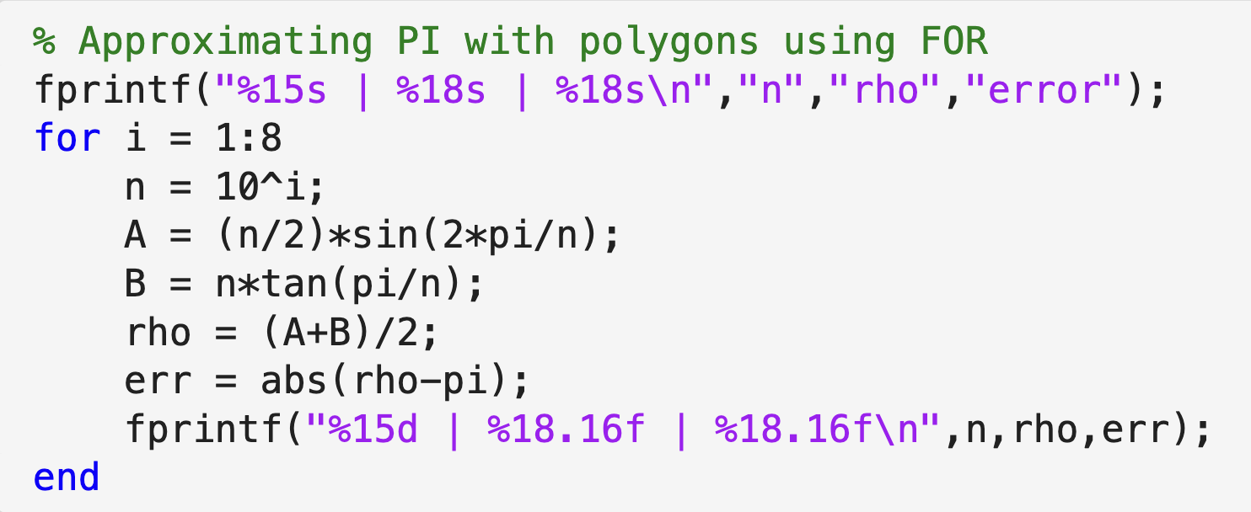
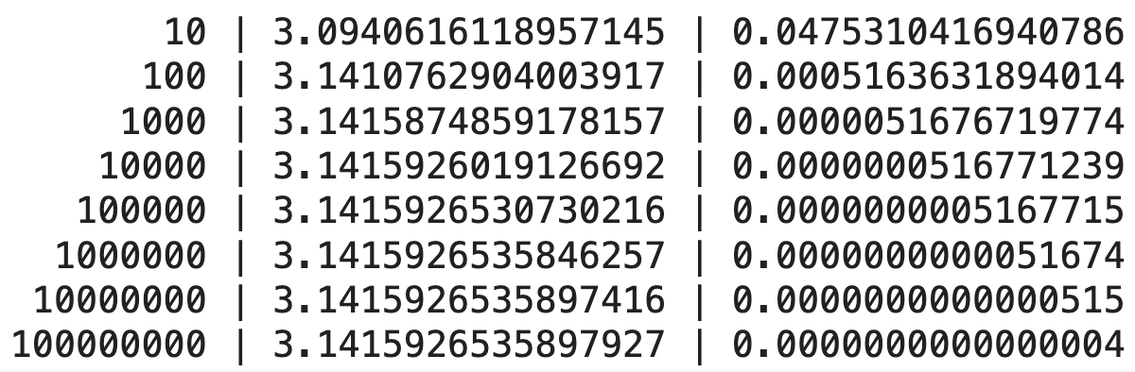
Behavior of the error
We can use a FOR loop to generate approximations for input n as powers of 10
The following code shows us how the error varies for different n
Notes:
We can try to find areas A and B for several N, and find the error tolerance to have an idea

Slide 12
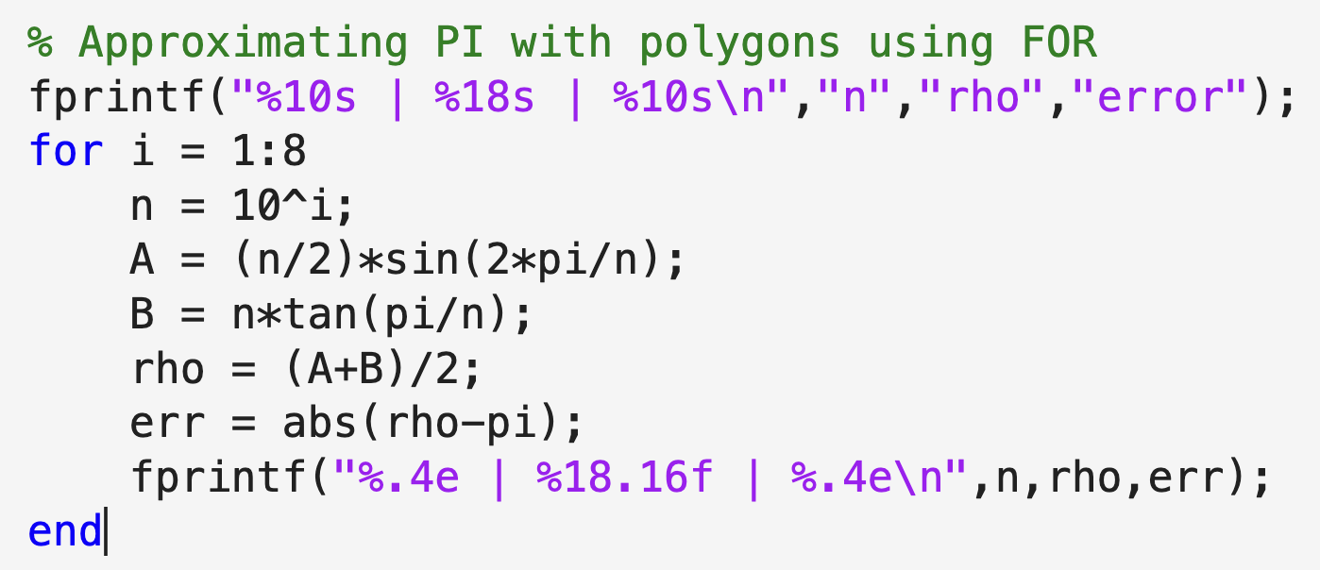
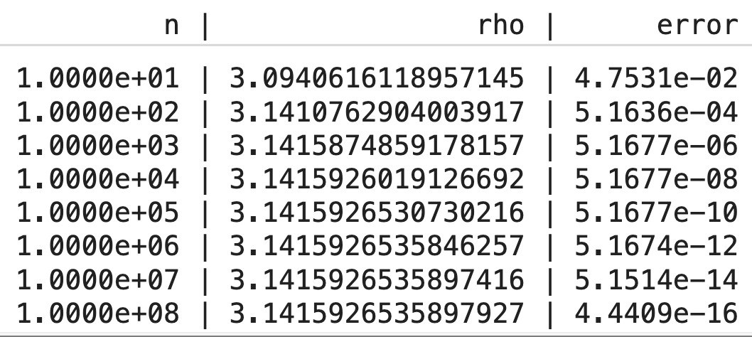
Behavior of the error
With the scientific formatting we notice something interesting,
For any input n, the error is about 1/n²
This allows us to estimate the value of n for a given error
However, this does not give us an exact answer to our question,
Given a tolerance level determine n such that error is less than tolerance!
Notes:
We can try to find areas A and B for several N, and find the error tolerance to have an idea

Slide 13
Polygons
To answer that, we need to repeat the process until the error is smaller than the given tolerance
The number of times we need to iterate is unknown in this case
We need an iteration that runs until the condition is met
Hence, the while-loop is the right choice for iteration
Inscribed Hexagon
An
Circumscribed Hexagon
Bn
Notes:
We can try to find areas A and B for several N, and find the error tolerance to have an idea
The n value can be printed using scientific notation
If the increment for n is increased before printing the value, then the wrong value will be displayed

Slide 14
Pseudo code
Polygons
  Input tolerance
  Calculate: An, Bn, and error
  While error > tolerance
  Increment n
  Calculate new An, Bn, and error
  Calculate final n and rho
Inscribed Hexagon
An
Circumscribed Hexagon
Bn
Notes:
We can try to find areas A and B for several N, and find the error tolerance to have an idea
The n value can be printed using scientific notation
If the increment for n is increased before printing the value, then the wrong value will be displayed

Slide 15
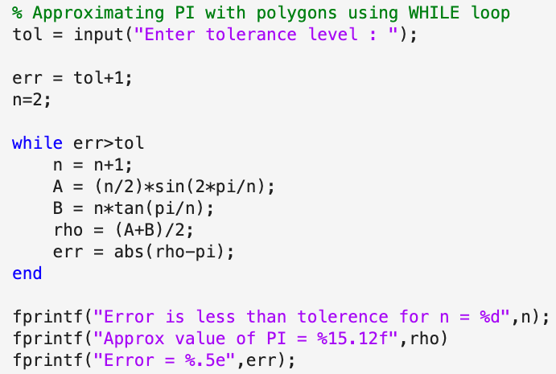


Code

