Slide 1
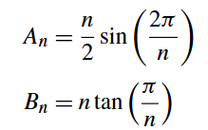
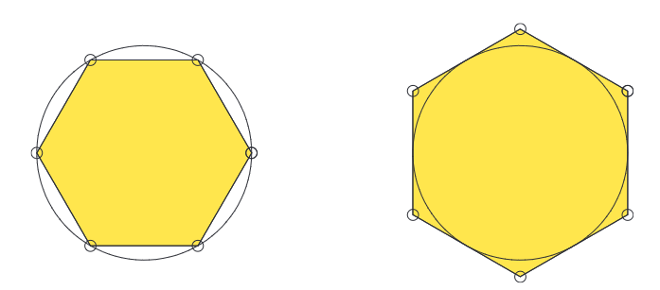


Pseudo code for approximating PI
Polygons
  Input tolerance
  Calculate: An, Bn, and error
  While error > tolerance
  Increment n
  Calculate new An, Bn, and error
  Calculate final n and rho
Inscribed Hexagon
An
Circumscribed Hexagon
Bn
What is strange about this method?
Notes:
We can try to find areas A and B for several N, and find the error tolerance to have an idea
The n value can be printed using scientific notation
If the increment for n is increased before printing the value, then the wrong value will be displayed

Slide 2
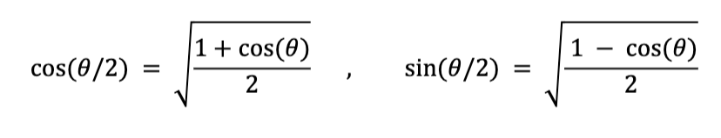
Dependancy on stored value of PI
We are approximating the value of PI using the built-in value of PI
This makes our method redundant for practical puposes
There must be a way to remove that redundancy!!!
Answer: Half-angle formulae

Slide 3
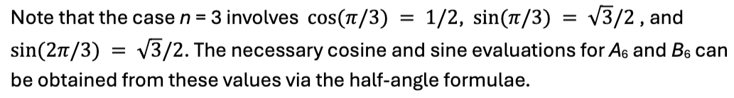
tan(π/6)
sin(π/6)
1
π/6
1
cos(π/6)
π/6
Notes:
The polygons problem
The circle area is pi, one area is smaller, the inscribed figure and the other area is larger, the circumscribed figure
So the area of the circle sits in between both areas An < pi < Bn

Slide 4
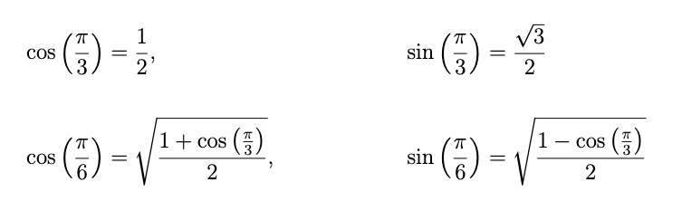
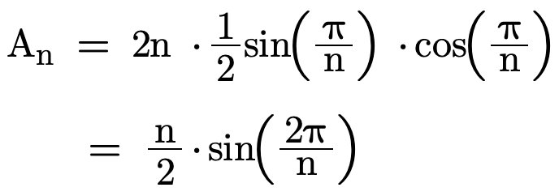
sin(π/6)
1
cos(π/6)
π/6
Use the above to obtain A₆
Notes:
The polygons problem
The circle area is pi, one area is smaller, the inscribed figure and the other area is larger, the circumscribed figure
So the area of the circle sits in between both areas An < pi < Bn

Slide 5
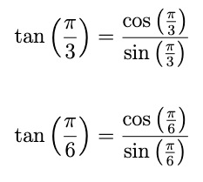

Using the cos and sin values, we can obtain
tan(π/6)
1
π/6
Which can be used to obtain B₆
Notes:
The polygons problem
The circle area is pi, one area is smaller, the inscribed figure and the other area is larger, the circumscribed figure
So the area of the circle sits in between both areas An < pi < Bn

Slide 6
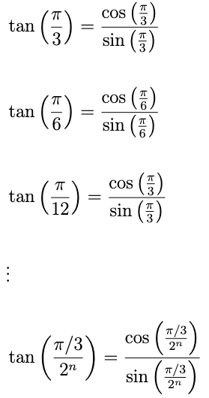
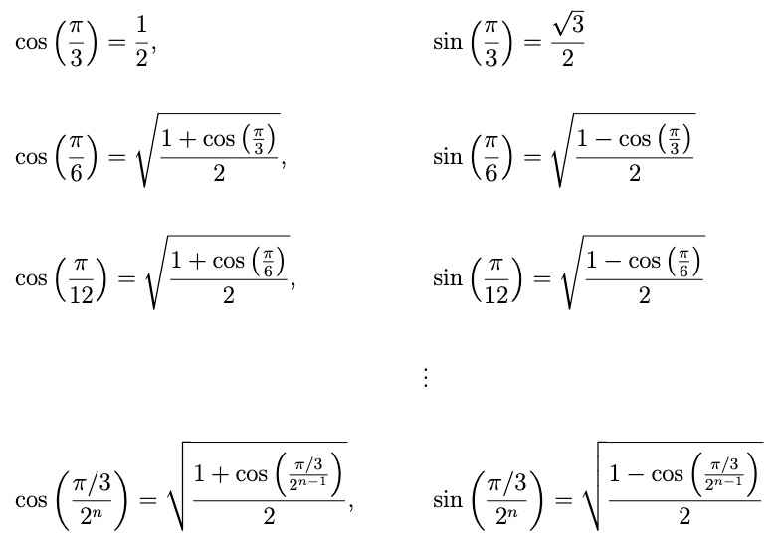
A6
B6
A12
3
B12
A_3×2n
A12
Notes:
The polygons problem
The circle area is pi, one area is smaller, the inscribed figure and the other area is larger, the circumscribed figure
So the area of the circle sits in between both areas An < pi < Bn

