Slide 1


IDS 1721
Computing and Problem Solving for STEM
More While loop

Slide 2
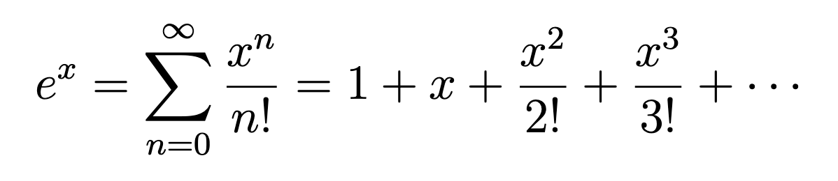
Sum of series
The Maclaurin series expansion of e^{x} is given by the following infinite series:
⁡
Where:
x is the input value (in radians),
n is the index of the series,
Factorial:
The series converges as more terms are added. For practical purposes, we compute the series up to a certain number of terms, say N.

Slide 3
Exercise: Series expansion of exp⁡(x)
Write a MATLAB script to approximate exp⁡(x) using its series expansion.
The script should:
Take an input x (in radians) from the user.
Compute the series sum until the absolute value of the terms get smaller than the tolerance value 10⁻⁵
Display the approximate value of exp(x)
Compare it to MATLAB’s built-in function exp(x).

Slide 4
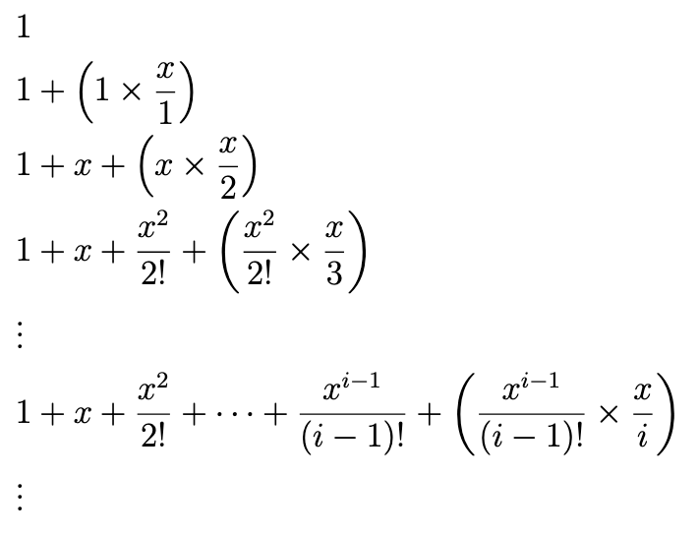
With that idea we can write our pseudocode,
Get x
Set tol = 10^(-5)
Set sum = 0
Set term = 1
Set i = 1
While abs(term)>tol
sum = sum + term
term = term * (x/i)
i = i+1
End while
Display sum
Note how we can break down this sum in steps
The i-th term in the sum is
[(i-1)-th term] × [x/i]
Stop when abs(term) smaller than tolerance

Slide 5
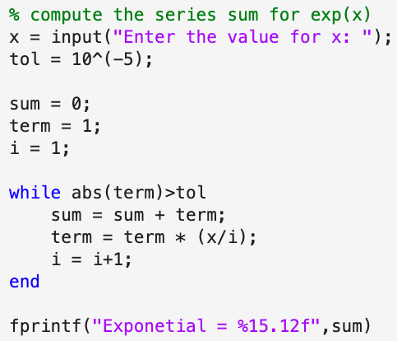
CODE

Slide 6
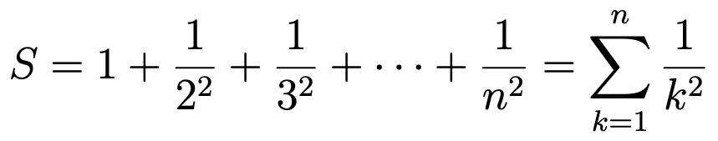
For practical purposes, we can only compute the sum for a finite number of terms.
Exercise: Write a psuedocode to find the above sum upto N terms where N is an user input.
Notes:
The polygons problem
The circle area is pi, one area is smaller, the inscribed figure and the other area is larger, the circumscribed figure
So the area of the circle sits in between both areas An < pi < Bn

Slide 7
Pseudocode
Get N
Initialize sum to 0
For k from 1 to N
sum = sum + 1 / k²
End for
Display sum

