Slide 1


IDS 1721
Computing and Problem Solving for STEM
Nested Loops

Slide 2
Nested Loop
A nested loop refers to a loop that is placed inside another loop.
In MATLAB, both for and while loops can be nested within one another
This helps perform repeated operations over multiple dimensions or data sets.
Nested loops are particularly useful when dealing with matrices, multi-dimensional arrays, or scenarios where multiple variables need to be iterated simultaneously.

Slide 3
Nested Loop overview
In a nested loop, the outer loop runs first
For each iteration of the outer loop, the inner loop completes all of its iterations.
Once the inner loop finishes, the outer loop progresses to the next iteration, and the cycle repeats.
This process allows complex tasks to be broken down and executed systematically.

Slide 4
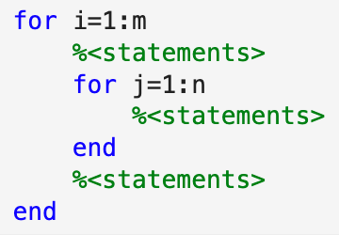
Nested FOR loop
Outer FOR
For some predefined m and n, this is how a nested for-loop looks like.
The statements inside the outer for-loop executes n-times
The statements inside the inner for-loop executes m×n-times
Inner FOR

Slide 5

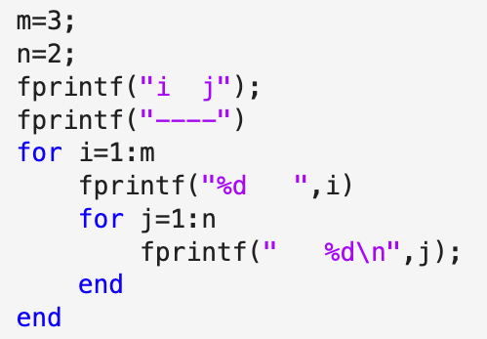
What is the outptut?

Slide 6
Exercise 1: Multiplication Table
Write a MATLAB script that uses nested for loops to generate a multiplication table for numbers from 1 to 10.
Steps:
Initialize two loops: the outer loop iterates over the rows (1 to 10), and the inner loop iterates over the columns (1 to 10).
In each iteration, compute the product of the current row and column number and display it.
Print the table in a formatted way.
Notes:
The polygons problem
The circle area is pi, one area is smaller, the inscribed figure and the other area is larger, the circumscribed figure
So the area of the circle sits in between both areas An < pi < Bn

Slide 7
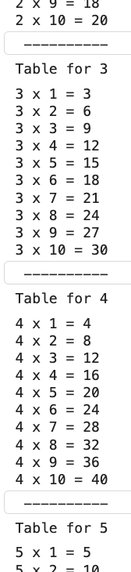
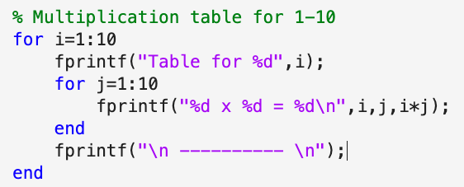
CODE

Slide 8
^{Exercise 2: Star pattern}
Write a MATLAB script that asks the user for a positive integer n and prints the following patterns with n lines on screen.
*
**
***
****
*****
(for n=5)
Pseudocode
Get n
for i from 1 to n
for j from 1 to n
display *
end
break line
end
Notes:
The polygons problem
The circle area is pi, one area is smaller, the inscribed figure and the other area is larger, the circumscribed figure
So the area of the circle sits in between both areas An < pi < Bn

Slide 9
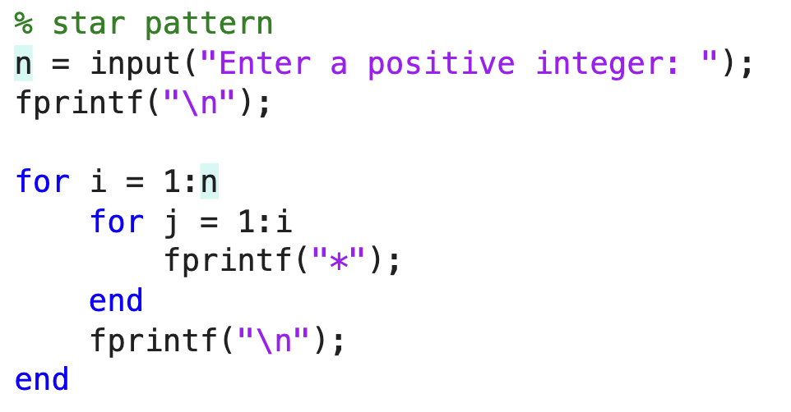

Slide 10
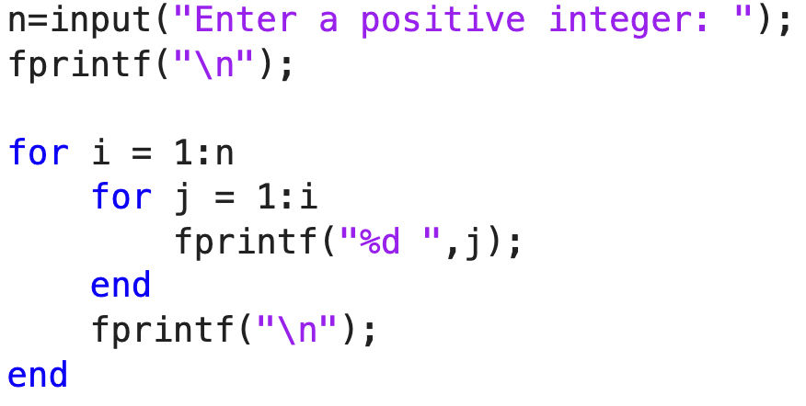
Exercise 3: Guess the output of the following code
Notes:
The polygons problem
The circle area is pi, one area is smaller, the inscribed figure and the other area is larger, the circumscribed figure
So the area of the circle sits in between both areas An < pi < Bn

Slide 11
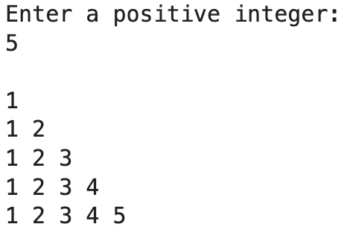
Exercise 3: Guess the output of the following code
Notes:
The polygons problem
The circle area is pi, one area is smaller, the inscribed figure and the other area is larger, the circumscribed figure
So the area of the circle sits in between both areas An < pi < Bn

Slide 12
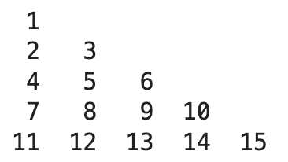
^{Exercise 4: Number pattern}
Write a MATLAB script that asks the user for a positive integer n and prints the following patterns with n lines on screen.
(for n=5)
Pseudocode
Get n
k=1
for i from 1 to n
for j from 1 to n
display k
k=k+1
end
break line
end
Notes:
The polygons problem
The circle area is pi, one area is smaller, the inscribed figure and the other area is larger, the circumscribed figure
So the area of the circle sits in between both areas An < pi < Bn

Slide 13
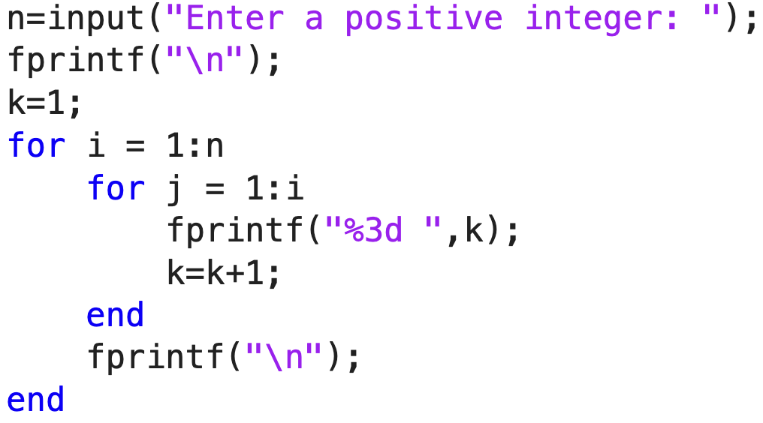
CODE

Slide 14
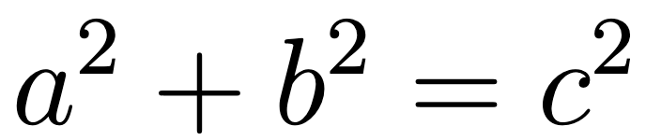
Exercise 5: Pythagorean triplets
A Pythagorean triplet consists of three positive integers a, b and c that satisfy the equation:
Write a MATLAB script to find all Pythagorean triplets a, b, and c such that they are less than or equal to a user input N.
The script should:
Take an integer input N from the user.
Use nested loops to find all values of a, b and c that satisfies the above equation.
Print out all the triplets that satisfy the equation.

Slide 15
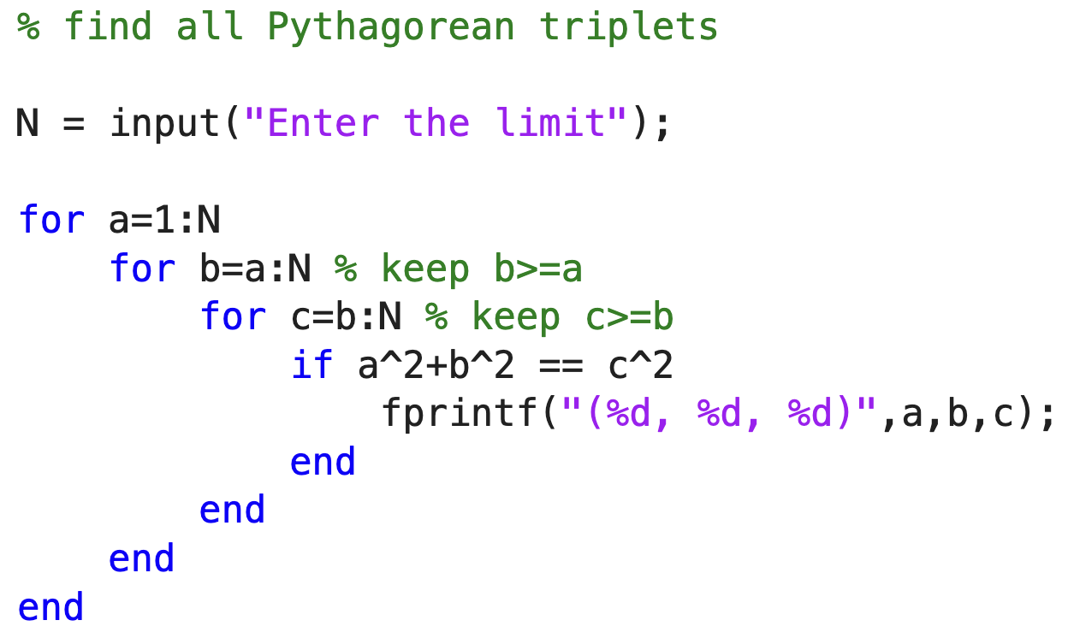
CODE

