Slide 1


IDS 1721
Computing and Problem Solving for STEM
Chapter 03
Approximations with Fractions

Slide 2
Problem 1: 22/7ths and counting
Rational Numbers:
A rational number is any number that can be expressed as the quotient or fraction of two integers.
The numerator is an integer, and the denominator is a non-zero integer.
Example: 22/7
Irrational Numbers:
An irrational number is a real number that cannot be expressed as the quotient (or fraction) of two integers.
When expressed as a decimal, irrational numbers do not terminate or repeat in a predictable pattern.
Example: π

Slide 3
Problem 1: 22/7ths and counting
The quotient 22/7 is often used as a good rational approximation to π .
Here both numerator and denominator are less than 100.
Goal:
Given a positive integer M how can we find the best approximation to π of the form p/q?
Where p and q are integers that satisfy
  1 ≤ p ≤ M and
  1 ≤ q ≤ M

Slide 4
Program Development
We need to:
Generate all possible quotients p/q and select the one that minimizes |p/q − π|
This means that we need a nested loop
An outer loop that goes over the values of p
An inner loop that goes over the values of q
For p from 1 to M
For q from 1 M
Find the best pair (p,q) so that |p/q - π| is minimum
End for
End for

Slide 5
Pseudocode
Get M
Start with p=1,q=1
Set error as |p/q - pi|
For i from 1 to M
For j from 1 M
If |i/j - pi| less than current error then
update p and q with values of i and j
update new error as |p/q - pi|
end if
End for
End for
Output p/q as the best rational approximation of pi

Slide 6
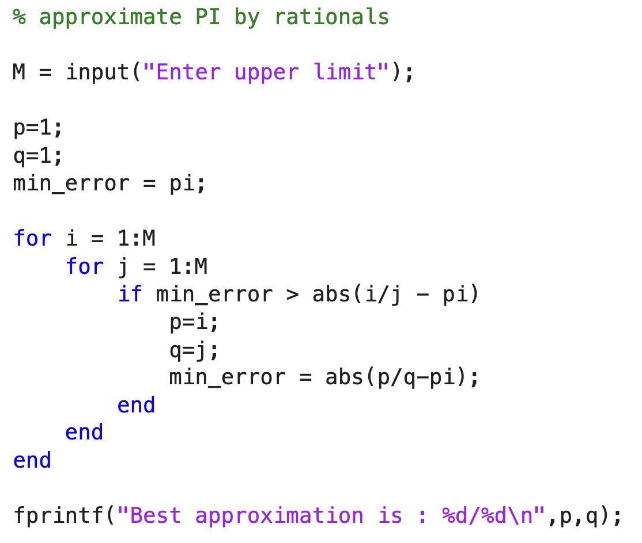
Code:

Slide 7
Program Development
We used nested loops (a loop inside another loop), and we stored temporary values and tested all combinations for the smallest error.
If the outer loop runs 10 times, and the inner loop runs 10 times. Thus, testing all the M options ends up being M ² combinations to check, which takes very long if M is large enough.
IS THERE ANY WAY WE CAN REDUCE THE COMPUTATIONAL STEPS?

Slide 8
Program Development
Notice that for each q (outer loop), we only need to test 2 values (instead on M values) if we select the appropriate p-value:
p/q ≈ π so that,
p ≈ π×q
When it comes to integer values, we only need to check two values, the integer right below and right above π×q.
We can obtain the integer below by rounding down as p- = floor(π×q)
And obtain the integer above by rounding up as p+ = ceil(π×q)
All other values will be less accurate, and we only need 2 tries out of M possibilities for p.
Thus, the code executes only 2M times instead of M² times.

Slide 9
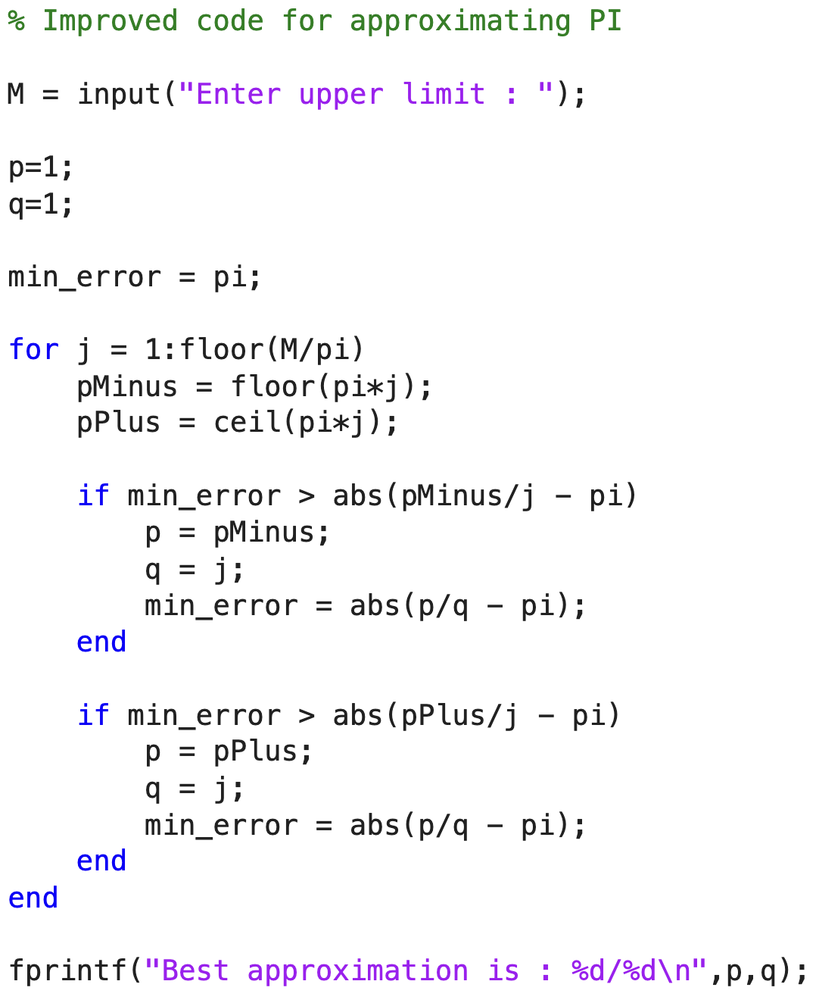
Faster Code:

Slide 10
Timing the code
The original code is slow if M is large, since it’s α M². For example,
  if M = 100,000 it takes close to 15 second on MATLAB online
  If M = 1,000,000 it takes about 20 minutes on MATLAB online
  if M = 10⁸ or 100 millions, it will take many months to run on a regular computer
Efficient code is crucial for projects in real world!
Recall that MATLAB has a function to calculate how long it takes to run a fragment of code, like a stopwatch:
tic % start the timer, time in clock
Code to be timed
T = toc % variable assignment when timer ends, time out

Slide 11
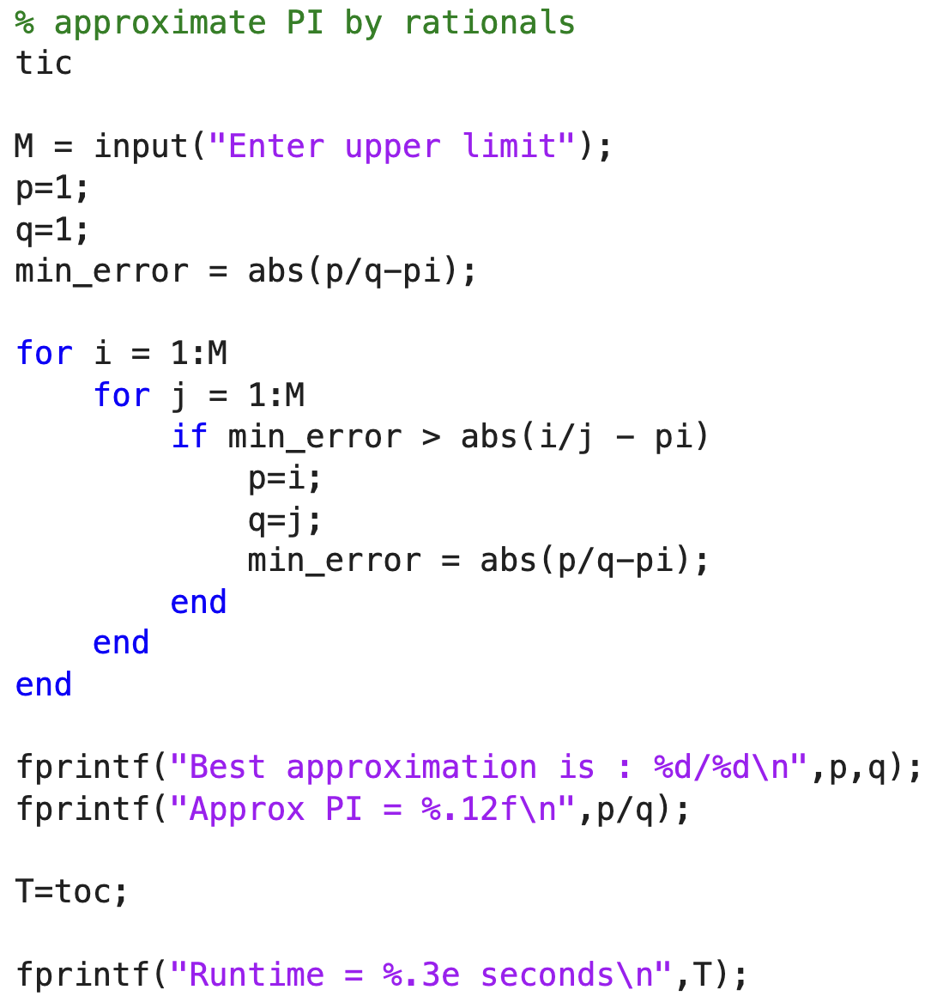
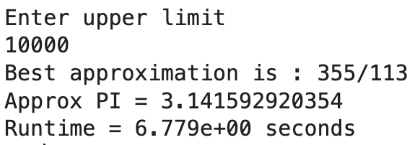
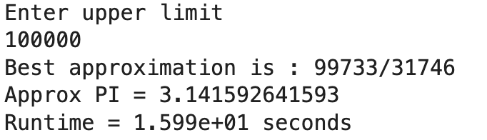
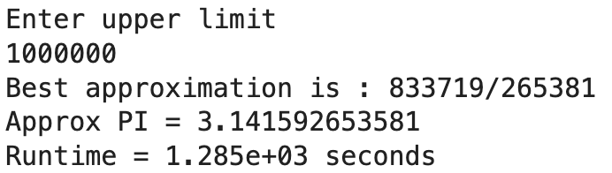
We see the following outputs:

Slide 12
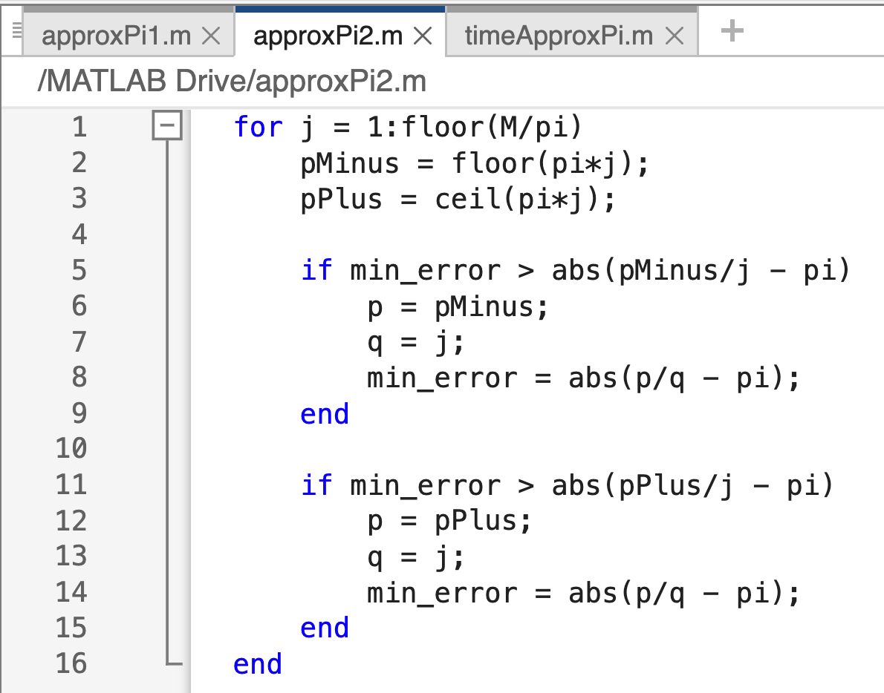
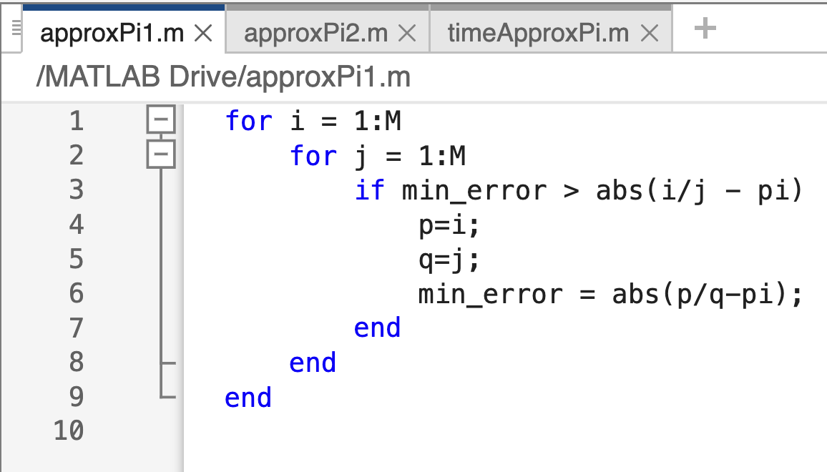
When comparing runtimes of two different code blocks, there is a better way timing them.
In MATLAB you can put code blocks in separate files and call them from another another command using the filenames like a command.
Create the following two files, one containing the nested loop and one without nested loop for the above approximation problem.
Comparing runtime

Slide 13
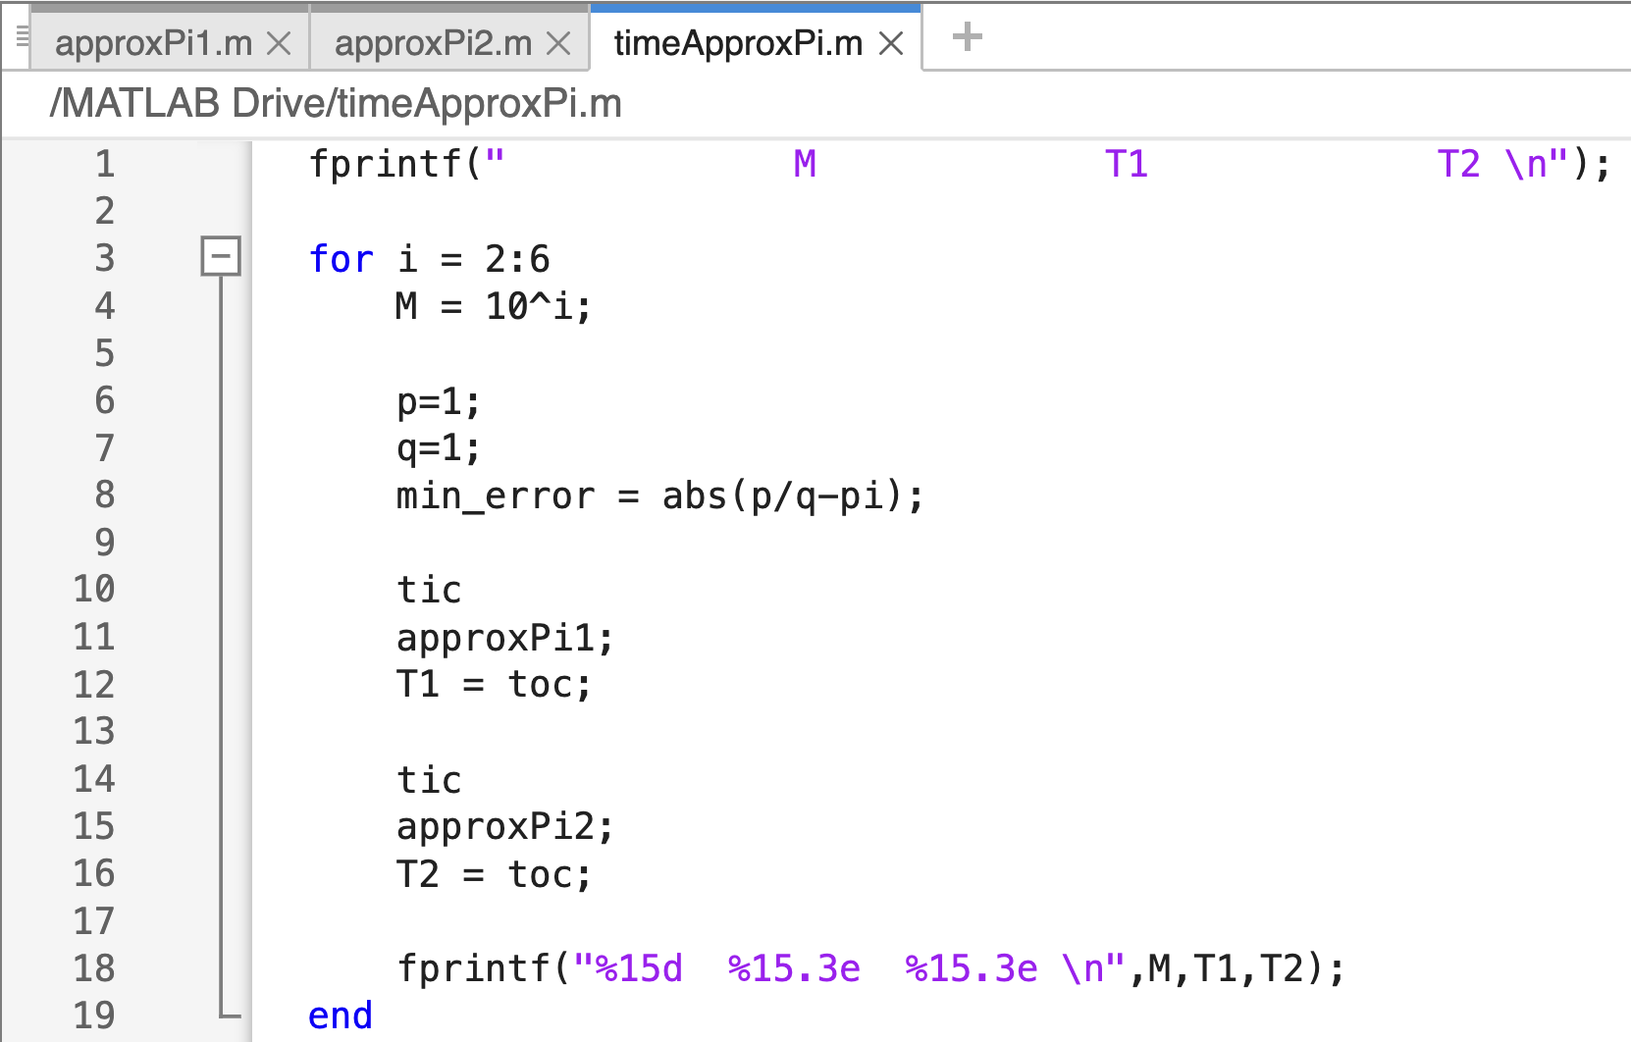
Calling scripts from scripts
Write a third script as this.
This script will compute the times for the other two scripts for different values of M.
The values of M are 10²,10³,10⁴,10⁵,10⁶.
You can try for higher values, but that will take a long time for the code to run.
Go ahead and check the output.

Slide 14
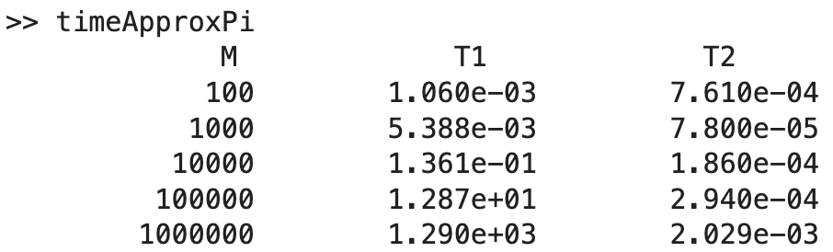
Output
You can run this for higher values, but that will take a long time for the code to run.
The results will vary by the computer used.

Slide 15
Fragments that involve nested loops can take a long time to execute
The example shows that the difference between a double-loop and a single-loop was an order of magnitude, O(M).
The faster code involves O(M) checks while the previous code requires O(M²) comparisons. The “big-O” notation is a way to represent the run-time behavior of an algorithm (code).
If M is multiplied by 100, the O(M²) method will take 100² longer to run while the O(M) technique only would be 100 times longer
Being able to look at the code and anticipate how long it will take to execute is an important skill since some sections can be modified for speed.

