Slide 1
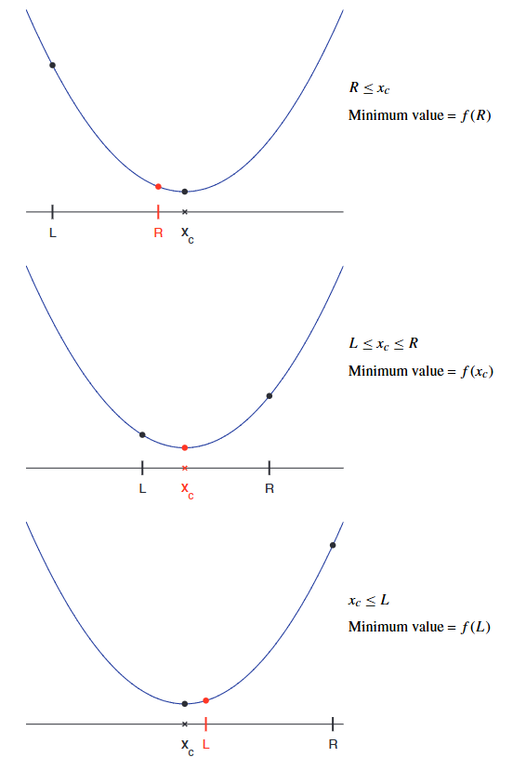
Problem :
Finding minimum value of a Quadratic
Problem Statement
A quadratic function of the form
f(x) = x² +bx +c attains its minimum value at the critical point x_{c} = −b/2.
Computing the minimum value of f on an interval [L,R] requires some checking.
If x_{c} is in the interval, then f(x_{c} ) is the answer.
Otherwise, f is minimized either at x = L or at x = R.
The figure shows the 3 options.
If x_{c} is in the interval, then f(x_{c}) is the answer

Slide 2
Problem :
Finding minimum value of a Quadratic
Problem Statement
Write a script that inputs real numbers L, R, b, and c
Obatin the minimum value of the quadratic function
f (x) = x² +bx +c on the interval [L,R].
The script should also display the value of x where the minimum occurs.
The figure shows the 3 options:
If x_{c} is in the interval, then f(x_{c}) is the answer

Slide 3
Pseudocode
Let’s study the three alternatives to get a sense of the problem
Given the possibilities, here is a pseudocode that identifies the steps
if x_{c} < L
print f (L) and L
else if L ≤ x_{c} ≤ R
print f (x_{c}) and x_{c}
else
print f (R) and R
end
Pseudocode is a technique used to describe the steps of an algorithm in a manner that’s easy to understand for anyone with basic programming knowledge.
It is a syntax-free description of an algorithm that provides a full description of the algorithm’s logic
if-else-if statement
if <condition #1>
steps
elseif <condition #2>
steps
else
do that instead
end

Slide 4

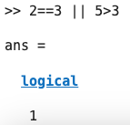


If-else-if statement
Executes when condition #1 has True value
Boolean statements that have True(1) or False(0) values.
if <condition #1>
steps
elseif <condition #2>
steps
else
do these instead
end
Executes when condition #1 has False value and condition #2 has True
Try these in your command line
Executes when both conditions #1 and #2 has False value

Slide 5
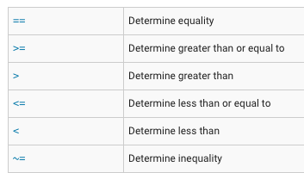
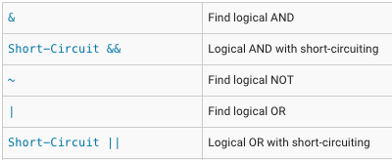
Relational Operations
Logical Operations
https://www.mathworks.com/help/matlab/relational-operators.html
https://www.mathworks.com/help/matlab/logical-operations.html

Slide 6
Try this in your command window
x = 9;
y = 22;
a = x == y
b = x > y
c = x < y
d = pi == 3.14159 && x < y
a =
b =
c =
d =
0
0
1
0
What do you think a-d are?
MATLAB stores true or false values as 1’s or 0’s
  1 → True
  0 → False

Slide 7
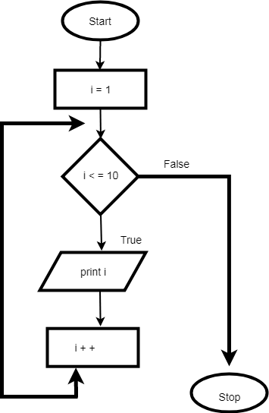

Flowchart
A flowchart is a graphical representation of an algorithm. Programmers often use it as a program-planning tool to solve a problem.
Problem-solving requires planning the steps to solve a program.
Flowcharts document the process; the math is just one of the steps.

Slide 8
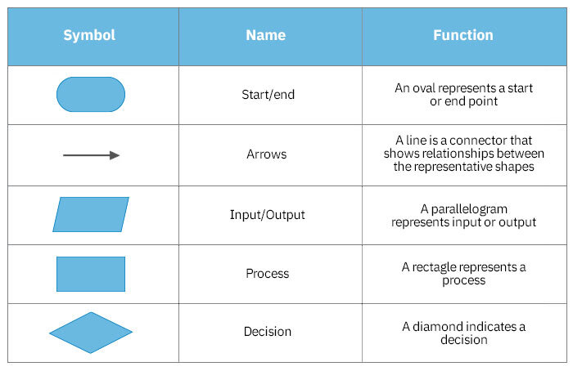
Flowchart
A flowchart is a graphical representation of an algorithm. Programmers often use it as a program-planning tool to solve a problem.

Slide 9
Problem 2: Check and Evaluate
Here is a pseudocode that identifies the steps
if x_{c} < L
print f (L) and L
else if L < x_{c} < R
print f (x_{c}) and x_{c}
else
print f (R) and R
end
Here is a flowchart that identifies the steps
false
is x_{c} < L
true
false
is L< x_{c}<R
true
print f (R) and R
print f (x_{c}) and x_{c}
print f (L) and L
end

Slide 10
Problem 2: The complete pseudocode
Obtain the values of b, c, L, R
Set x_{c} = -b/2
if x_{c} < L
print f (L) and L
else if L < x_{c} < R
print f (x_{c}) and x_{c}
else
print f (R) and R
end
Let's write a new MATLAB script...
Enter the following in your command Line:
>> edit QuadMin.mlx

Slide 11
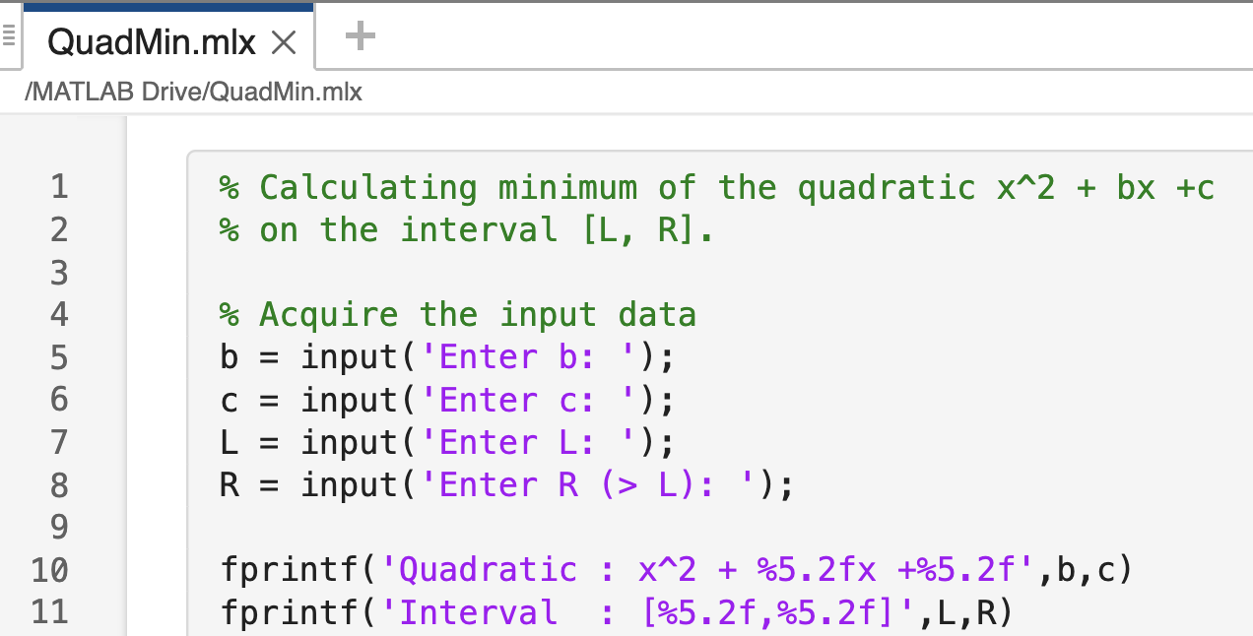
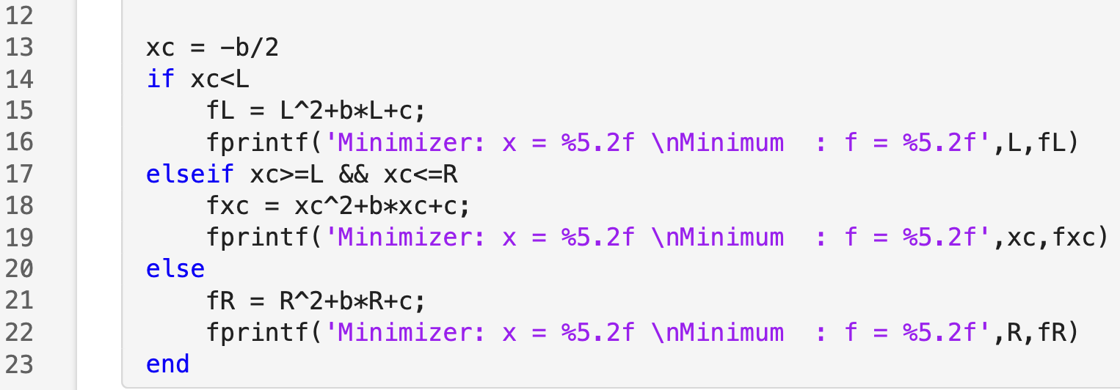
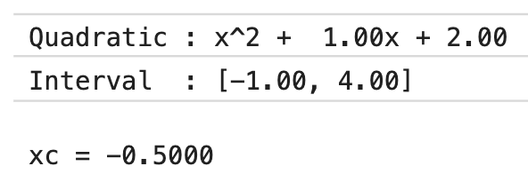
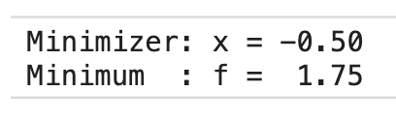
Type along with me
Execute it twice for the values
b=1, c=2, L=0, R=5
b=1, c=2, L=-1, R=4
Output for b=1, c=2, L=-1, R=4

