Slide 1
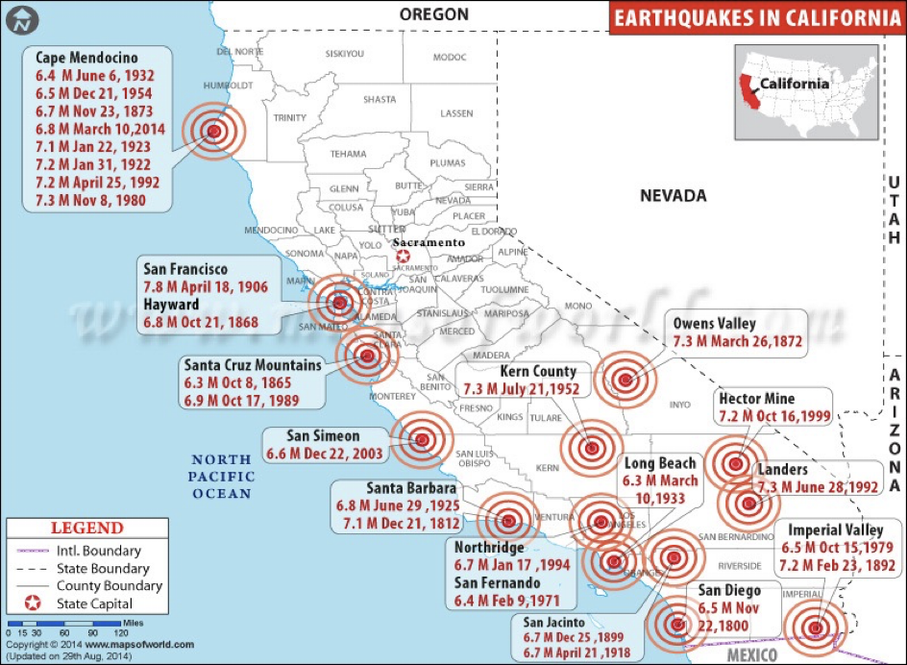
Problem:Earthquake Data Analysis
Problem
We’ll need data!
We want to know if and how many earthquakes happened each year and what magnitude were they on the Richter scale.
What information do we need?
  Years that the earthquakes (if they) happened
  Richter scale readings for those years
Goal:
To write a computer program that asks the user to enter a year.
Based on that input, output how many earthquakes happened that year and the Richter scale reading.

Slide 2
Earthquake Data Analysis
Year | Richter Scale | Year | Richter Scale
1906 | 8.3 | 1980 | 7.0
1911 | 6.6 | 1980 | 6.6
1923 | 7.2 | 1983 | 6.5
1925 | 6.3 | 1984 | 6.2
1926 | 6.1 | 1986 | 6.0
1927 | 7.7 | 1987 | 5.9
1933 | 6.3 | 1989 | 7.1
1940 | 6.7 | 1991 | 7.1
1952 | 7.8 | 1991 | 5.8
1968 | 6.4 | 1991 | 6.1
1971 | 6.4 | 1992 | 6.1
1979 | 6.4 | 1992 | 6.9
Here is some data for earthquakes from 1906 - 1992
Over 80 years of data!
Do you notice anything particular about this data set?

Slide 3
Earthquake Data Analysis
Year | Richter Scale | Year | Richter Scale
1906 | 8.3 | 1980 | 7.0
1911 | 6.6 | 1980 | 6.6
1923 | 7.2 | 1983 | 6.5
1925 | 6.3 | 1984 | 6.2
1926 | 6.1 | 1986 | 6.0
1927 | 7.7 | 1987 | 5.9
1933 | 6.3 | 1989 | 7.1
1940 | 6.7 | 1991 | 7.1
1952 | 7.8 | 1991 | 5.8
1968 | 6.4 | 1991 | 6.1
1971 | 6.4 | 1992 | 6.1
1979 | 6.4 | 1992 | 6.9
Repeated Entries!
Thus, our computer program:
  Will have to check the user input
  Based on the input, the program will then evaluate and give us the desired result(s)

Slide 4
Earthquake Data Analysis
Enter the year
If year is 1906
Number of earthquakes is 1
Store the Richter Scale data 8.3
Else if year is 1911
Number of earthquakes is 1
Store the Richter Scale data 6.6
Else if ...
.
.
.
Else
No earthquakes occurred
End
Pseudocode
Let’s code it up!!

Slide 5
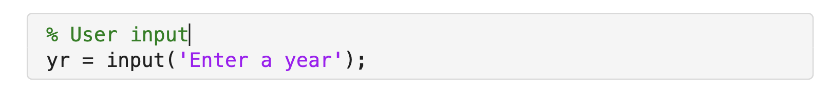
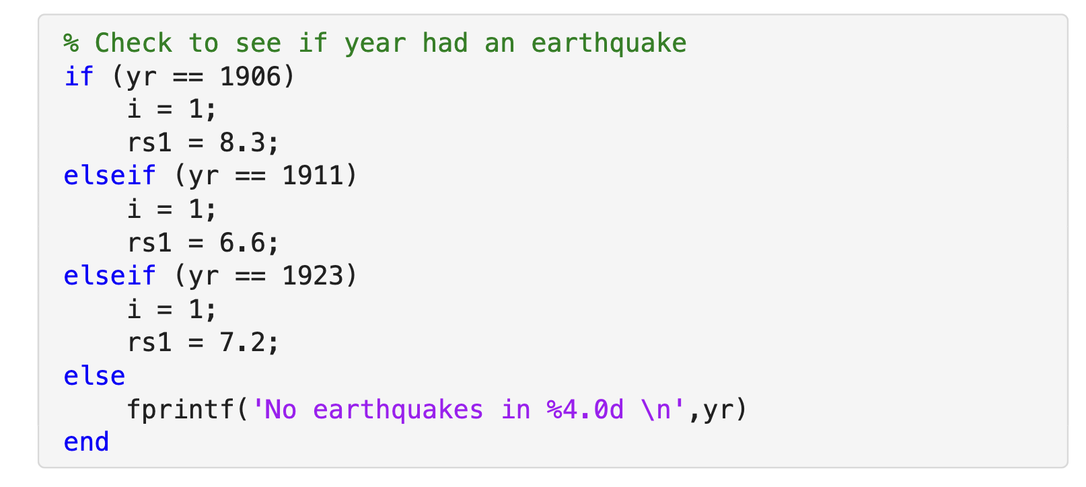
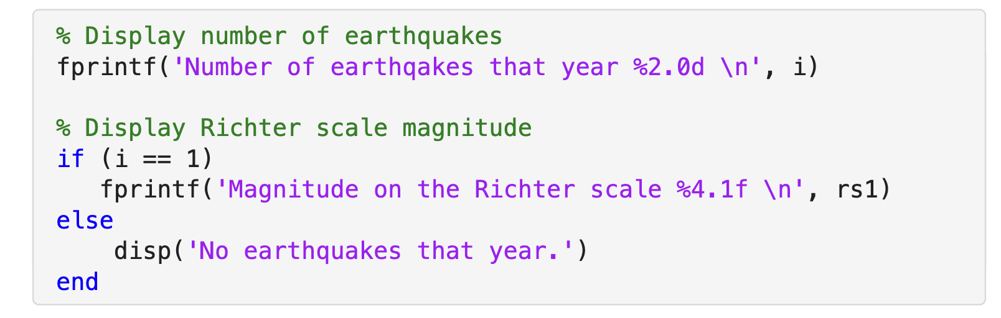
What about the repeated entries in our data set?

Slide 6
Earthquake Data Analysis
Year | Richter Scale | Year | Richter Scale
1906 | 8.3 (rs 1) | 1980 | 7.0
1911 | 6.6 (rs 1) | 1980 | 6.6
1923 | 7.2 (rs 1) | 1983 | 6.5
1925 | 6.3 | 1984 | 6.2
1926 | 6.1 | 1986 | 6.0
1927 | 7.7 | 1987 | 5.9
1933 | 6.3 | 1989 | 7.1
1940 | 6.7 | 1991 | 7.1
1952 | 7.8 | 1991 | 5.8
1968 | 6.4 | 1991 | 6.1
1971 | 6.4 | 1992 | 6.1
1979 | 6.4 | 1992 | 6.9
i = 1

Slide 7
Earthquake Data Analysis
Year | Richter Scale | Year | Richter Scale
1906 | 8.3 (rs 1) | 1980 | 7.0
1911 | 6.6 (rs 1) | 1980 | 6.6
1923 | 7.2 (rs 1) | 1983 | 6.5
1925 | 6.3 | 1984 | 6.2
1926 | 6.1 | 1986 | 6.0
1927 | 7.7 | 1987 | 5.9
1933 | 6.3 | 1989 | 7.1
1940 | 6.7 | 1991 | 7.1
1952 | 7.8 | 1991 | 5.8
1968 | 6.4 | 1991 | 6.1
1971 | 6.4 | 1992 | 6.1
1979 | 6.4 | 1992 | 6.9
i = 1
i = 2
i = 2

Slide 8
Earthquake Data Analysis
Year | Richter Scale | Year | Richter Scale
1906 | 8.3 (rs 1) | 1980 | 7.0
1911 | 6.6 (rs 1) | 1980 | 6.6
1923 | 7.2 (rs 1) | 1983 | 6.5
1925 | 6.3 | 1984 | 6.2
1926 | 6.1 | 1986 | 6.0
1927 | 7.7 | 1987 | 5.9
1933 | 6.3 | 1989 | 7.1
1940 | 6.7 | 1991 | 7.1
1952 | 7.8 | 1991 | 5.8
1968 | 6.4 | 1991 | 6.1
1971 | 6.4 | 1992 | 6.1
1979 | 6.4 | 1992 | 6.9
i = 1
i = 2
i = 3
i = 2
Rest of the years are also i = 1

Slide 9
Earthquake Data Analysis
Year | Richter Scale | Year | Richter Scale
1906 (rs 1) | 8.3 | 1980 | 7.0 (rs 1)
1911 (rs 1) | 6.6 | 1980 | 6.6 (rs 2)
1923 (rs 1) | 7.2 | 1983 | 6.5
1925 | 6.3 | 1984 | 6.2
1926 | 6.1 | 1986 | 6.0
1927 | 7.7 | 1987 | 5.9
1933 | 6.3 | 1989 | 7.1
1940 | 6.7 | 1991 | 7.1 (rs 1)
1952 | 7.8 | 1991 | 5.8 (rs 2)
1968 | 6.4 | 1991 | 6.1 (rs 3)
1971 | 6.4 | 1992 | 6.1 (rs 1)
1979 | 6.4 | 1992 | 6.9 (rs 2)

Slide 10
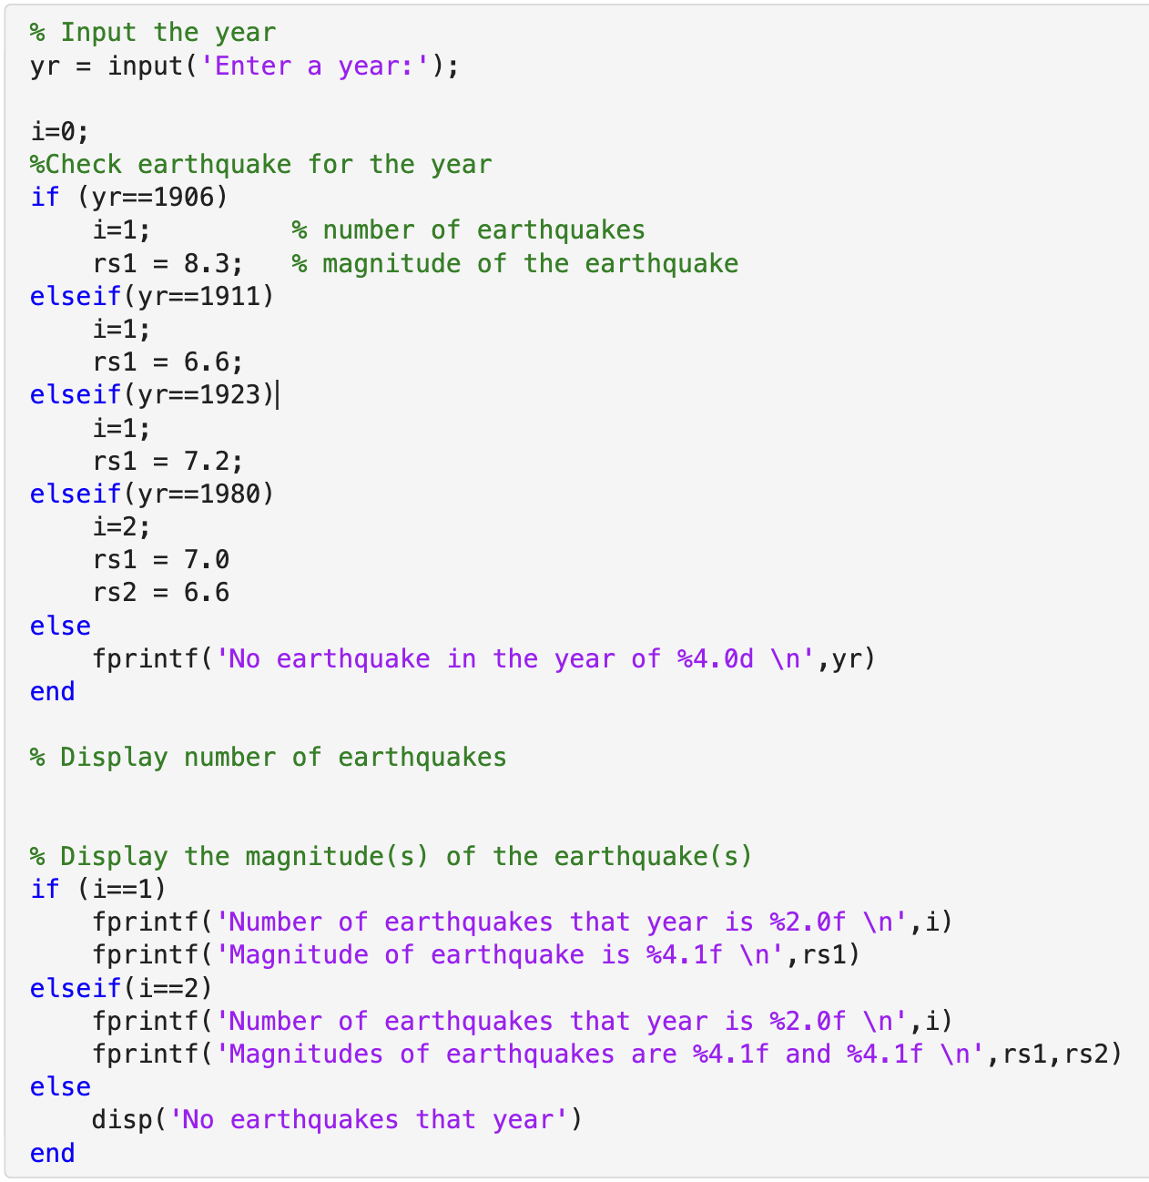
Partial Code
For years 1906, 1911, 1923, 1980, this is how the code will look.
What is the maximum number of earthquakes recorded in any year?
Complete the entire analysis to include the rest of the years.

Slide 11
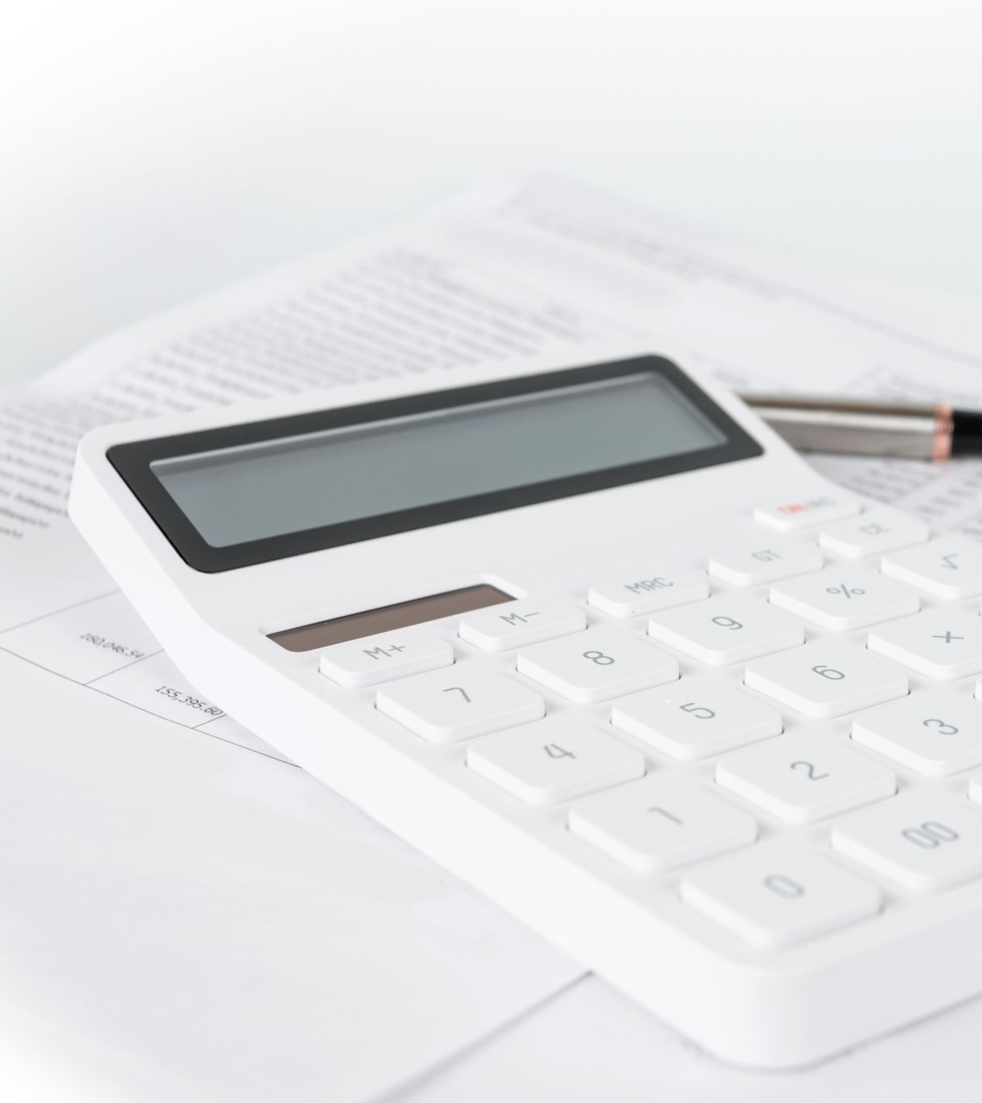
Activity: Electricity bill calculator
Write a MATLAB program to calculate the electricity bill based on the number of units consumed. The billing rates are as follows:
  First 100 units: $0.50 per unit
  Next 100 units: $0.75 per unit
  Above 200 units: $1.20 per unit
Instructions:
  Prompt the user to enter the number of units consumed.
  Use if-else-if statements to calculate the bill.
  Display the total bill amount.

Slide 12
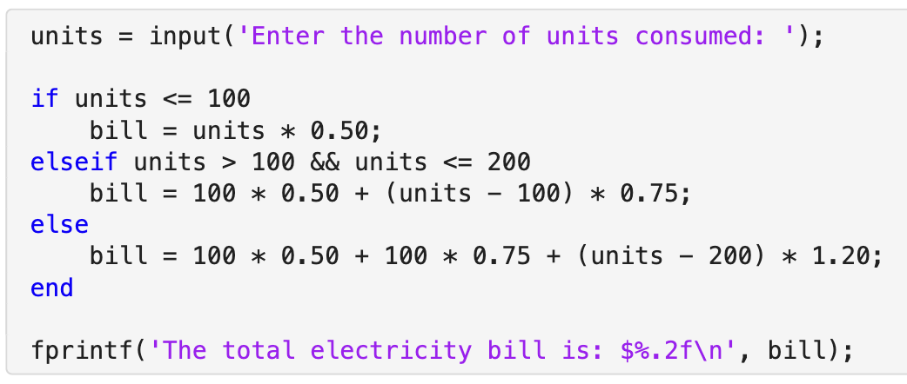
Solution code
Execute you code for 80,140, 250 units

