Slide 1


IDS 1721
Computing and Problem Solving for STEM
Chapter 02
Examples on If-else-If

Slide 2
Practice problem 1
Write a pseudocode and a MATLAB script to determine the real roots of a quadratic function
f(x) = ax²+bx+c
Instructions:
Get the coefficients a, b and c from the user.
Display the quadratic function using formatted printing.
Display whether the quadratic has a real or imaginary roots
Display the roots if they are real.

Slide 3
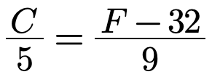
Practice problem 2
Write a temperature-conversion program that gives the user the options :
'Enter 1 to convert from Farenheit to Celsius'
'Enter 2 to convert from Celsius to Farenheit'
Based on the choice the code should carry out the appropriate conversion described by the following equation,

Slide 4
Practice problem 3
Classifying Iris species by petal length
Write a MATLAB script to classify iris flower species based on their petal length using if-else-if statements. You will work with the famous Iris dataset, UCI Machine Learning Repository to categorize each flower into one of three species based on the petal length.
Problem Statement:
The Iris dataset is a classic dataset in machine learning and statistics, containing measurements for 150 iris flowers from three different species: Setosa, Versicolor, and Virginica. The dataset includes the following attributes:
Sepal Length (cm), Sepal Width (cm), Petal Length (cm), Petal Width (cm), Species (Setosa, Versicolor, Virginica)
For this exercise, you'll assign your own classification to each iris flower based solely on its petal length using the following criteria:
Setosa: Petal Length less than 2.0 cm
Versicolor: Petal Length between 2.0 cm and 5.0 cm
Virginica: Petal Length greater than 5.0 cm

Slide 5
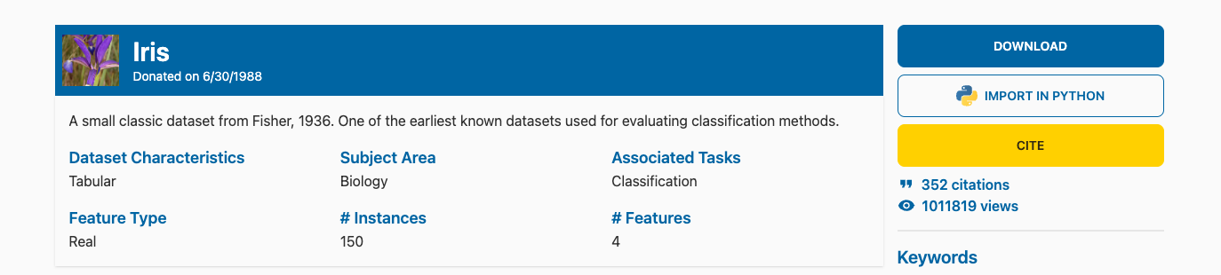
Obtain the data
This exercise requires us to handle real dataset that we need to obtain from an external source
Go to https://archive.ics.uci.edu/dataset/53/iris
Click on download at the upper right side of the page.

Slide 6
Extract
The download is a compressed file 'iris.zip'.
Extract it on your computer :
MAC users have to double click it.
WINDOWS user can right click on the folder and click on extract.
Once extracted, you should have a folder named 'iris' on your local.
Upload this to Matlab Drive...

Slide 7
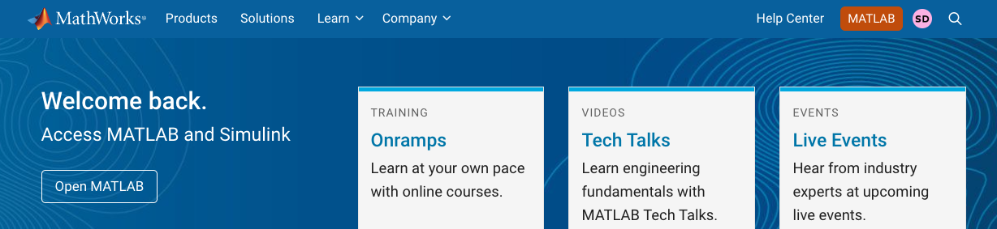
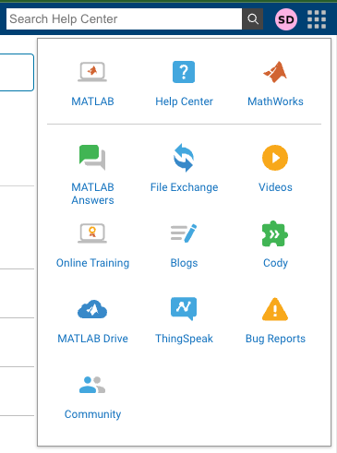
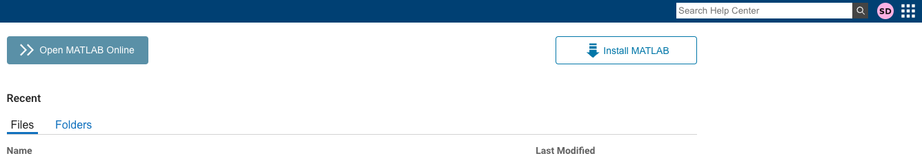
Open Matlab Drive
Step 1 : Log in to Mathworks account
Step 2: Click on MATLAB
Opens a drop down menu
Step 3 : On the second page, click on the dots next to your initials.
Step 4: Click on MATLAB Drive

Slide 8
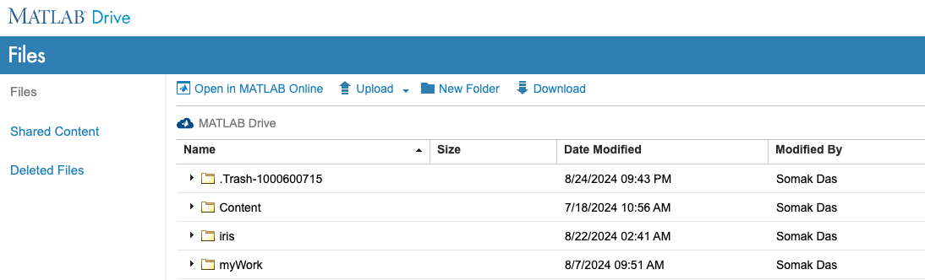
Upload on Matlab Drive
Once you are inside MATLAB Drive, you can either,
Use the Upload, or
Drag and drop
To upload your folder
Upload
Drag and drop in this region
The folder should show up in the list

Slide 9
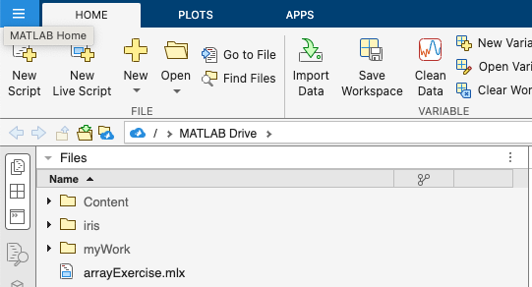
Go to MATLAB
This folder should be accessible from MATLAB now
Look under Files
We are going to work inside this folder
Go ahead and double click on the folder
Alternately, in the command window enter,
>> cd iris
(cd stands for change directory)

Slide 10
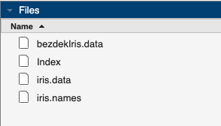
Inside you will see these files
The folder should contain these files inside
We are going to work inside this folder
Create a live script inside this folder
Name it 'IrisAnalysis.mlx'
We are going to use the 'iris.data' for our analysis
In your command window enter
>> edit IrisAnalysis.mlx

Slide 11
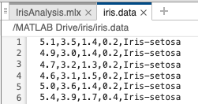
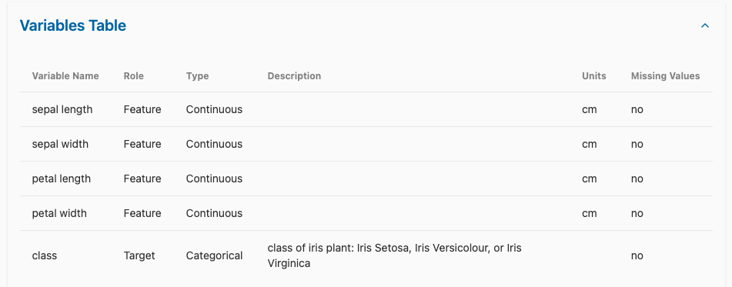
Look at the data
Before we proceed, let us have a quick look at the data
Double-click on the 'iris.data'
The file will open in the editor
We see a lines with information separated by commas
The following is the explaination for the data found at the
UCI Machine Learning Repository

Slide 12

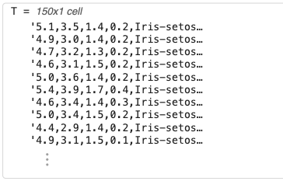
Import the data
Add a section to import the data
The variable T looks like a 150x1 vector
You should see this in your workspace too
This data is not helpful since it is all stuck together in form of a string
We need to be able to separate these and extract the petal length as numbers

Slide 13

Load the data
Load

