Slide 1


IDS 1721
Computing and Problem Solving for STEM
Chapter 03
Approximations with Fractions

Slide 2
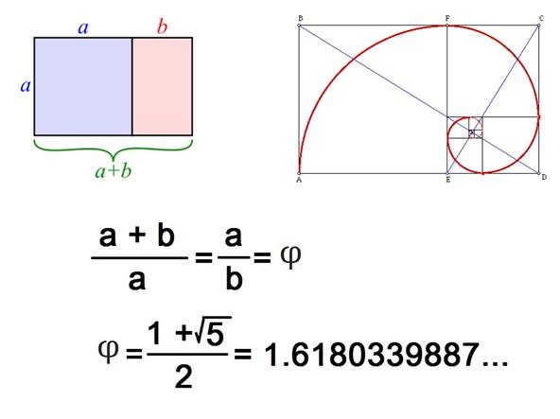
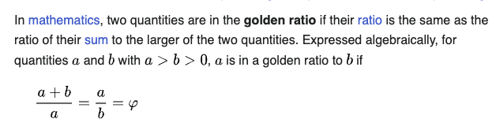
Golden Ratio

Slide 3
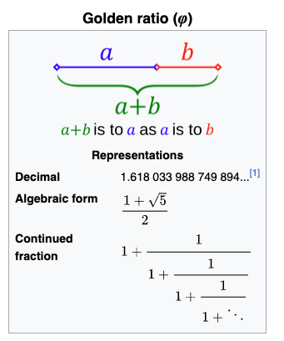
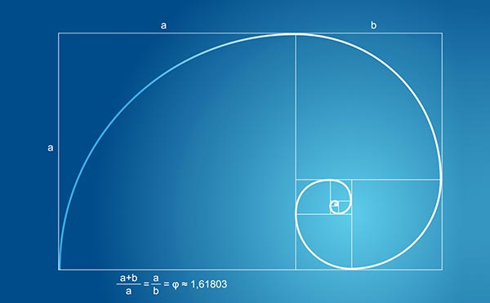
Chapter 3: Approximations with Fractions

Slide 4

Chapter 3: Approximations with Fractions
Just like π, we have irrational numbers, e=2.71828182845905… and the golden ratio; that cannot be expressed as a ratio of two whole numbers.
Even though the golden ratio cannot be expressed as a fraction, but it can be approximated using fractions...

Slide 5
Fibonacci sequence
Recall the Fibonacci sequence f₀ , f₁ , ...
f₀ = 0 , f₁ = 1
f_{n+1} = f_{n} +f_{n−1}
Turns out that the quotients r_{n} = f_{n+1} / f_{n} converge to the golden ratio:
Objective: Write a MATLAB script that displays
the values of n , f_{n} , r_{n} , and |φ −r_{n}|
for n = 1:n∗ where n∗ is the smallest value of n such that |r_{n} −r_{n+1}| ≤ 10⁻¹⁵

Slide 6
Chapter 3: Approximations with Fractions
We can start calculate this ratio as follows
  f₀ = 0, f₁ = 1
  f₂ = f₁ + f₀ = 1 + 0 = 1 r₁ = f₂ / f₁ = 1/1 = 1
  f₃ = f₂ + f₁ = 1 + 1 = 2 r₂ = f₃ / f₂ = 2/1 = 2
  f₄ = f₃ + f₂ = 2 + 1 = 3 r₃ = f₄ / f₃ = 3/2 = 1.5
  f₅ = f₄ + f₃ = 3 + 2 = 5 r₄ = f₅ / f₄ = 5/3 = 1.67
  f₆ = f₅ + f₄ = 5 + 3 = 8 r₅ = f₆ / f₅ = 8/5 = 1.60
  … and so on ...
  We do this until |r_{n}−r_{n+1}| ≤ 10⁻¹⁵

Slide 7
Chapter 3: Approximations with Fractions
Pseudocode
  The pseudocode could be designed as:
  Initializations
  while r_{n} and r_{n+1} are not close enough
  Get the next Fibonacci number and the next ratio
  end
  The initializations here will involve extra terms:
  We need to keep track of the three variables
  Thus, we know the first two numbers on the sequence and must provide a tolerance (to check when they are close enough)

Slide 8
Chapter 3: Approximations with Fractions
Program Development
  Thus, the required initializations are
      tol = 10⁻¹⁵;
      n = 2; % We know the first Fibonacci numbers
      f_old = 1; % (n-1)st Fibonacci number
      f_cur = 1; % nth Fibonacci number
      f_new = 2; % (n+1)st Fibonacci number
      r_cur = f_cur/f_old;
      r_new = f_new/f_cur;

Slide 9
Chapter 3: Approximations with Fractions
Program Development
  Then, the loop oversees the updates for:
      n = n+1;
      f_old = f_cur;
      f_cur = f_new;
      f_new = f_old + f_cur;
      r_cur = r_new;
      r_new = f_new/f_cur;
  The while loop then uses this boolean expression:
      abs(r_cur - r_new) > 10⁻¹⁵
Let’s code it up!
Type along as I go along the slide deck!
>> edit lect13ExP2.mlx

Slide 10
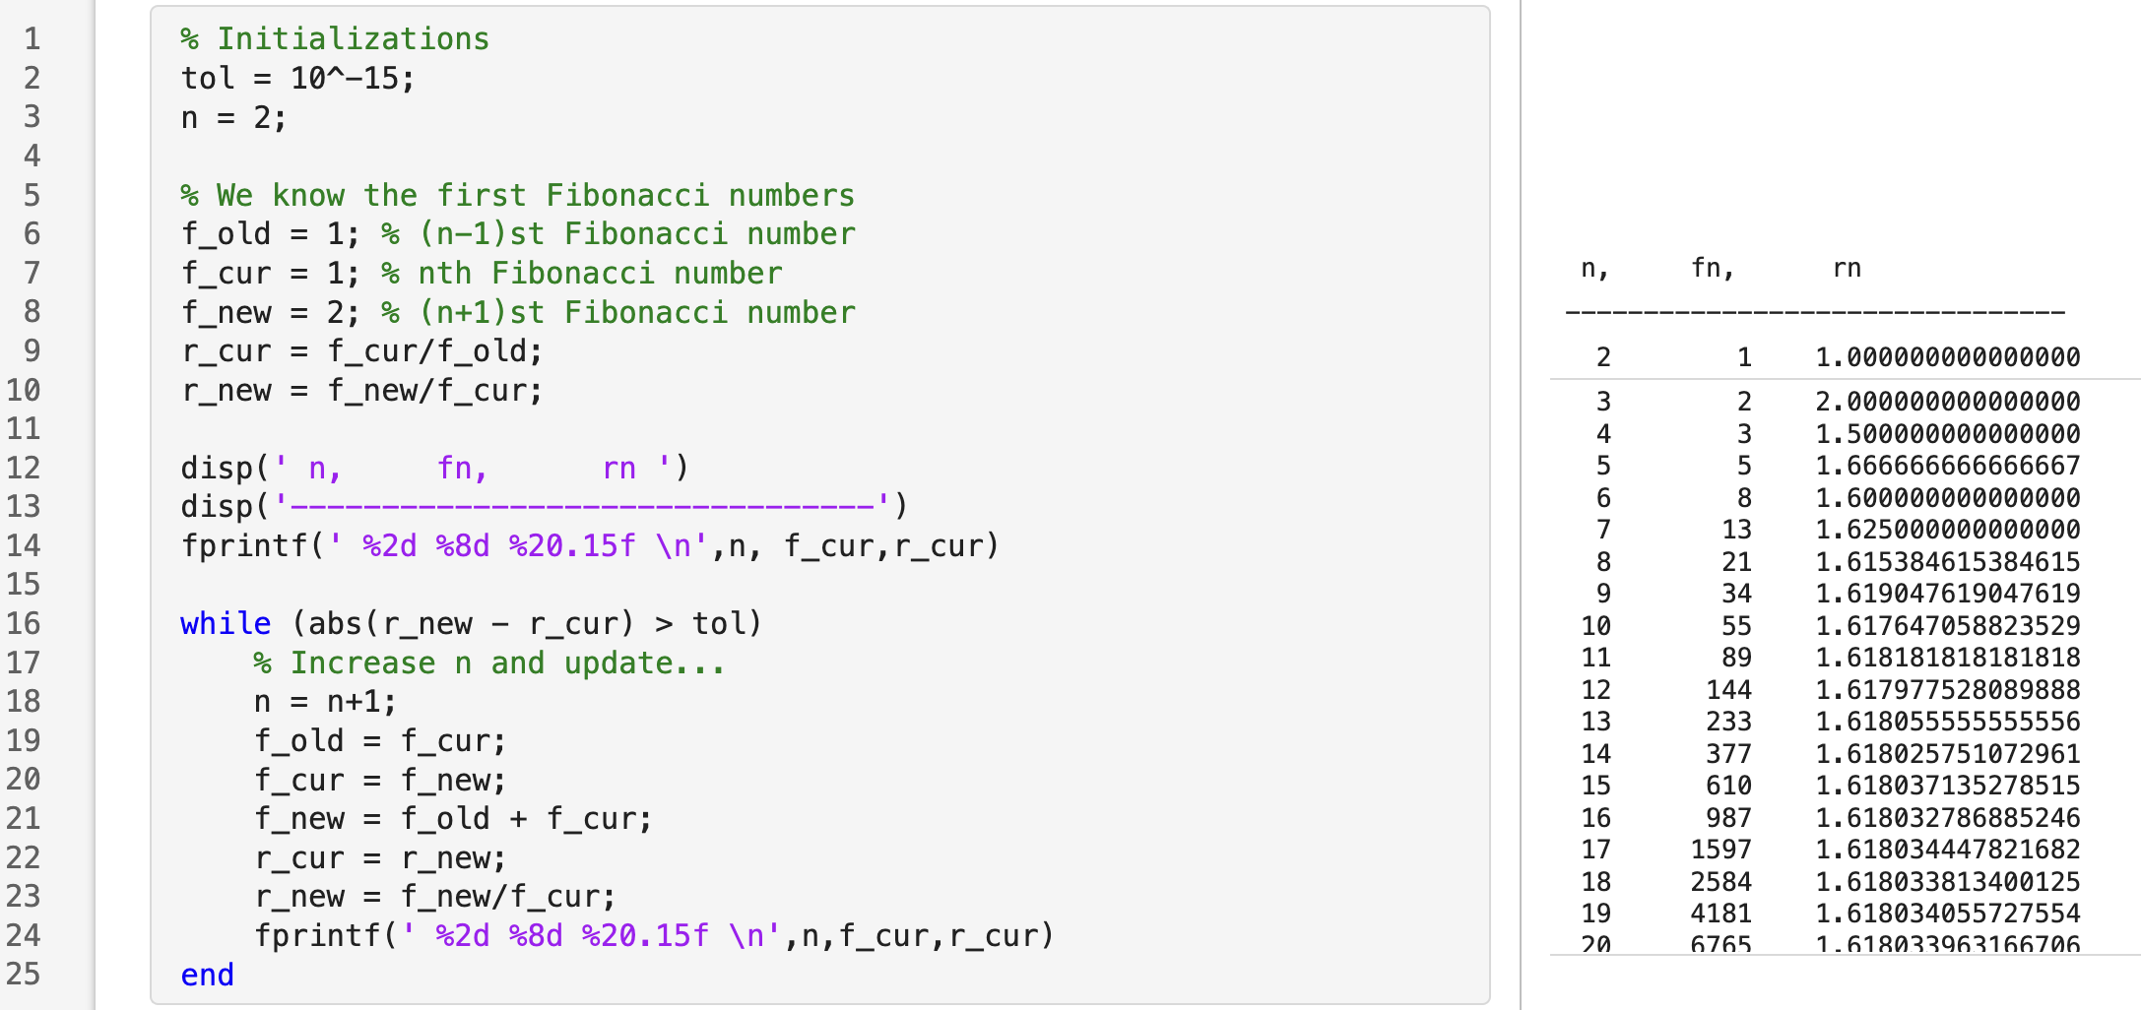
Chapter 3: Approximations with Fractions

Slide 11
Chapter 3: Approximations with Fractions

Slide 12
Chapter 3: Approximations with Fractions

Slide 13
Chapter 3: Approximations with Fractions

Slide 14
Chapter 3: Approximations with Fractions

Slide 15
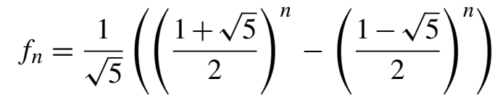

Chapter 3: Approximations with Fractions
Explicit formulas seem easier since it’s a single formula to code, like this one for the Fibonacci sequence:
On the other hand, implicit formulas like the one below might be more appealing if we realize that recursion might be needed while learning about loops and nested loops better

