Slide 1
LLM Adaptation Comparison
Which policy does a support assistant answer from?
30 days
45 days
Original window
Updated window
Somama Siddiqui / Senior Seminar I
Notes:
Cue: Start on the title slide.
Imagine a customer asks for a refund thirty-five days after buying a storage plan. Under the old handbook, they’re too late. Under the new one, they’re within the refund window. The customer asks exactly the same question, but the correct answer has changed. I’m Somama Siddiqui, and my project tests three ways to keep a small language model current when a policy changes.

Slide 2
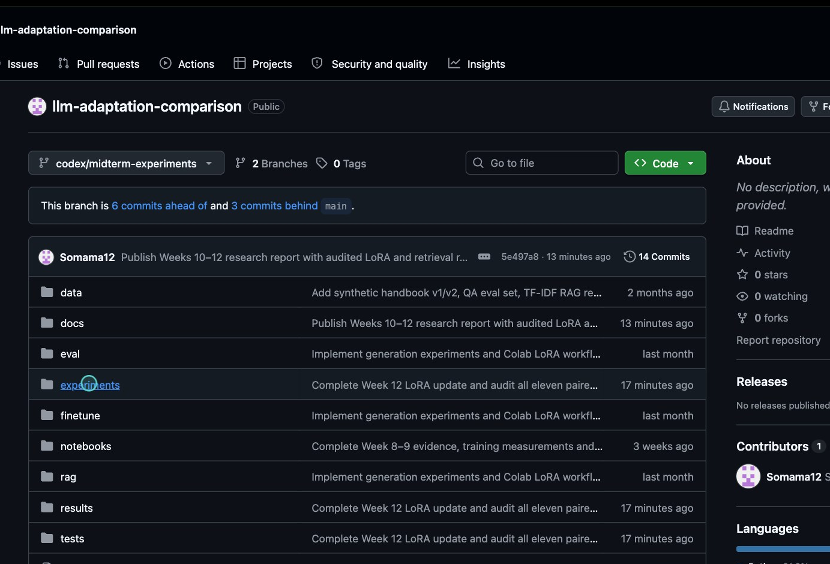
Three ways to give the model the policy
Retrieval
Look up a passage at answer time.
Few-shot prompting
Put handbook examples in the prompt.
LoRA fine-tuning
Train a small adapter on policy answers.
Notes:
Cue: Show the repository image or briefly open GitHub. Point to the experiments and finetune folders.
This is the Nimbus project repository. I created two versions of a fictional handbook so I could control which facts changed. Six changed and five stayed the same. Retrieval gives the model a relevant passage with its question. Few-shot prompting gives it examples in the prompt. LoRA trains a small set of extra weights. The Python runner scores the original answer twice: once against the old handbook and once against the new one. That second score tells us exactly how stale the old answer became.

Slide 3
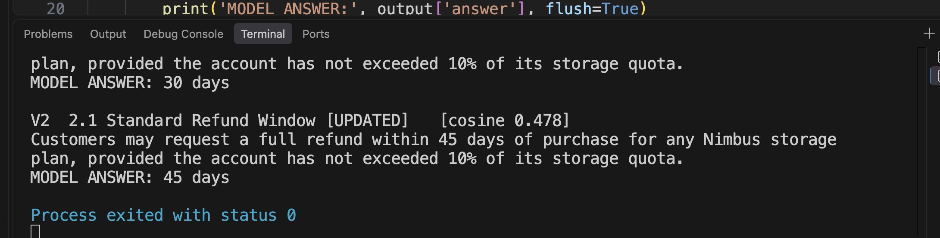
Same question, different handbook
Local inference: Llama 3.2 3B with Ollama. The scored GPU experiment uses Qwen 2.5 3B.
Notes:
Cue: Point to each MODEL ANSWER line. Optional live run: python -m experiments.demo ask (start Ollama with llama3.2:3b first).
Here’s the refund question running locally in VS Code. The code retrieves a section, adds its text to the prompt, and calls the model. Version one returns the standard refund policy, and the model answers thirty days. With the updated handbook, it finds the revised passage and answers forty-five days. Nothing about the question changed. This screenshot is from the actual Llama run on my Mac. For the scored comparison, I used the same Qwen model across all three methods on a Colab T4.

Slide 4
How many answers stayed correct?
Method | Original | Stale | Updated
Word retrieval | 10 / 11 | 6 / 11 | 11 / 11
Embedding retrieval | 10 / 11 | 6 / 11 | 11 / 11
Few-shot prompting | 10 / 11 | 5 / 11 | 10 / 11
LoRA adapter | 5 / 11 | 4 / 11 | 4 / 11
Audited core facts on Qwen 2.5 3B Instruct. Six policies changed; five stayed the same.
Notes:
Cue: Read across the retrieval row, then compare the last column. All counts are out of eleven.
Read this table from left to right. Original means the method used the first handbook. Stale means yesterday’s answers were judged against today’s policy. Updated means the method received the new information. Both retrieval methods went from six correct stale answers to eleven after the refresh. Few-shot prompting reached ten. LoRA stayed at four after review. The first three rows come from the earlier same-model baselines; the LoRA row uses the matched run where I rebuilt the first adapter and continued training it on version two.

Slide 5
Four correct before. Four correct after.
Two answers gained
Two answers lost
Password reset: every 60 days
Backup retention: 90 days
Pro Plan capacity: 2 TB
Two-factor authentication: already required
The update took 129 seconds on a Tesla T4 with 13 examples and 20 epochs.
Notes:
Cue: Point to the gains and losses. Pause on the two-factor authentication example.
That flat total hides the most interesting result. The updated adapter learned that passwords must be reset every sixty days and that deleted-account backups are retained for ninety days. But it lost the correct Pro Plan capacity and the two-factor authentication rule. The updated answer said authentication was voluntary now and required later. The automatic scorer saw the word required and gave it credit. Checking the full sentence against the policy brought the updated score down from five to four. I kept both decisions so the correction can be checked.

Slide 6
Rewording a question can hide the right passage
7 / 11
10 / 11
Whole-word matching
Character matching
Correct section among the first three passages, using paraphrased Version 2 questions.
Notes:
Cue: Emphasize that these numbers measure passage retrieval, not generated answers.
I also tested what happens when a customer uses different words from the handbook. On the original questions, every lexical configuration found the correct section first. Paraphrases exposed a difference. On version two, whole-word matching placed the right section in the top three for seven questions. Matching short character sequences did it for ten. That result tells us the evidence was easier to find. It doesn’t tell us that a model would read the passage correctly.

Slide 7
For Nimbus, refreshing retrieval worked best
11 of 11
correct after the handbook refresh
Next test: more policies and independent training runs.
github.com/Somama12/llm-adaptation-comparison
Notes:
Cue: Finish here. If time allows, show the report or the audited answer file on GitHub.
For this handbook, refreshing the retrieval source was the most reliable way to keep answers current. The important lesson is to inspect which facts changed, not just the total score. This is one small experiment with eleven synthetic facts and one matched training run. I’d test a larger set of policies and repeat the training before drawing a broader conclusion. The code, raw answers, audit, and research report are all in the repository.

