Slide 1
MoMBOT for Hackathon
By Black Pearl Team

Slide 2
Problem Statement and Design Approach
Problem statement
Build a BOT to generate meeting summary and action items out of transcription from online meeting. Also MoM need to be sent to all participants.
Why this Problem
Problem2 was chosen as it is useful and we found it challenging and it had scope to learn new things like – NLP
Approaches Considered
Use Azure NLP service which has its own inbuilt models to get summary out of meeting text.
Expose Python API using already trained NLP model to convert Transcript to Minutes summary and action items.
Approach 1 was discarded as it had no scope for customization and results were not satisfactory.
Approach 2 was chosen with Java Rest API to invoke Python API, which will generate meeting summary using “Transformers” package in Hugging face “Meeting_Summary” model. Also intelligent is built in it to get action items out of meeting text. Then Java API will take response back and send mail with information filled in MoM template.

Slide 3
Solution
JSON Request
having
Meeting information
&Transcript
Java Rest API
In Springboot
Meeting Text JSON
Python API using
Hugging face
NLP model
Subject
Attendees
Apologies
MoM Template
(HTML)
Meeting Summary JSON
Summary
Action items
Action Items JSON
Send Mail
To all Participants

Slide 4
How It Works
Python Backend API
Python API will take the transcript JSON input and generate Minutes and action items.
Hugging face NLP model - Meeting_Summary, is used for summarization of transcript.
This model uses Transformers package and is obtained by fine tuning 'facebook/bart-large-xsum' using AMI Meeting Corpus, SAMSUM Dataset, DIALOGSUM Dataset, XSUM Dataset
For better results, Model is not applied to full transcript at a time. Only 3-4 lines or Min 200 characters till ending sentence are processed by model at one time.
For Action Items, we have configured set of key words combination to be searched at each sentence of transcript.
If sentence qualifies any of keywords combination then that sentence is candidate for action items.
Also we have some intelligence built to filter out the sentences which are not the action items. e.g. Sentence with Questions
Meeting Summary and Action Items are sent back to Java API in JSON format
Java REST API in Springboot
Accept JSON request input containing Meeting information along with its Transcript.
Transcript is sent to Python API and receives response for Summary and Action items.
Then it fills the information received to a predefined HTML template for MoM format
It will also fill other meeting information of Title, Date, Attendees, Absentees etc
Finally it sends mail to all the participants received in Input meeting information.

Slide 5
Technology Stack
Python
Java
Rest API
Springboot
HTML
NLP
Docker
Azure cloud
Postman for testing

Slide 6
Assumptions
BOT will be part of meeting and will be able to collect required Meeting information and its transcript.
Transcript will be in English language only.
To Be Implemented
Backlog Jiras will be created automatically for each action item if we have project information.
Performance improvement for meeting summary by doing parallel processing.
Should be able to merge multiple transcript files into one in order of time.
Also can add API for audio to text conversion if input received is Audio format.

Slide 7
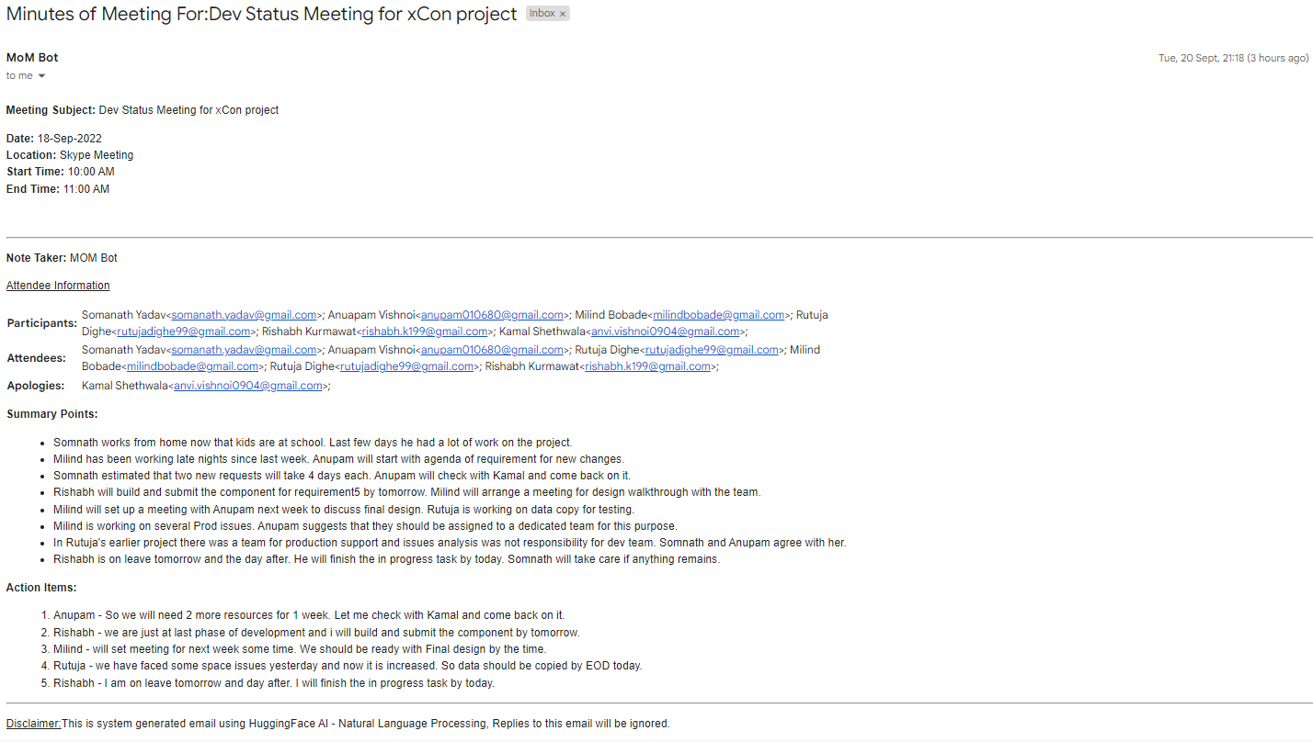
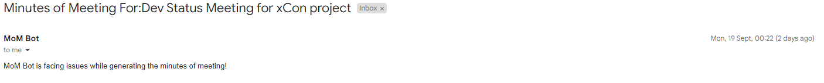
Mail Output
Exception Scenario Mail:

Slide 8
Thank You

