Slide 1


Review-I
NON- INVASIVE BIOSENSING PLATFORMS FOR THE EARLY DETECTION OF CRITICAL DISEASES
AY 2025-26
Capstone Project – Introduction (PROJ2999)
GITAM (Deemed-to-be) University
Department of Electrical Electronics and Communication Engineering
Project Team:
V. Satya Bharadwaj - BU22EECE0100520
J.Poojitha Chowdary – BU22EECE0100306
S Harshini – BU22EECE0100191
Project Mentor:
Dr.Titisha Chakraborty
Project In-charge:
Kshitij Shakya
www.gitam.edu

Slide 2
Objective and Goals
Objective
Develop a user-friendly mobile/desktop application for real-time monitoring, visualization, and analysis of biosensor data.
Minimize electrical noise and interference in the bio sensing hardware by optimizing PCB design and signal processing.
Goals
Main Goals
Analyze and regulate the noise sources in the existing PCB.
Design and implement a cross-platform app with intuitive UI/UX.
Enable live data streaming, storage, and cloud connectivity for remote monitoring.
Integrate advanced analytics for early disease detection.
Additional Goals
Wireless Data Transmission
User-Friendly Interface

Slide 3
Project Plan (Literature Survey)

Slide 4
Literature Survey
Key Publications
Wu, T.; Liu, G. Non-Invasive Wearables in Inflammation Monitoring: From Biomarkers to Biosensors, Biosensors
Shamkhalichenar, H.; Bueche, C.J.; Choi, J.-W. Printed Circuit Board (PCB) Technology for Electrochemical Sensors and Sensing Platforms. Biosensors, 2020
Chen, M.; Wang, J.; Anzai, D.; Fischer, G.; Kirchner, J. Common-Mode Noise Reduction in Noncontact Biopotential Acquisition Circuit Based on Imbalance Cancellation of Electrode-Body Impedance. Sensors
Frontiers in Bioengineering and Biotechnology. DENOISING: Dynamic enhancement and noise overcoming in multimodal neural observations via high-density CMOS-based biosensors.
Wearable Electrochemical Biosensors for Advanced Healthcare Monitoring — Duan et al. Advanced Science, 2025.
Key Resources – Whitepaper| Application Notes | Datasheet| Others
Analog Devices – “Electrochemical Measurement Techniques: Cyclic Voltammetry, Linear Sweep, and Chrono amperometry” → explains operation and measurement modes.
National Instruments – “Practical Guide to Low-Noise Measurement” → strategies for PCB layout and instrumentation in sensitive circuits.
Existing Implementations – Products| Opensource| GitHub etc
Microchip AN1258: Implementing a Potentiostat Using Operational Amplifiers – practical op-amp circuit guide.
Maxim Integrated AN-5126: Improving Noise Performance in Sensor Interfaces – useful filtering and biasing tricks.

Slide 5
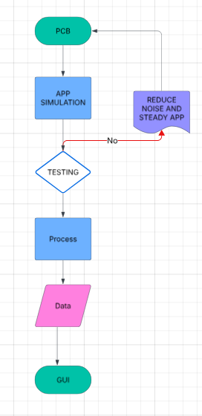
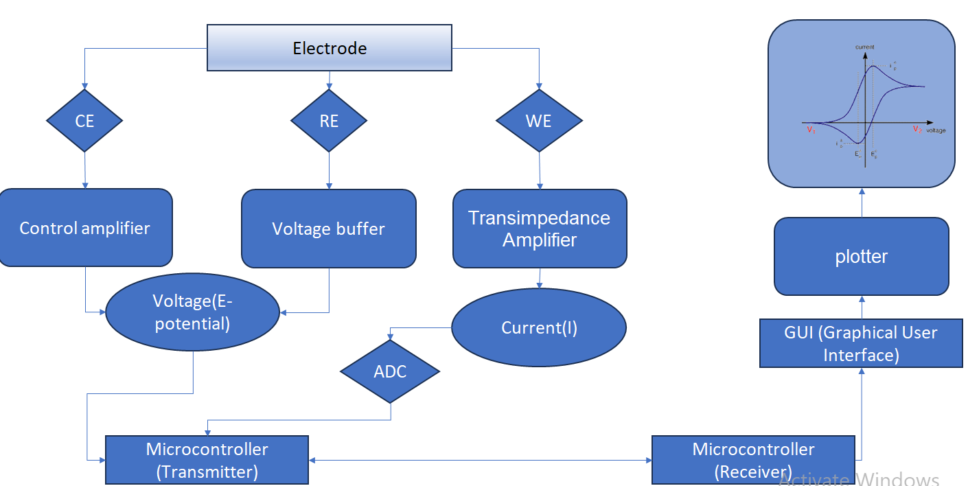
Architecture
Structural Diagram
Block Diagram
Behaviour Diagram

Slide 6
Use Cases & Testing
Use Cases
Remote Health Monitoring
Point-of-Care Diagnostics
Home-Based Screening
Research & Clinical Trials
Test Cases
Sensor Calibration
Stress & Reliability Testing
Software Testing

Slide 7
Conclusion & Future Work
Summary and Conclusion
Conducted an literature survey on non-invasive bio sensing platforms, PCB noise reduction techniques, and mobile app frameworks.
Identified key challenges such as signal noise, miniaturization, and real-time data handling.
Established a conceptual framework for integrating sensors, optimized PCB, and application development.
Current work provides a baseline understanding to guide prototype design.
Future Work
Development of a mobile/desktop app for real-time bio signal visualization.
Prototype fabrication and testing of the bio sensing platform.
Integration of wireless connectivity (Wi-Fi/BLE) for data transfer.
Validation experiments comparing results with standard laboratory instruments.

Slide 8
THANK YOU
Have a Great Day !

