Slide 1


Students Social Media Addiction Analysis
Programming Starter (PRS) – SoSe 2025
Team No = 11
Team Member 1 : Poovallal Jayepalan
Team Member 2 : Somantha Manuranga
Team Member 3 : Sai Pavan Bolgani
© 2025 OTH Amberg-Weiden

Slide 2
Research Question
Do students who report that social media affects their academic performance also:
Sleep fewer hours?
Report poorer mental health?
addiction levels across relationship statuses?
This question explores whether academic stress due to social media is linked to other lifestyle disruptions.
Präsentationstitel | Verfasser
1. November 2024

Slide 3
Background and Motivation
With the rising use of social media among students, questions arise about its side effects on academic success and personal well-being.
This analysis explores whether students who feel that social media negatively affects their academic performance also experience disruptions in other areas of life, such as:
Reduced sleep
Increased mental stress
Addicted Score grouped by Relationship Status.
Goal → Investigate if students who feel academically affected also face more lifestyle disruptions.
Präsentationstitel | Verfasser
1. November 2024

Slide 4
Dataset and Variables
Dataset of 705 student responses from multiple countries.
Key variable: 'Affects_Academic_Performance' (Yes/No)
Compared groups across:
                Sleep Hours per Night
                Mental Health Score (scale of 1–10)
                Addicted Score by Relationship Status (scale of 1–10)
Used pandas, seaborn, and matplotlib in Python for analysis.
Präsentationstitel | Verfasser
1. November 2024

Slide 5
Applied Methods
Split the dataset into two groups based on academic impact (Yes vs No) .
Used:
Boxplots to visualize group distributions
Descriptive statistics: mean, median, IQR
Compared results across Sleep, Mental Health, Addiction Score by Relationship Status.
Interpreted visual differences and extracted insights.
Präsentationstitel | Verfasser
1. November 2024

Slide 6
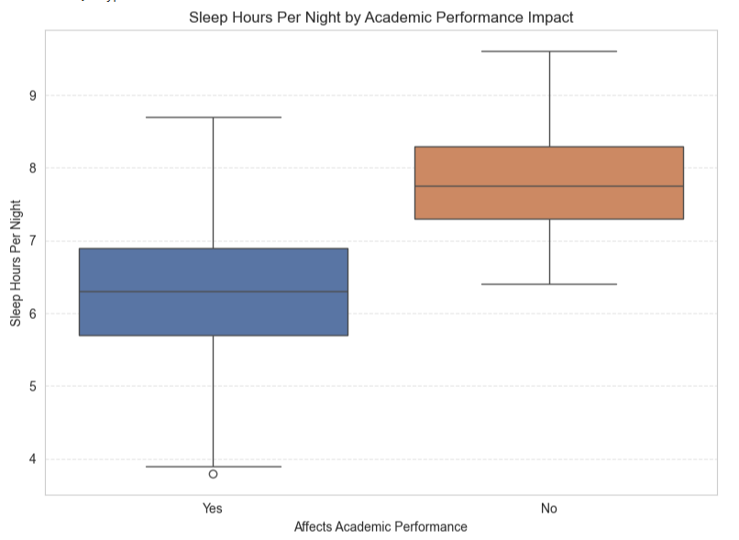
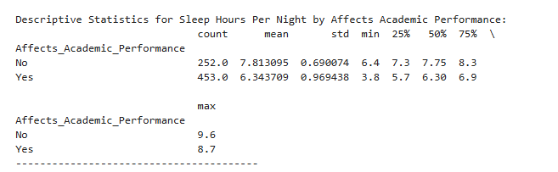
Results on Sleep Hours Distribution by Academic Impact Group
Statistical Insight:
Students who reported that social media affects their academics (YES group) sleep on average 6.3 hours, compared to 7.8 hours for the NO group
Figure 1. Sleep Hours Distribution by Academic Impact Group
Präsentationstitel | Verfasser
1. November 2024

Slide 7
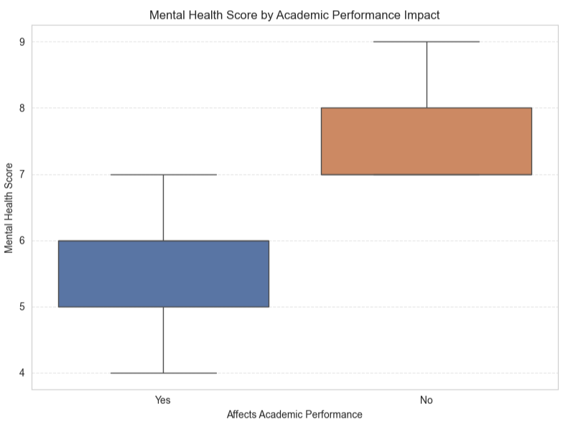
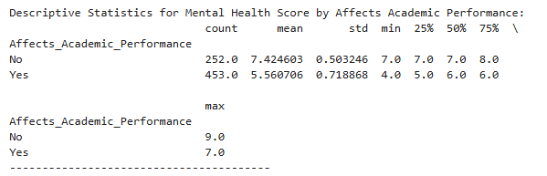
Results on Mental Health Score Distribution by Academic Impact Group
Statistical Insight:
The YES group has a mean mental health score of 5.6, while the NO group averages 7.4.
Figure 2. Mental Health Score Distribution by Academic Impact Group
Präsentationstitel | Verfasser
1. November 2024

Slide 8
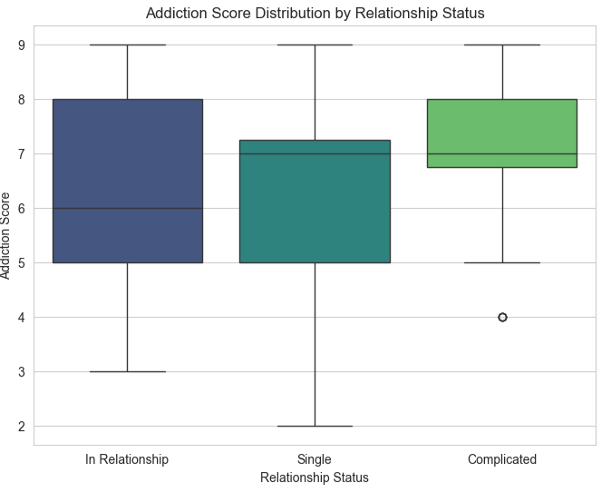
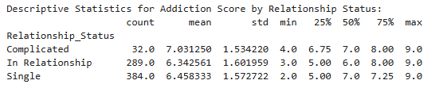
Results on Addiction Score Distribution by Relationship Status
Statistical Insight:
Students in a complicated relationship have addiction score (7.03), and single students (6.46), and relationship students (6.34).
Figure 3. Addiction Score by Relationship Status
Präsentationstitel | Verfasser
1. November 2024

Slide 9
Conclusion
Clear pattern of co-occurring issues in affected students:
  Reduced sleep duration
  Lower mental health
  Higher addiction scores especially among single and complicated relationship groups
Academic impact due to social media is part of a larger lifestyle issue.
These insights can help in targeting digital wellness initiatives in student communities.

Slide 10
References
Shamim, A. (2025) Students’ social media addiction, Kaggle. Available at: https://www.kaggle.com/datasets/adilshamim8/social-media-addiction-vs-relationships (Accessed: 30 June 2025).
VanderPlas, J. (no date) Visualization with Seaborn, Visualization with Seaborn | Python Data Science Handbook. Available at: https://jakevdp.github.io/PythonDataScienceHandbook/04.14-visualization-with-seaborn.html (Accessed: 30 June 2025).
Habib, J.M. (2024) Choosing the right tool: Matplotlib vs. Pandas vs. Seaborn, Medium. Available at: https://medium.com/@jaberi.mohamedhabib/choosing-the-right-tool-matplotlib-vs-pandas-vs-seaborn-4468b6b3c0a5 (Accessed: 30 June 2025).

Slide 11

VIELEN DANK!
Ostbayerische
Technische Hochschule (OTH) Amberg-Weiden

