Slide 1


SATWA 2025
Smart Waste-to-Energy Conversion Using IoT Technology
Problem Statement Title - Smart Waste-to-Energy Conversion Using IoT Technology
Team Name - EcoDrive Innovators
College Name – Sanjivani University
College Address – At: Kopargaon, Dist: Ahmednagar, Maharashtra, India - 423601
@SATWA 2025 - Template

Slide 2
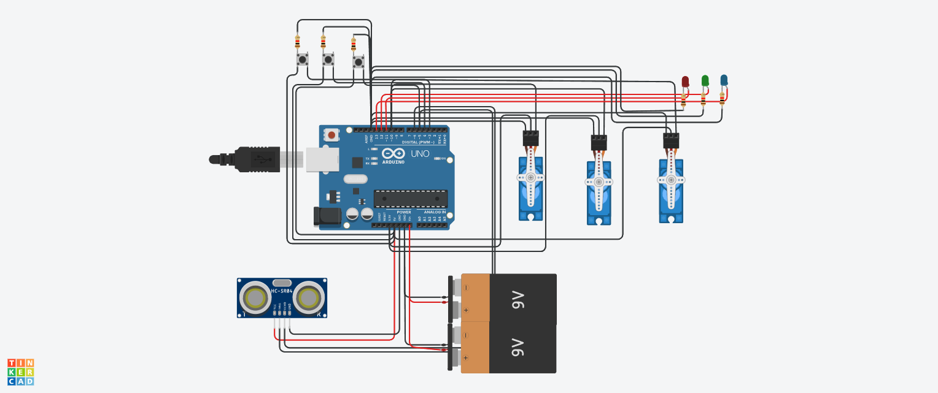
SATWA 2025
Smart Waste-to-Energy Conversion Using IoT Technology
@SATWA 2025 - Template

Slide 3
SATWA 2025
Smart Waste-to-Energy Conversion Using IoT Technology
@SATWA 2025 - Template

