Slide 1
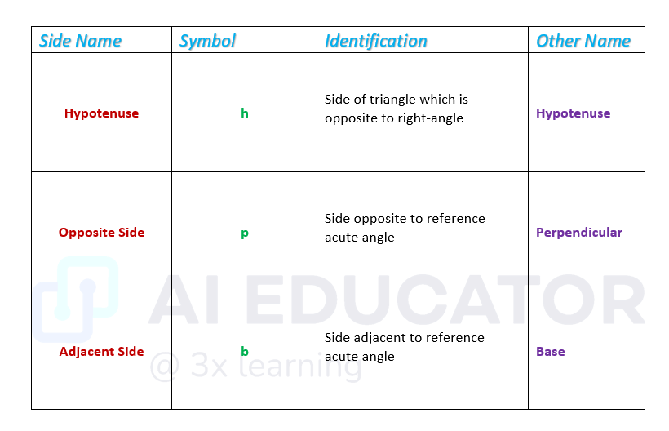
Sides name and its identification

Slide 2
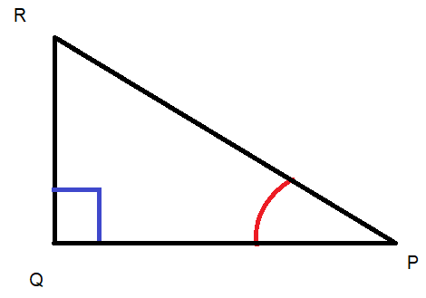
Example 1
For acute angle P
Hypotenuse = Side of triangle which is opposite to right-angle (∠Q = 90°) = PR
Side opposite to reference acute ∠P = QR
Side adjacent to reference acute angle ∠P = PQ

