Slide 1
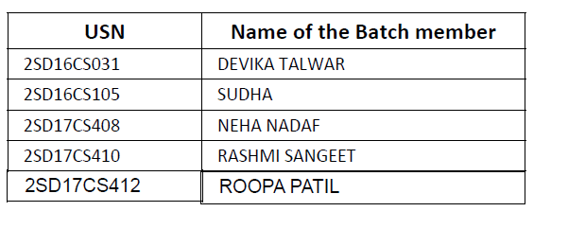
Crop Recommendation System Using Machine Learning Under the Guidance of Prof. SANDHYA S V Batch ID: A20

Slide 2
CONTENTS
Introduction
Existing system
Proposed system
Problem identification
Design methodology
System Requirement Specification
Software design
Implementation
GUI
Testing
Conclusion
References

Slide 3
ABSTRACT
The proposed project is an attempt to make use of machine learning concept in crop recommendation, by implementing KNN, Naïve Bayes algorithms.
Real time soil test report from district agriculture department is collected and used as training data.
Training data is the data that is directly fetched from the soil grids using REST API.
By Normalizing the raw data implemented through KNN algorithm for crop recommendation.
The whole process is illustrated graphically using Google’s Bar Chart API.

Slide 4
Objective
To implement machine learning concept predict the crops.
To make use of enabling technique for prediction.
To help the farmers to plant the right crop.
increasing his yield and also increasing the overall productivity.

Slide 5
INTRODUCTION
What is Machine Learning? what is the role of machine learning in our project?
Various factors have affected the health of agriculture in India.
Many new technologies have been evolved to regain the health. One such technique is precision agriculture..
Precision agriculture is the technology of “site-specific” farming.
Although precision agriculture has delivered better improvements it is still facing certain issues.
There exist many systems which propose the inputs for a particular farming land. Systems propose crops, fertilizers and even farming techniques.

Slide 6
Recommendation of crops is one major domain in precision agriculture.
Recommendation of crops is dependent on various parameters.
The “site-specific” technique has improved the results yet there is a need to supervise the results of such systems.
Not all precision agriculture systems provide accurate results.
But in agriculture it is important that the recommendations made are accurate and precise because incase of errors it may lead to heavy material and capital loss.
Among these various machine learning techniques that are being used in this field, this system uses the voting method to build an efficient and accurate mode
Many research works is being carried out, in order to attain an accurate and efficient model for crop prediction.

Slide 7
Existing System
Most of the research focus on the crop management, crop disease management and crop yield forecasting although a lot of research has been conducted for developing the decision support system for farmers.
One of the most important factors is crop selection at the earlier stage by farmers which help the farmers to improve crop management and crop yield.
One of the widespread problem that occurs is crop prediction. Every farmer will be having curiosity in knowing how much yield he is about to expect, during the rising season.
Yield prediction become a matter of fact In the earlier period, hat relied on farmer's long-term experience for specific yield, crops and climatic conditions.
Most of the farmers goes for yield prediction with the existing system rather than crop prediction.

Slide 8
Disadvantages of Existing System
Not reliable
Less yield
Farmers may run into crop loss.

Slide 9
Proposed System
Precision agriculture is a modern farming technique that research data of soil characteristics, soil1 types, crop yield data collection and suggests the farmers the right crop based on their site specific parameters.
This increases the productivity by reducing the wrong choice on a crop.
One of the data mining model called Ensemble is also known as Committee Methods or Model Combiners.
Farmers can get more yield by choosing the crop which can give more profit to them.

Slide 10
PROBLEM IDENTIFICATION
Problem Statement
Data mining in agriculture is used for analyzing the various biotic and abiotic factors.
Agriculture in India plays a predominant role in economy and employment.
The common problem existing among the Indian farmers are they don’t choose the right crop based on their soil requirements.
Due to this they face a serious setback in productivity. This problem of the farmers has been addressed through precision agriculture

Slide 11
The Solution
The proposed application system is designed to fetch parameters of the soil from soil grid database using REST api provided by the open soil grid community
User has to just permit the browser to trace the location
longitude and latitude of the location is fetched automatically and it is further given to api which returns soil parameters, these parameters are analyzed with the dataset being saved in the database and crop recommendation is done.

Slide 12
DESIGN METHODOLOGY
The project follows a Waterfall model of Software Engineering.
The Waterfall model is a sequential design process, often used in software development processes, in which progress is seen as flowing steadily downwards(like a waterfall) through the phase of conception, Initiation, Analysis, Design, Construction, Testing and Maintenance.
The result of each phase are one or more documents that are approved are finished.
The phase should not start until the previous phase has finished.
The software process is not a simple linear model but involves a sequence of iteration of the development activities.

Slide 13
SYSTEM REQUIREMENT SPECIFICATION
Software requirement
OS: Windows 7
Language: PHP
Server: WAMP
Hardware requirement
Processor:i3
Ram: 4gb
Hard disk:40gb

Slide 14
SYSTEM REQUIREMENT SPECIFICATION
Functional requirements
Data set collection
GPS
Soil properties
Non functional requirements
Correctness
Reliability
Robustness
Maintainability
portability

Slide 15
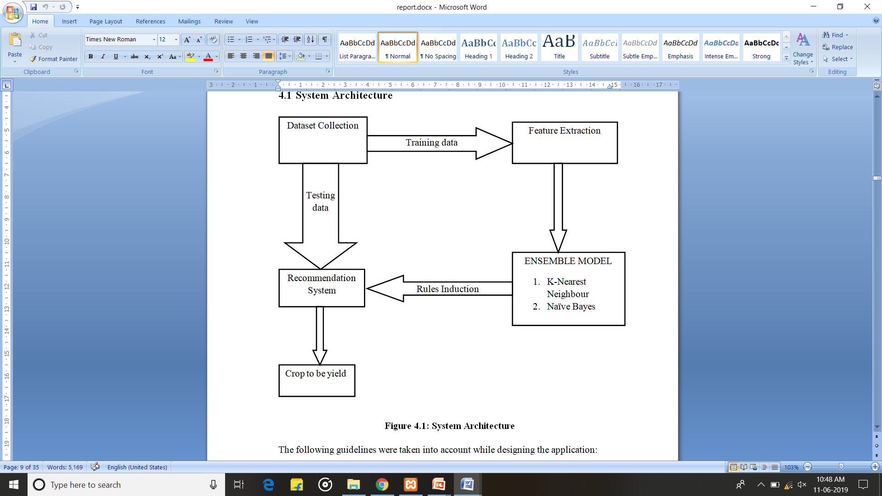
SOFTWARE DESIGN
System Architecture
Figure-2:System Architecture

Slide 16
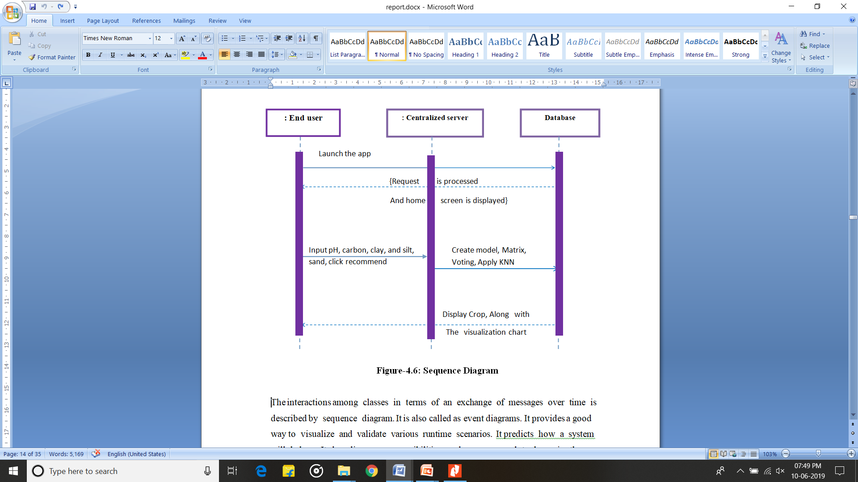
Sequence diagram
Figure-3: Sequence diagram

Slide 17
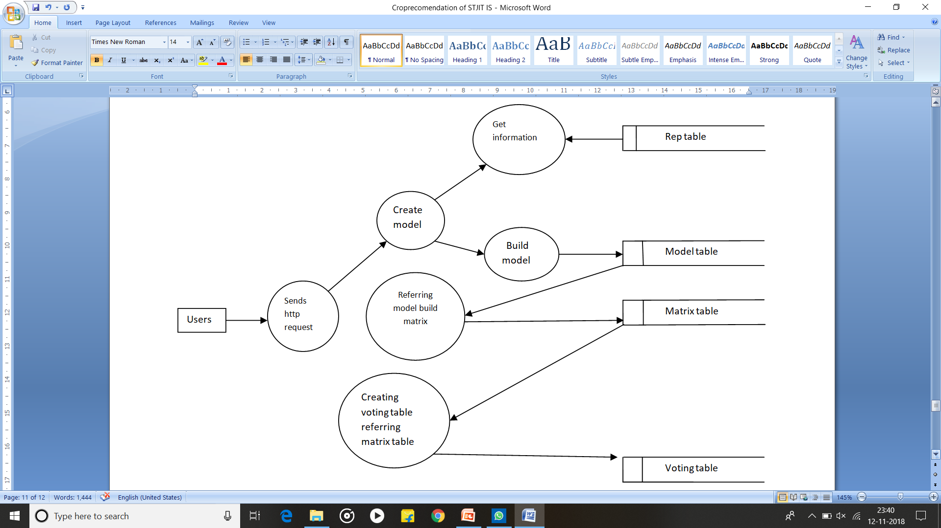
Dataflow diagram
Figure-4: Dataflow diagram

Slide 18
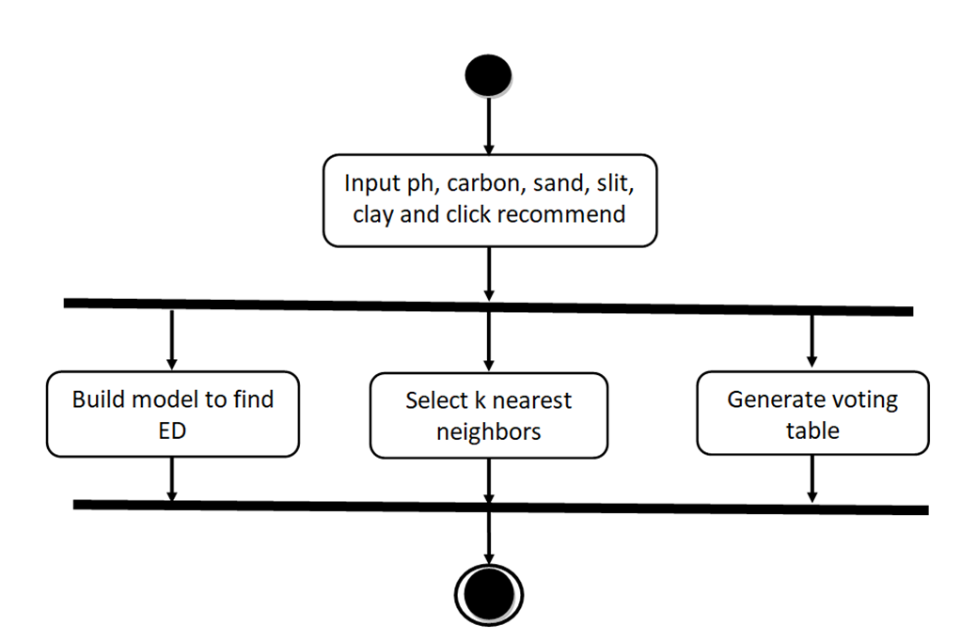
Activity diagram
Figure-5: Activity diagram

Slide 19
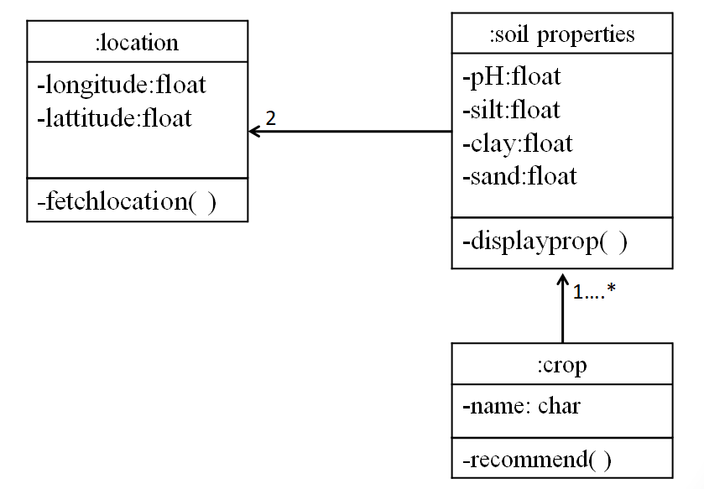
Class diagram
Figure-6: Class diagram

Slide 20
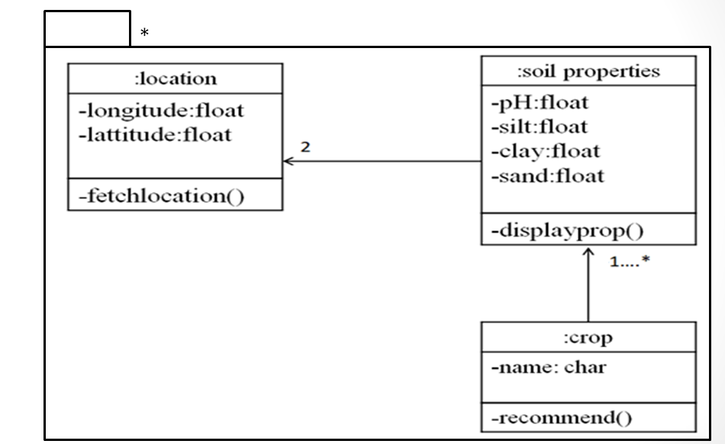
Package diagram
Figure-7: Package diagram

Slide 21
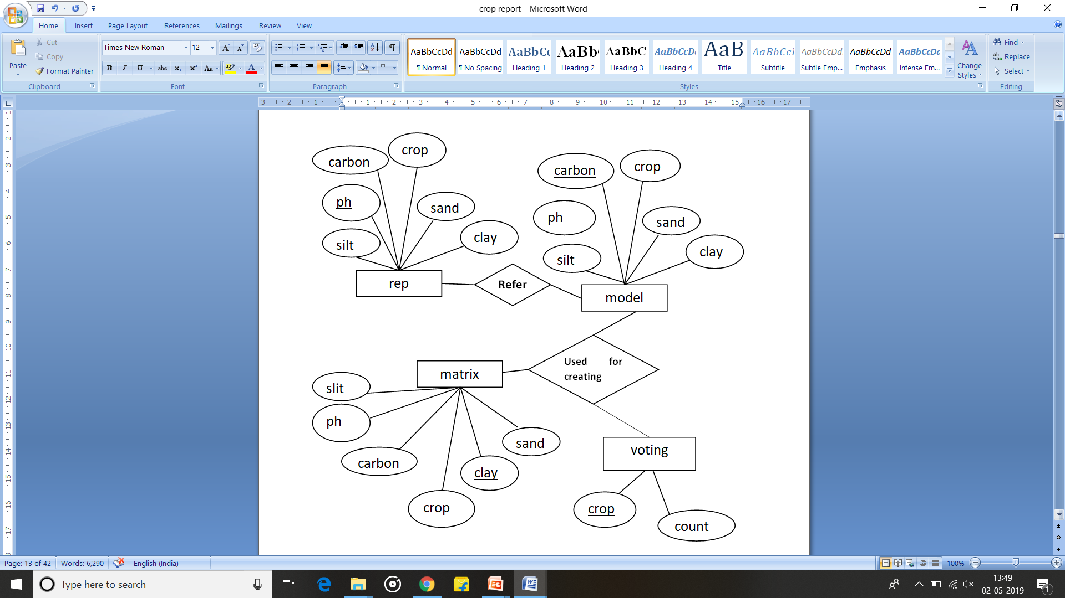
E-R diagram
Figure-8: E-R diagram

Slide 22
IMPLEMENTATION
MODULE
User:
User should select the location of the land.
Based on the longitude and latitude of the land the soil properties will be fetched.
Repository:
The soil grid repository is used to provide the soil properties of the location selected by the user.
Depending on the soil properties the model is created and voting is made to the crops obtained by matrix and crop is recommended.

Slide 23
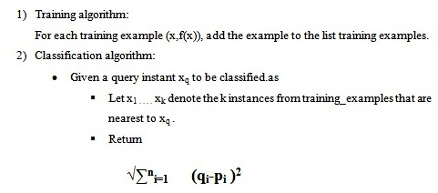
ALGORITHM
KNN Algorithm

Slide 24
Working of project
Load the data.
Initialize the value of k.
For getting the predicted crop, iterate from 1 to total number of training data points.
Calculate the distance between test data and each row of training data. Here we will use Euclidean distance as our distance metric ,since it’s the most popular method.
Based on distance values Sort the calculated distances in ascending order
Get top k rows from the sorted array.
Get the most frequent crop of these rows.
Return the predicted crop.

Slide 25
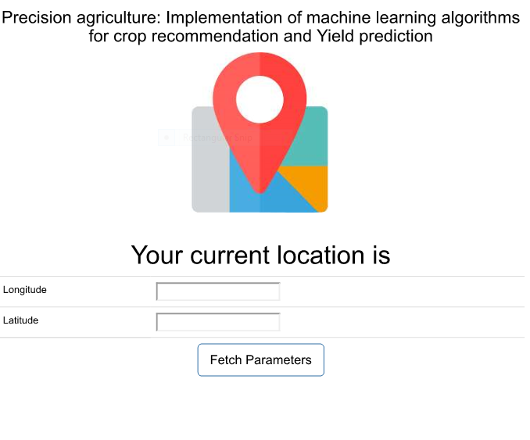
GRAPHICAL USER INTERFACE

Slide 26
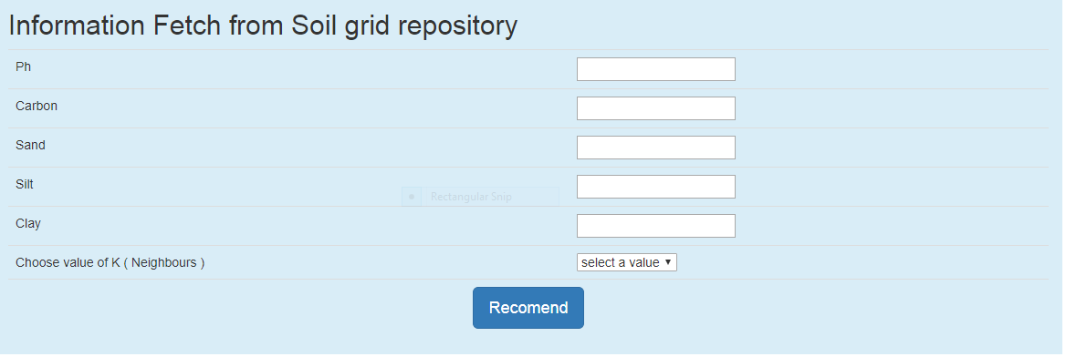
GRAPHICAL USER INTERFACE

Slide 27
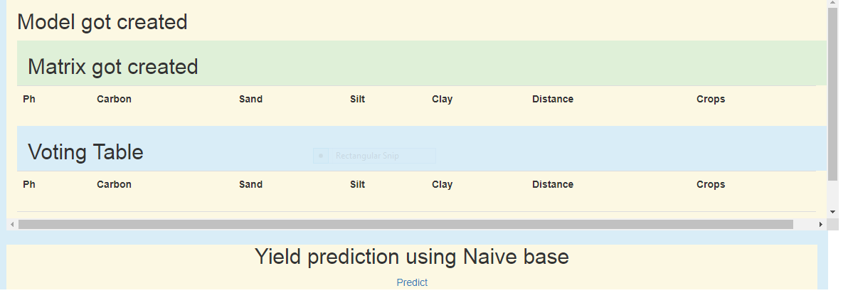
GRAPHICAL USER INTERFACE

Slide 28
TESTING
TEST CASES | DESCRIPTION | EXPECTED RESULT | ACTUAL RESULT | STATUS OF EXECUTION PASS/FAIL
TC 01 | Launch the application and allow to trace the location | Crop to be yield after having applied KNN should be displayed | Crop along with statistical calculation details ,chart showing nearest neighbors to be displayed | Pass
TC 02 | Launch the application with good internet connection | The location of the user must be displayed | The location is not displayed | Fail

Slide 29
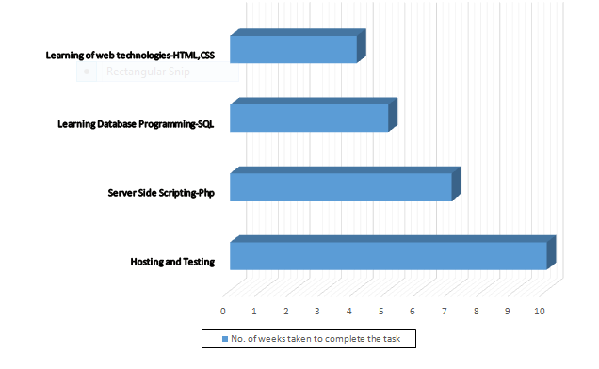

Slide 30
CONCLUSION
The first important outcome of this project is overcoming the disadvantage of the existing system.
The proposed project is an attempt to make use of machine learning concept in crop recommendation, by implementing KNN algorithm.
Real time soil test report from district agriculture department is collected and used as training data.
Training data is the data that is directly fetched from the soil grids using REST API.
Project could be further improved by increasing volume of observation’s, it is the soil test data can be implemented by using other machine learning algorithms.

Slide 31
REFERENCES
Satish Babu (2013), ‘A Software Model for Precision Agriculture for Small and Marginal Farmers’, at the International Centre for Free and Open Source Software (ICFOSS) Trivandrum, India
AnshalSavla, ParulDhawan, HimtanayaBhadada, NiveditaIsrani, Alisha Mandholia ,Sanya Bhardwaj (2015), ‘Survey of classification algorithms for formulating yield prediction accuracy in precision agriculture', Innovations in Information, Embedded and Communication systems (ICIIECS).
AakunuriManjula, Dr.G .Narsimha (2015), ‘XCYPF: A Flexible and Extensible Framework for Agricultural Crop Yield Prediction’ , Conference on Intelligent Systems and Control (ISCO)

Slide 32
Thank You

