Slide 1
InfraDriftGuard
InfraDriftGuard: AI-Based Infrastructure Configuration Drift Detection and Risk Classification on AWS using Explainable Machine Learning
BCSE355L – Cloud Architecture Design · Project Phase-I · Dr. Priya V
Keshav Khandelwal (24BIT0461) · Somasundar Shivappa Badami (24BIT0465)

Slide 2
The problem: configuration drift
Declared ≠ deployed. Terraform describes the infrastructure, but console edits, hot-fixes and scripts change the live AWS account afterwards.
Drift causes breaches. A public S3 bucket, SSH open to 0.0.0.0/0, or an IAM role escalated to Action:* can each expose the whole account.
Today's tools fall short. Static scanners never see the live account; terraform plan / AWS Config say “something changed” without saying how dangerous; ML/LLM tools are opaque or hallucinate.
Goal. Detect drift continuously, rate its risk, explain why, and respond within the free tier.

Slide 3
Literature survey — 15 papers (2023–2026)
IEEE · ACM · Springer · Frontiers · Scopus
Static IaC analysis GLITCH (ASE'23), GASEL (MSR'23), SLI-KUBE (TOSEM'23), TerraMetrics (ICPC'24), Verdet (EMSE'25), SlsDetector (TOSEM'26) → miss post-deployment changes
Drift & state Thiyagarajan (IJCNIS'24), Hassan (FSE'24), RIVA (ACM'26) → no severity, or costly LLM agents
Repair InfraFix (ISSTA'25), LLM repair (SecDev'24) → fixes code; 20% hallucinated fixes
ML / XAI for security Begoug (MSR'24), Saleh (CCSW'24), Rjoub (TNSM'23), Mohale (Frontiers'25) → explanations needed, not yet applied to cloud drift

Slide 4
Research gap → objectives
• Static scanners never observe the deployed account, so post-deployment drift goes unnoticed.
• Drift detectors report that something changed, but not how severe it is, so every alert looks equally urgent.
• ML-based approaches are opaque; none explains which property of the change made it risky.
• LLM-based approaches are expensive, non-deterministic and hallucinate a measurable share of their output.
• Automated responses either do not exist or rewrite code; safe, scoped remediation of the live resource is missing.
• 1. Detect drift continuously
• 2. Classify risk accurately
• 3. Explain every prediction
• 4. Respond automatically and safely
• 5. Secure access and observability
• 6. Stay inside the AWS free tier

Slide 5
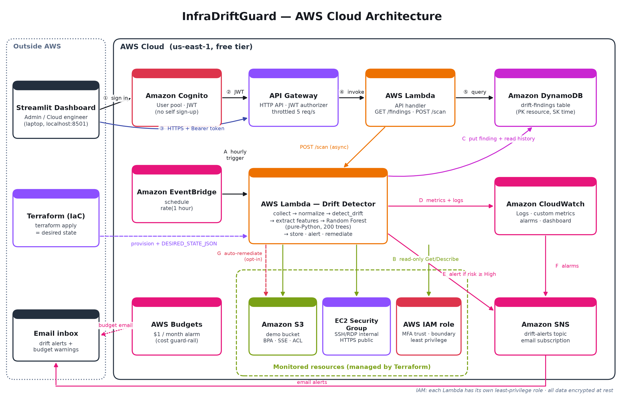
AWS cloud architecture
Notes:
Walk the two paths: A-G detection path triggered hourly by EventBridge; 1-5 user path through Cognito and API Gateway. Terraform renders the desired state into the Lambda environment.

Slide 6
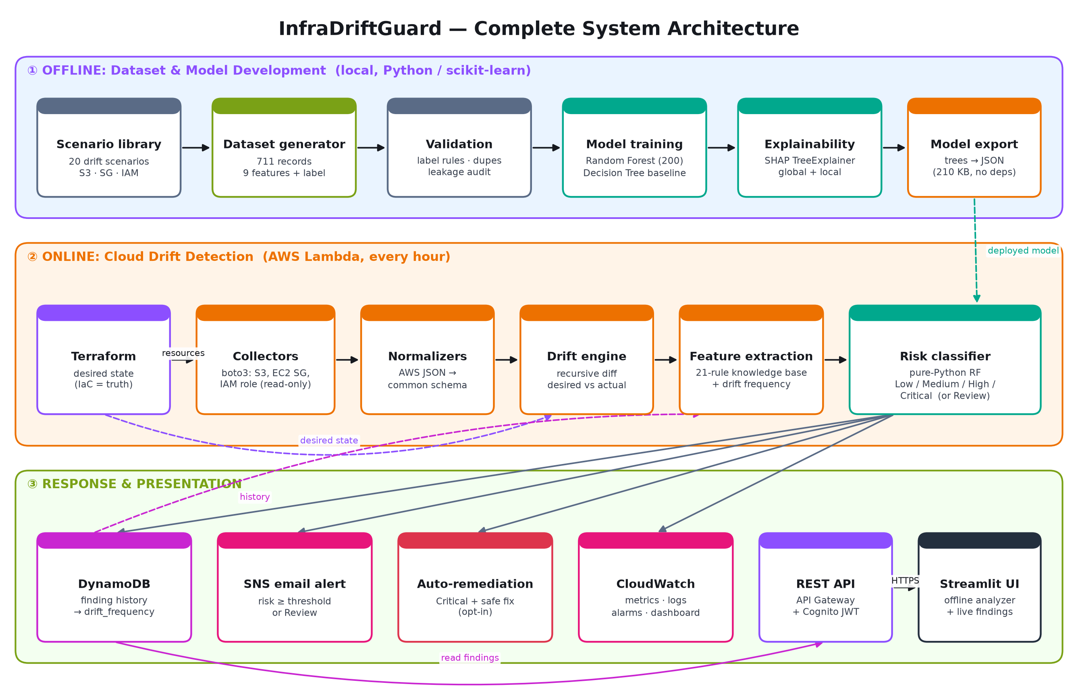
Complete system architecture

Slide 7
Novelty
Runtime, not just code: compares live AWS with Terraform's desired state every hour
Risk level per drift: 9 security features → Low / Medium / High / Critical
Explainable: exact SHAP explanations for every prediction
No guessing: never-seen changes are flagged Review, not forced into a class
Fully serverless AWS: EventBridge → Lambda → DynamoDB / SNS / CloudWatch, Cognito-secured API
Safe automation: opt-in revert of public S3 access and internet-open SSH/RDP only
Free-tier by design: 210 KB dependency-free model, $1 budget guard-rail, least-privilege IAM

Slide 8
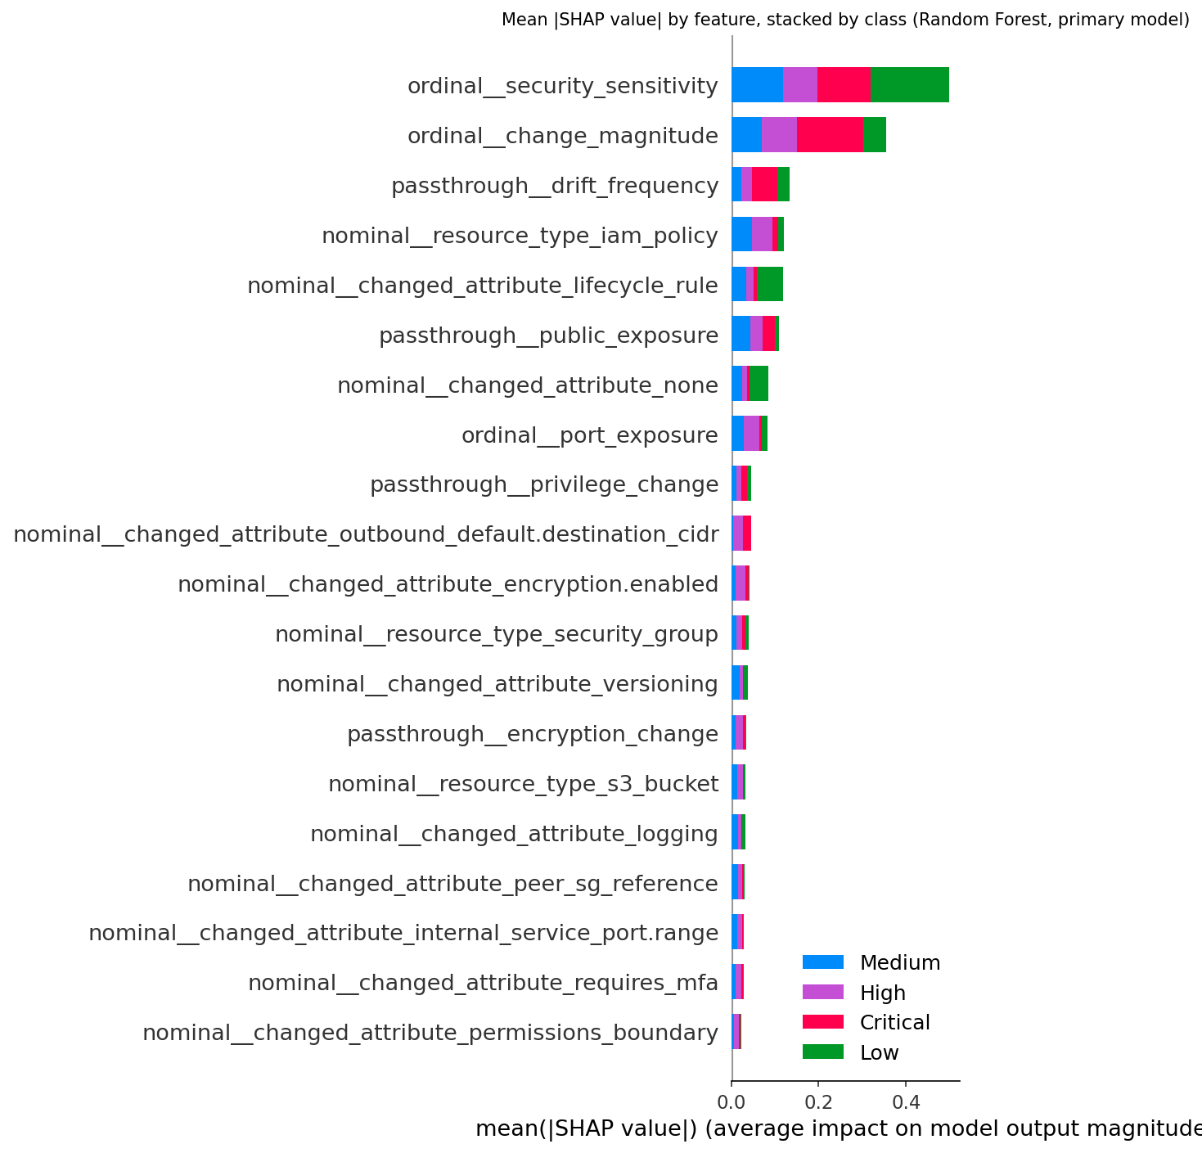
Dataset & model
711 records, 20 drift scenarios (7 S3, 7 security group, 6 IAM), balanced across 4 risk levels
9 features: resource type, changed attribute, sensitivity, public exposure, encryption change, privilege change, port exposure, magnitude, drift frequency
Random Forest (200 trees) + Decision Tree baseline; SHAP TreeExplainer
Exported to 210 KB JSON → pure-Python inference in Lambda, identical to scikit-learn on all 711 records

Slide 9
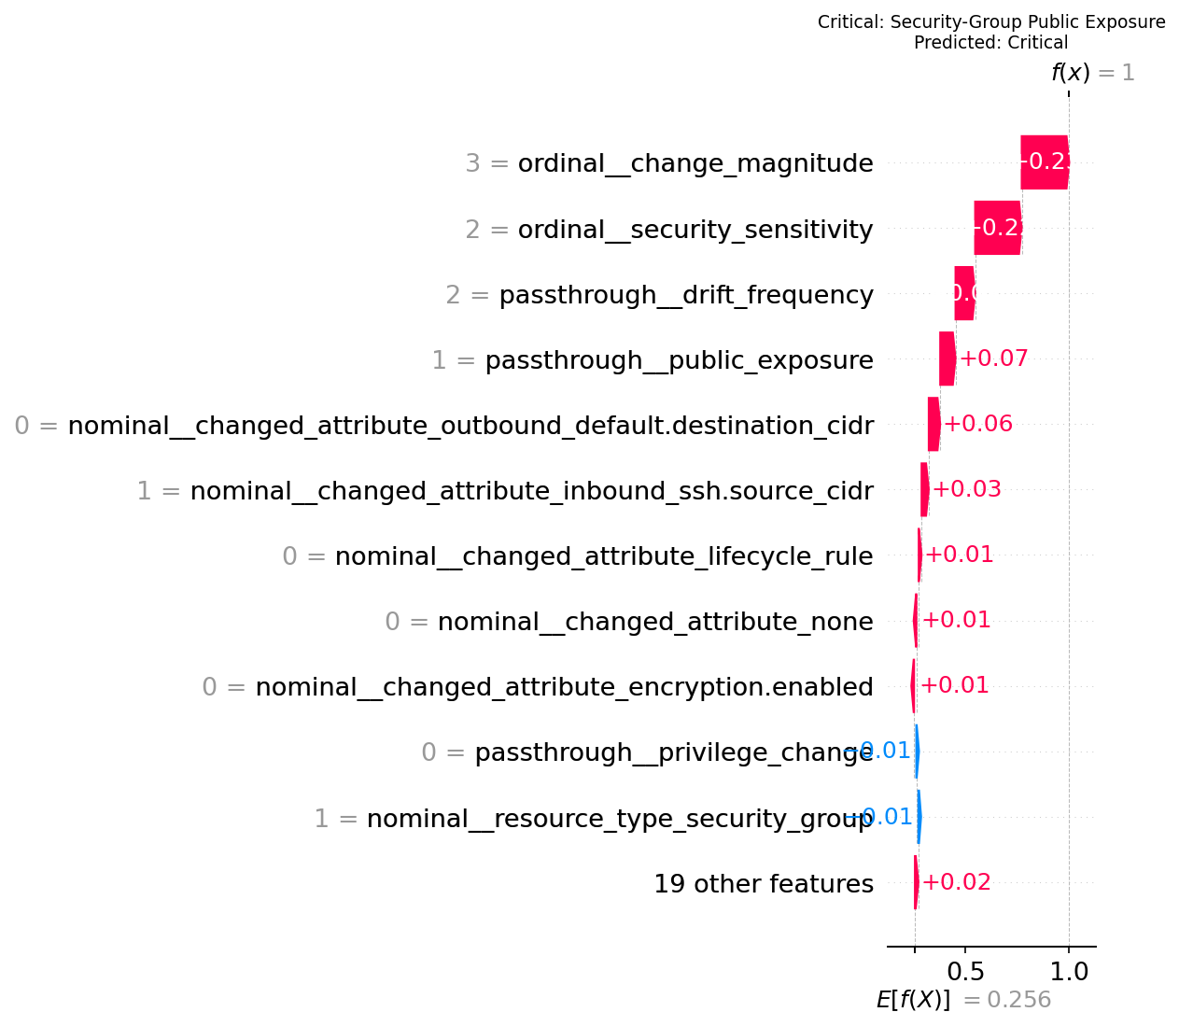
Results
Evaluation | Accuracy | Macro F1
RF – record-level split | 1.000 | 1.000
RF – scenarios held out | 0.370 | 0.296
DT – scenarios held out | 0.706 | 0.565
• 218 automated tests pass (moto-simulated AWS)
• Public SSH → Critical + email; auto-remediation verified
• Unseen change → Review (never guessed)
• Honest limitation: generalisation to new scenarios

Slide 10
Live demo · GitHub · next steps
Demo: terraform apply → open SSH 0.0.0.0/0 in console → Scan now → Critical email → auto-revert
GitHub: InfraDriftGuard_Cloud_Project_2026 — main ← develop ← feature/student1, feature/student2, tag v1.0-Phase1
Cost: $0 within free tier; $1 AWS Budget guard-rail; terraform destroy when done
Phase II: real drift data, CloudTrail event-driven scans, more services (RDS, KMS, VPC), multi-account

