Slide 1
Flutter News Reader App
By Somasundaram V

Slide 2
Problem Statement
Develop a Flutter-based News Reader App for Android that provides users with the latest news articles in an engaging and user-friendly interface. The app should integrate real-time news API fetching, bookmarking functionality, theming, localization, Firebase integration, and a structured UI/UX.

Slide 3
Project Modules
UI Components (Widgets, Styling, Theming)
Navigation & Gestures
API Integration (News API)
Database (Firebase for Bookmarks)
Localization Support

Slide 4
Widgets in Flutter
Widgets are the building blocks of a Flutter app. Types include:
StatelessWidget: Static UI components.
StatefulWidget: Dynamic UI components that change state.
Common Widgets: Text, Buttons, Lists, Images, etc.

Slide 5
Stateless vs Stateful Widgets
Stateless Widgets: Do not change once built
->Text
->Icons
Stateful Widgets: Can change dynamically based on user input
-> Dark mode switch
-> News list refresh

Slide 6
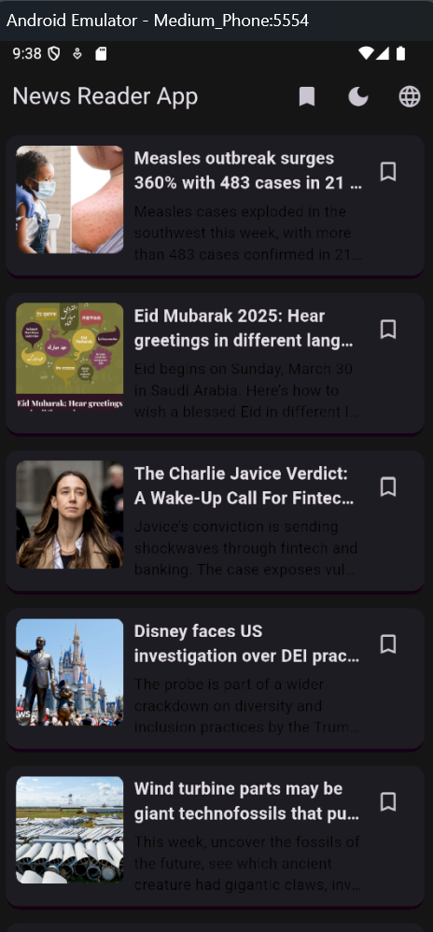
Styling & Theming
Uses ThemeData for global styling.
Supports Light & Dark themes.
Custom fonts, colors, and typography.

Slide 7
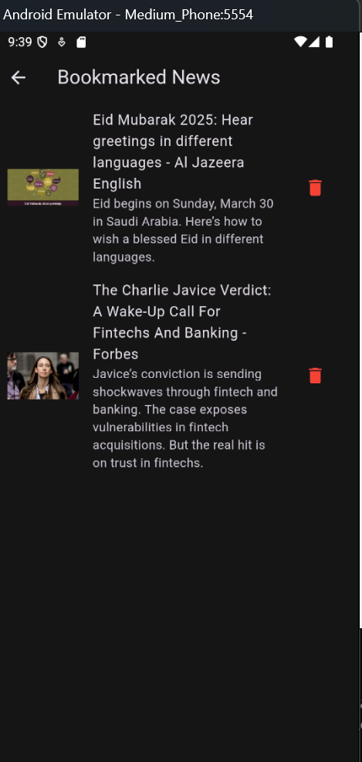
Layouts & Views
Flutter uses Widgets for layout (Column, Row, Stack, GridView).
Adaptive UI for different screen sizes.

Slide 8
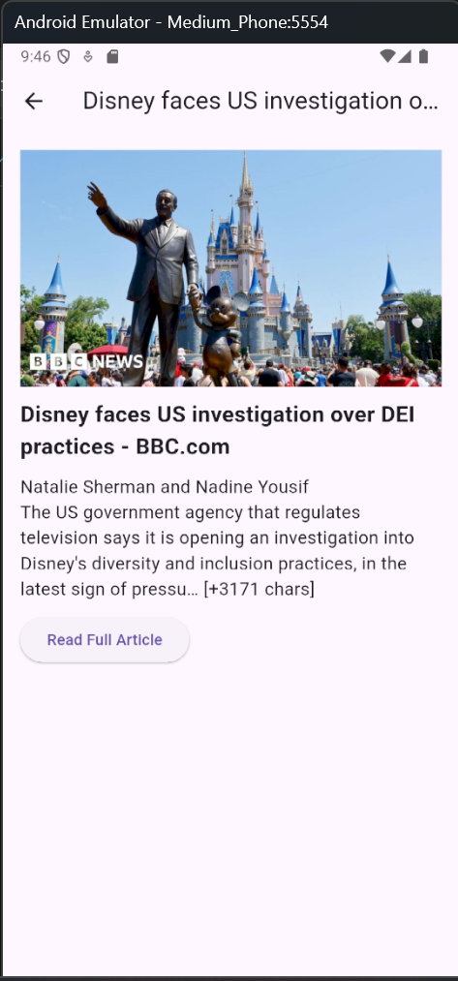
Navigation & Routing
Uses Navigator.push() and Navigator.pop() for page transitions.
Named routes for better management.

Slide 9
Gestures & User Interaction
Supports taps, swipes, and long presses.
GestureDetector widget for custom interactions.

Slide 10
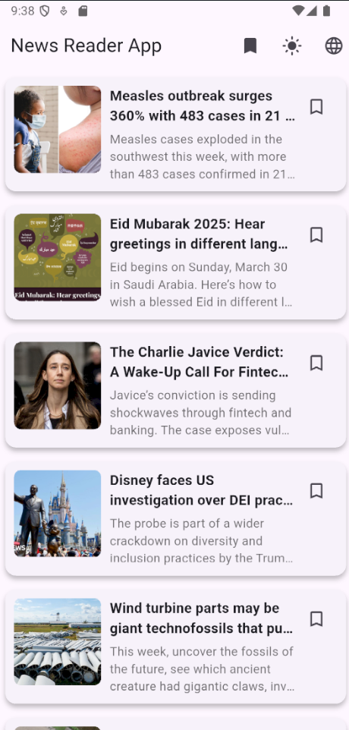
API Integration (News API)
Uses HTTP package for API calls.
Fetches latest news from NewsAPI.
Displays news articles dynamically.

Slide 11
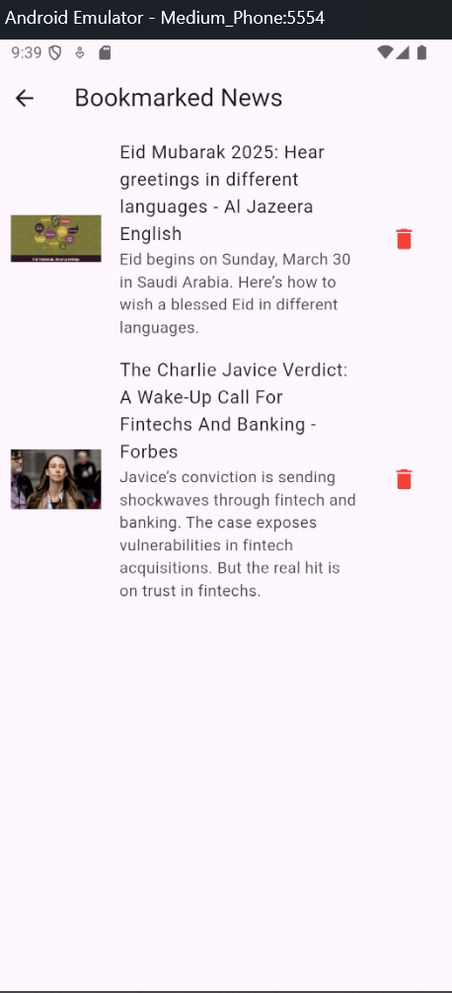
Database & Firebase
Firebase Firestore used for storing bookmarks.
Firestore integration for persistent data.

Slide 12
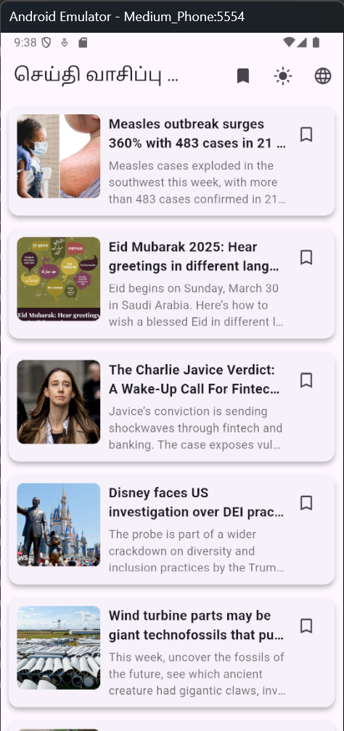
Localization Support
Supports multiple languages (English & Tamil).
Uses Flutter Intl package.
Stores translations in .arb files.

Slide 13
Conclusion
The Flutter News Reader App integrates modern UI, API, Firebase, and Localization techniques to create a feature-rich and scalable application.

