Slide 1
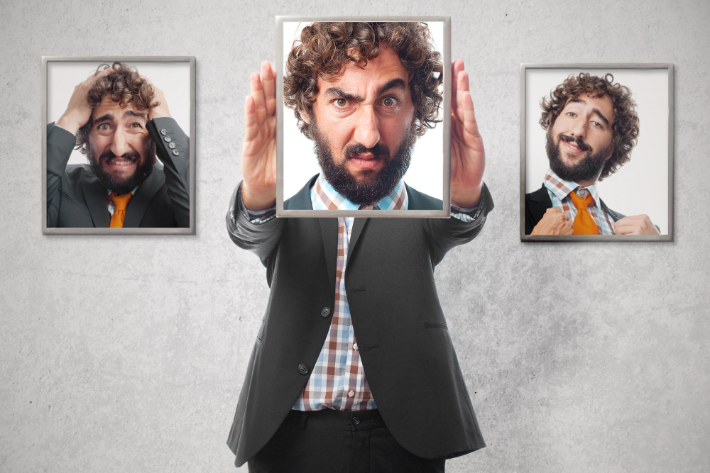
Pessimism
What happens when we avoid reality?

Slide 2

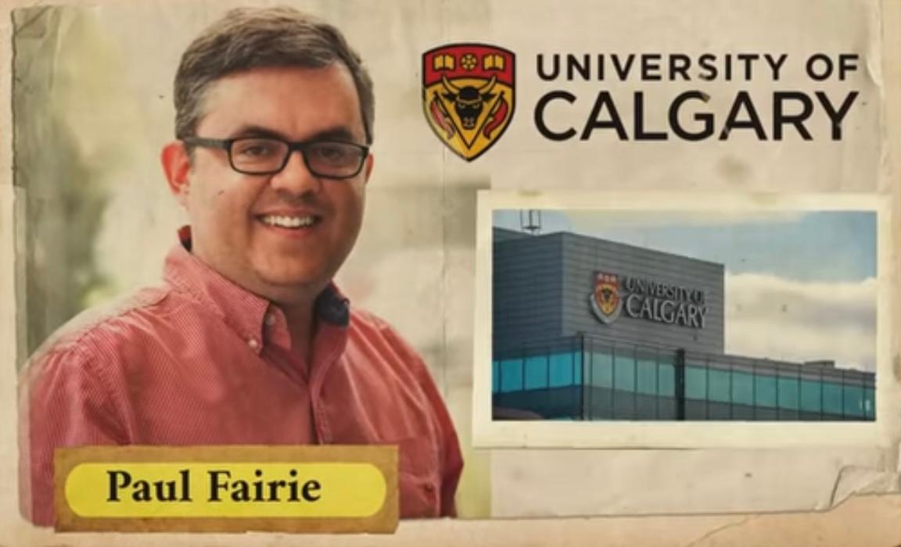
"Gathered predictions from 1923 newspapers"

Slide 3
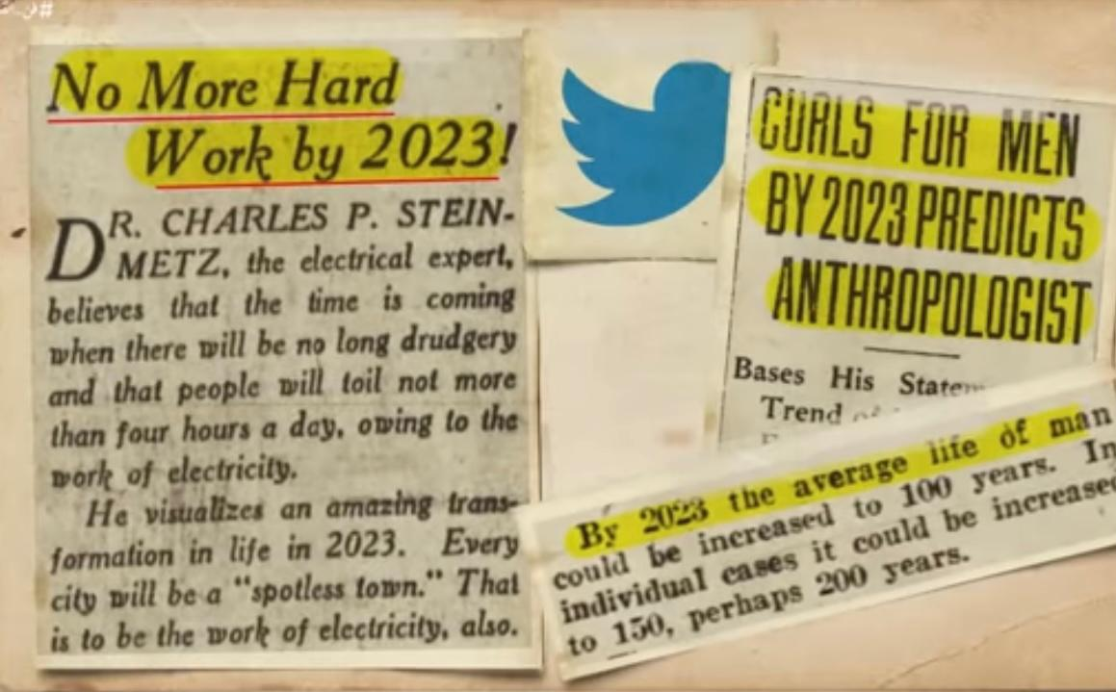
"Shorter working hours, cleaner cities, and longer lives!"

Slide 4
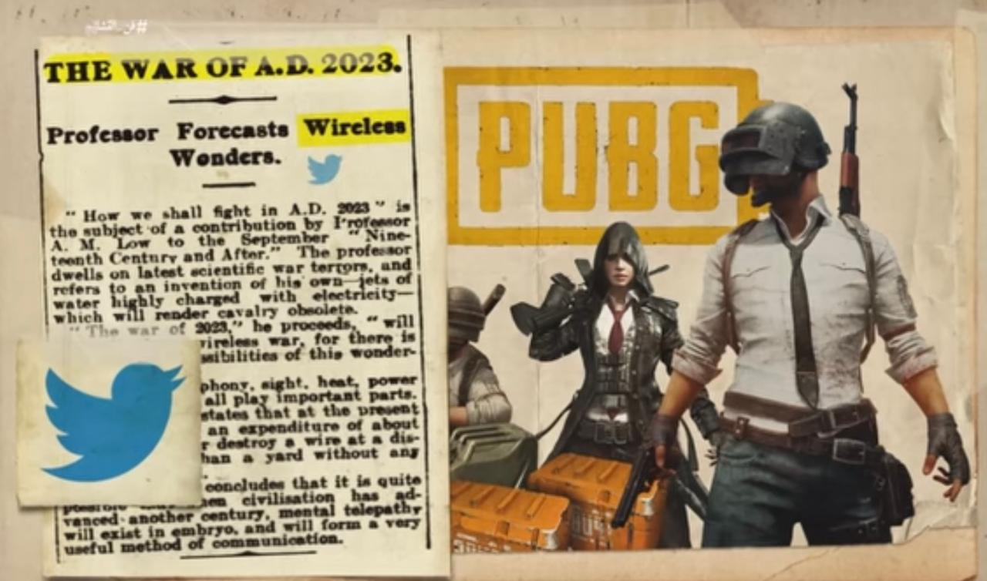
"They thought wars would be wireless, like playing PUBG... but for real."

Slide 5
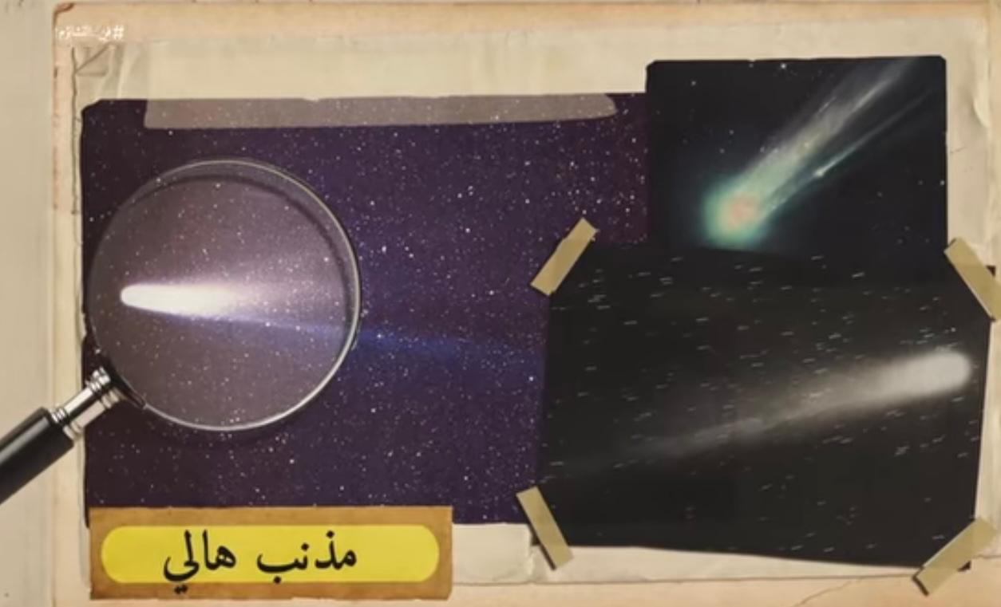
"In 1910, many believed the world would end with Halley's Comet."
"1910: The Sky's Evil"

Slide 6
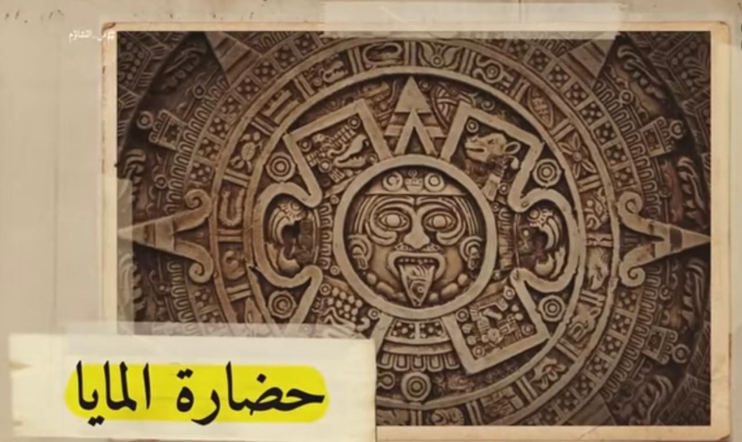
"End of the World? 2012 Predictions"
"On December 21st, 2012, the world didn't end... but the predictions lived on."

Slide 7

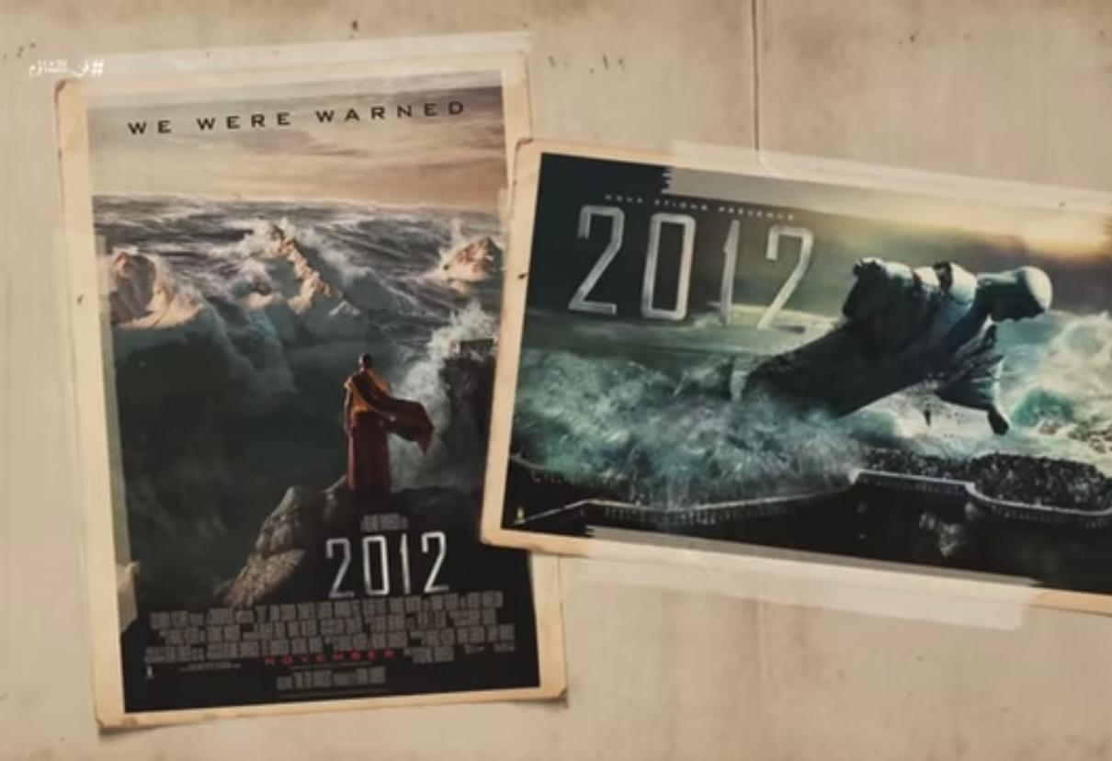
"When the movie 2012 was released in 2009, it caused mass panic among people who believed it was a real prediction of the apocalypse."
"NASA had to release an official statement reassuring everyone: 'It's just a movie!'"

Slide 8
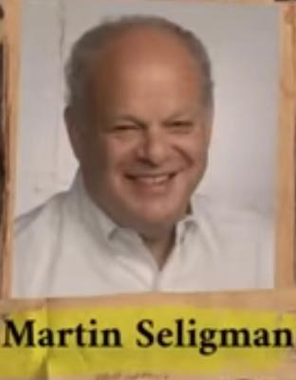
"Homo Prospectus - The Creature of the Future“ (Homo Sapiens)
"Martin Seligman describes humans as Homo Prospectus, a species that focuses more on future scenarios than living in the present."
"Our actions today are shaped by our expectations of the future – be it optimistic or fearful." "Optimism is the hopeful vision, while pessimism is the fearful one."
"The Power of Future Scenarios"

Slide 9
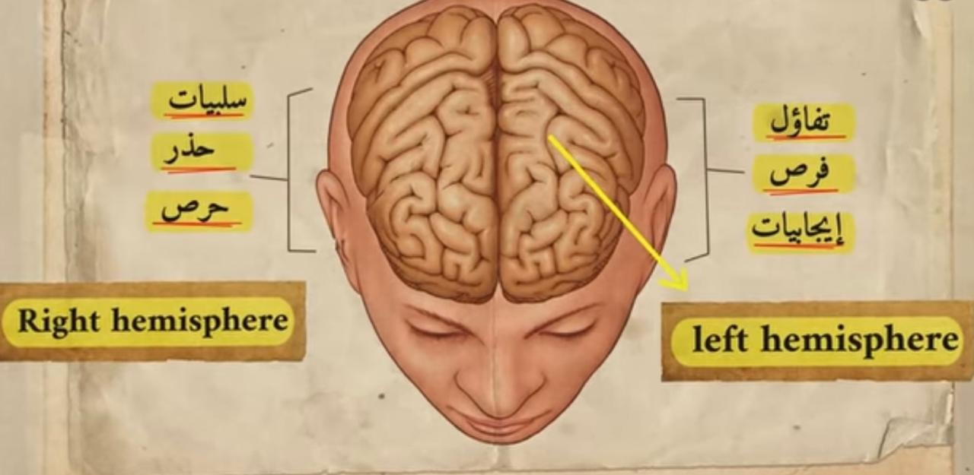
"The study 'The Neural Basis of Optimism and Pessimism' (2013)
"The Brain's Dual Nature: Optimism vs. Pessimism"

Slide 10
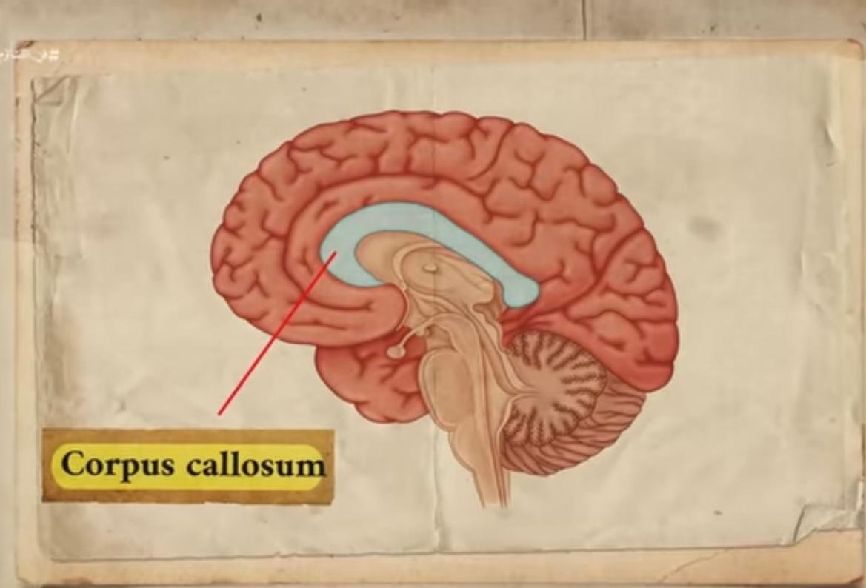
"Corpus Callosum: Uniting the Brain's Two Halves"
"Your brain isn't split into two voices, but uses a massive neural network to create one cohesive voice that blends information from both sides and shapes your perception."

Slide 11
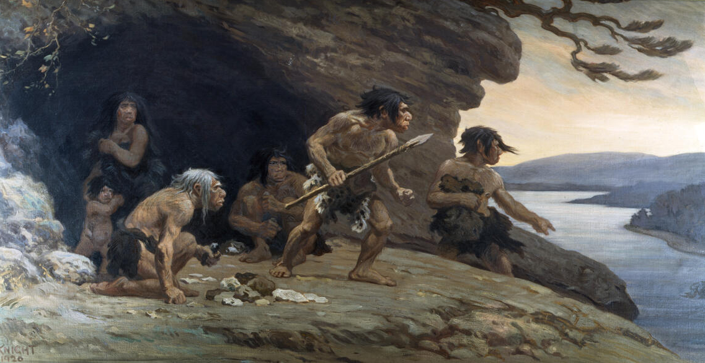
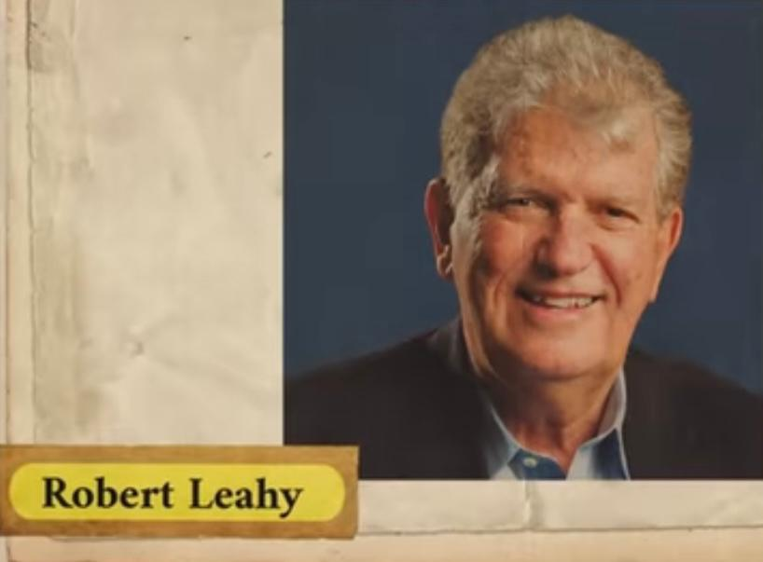
In prehistoric times, our ancestors were wired to focus on the negative for survival. A rustling sound in the trees? It was safer to assume danger rather than ignore it. “(you can always be the one) “
evolved bias toward negative

Slide 12

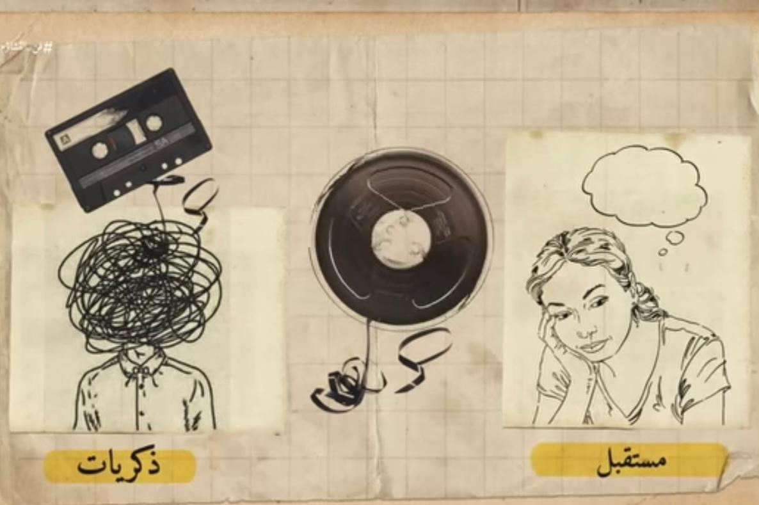
"Memory and imagination both rely on the hippocampus — and both are colored by hope."

Slide 13
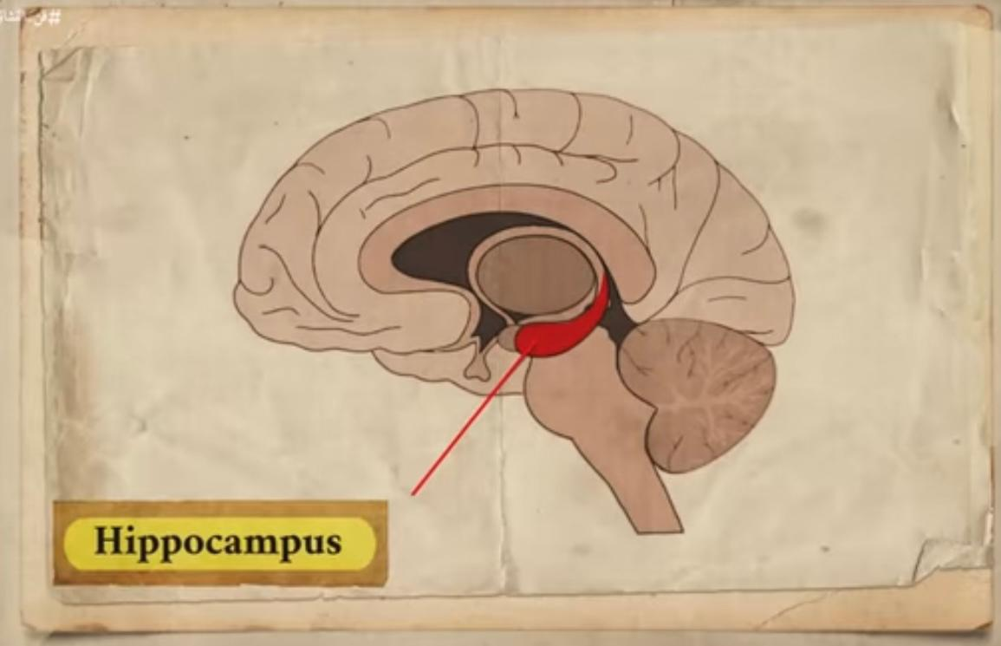
"Both memory (past) and imagination (future) depend on the same brain area: the hippocampus."

Slide 14
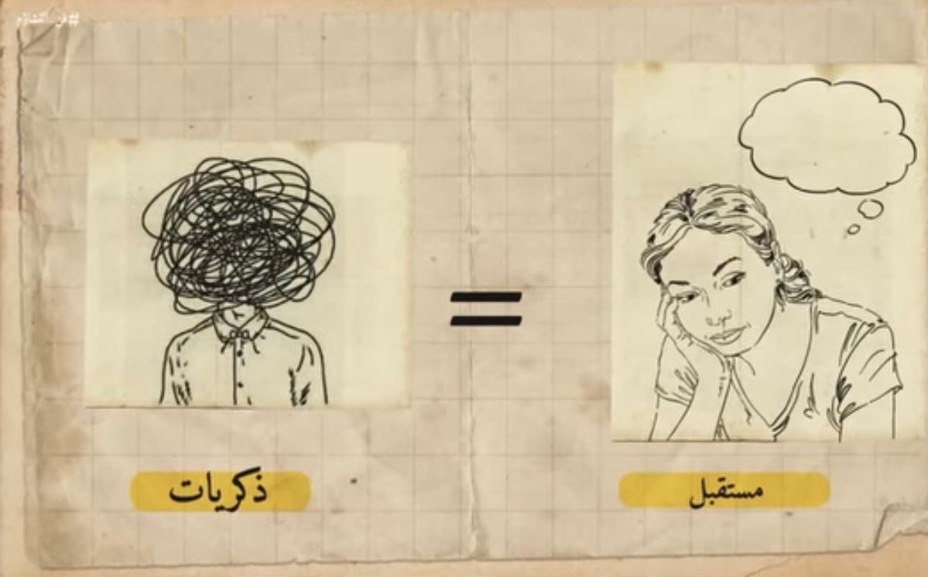
Hollywood Director Effect
(Neural memory system)
جهاز الذاكرة العصبي
"Our brain edits memories and imaginations like a Hollywood movie."

Slide 15
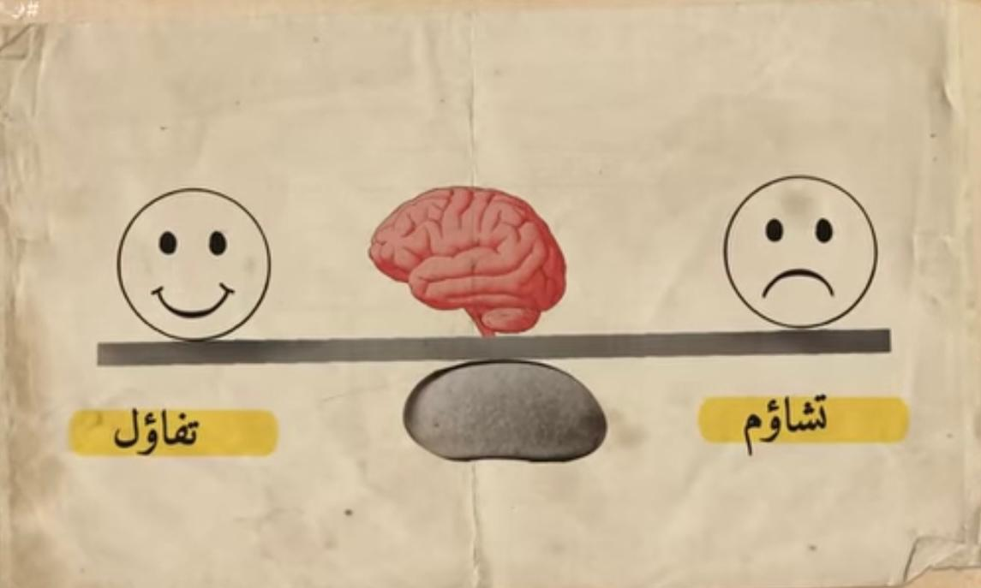
Balance Between Optimism and Pessimism
"Survival needs pessimism. Growth needs optimism. Success needs balance."

Slide 16
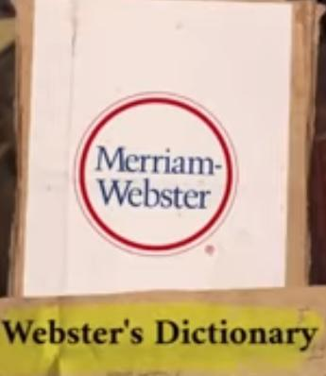
"Webster’s Dictionary:.
Attribution of reality to what one wishes to be true..
The Danger of “Wishful Thinking”
"Pessimism keeps us grounded. Wishful thinking can break reality."

Slide 17
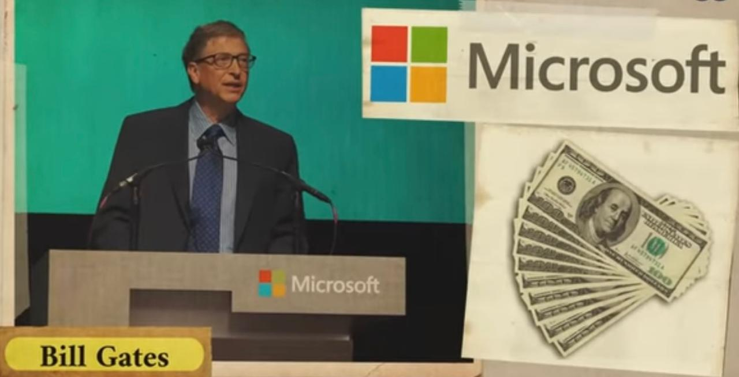
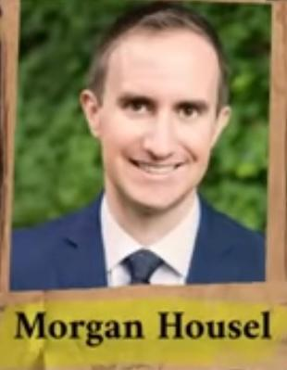
The Hidden Side of Success
"Behind optimism lies strategic paranoia: Bill Gates saved enough cash to keep Microsoft
Alive for “12 months” — expecting no profits."

Slide 18
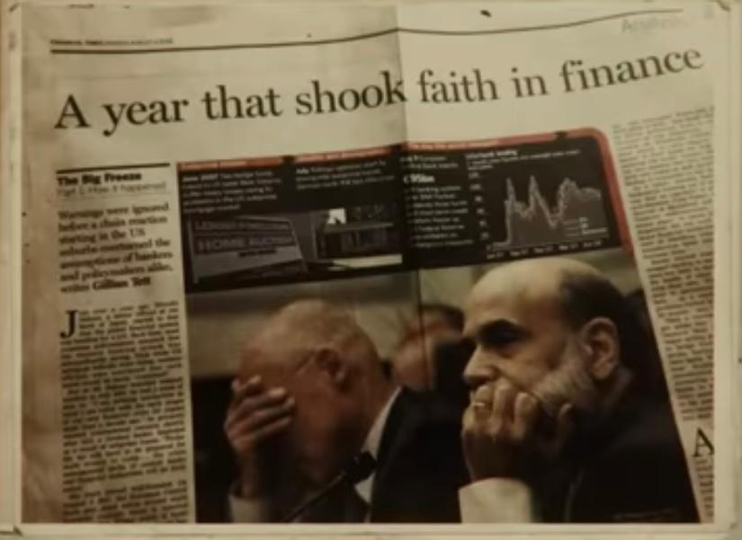
When Positive Thinking Turns Dangerous “A global economic disaster…”
"One of the reasons for the 2008 crisis was excessive Positive Thinking.“

Slide 19
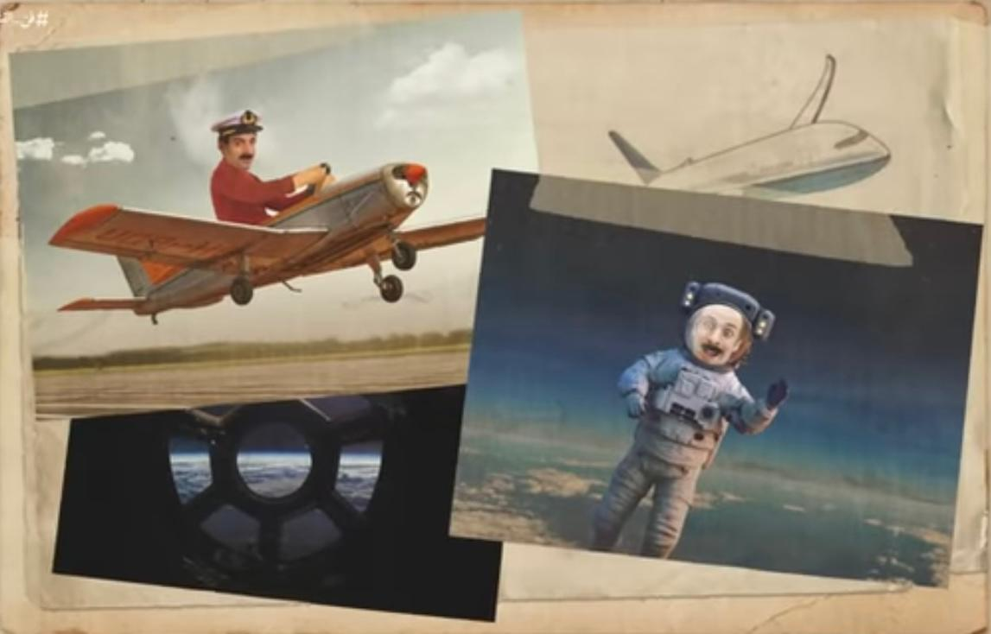
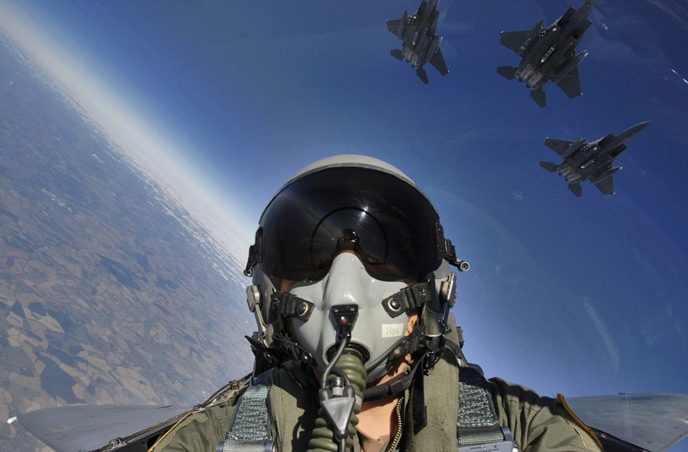
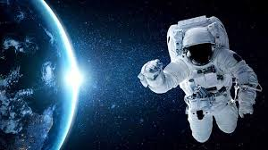
we would never have turned them into reality.
If we hadn't followed optimistic thinking..
Effects of Optimism on Creativity:.

Slide 20
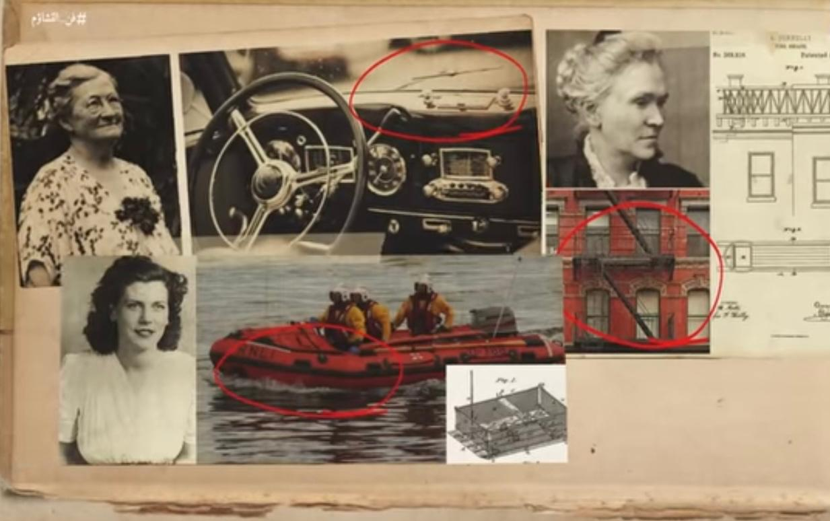
How Women Shaped Safety Inventions:
“ From Windshield Wipers to Lifeboats "
"Women Are Often More Pessimistic Than Men, Explaining Their Role in Inventing Safety Innovations”
(wishful thinking)

Slide 21


