Slide 1
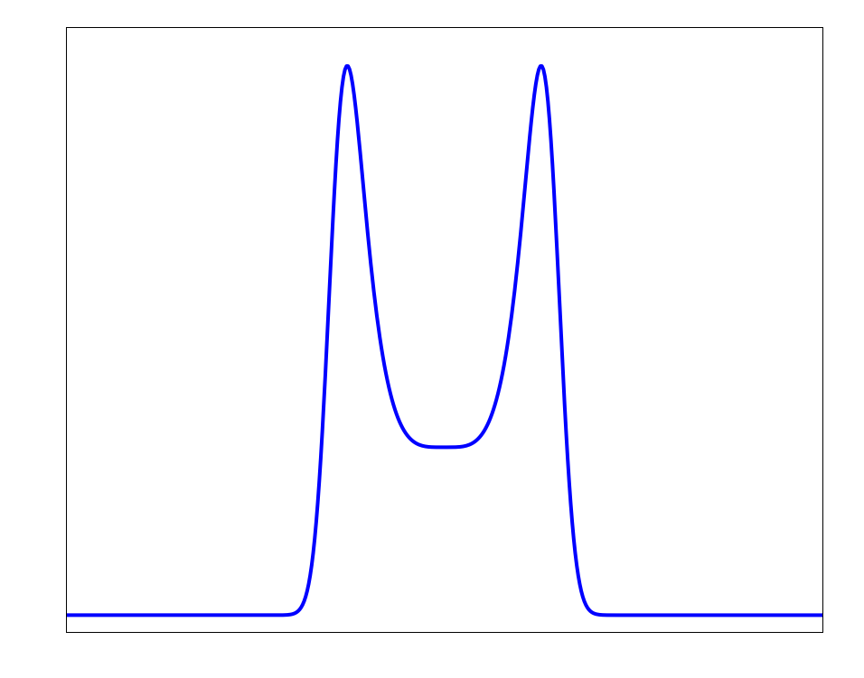







$$c$$
$$n$$
Magnification
$δ$₁
$δ$₂
$$w$$
$$a$$
$$x_{e} {,x}_{p}$$
Time

