Slide 1
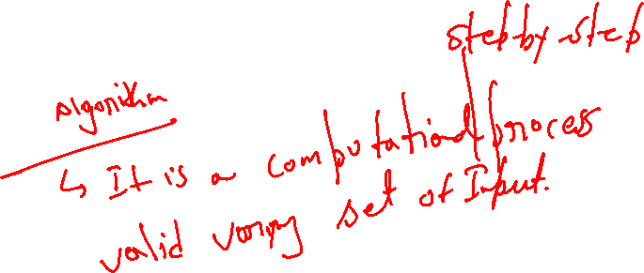
Designing and Analysis of Algorithms Course Code: ECS 5101
Dr Rahul Mishra
IIT Patna
Lecture 1

Slide 2
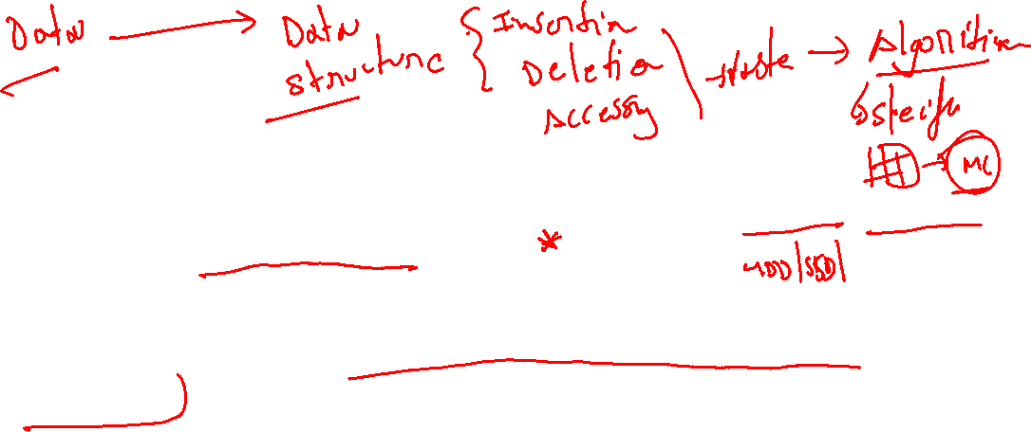
Data
Data refers to any set of information that can be stored, analysed, and used to inform decision-making.
Data can take many forms, such as numbers, words, images, or any other type of input that can be recorded digitally or manually.
Data can come from various sources, including sensors, surveys, databases, social media, and more.

Slide 3
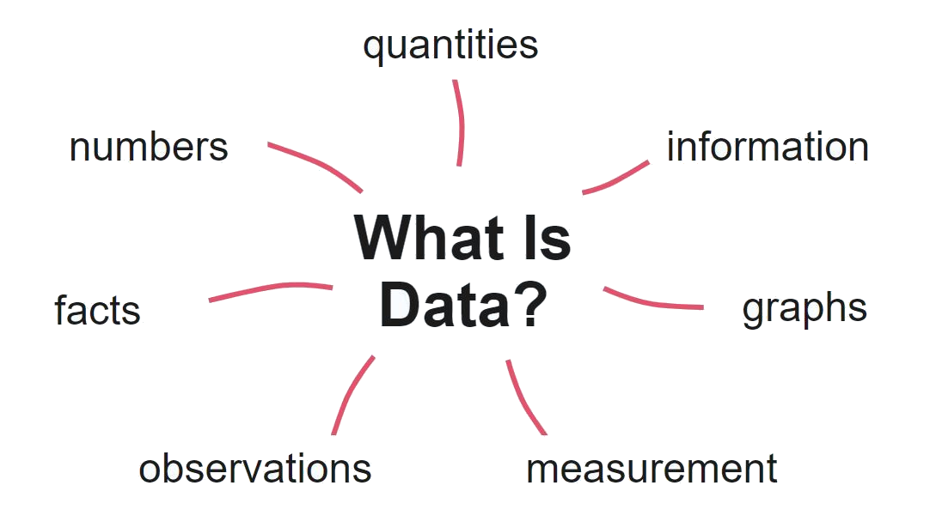
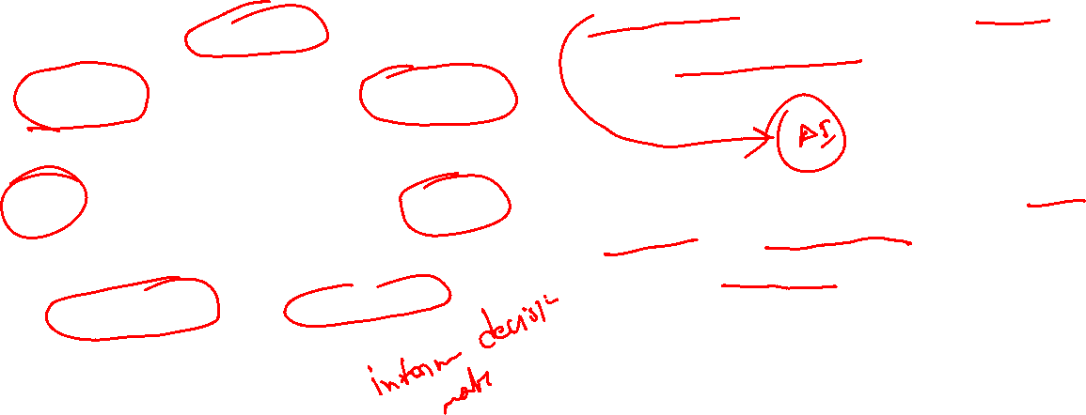
In order to be useful, data must be organized, analysed, and interpreted.
Data analysis involves using statistical and computational tools to identify patterns, trends, and relationships within the data.
This analysis can be used to draw conclusions, make predictions, and inform decision-making in a wide variety of fields, including business, healthcare, science, and more.
Data

Slide 4

Data Structure
Data may be organized in many different ways; the logical or mathematical model of a particular organization of data is called a data structure.
The choice of particular data structure depends on two considerations:
1). It must be rich enough in structure to mirror the actual relationships of the data in the real world.
2). The structure should be simple enough that one can effectively process the data when necessary.

Slide 5
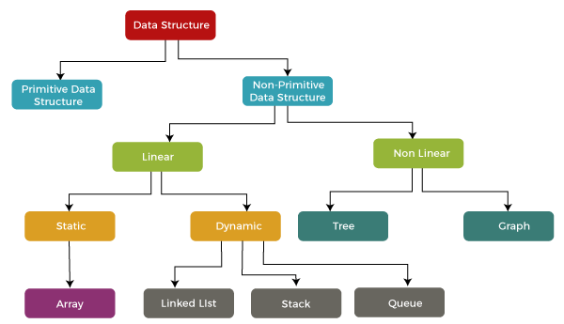
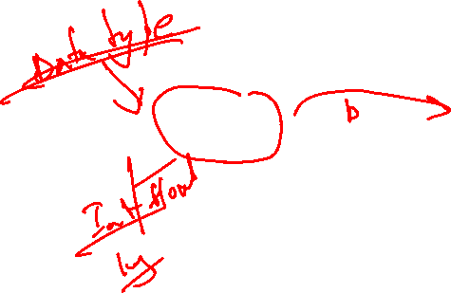
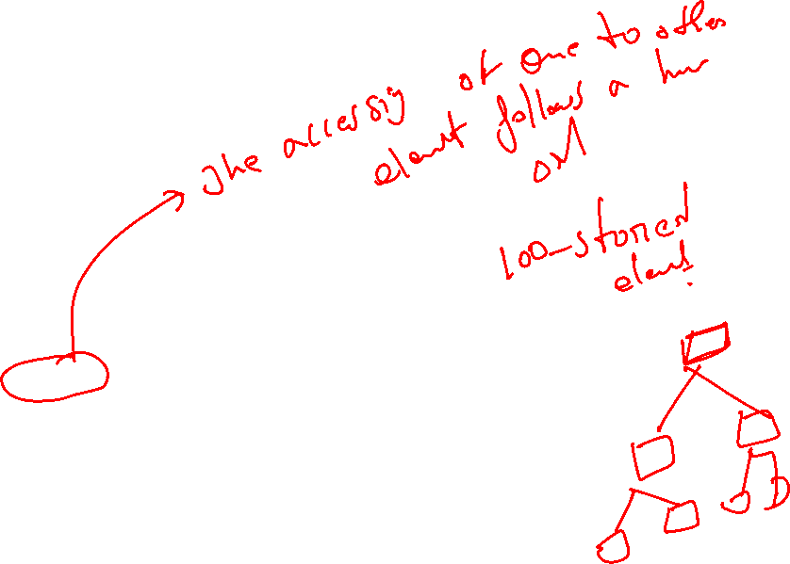
Data Structure

Slide 6
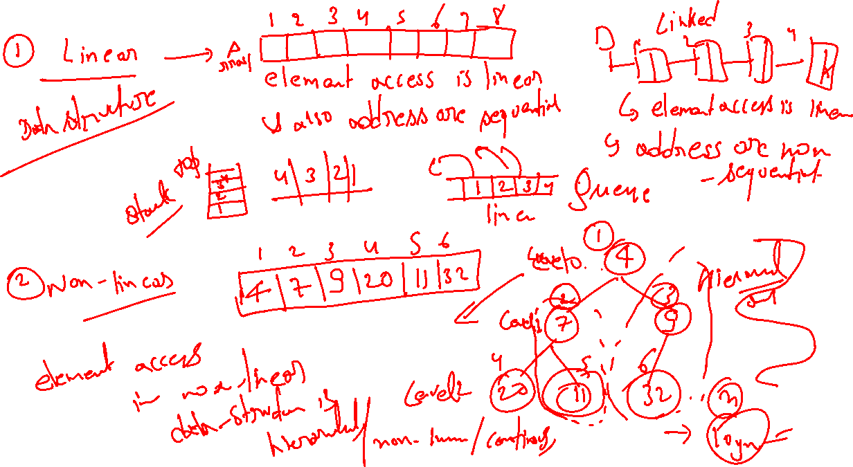

Slide 7
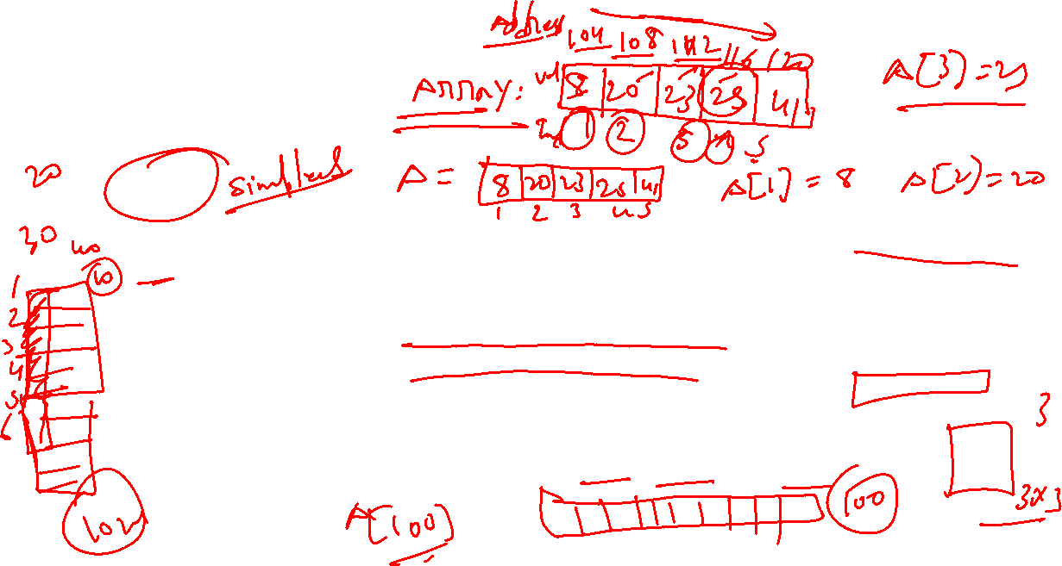
Data Structure
Arrays
An array is a data structure that stores a collection of elements, all of the same type, in contiguous memory locations.
The elements in an array are accessed using an index, which is an integer value that represents the position of the element in the array.
Arrays are commonly used for a variety of tasks, including storing and manipulating collections of data such as lists, tables, and matrices.

Slide 8
Arrays
It can also be used to represent data structures such as stacks, queues, and trees.
In most programming languages, arrays have a fixed size, meaning that once an array is created, its size cannot be changed.
Some languages also support dynamic arrays, which can grow or shrink in size as needed.
Arrays are a fundamental data structure in computer programming and are used extensively in a wide range of applications, including scientific computing, data analysis, and web development.

Slide 9
Linked Lists
A linked list is a linear data structure in computer science that is used to store a sequence of elements or nodes.
Linked lists are not stored in contiguous memory locations. Instead, each element or node in a linked list contains a reference to the next node in the sequence.
The first element in the sequence is called the head of the linked list, and the last element is called the tail. Each node in a linked list contains two fields, one for storing the data and the other for storing a reference to the next node. The last node in the list has a null reference as its "next" field to signify the end of the list.
There are several types of linked lists, including singly linked lists (where each node has a reference to only the next node), doubly linked lists (where each node has a reference to both the next and previous nodes), and circular linked lists (where the last node in the list has a reference to the first node, creating a loop).

Slide 10
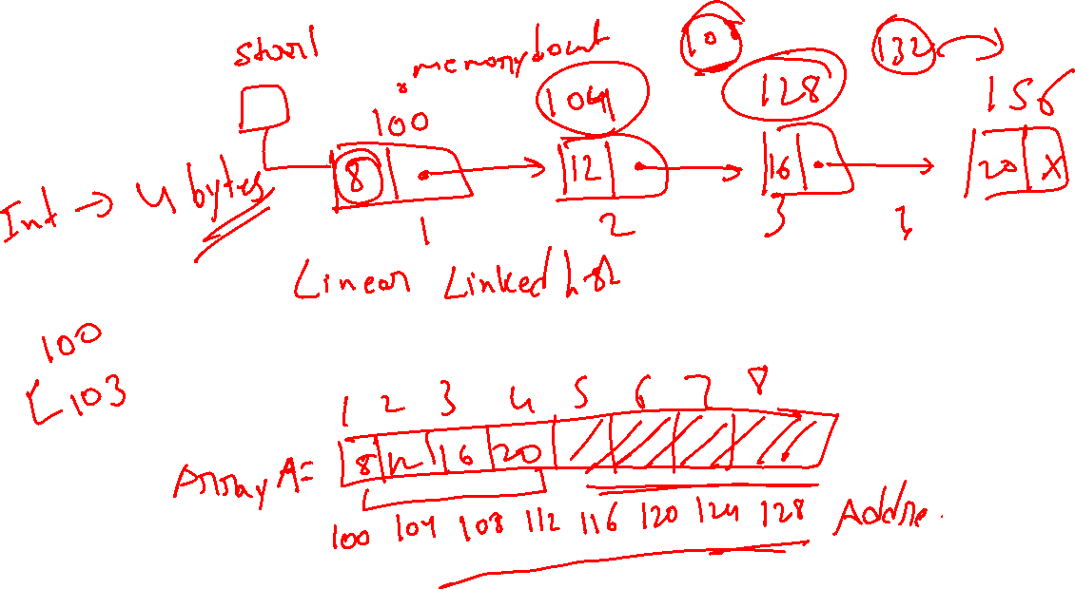
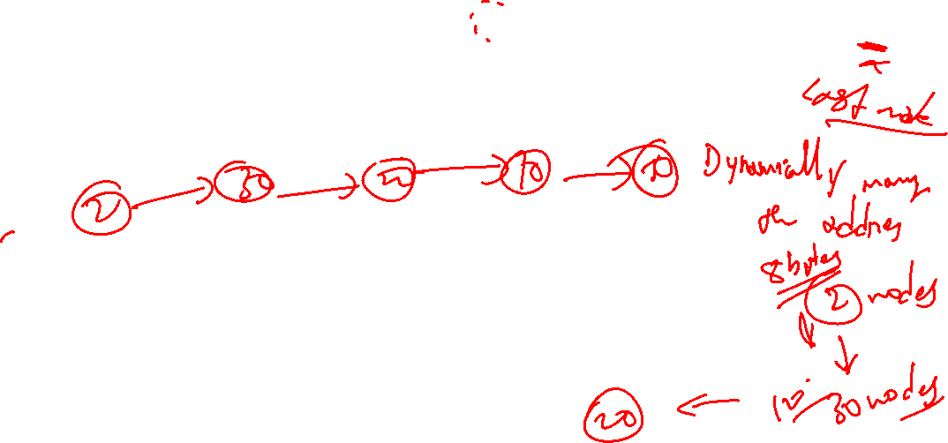

Slide 11
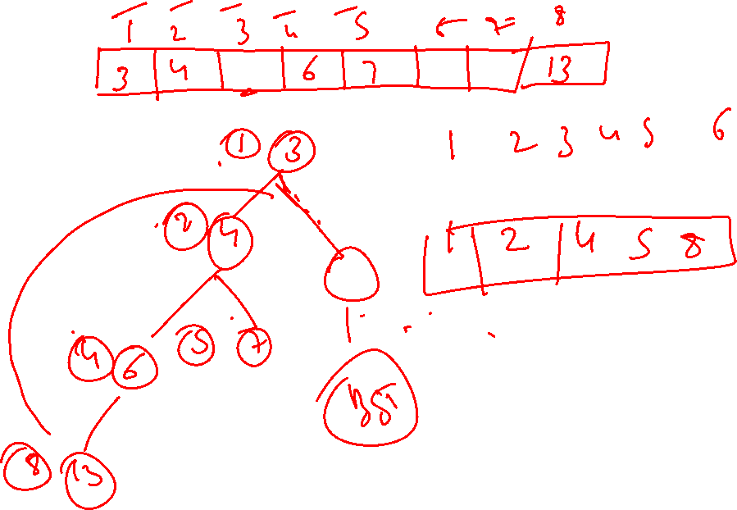

Slide 12
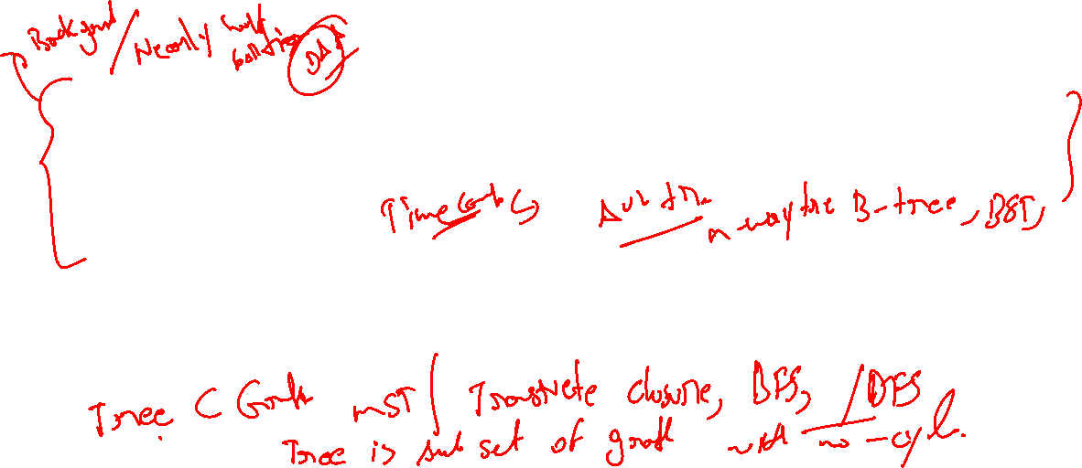
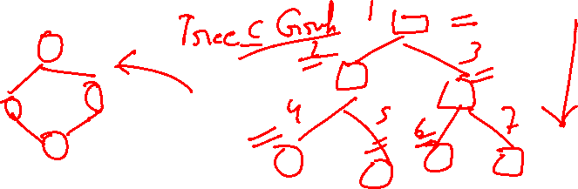
Data Structure
Tree and Graph
A tree is a hierarchical data structure consisting of nodes connected by edges. It is a special type of graph where each node has exactly one parent, except for the root node which has no parent. A tree is a recursive data structure because each node can have its own subtree. Trees are commonly used to represent hierarchical structures, such as file systems, organizational charts, and family trees.
A graph is a collection of nodes, also called vertices, that are connected by edges. Unlike a tree, a graph can have multiple edges between the same pair of nodes and can also have cycles, which are loops that start and end at the same node. Graphs are used to represent complex relationships between objects or entities, such as social networks, road maps, and computer networks.

Slide 13

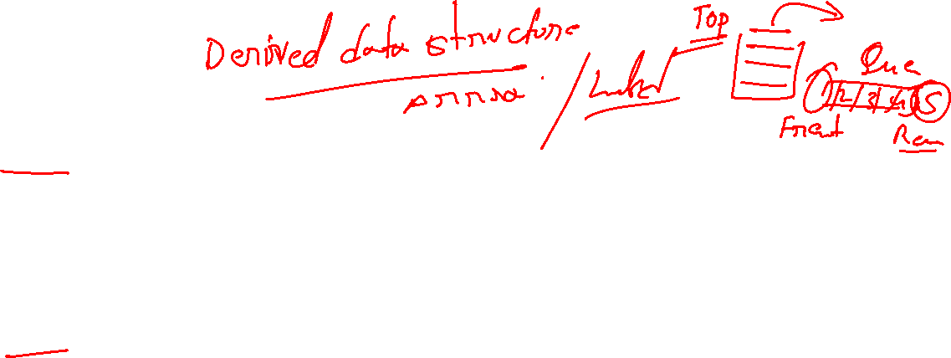
Stack and Queue
A stack is a data structure that stores elements in a last-in-first-out (LIFO) order. This means that the last element added to the stack is the first one to be removed. Elements can only be added or removed from the top of the stack. This makes a stack useful for tasks such as keeping track of function calls in a program, undoing operations in a text editor, or processing expressions in a calculator.
A queue, on the other hand, is a data structure that stores elements in a first-in-first-out (FIFO) order. This means that the first element added to the queue is the first one to be removed. Elements can only be added at the back of the queue and removed from the front. This makes a queue useful for tasks such as processing requests in a web server, printing documents in a printer, or handling messages in a message queue.

Slide 14
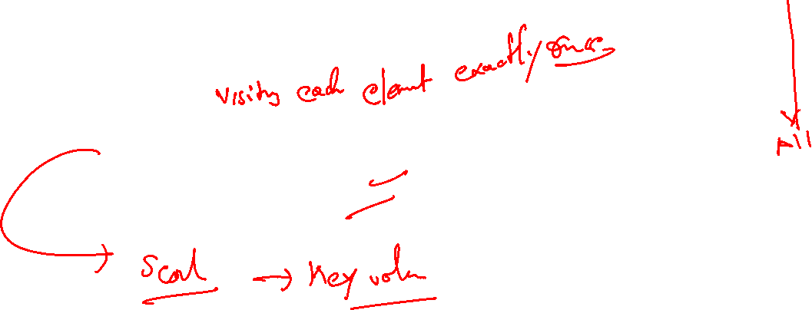
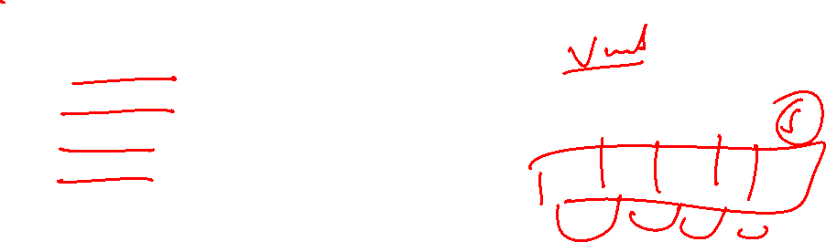
Data Structure Operations
Traversing: Accessing each record exactly once.
Searching: Particular record finding
Inserting: Adding a new record
Deleting: Removing record

Slide 15

Linear and Non-Linear Data Structures
Criteria | Linear Data structure | Non-Linear Data structure
Basic | In this structure, the elements are arranged sequentially or linearly and attached to one another. | In this structure, the elements are arranged hierarchically or non-linear manner.
Types | Arrays, linked list, stack, queue are the types of a linear data structure. | Trees and graphs are the types of a non-linear data structure.
Implementation | Due to the linear organization, they are easy to implement. | Due to the non-linear organization, they are difficult to implement.
Traversal | As linear data structure is a single level, so it requires a single run to traverse each data item. | The data items in a non-linear data structure cannot be accessed in a single run. It requires multiple runs to be traversed.
Arrangement | Each data item is attached to the previous and next items. | Each item is attached to many other items.

Slide 16
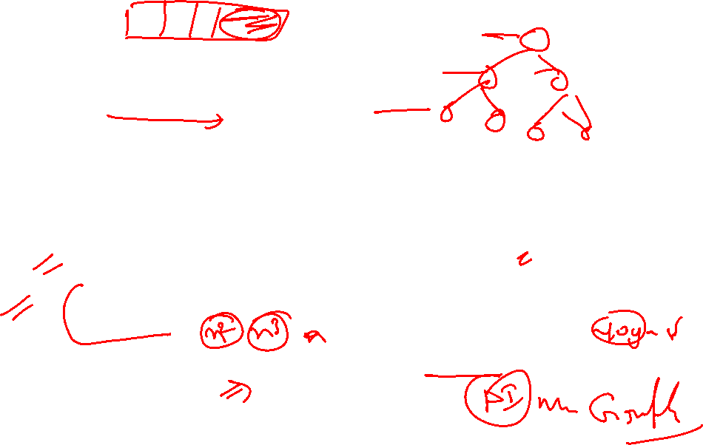
Linear and Non-Linear Data Structures
Criteria | Linear Data structure | Non-Linear Data structure
Levels | This data structure does not contain any hierarchy, and all the data elements are organized in a single level. | In this, the data elements are arranged in multiple levels.
Memory utilization | In this, the memory utilization is not efficient. | In this, memory is utilized in a very efficient manner.
Time complexity | The time complexity of linear data structure increases with the increase in the input size. | The time complexity of non-linear data structure often remains same with the increase in the input size.
Applications | Linear data structures are mainly used for developing the software. | Non-linear data structures are used in image processing and Artificial Intelligence.

Slide 17
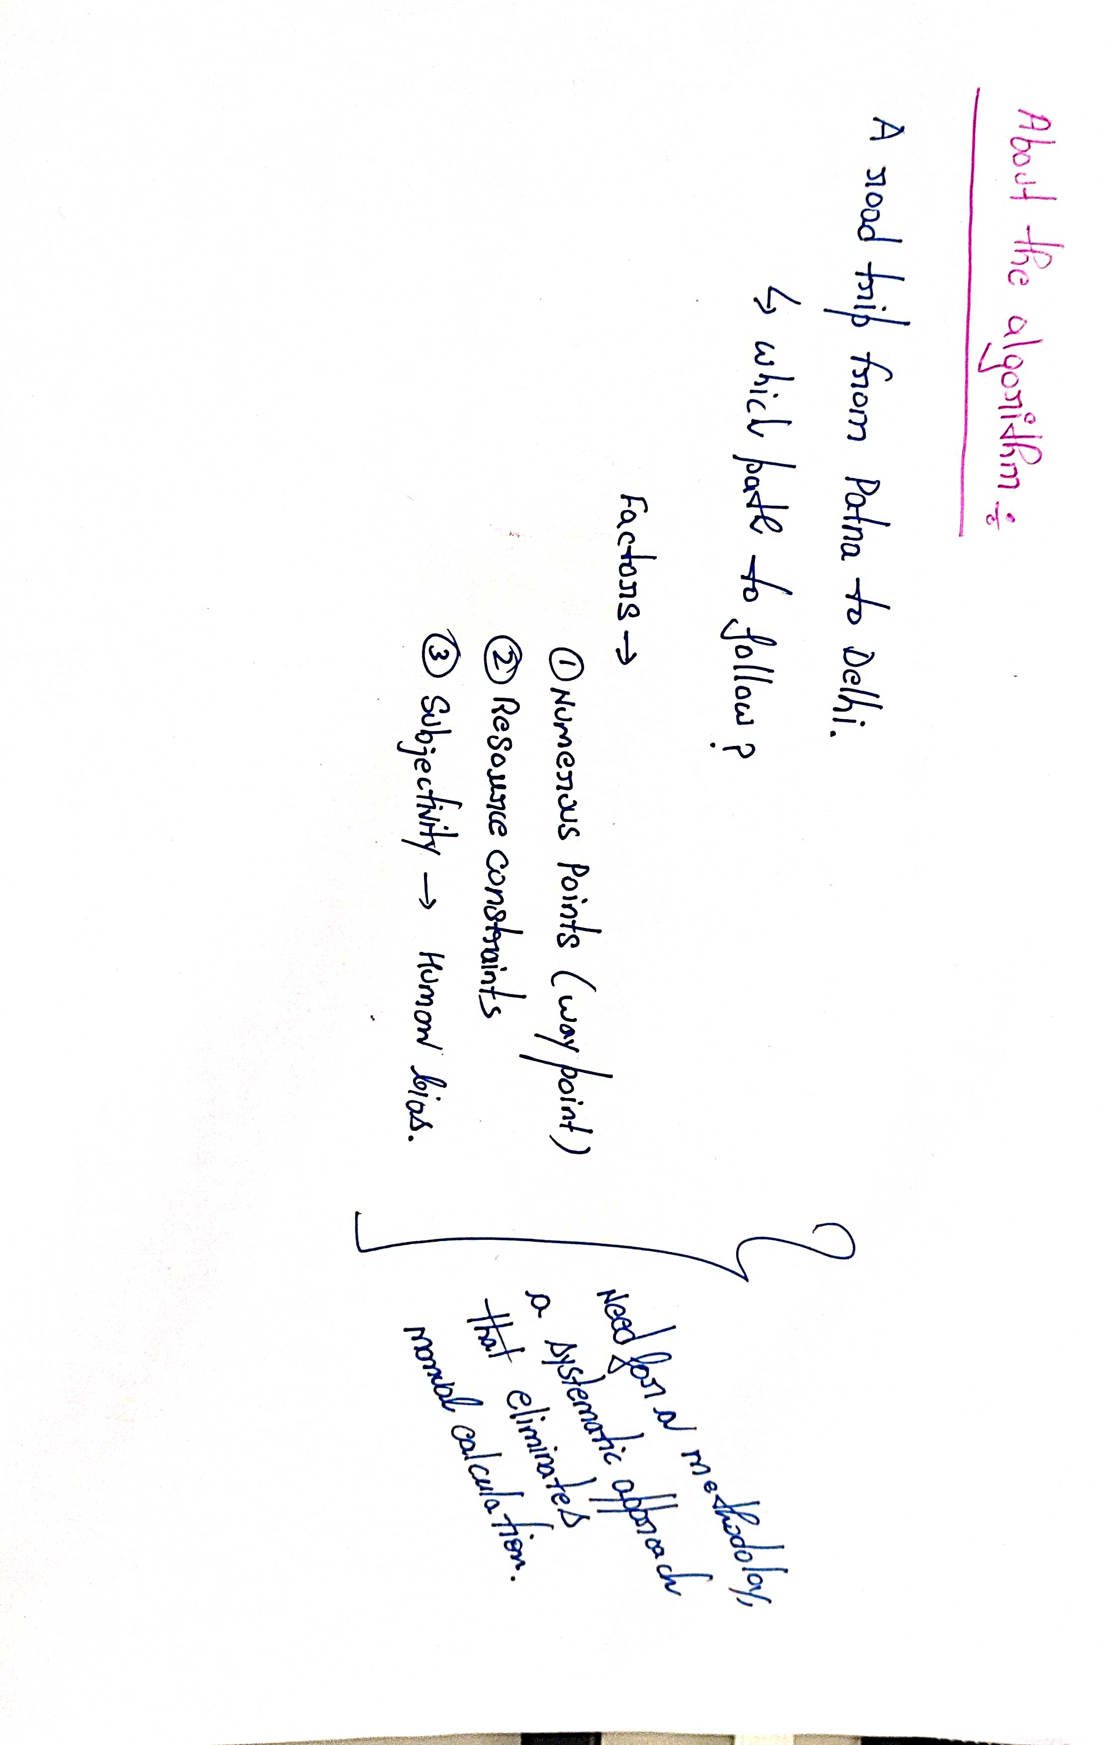
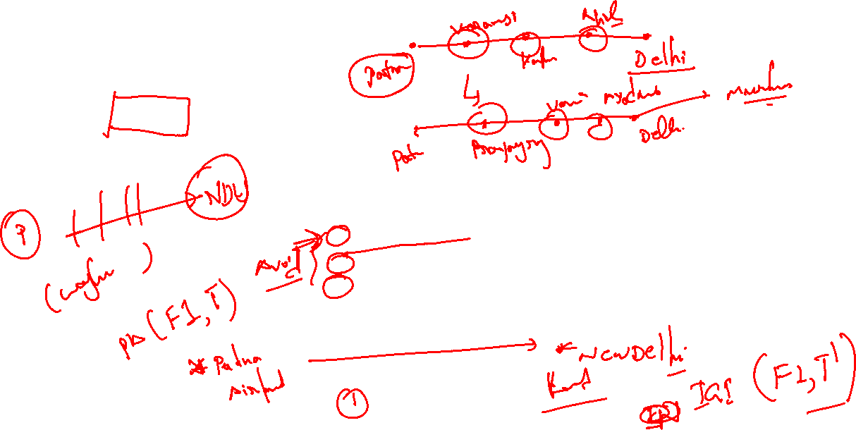

Slide 18
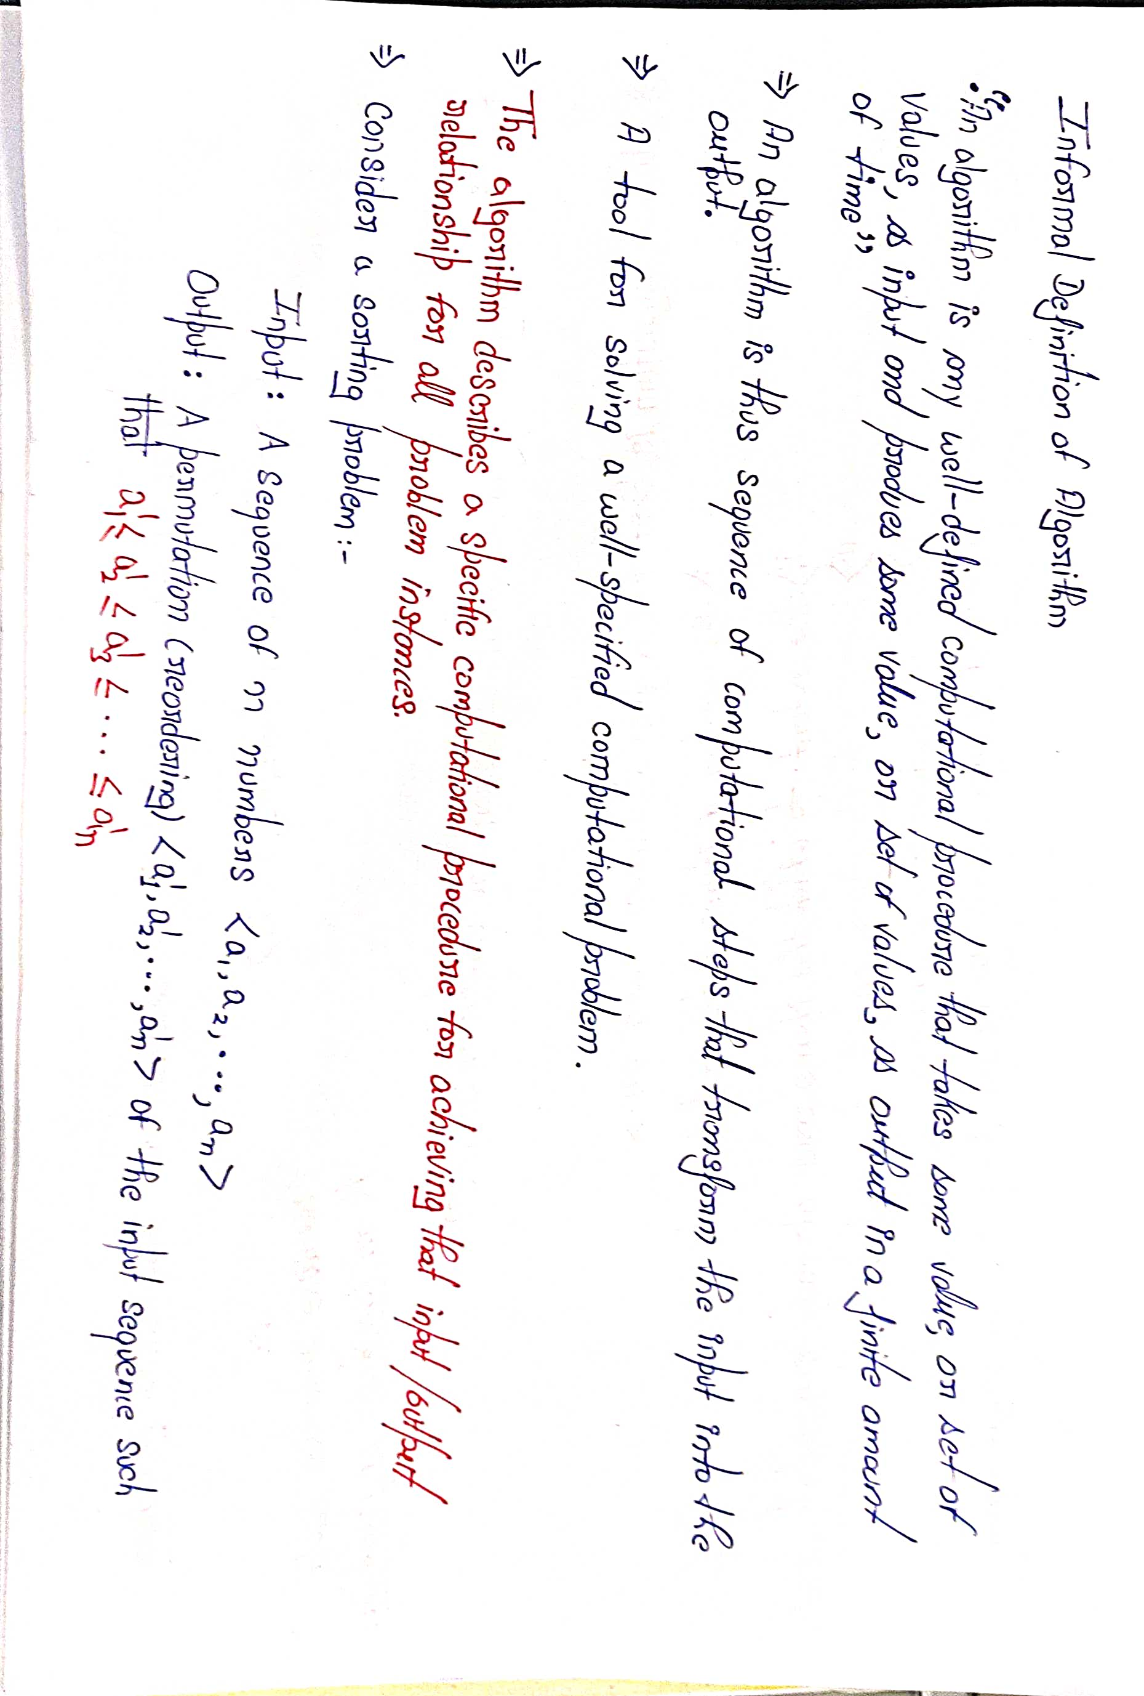
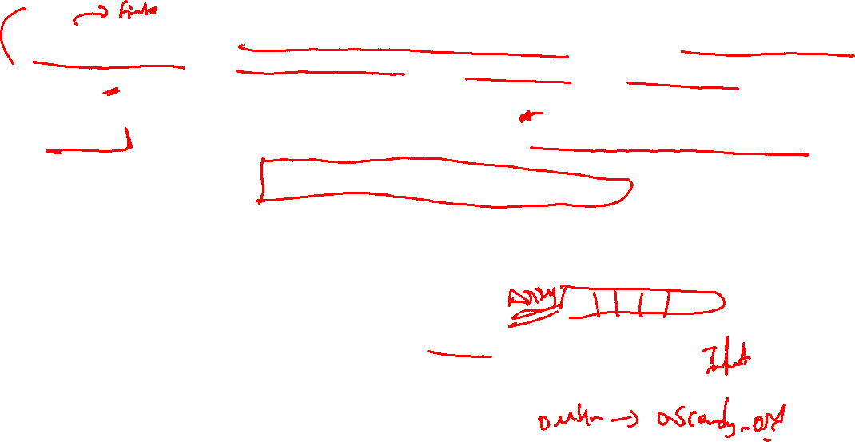

Slide 19
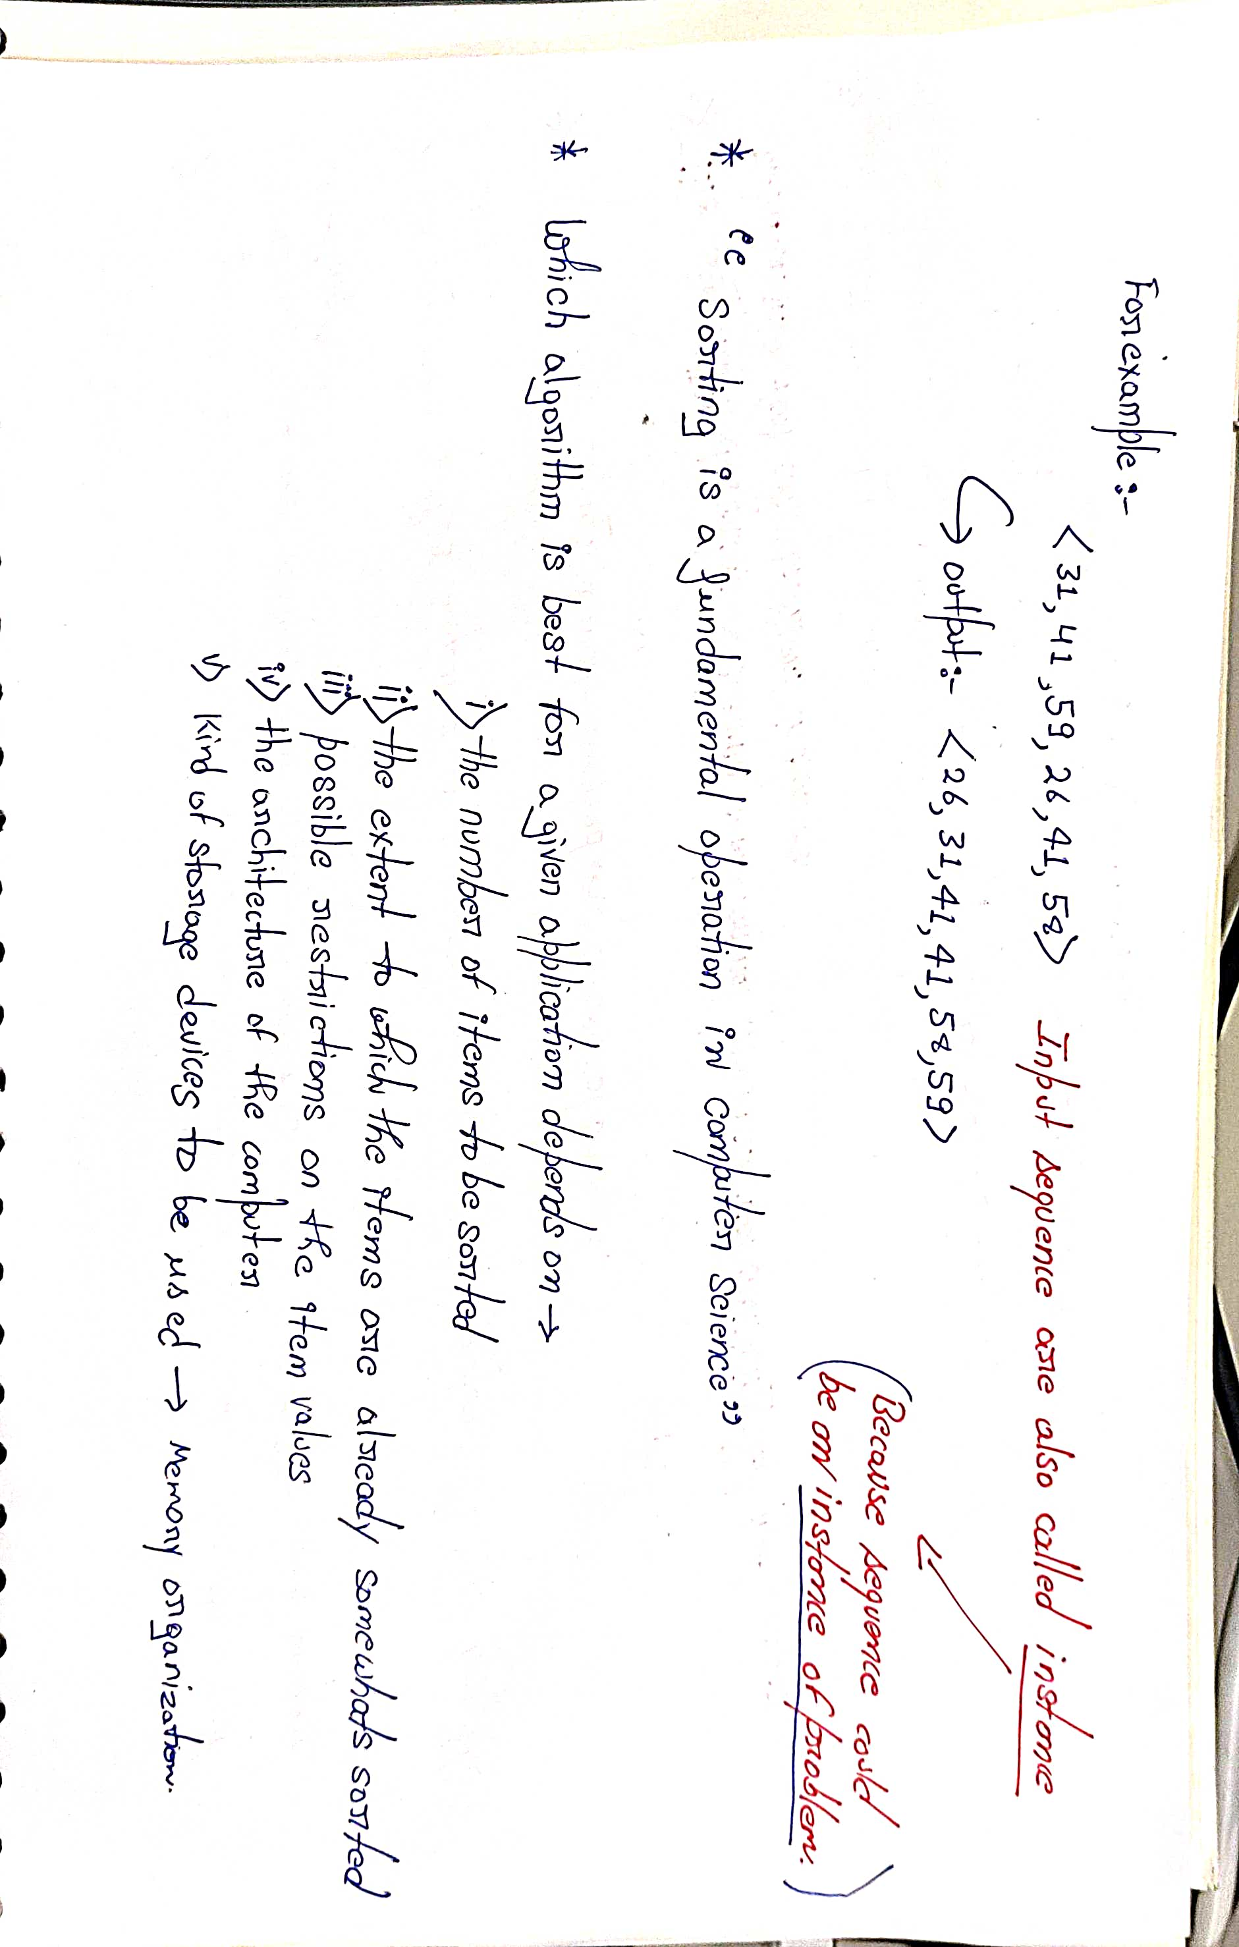
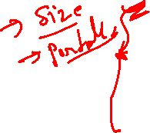

Slide 20
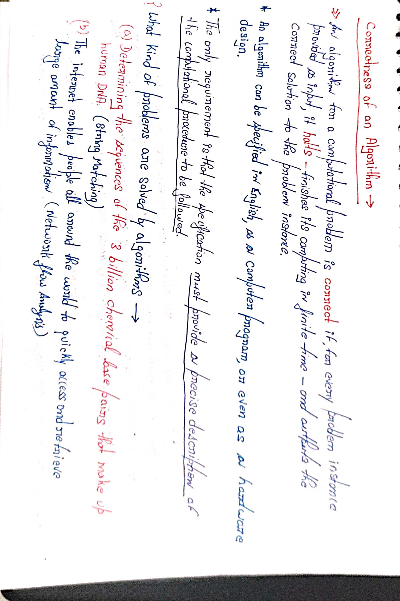
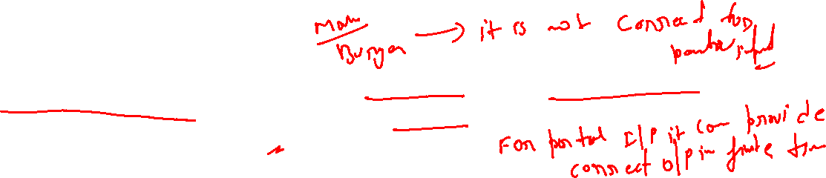

Slide 21
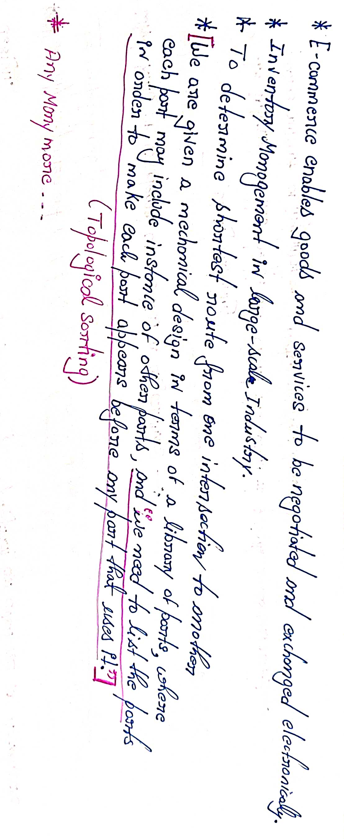

Slide 22
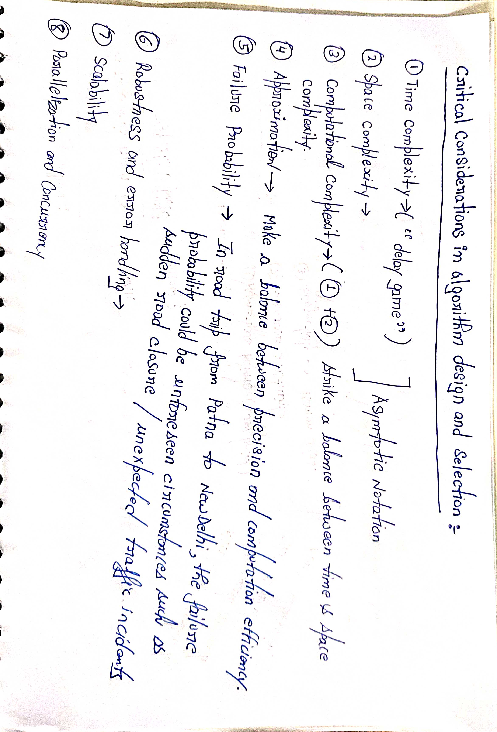
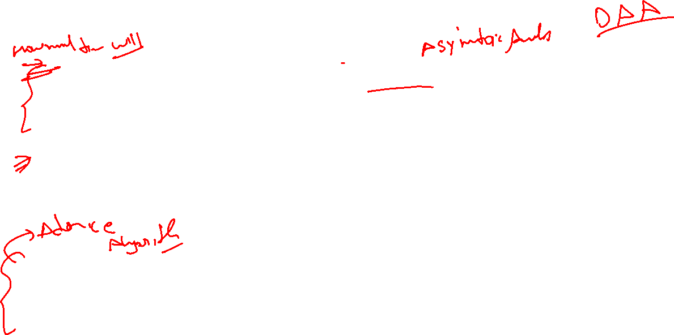

Slide 23
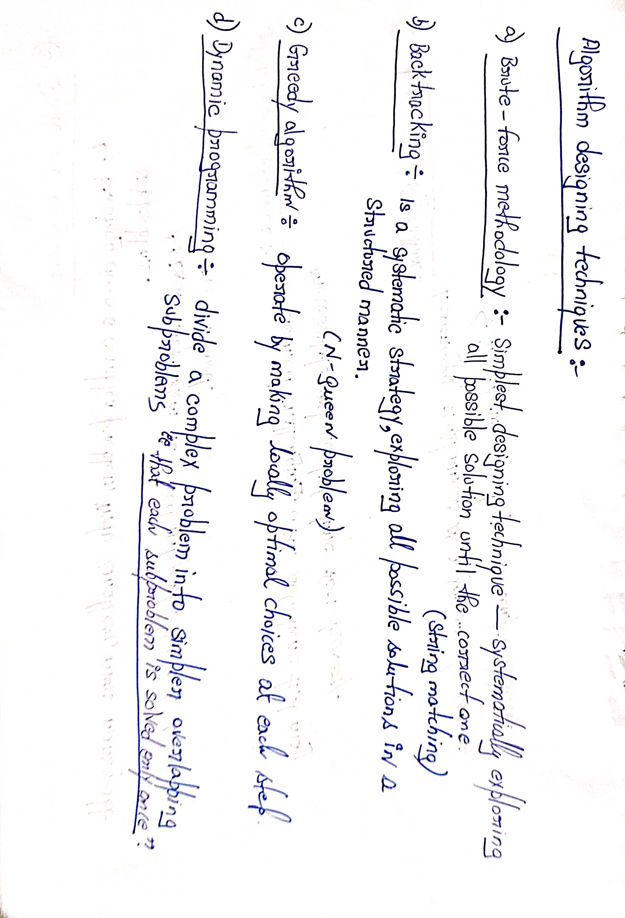
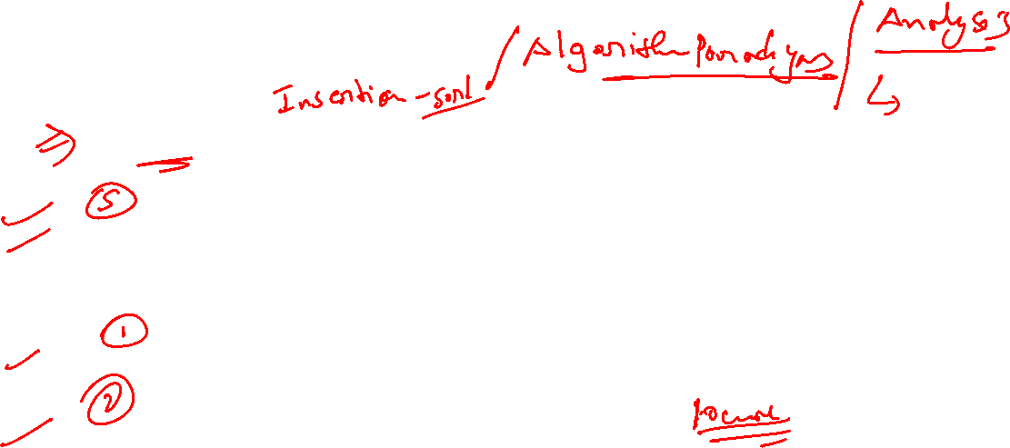

Slide 24
