Slide 1
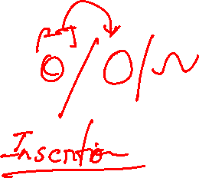
Designing and Analysis of Algorithms Course Code: ECS 5101/CS514
Dr Rahul Mishra
IIT Patna
Lecture 4

Slide 2
Growth of function

Slide 3
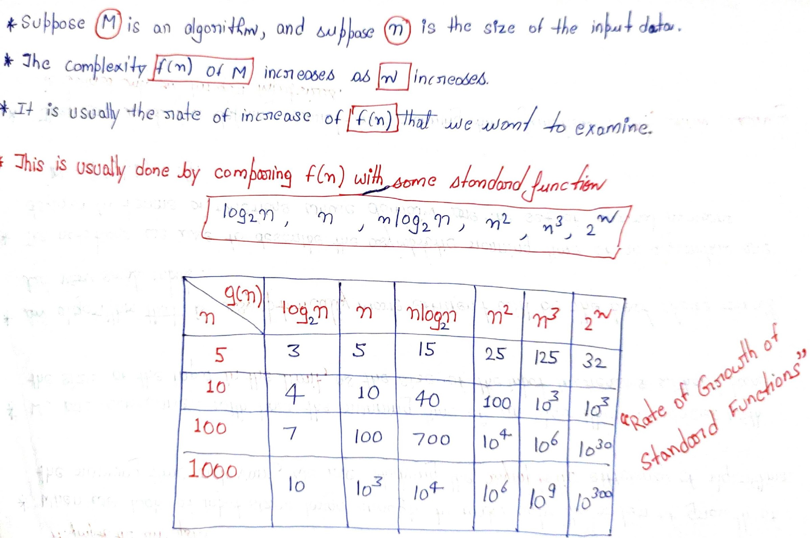

Slide 4
Asymptotic Analysis
Dictionary meaning: “Asymptotic function approaches a given value as an expression containing a variable tends to infinity.”
We are concerned with how the running time of an algorithm increases with the size of the input in the limit, as the size of the input increases without bounds.
An algorithm that is asymptotically more efficient will be the best choice for all but very small input.
The notations we use to describe the asymptotic running time of an algorithm are defined in terms of functions whose domain is the set of natural numbers, N = {0,1,2,…}.
They are used for defined worst-case running-time function T(n), which usually is defined only on integer input sizes.

Slide 5
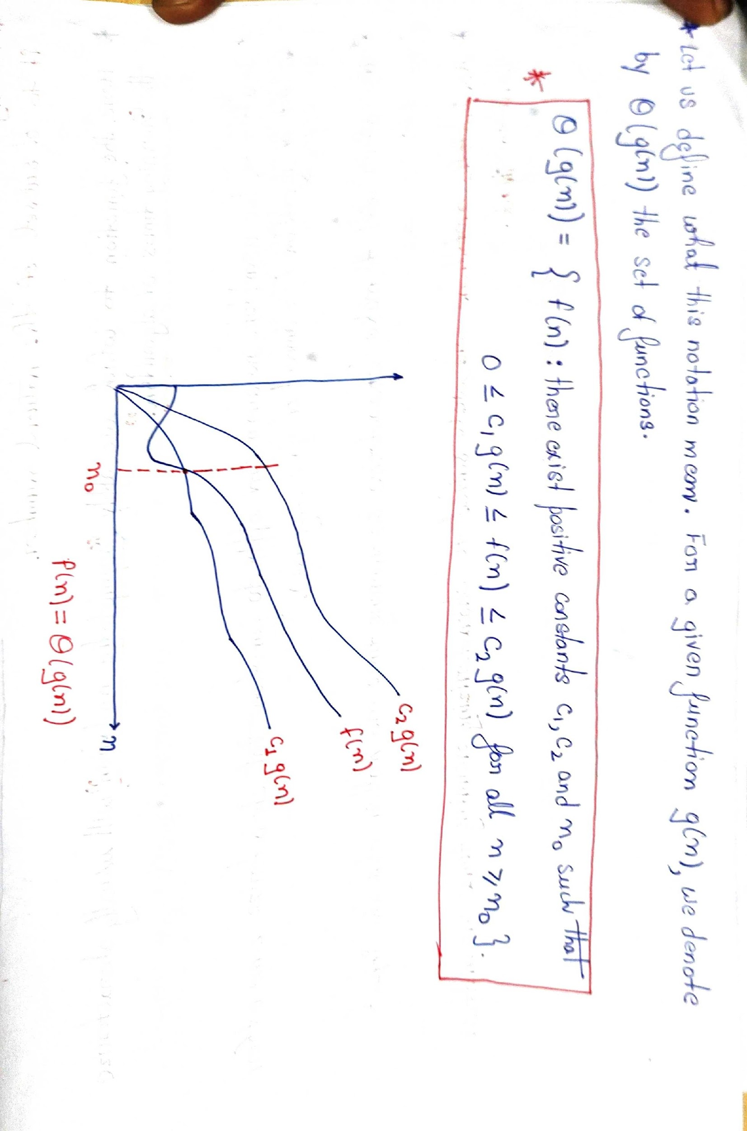
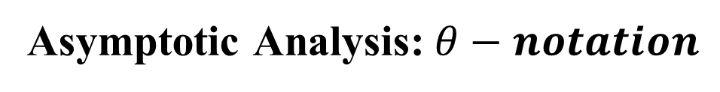
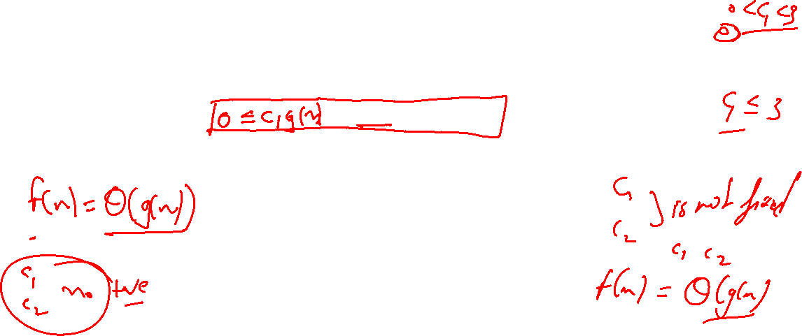

Slide 9
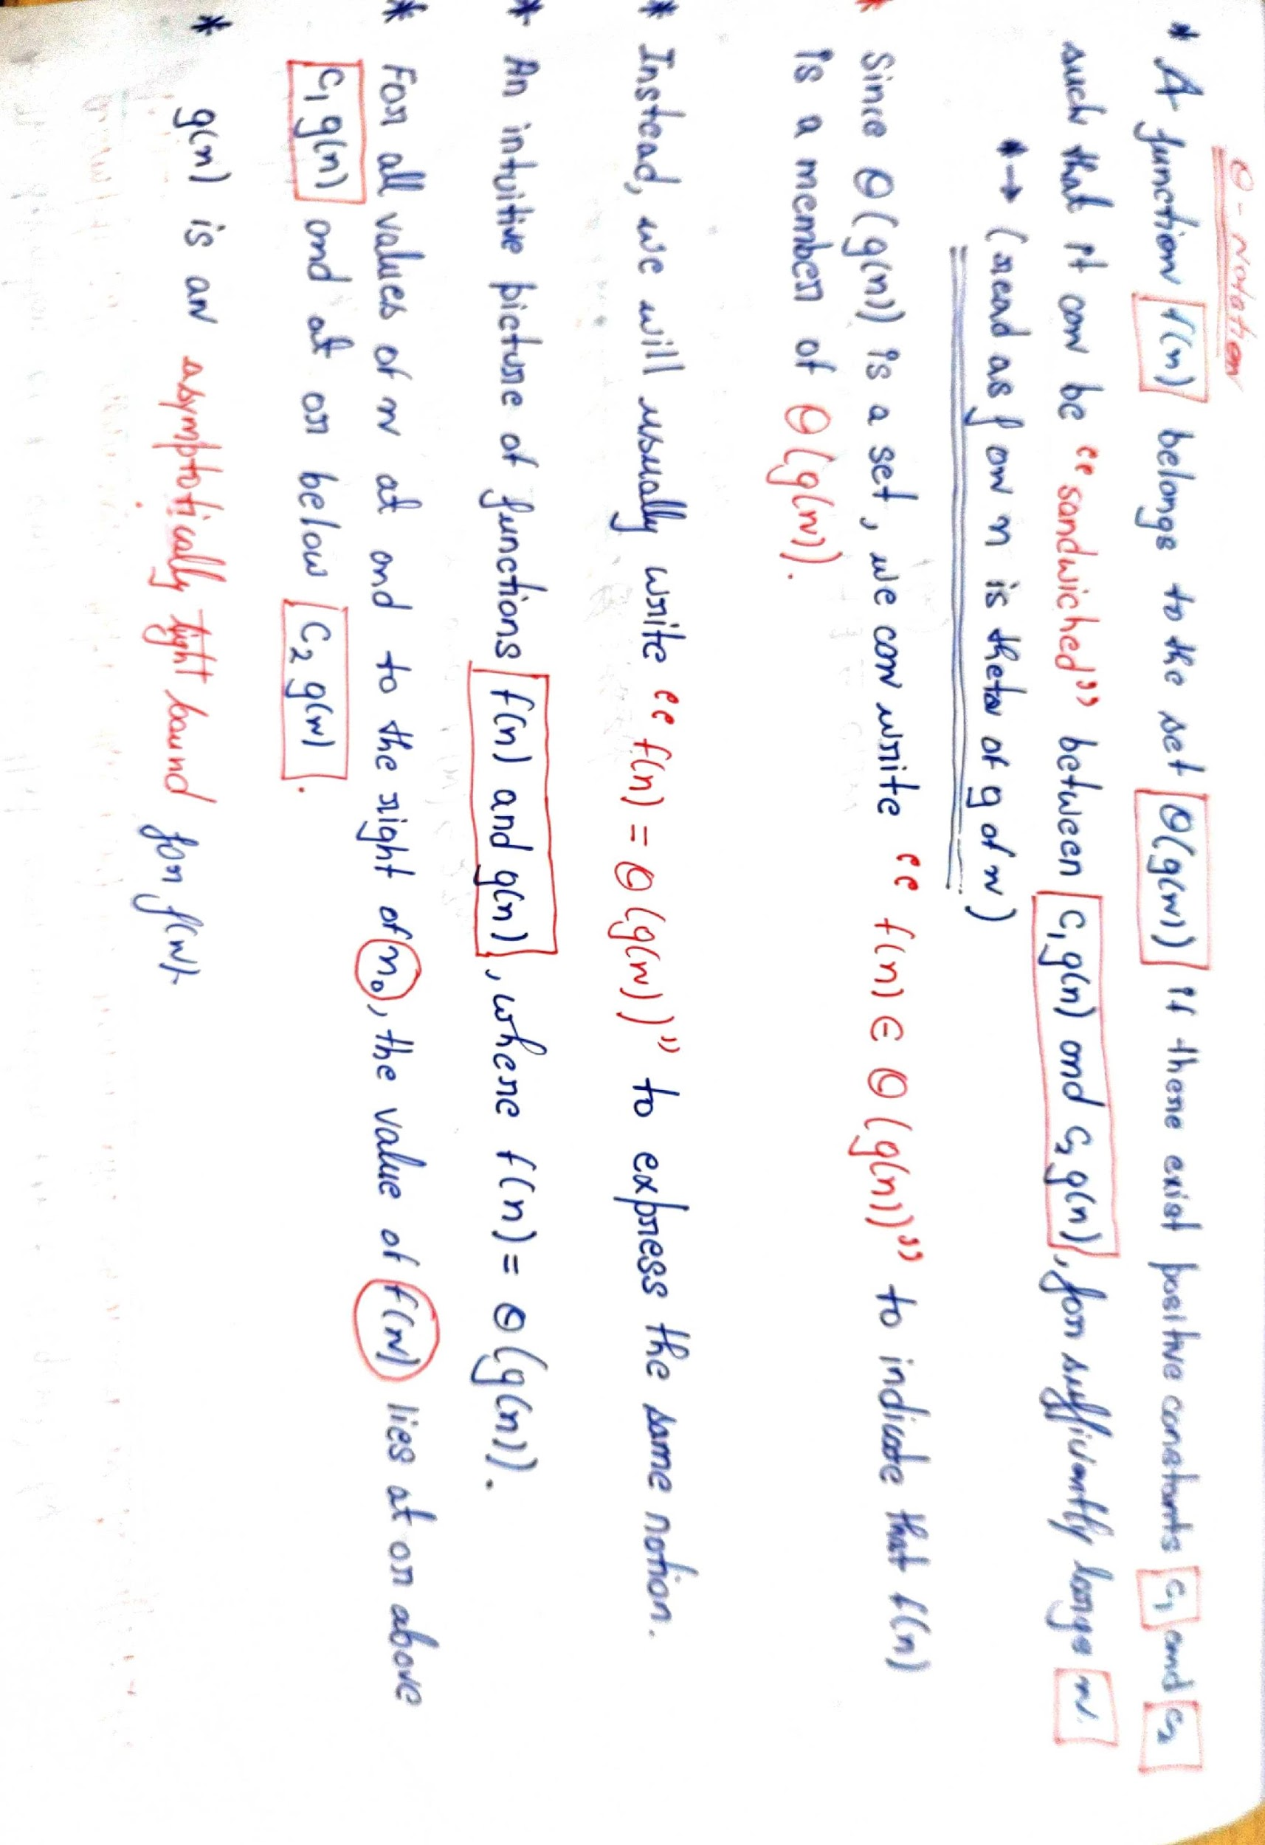

Slide 10
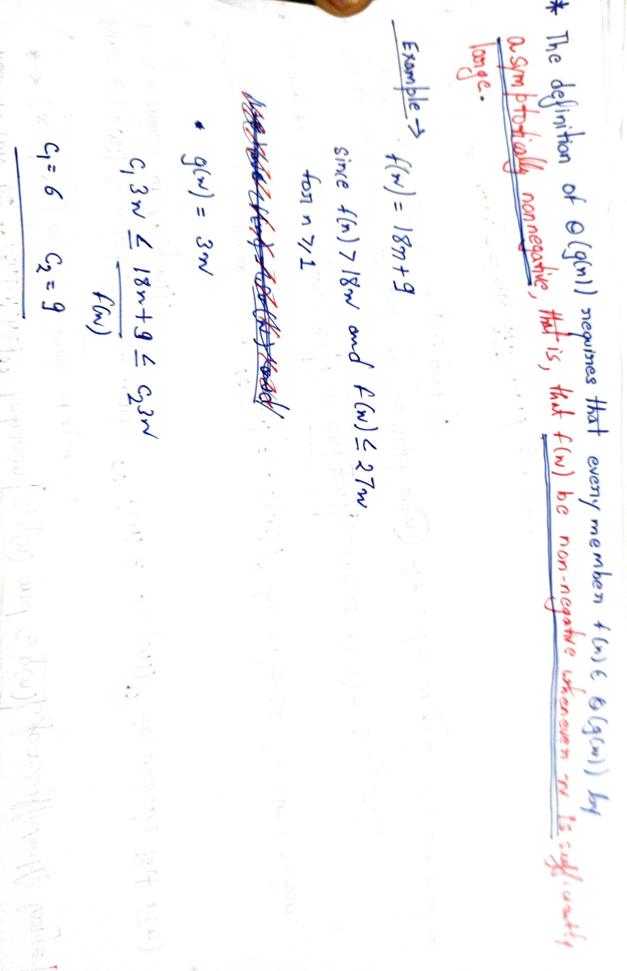
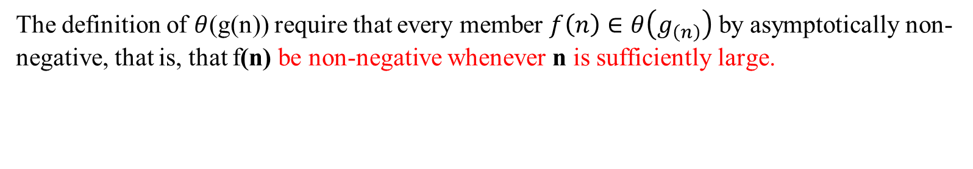

Slide 11
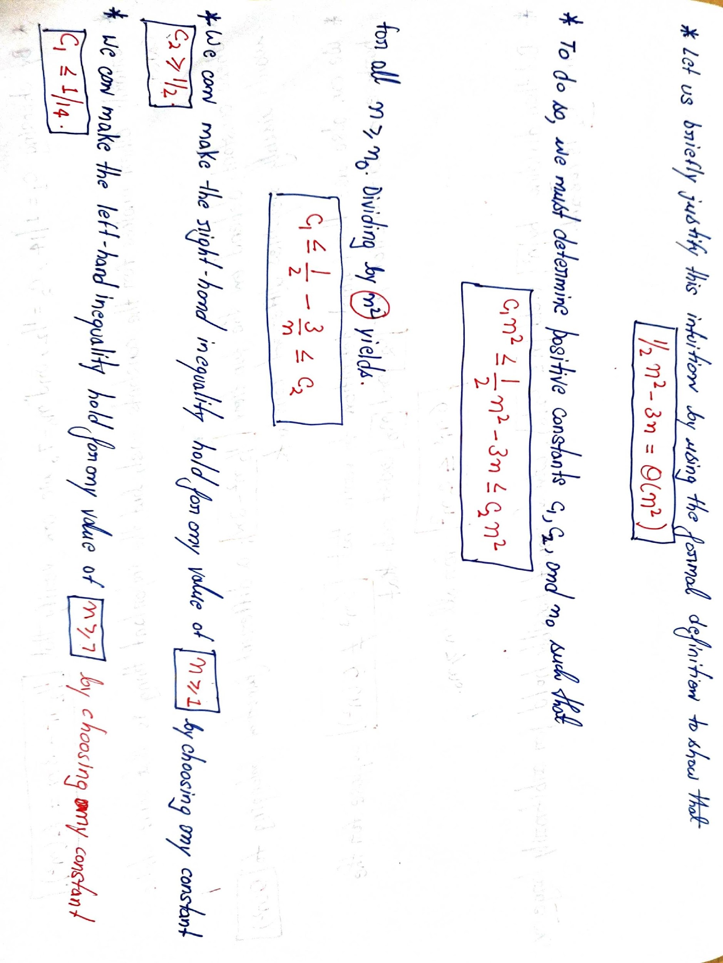
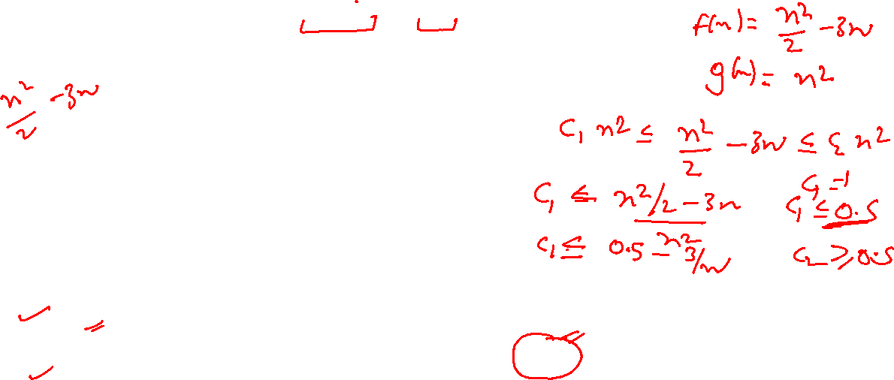

Slide 12
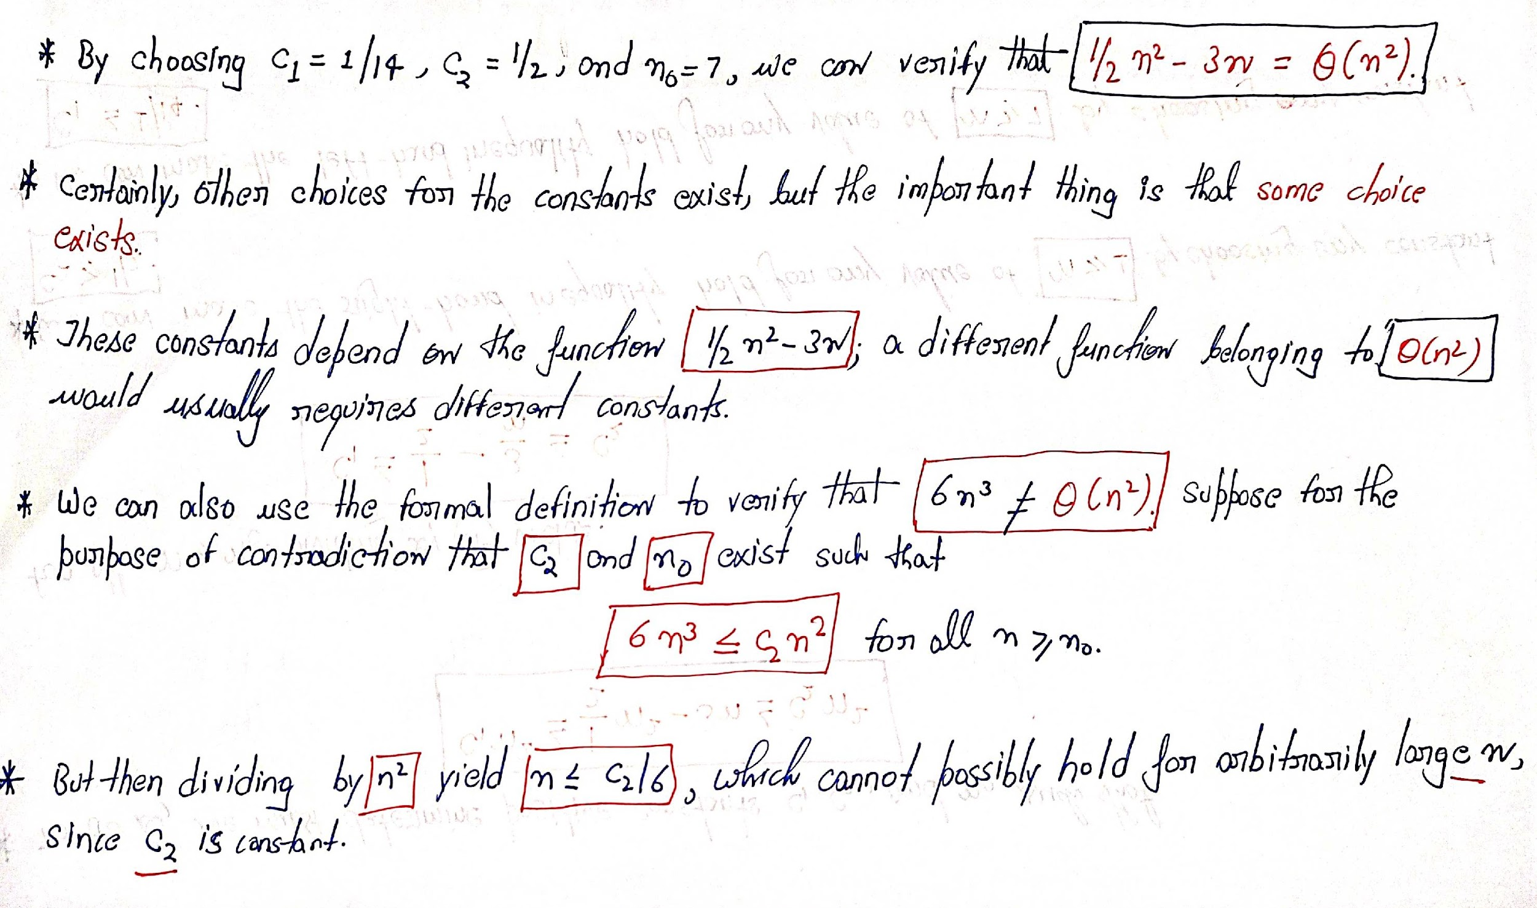

Slide 13
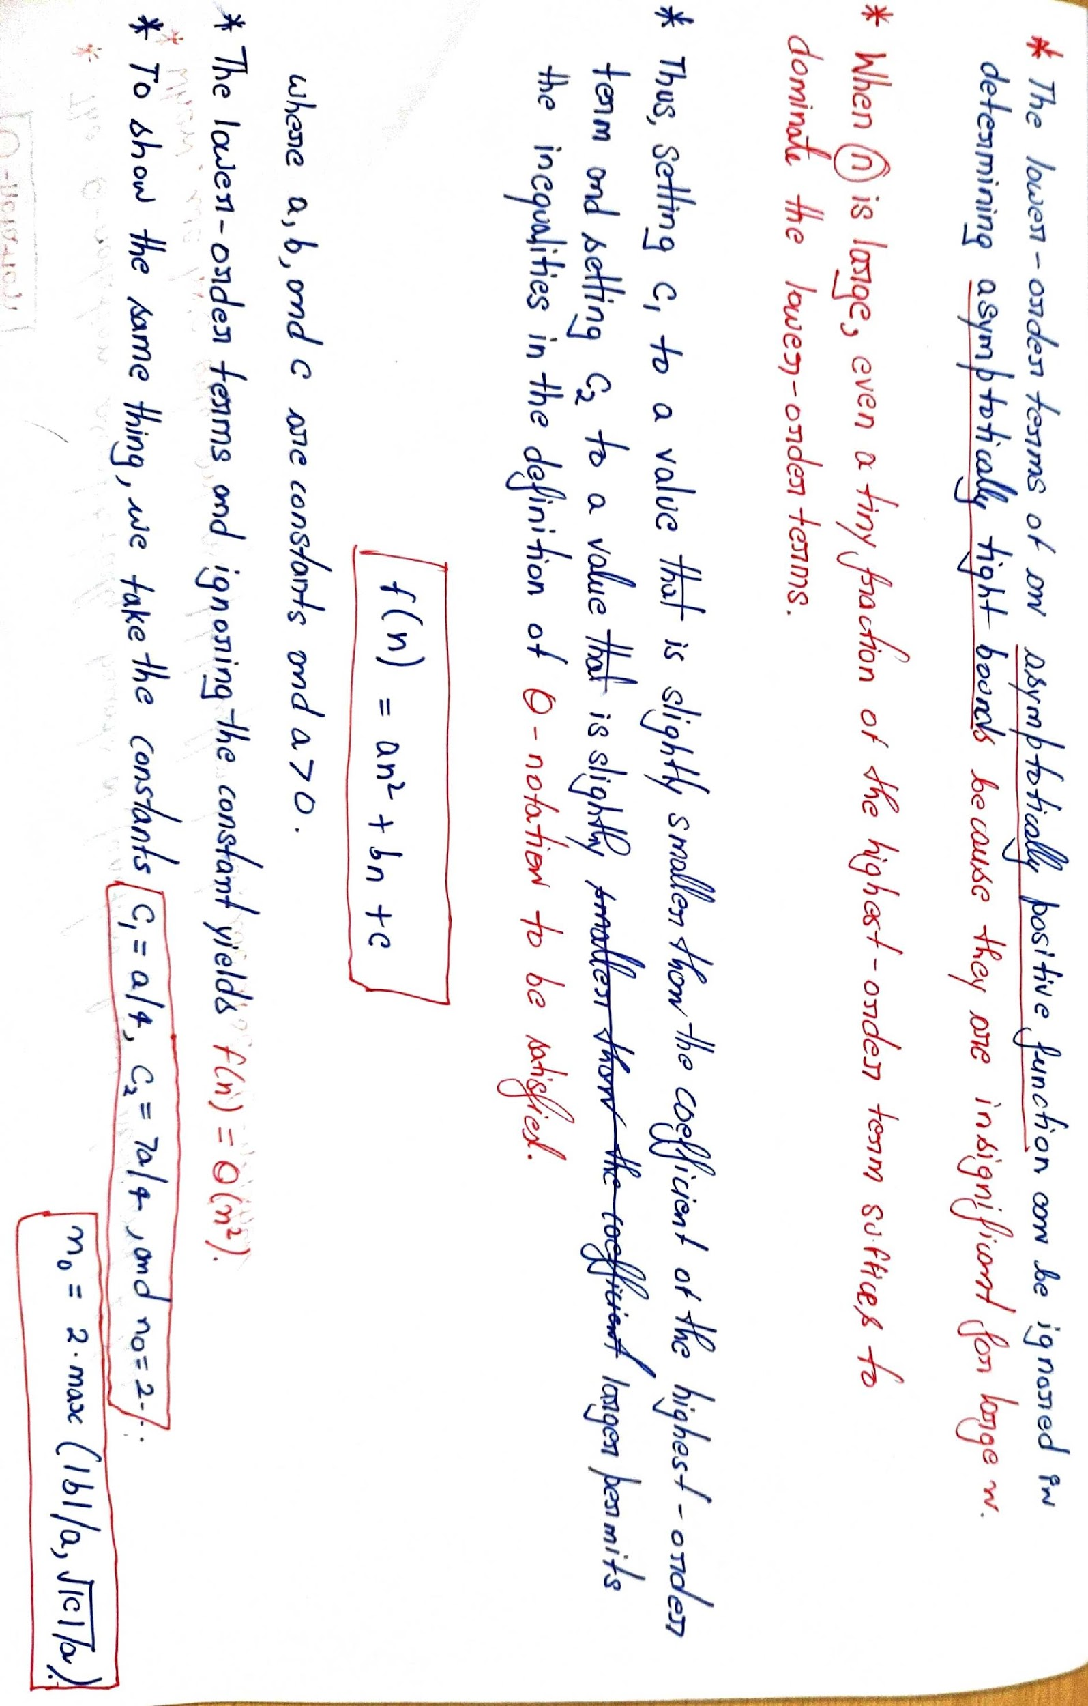
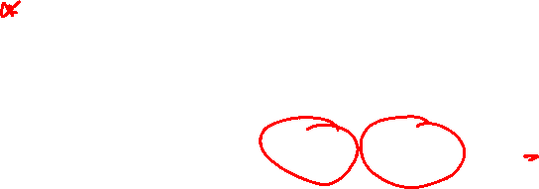
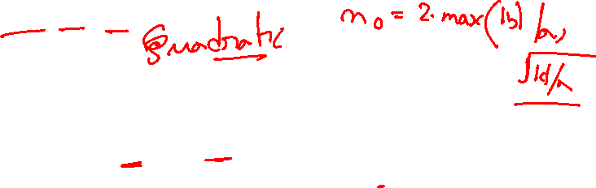

Slide 14
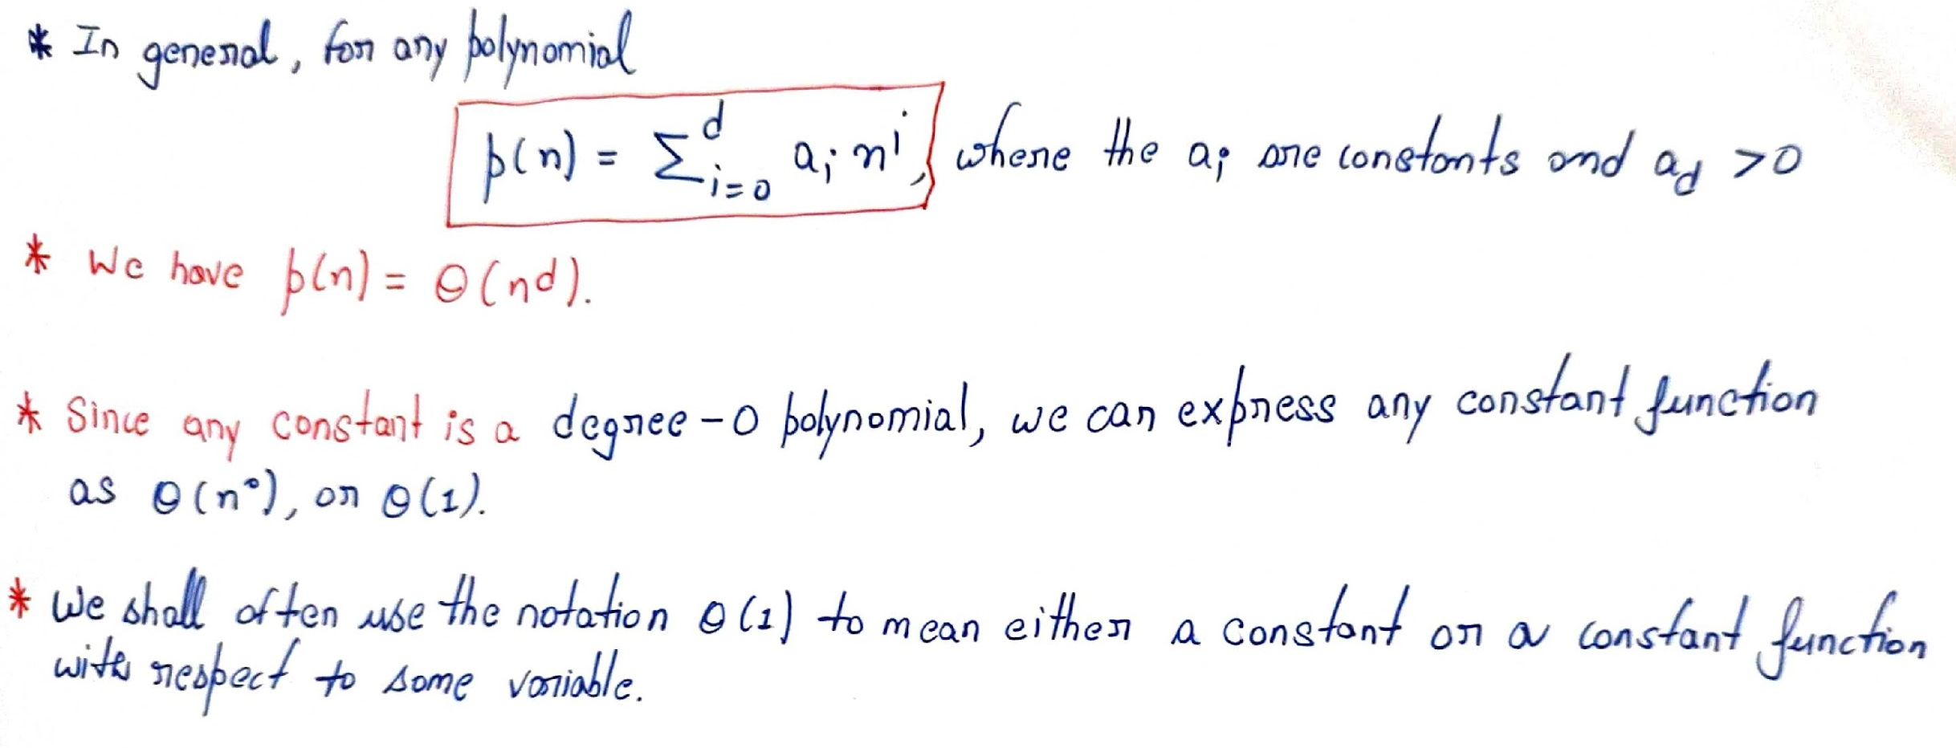
for all n>= n0.

Slide 15
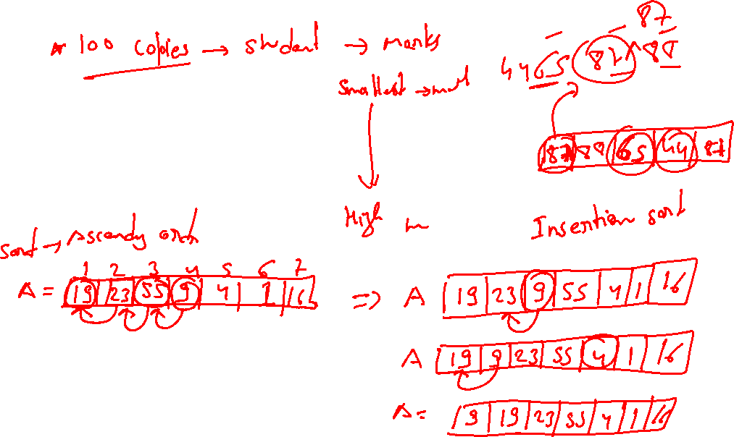

Slide 17
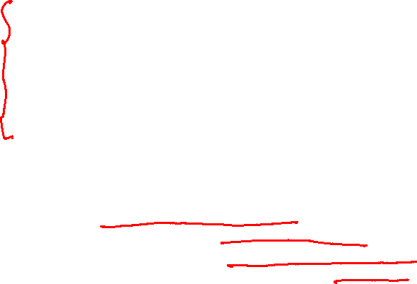
Insertion sort
Let us consider a simple example of the Insertion sort algorithm. It is a simple comparison-based sorting algorithm. Insertion sort is an effective algorithm used for sorting a limited number of elements.
This method resembles how teachers typically sort our exam copies. It involves organizing a collection of exam copies based on their grades or other relevant criteria. The process resembles how people sort a hand of playing cards. Initially, You have a stack of exam copies face down on a table. You start with an empty pile. You pick up one copy at a time and insert it into its correct position among the copies you've already sorted. Next, to find the correct position, you compare the selected copy with the ones already in your sorted pile. This comparison is usually done from right to left, making sure that you place the copy in the right position based on the sorting criteria (e.g., highest grade to lowest grade). You repeat this process until you've gone through all the exam copies. By the end of this process, you will have a sorted stack of exam copies. The ones you are holding are sorted, and they were originally the top copies from the initial unsorted stack on the table.
Different steps of Insertion sort are as follows:
Start with the second element (Index 1) in the unsorted array and assume it is the start of the sorted portion.
Compare the current element with the one before it. If they are in the wrong sorted order, swap them.
Move the current element back through the sorted portion of the array until it is in the correct position.
Move to the next element (Index 2) and repeat steps 2 and 3 until the entire array is sorted.

Slide 18
Insertion sort
INSERTION-SORT (A, n) ⊳ A[1 . . n]
for j ← 2 to n
do key ← A[ j]
i ← j – 1
while i > 0 and A[i] > key
do A[i+1] ← A[i]
i ← i – 1
A[i+1] = key
“pseudocode”
1
i
j
n
A:
key
sorted

Slide 19





Example of insertion sort
8
2
4
9
3
6

Slide 20

Example of insertion sort
8
2
4
9
3
6
2
8
4
9
3
6

Slide 21

Example of insertion sort
8
2
4
9
3
6
2
8
4
9
3
6

Slide 22
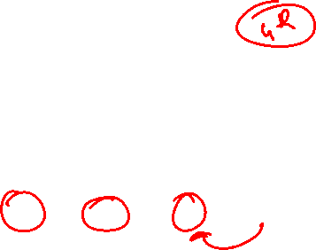
Example of insertion sort
8
2
4
9
3
6
2
8
4
9
3
6
2
4
8
9
3
6

Slide 23
Example of insertion sort
8
2
4
9
3
6
2
8
4
9
3
6
2
4
8
9
3
6

Slide 24
Example of insertion sort
8
2
4
9
3
6
2
8
4
9
3
6
2
4
8
9
3
6
2
4
8
9
3
6

Slide 25

Example of insertion sort
8
2
4
9
3
6
2
8
4
9
3
6
2
4
8
9
3
6
2
4
8
9
3
6

Slide 26
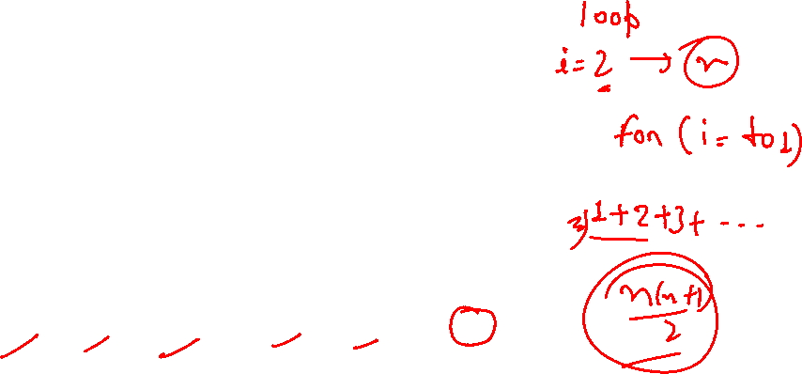
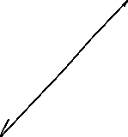
Example of insertion sort
8
2
4
9
3
6
2
8
4
9
3
6
2
4
8
9
3
6
2
4
8
9
3
6
2
3
4
8
9
6

Slide 27
Example of insertion sort
8
2
4
9
3
6
2
8
4
9
3
6
2
4
8
9
3
6
2
4
8
9
3
6
2
3
4
8
9
6

Slide 28
Example of insertion sort
8
2
4
9
3
6
2
8
4
9
3
6
2
4
8
9
3
6
2
4
8
9
3
6
2
3
4
8
9
6
2
3
4
6
8
9
done

Slide 29


Slide 30
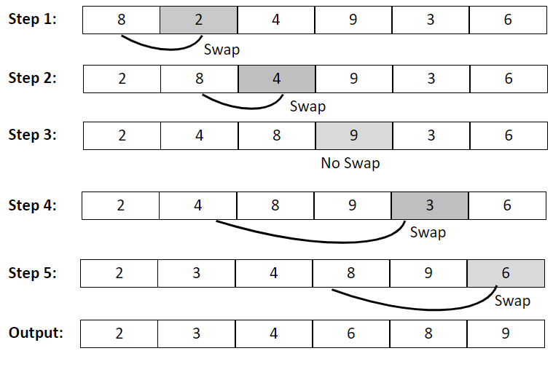
Insertion sort

Slide 31







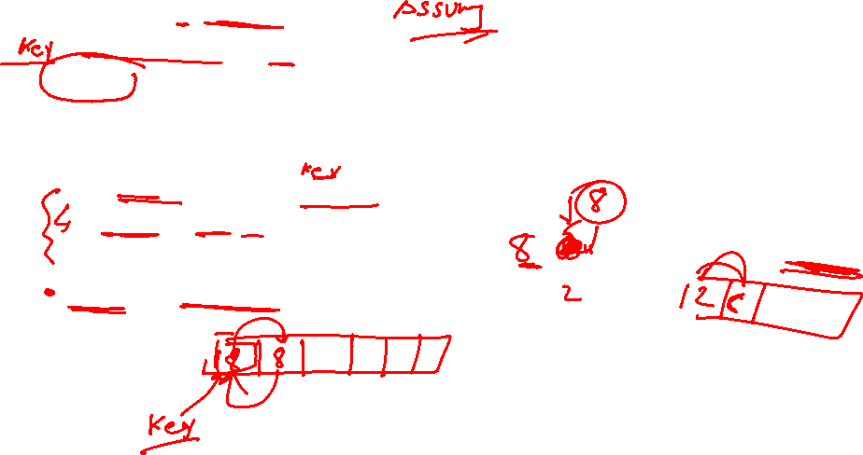
InsertionSort (array Arr): for i in range(1, len(Arr)): current_element = Arr[i] j = i - 1 # Move elements of arr[0..i-1], that are greater than current_element, # one position ahead of their current position while j >= 0 and current_element < Arr[j]: Arr[j + 1] = Arr[j] j = j-1 Arr[j + 1] = current_element

