Slide 1
Merge-Sort
Algorithm:
Divide: If S has at least two elements (nothing needs to be done if S has zero or one element), remove all the elements from S and put them into two sequences, S₁ and S₂, each containing about half of the elements of S. (i.e. S₁ contains the first ⎡n/2⎤ elements and S₂ contains the remaining ⎣n/2⎦ elements.
Conquer Recursive sort sequences S₁ and S₂.
Combine: Put back the elements into S by merging the sorted sequences S₁ and S₂ into a unique sorted sequence.

Slide 2
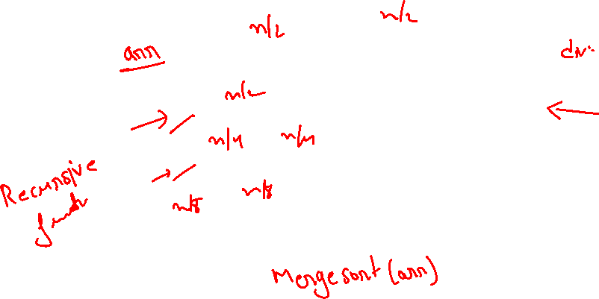
Merge-Sort

Slide 3
Merge-Sort(cont.)

Slide 4
Merge-Sort (cont.)

Slide 5
Merge-Sort (cont.)

Slide 6
Merge-Sort (cont.)

Slide 7
Merge-Sort (cont.)

Slide 8
Merge-Sort (cont.)

Slide 9
Merge-Sort(cont.)

Slide 10
Merge-Sort (cont.)

Slide 11
Merge-Sort (cont.)

Slide 12
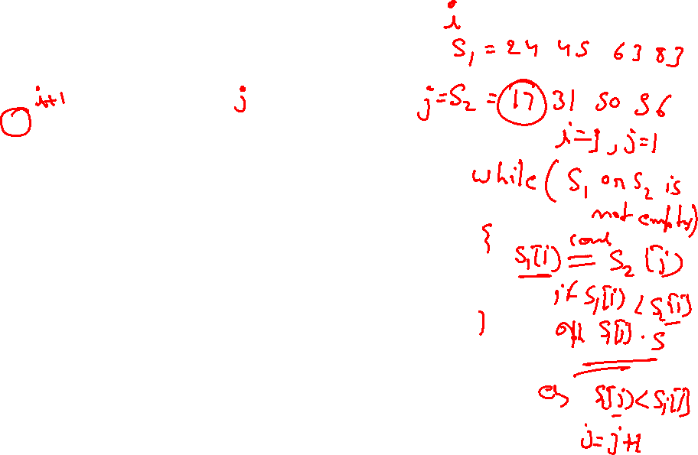
Merge-Sort (cont.)

Slide 13
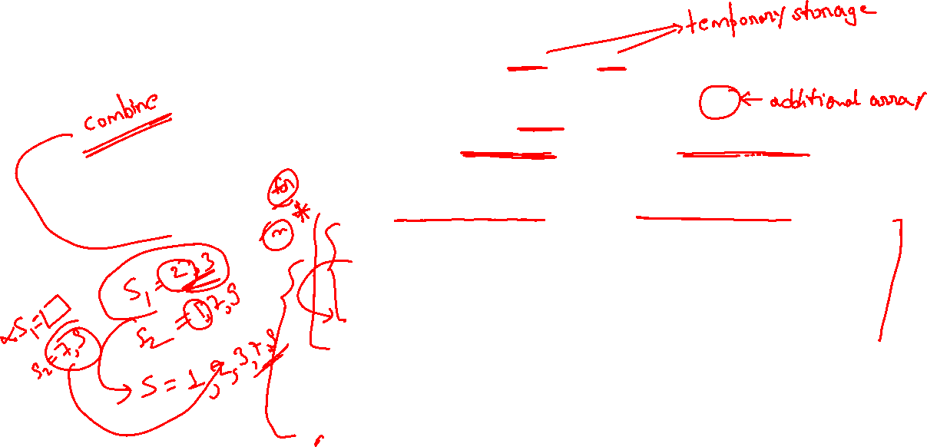
Merging Two Sequences

Slide 14
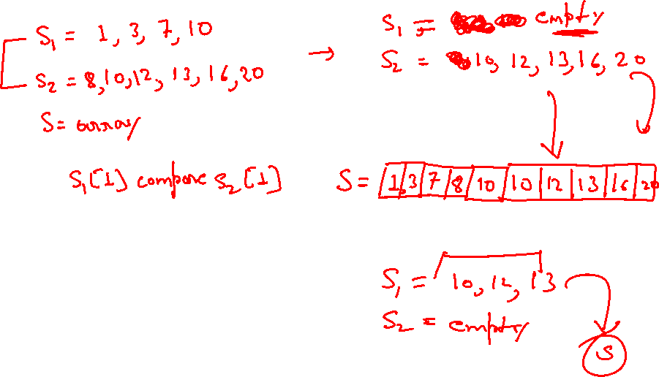

Slide 15
Merging Two Sequences (cont.)

Slide 16
Merging Two Sequences (cont.)

Slide 17
Merging Two Sequences (cont.)

Slide 18
Merging Two Sequences (cont.)

Slide 19
Merging Two Sequences (cont.)

Slide 20
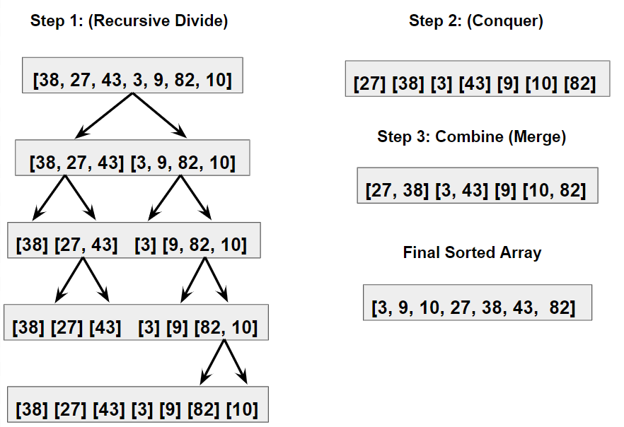
Merge sort

Slide 21

Merge sort
#Procedure for Merge
Merge(left, right):
result = []
left_index = right_index = 0
while left_index < length(left) and right_index < length(right):
if left[left_index] < right[right_index]:
result.append(left[left_index])
left_index += 1
else:
result.append(right[right_index])
right_index += 1
result.extend(left[left_index:])
result.extend(right[right_index:])
return result
#Procedure for MergeSort
MergeSort(arr):
if length(arr) <= 1:
return arr
middle = length(arr) / 2
left_half = MergeSort(arr[:middle])
right_half = MergeSort(arr[middle:])
return Merge(left_half, right_half)

Slide 22
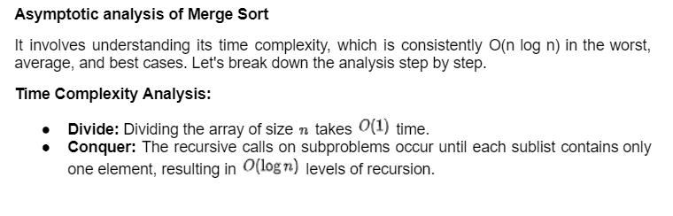
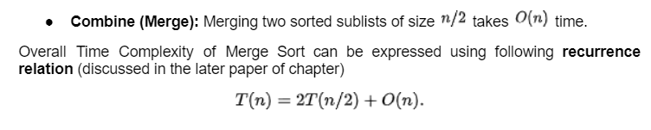


Slide 25
Binary Search
Binary search. Given value and sorted array a[], find index i such that a[i] = value, or report that no such index exists.
Invariant. Algorithm maintains a[lo] ≤ value ≤ a[hi].
Ex. Binary search for 33.
6
13
14
25
33
43
51
53
64
72
84
93
95
96
97
0
1
2
3
4
5
6
7
8
9
10
11
12
13
14
lo
hi

Slide 26
Binary Search
Binary search. Given value and sorted array a[], find index i such that a[i] = value, or report that no such index exists.
Invariant. Algorithm maintains a[lo] ≤ value ≤ a[hi].
Ex. Binary search for 33.
6
13
14
25
33
43
51
53
64
72
84
93
95
96
97
0
1
2
3
4
5
6
7
8
9
10
11
12
13
14
lo
mid
hi

Slide 27
Binary Search
Binary search. Given value and sorted array a[], find index i such that a[i] = value, or report that no such index exists.
Invariant. Algorithm maintains a[lo] ≤ value ≤ a[hi].
Ex. Binary search for 33.
6
13
14
25
33
43
51
53
64
72
84
93
95
96
97
0
1
2
3
4
5
6
7
8
9
10
11
12
13
14
lo
hi

Slide 28
Binary Search
Binary search. Given value and sorted array a[], find index i such that a[i] = value, or report that no such index exists.
Invariant. Algorithm maintains a[lo] ≤ value ≤ a[hi].
Ex. Binary search for 33.
6
13
14
25
33
43
51
53
64
72
84
93
95
96
97
0
1
2
3
4
5
6
7
8
9
10
11
12
13
14
lo
mid
hi

Slide 29
Binary Search
Binary search. Given value and sorted array a[], find index i such that a[i] = value, or report that no such index exists.
Invariant. Algorithm maintains a[lo] ≤ value ≤ a[hi].
Ex. Binary search for 33.
6
13
14
25
33
43
51
53
64
72
84
93
95
96
97
0
1
2
3
4
5
6
7
8
9
10
11
12
13
14
lo
hi

Slide 30
Binary Search
Binary search. Given value and sorted array a[], find index i such that a[i] = value, or report that no such index exists.
Invariant. Algorithm maintains a[lo] ≤ value ≤ a[hi].
Ex. Binary search for 33.
6
13
14
25
33
43
51
53
64
72
84
93
95
96
97
0
1
2
3
4
5
6
7
8
9
10
11
12
13
14
lo
mid
hi

Slide 31
Binary Search
Binary search. Given value and sorted array a[], find index i such that a[i] = value, or report that no such index exists.
Invariant. Algorithm maintains a[lo] ≤ value ≤ a[hi].
Ex. Binary search for 33.
6
13
14
25
33
43
51
53
64
72
84
93
95
96
97
0
1
2
3
4
5
6
7
8
9
10
11
12
13
14
lo hi

Slide 32
Binary Search
Binary search. Given value and sorted array a[], find index i such that a[i] = value, or report that no such index exists.
Invariant. Algorithm maintains a[lo] ≤ value ≤ a[hi].
Ex. Binary search for 33.
6
13
14
25
33
43
51
53
64
72
84
93
95
96
97
0
1
2
3
4
5
6
7
8
9
10
11
12
13
14
lo hi mid

Slide 33
Binary Search
Binary search. Given value and sorted array a[], find index i such that a[i] = value, or report that no such index exists.
Invariant. Algorithm maintains a[lo] ≤ value ≤ a[hi].
Ex. Binary search for 33.
6
13
14
25
33
43
51
53
64
72
84
93
95
96
97
0
1
2
3
4
5
6
7
8
9
10
11
12
13
14
lo hi mid

Slide 35
10 | 20 | 50 | 100 | 200 | 500 | 2000
Search 20

Slide 37
Example: Binary Search
Searching for an element k in a sorted array A with n elements
Idea:
Choose the middle element A[n/2]
If k == A[n/2], we are done
If k < A[n/2], search for k between A[0] and A[n/2 -1]
If k > A[n/2], search for k between A[n/2 + 1] and A[n-1]
Repeat until either k is found, or no more elements to search
Requires a smaller number of comparisons than linear search in the worst case (log₂n instead of n)

