Slide 1
EHS 5104
Technical Writing and Soft Skills
Dr. Sweta Sinha
Department of HSS
IIT Patna

Slide 2
Process of Communication
Ideation
Encoding
Transmission
Decoding
Feedback
Stage 1
Stage 2
Stage 3
Stage 5
Stage 4

Slide 3
6 Domains of Non- verbal Communication
Kinesics
Chronemics
Proxemics
Oculesics
Vocalics
Haptics

Slide 4
Contd..
Kinesics:
The word kinesics comes from the root word kinesis, which means “movement,” and refers to the study of hand, arm, body, and face movements. Specifically, this section will outline the use of gestures, head movements and posture, eye contact, and facial expressions as nonverbal communication.

Slide 5
Contd..
Chronemics refers to the study of how time affects communication. Time can be classified into several different categories, including biological, personal, physical, and cultural time.
When?
How Long?

Slide 6
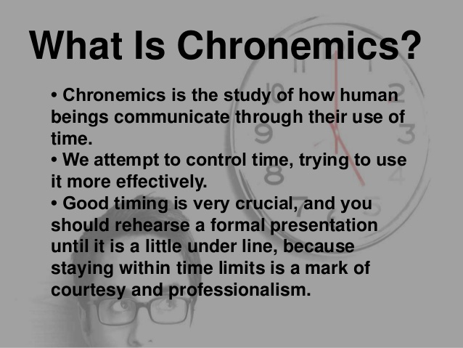
Contd..

Slide 7
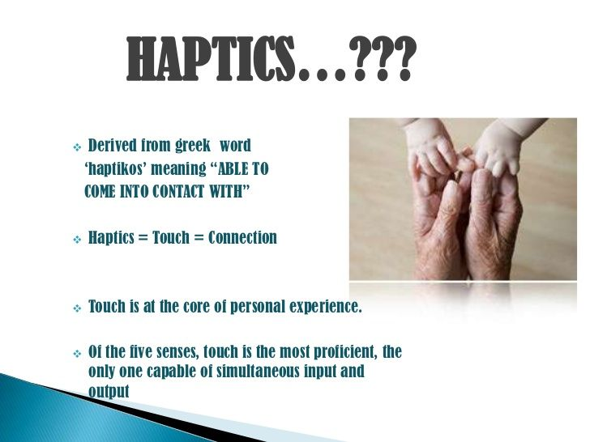
Contd..
Haptics is the study of touch in nonverbal communication.

Slide 8
Types of handshake:
Power Shake
To avoid the power shake step in with left foot when you see the power shake coming. This will invade the other person’s space and put them off kilter.
Board Room Shake
This person shakes hands strongly and grips the forearm with the other hand. Usually it is a managing director who wants to show control.
Bone Crusher Shake
While this grip may be okay between two alpha males, in most circumstances it is too hard and holds for too long.
Wet Fish Shake
This is known as the limp lettuce handshake. If you’re on the receiving end, take control by adjusting this handshake and giving two firm shakes.

Slide 9
Contd..
Confident Shake
This is described as a firm hold with two shakes and eye contact.
Empathetic Shake
This type of handshake involves a brush of the forearm with the left hand for no longer than three to four seconds. Those who use this type of handshake will have an 80 per cent chance of getting on well with the other person. Be warned though – touching for longer than five seconds invades the other person’s personal space.
Patronising Shake
Do not grab hold of the other person’s wrist when shaking hands.

Slide 10
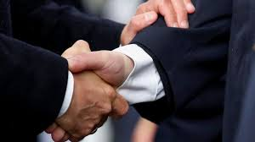
Identify?

Slide 11
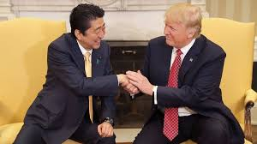
Identify?

Slide 12
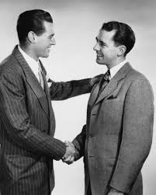
Identify?

Slide 13

Contd..

Slide 14
Contd..
Proxemics refers to the study of how space and distance influence communication. We only need look at the ways in which space shows up in common metaphors to see that space, communication, and relationships are closely related.
For example, when we are content with and attracted to someone, we say we are “close” to him or her. When we lose connection with someone, we may say he or she is “distant.” In general, space influences how people communicate and behave.

Slide 15
Contd..
Oculesics:
We also communicate through eye behaviors, primarily eye contact. While eye behaviors are often studied under the category of kinesics, they have their own branch of nonverbal studies called oculesics, which comes from the Latin word oculus, meaning “eye.” The face and eyes are the main point of focus during communication, and along with our ears our eyes take in most of the communicative information around us. The saying “The eyes are the window to the soul” is actually accurate in terms of where people typically think others are “located,” which is right behind the eyes.

Slide 16
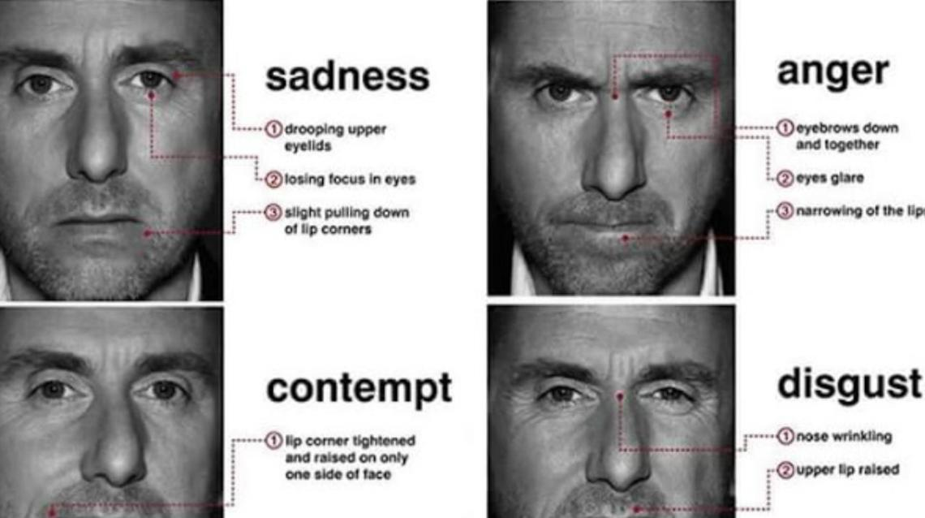
Contd..

Slide 17
Contd..
We learned earlier that paralanguage refers to the vocalized but nonverbal parts of a message. Vocalics is the study of paralanguage, which includes the vocal qualities that go along with verbal messages, such as pitch, volume, rate, vocal quality, and verbal fillers.

Slide 18
Points to note!!
Never, never, never let words come out of your mouth when your eyes are looking down!
If there is more than one interviewer, you can maintain eye contact with everyone as you shift your gaze.
Great posture never goes out of style!
Slouching sends a message to the interviewer that you lack energy and confidence.

Slide 19
Contd..
Hands have their own language!
For example, right-hand movements signal that you are giving out information, while left-hand gestures indicate your readiness to receive information.
Dressing well is a form of good manners!
The key is focusing more on comfort than showing off your wardrobe.

Slide 20
Power to Listen
Importance of Active Listening: In today’s fast-paced professional world, active listening is a crucial but often overlooked skill that can greatly enhance success.
Building Stronger Relationships: Actively listening to colleagues, clients, and team members demonstrates respect and interest, fostering trust, empathy, and open communication, which are key to productive collaborations and lasting partnerships.
Enhancing Understanding and Empathy: Listening involves not just hearing words but also understanding the emotions and meaning behind them, which fosters empathy and allows you to tailor your communication to meet others' needs.

Slide 21
Contd..
Improving Problem-Solving: By listening to diverse perspectives, you gain insights and alternative viewpoints that can lead to innovative solutions, creating a collaborative environment where everyone feels valued.
Strengthening Leadership Skills: Effective leaders are great listeners, understanding team members’ concerns and ideas, fostering inclusivity, and empowering their teams, which boosts productivity and engagement.
Enhancing Personal Growth: Listening exposes you to new ideas and perspectives, enriching your knowledge, fostering adaptability, and supporting continuous personal and professional growth.

Slide 22
Language Skills: Listening
Lectures
Tutorials and practical
Seminars and workshops
Technical presentations
Academic discussions
Viva voce

Slide 23
Hearing and Listening
Hearing: involuntary, happens automatically, passive process, the listener plays a passive part, one – way process
Listening: voluntary, requires conscious effort, active process, the listener plays a very active part, two- way process

Slide 24
Types of listening:
Superficial: little awareness of the content, output is zero, ignoring the message, lack of concentration.
Appreciative: main purpose is to get enjoyment and pleasure, entertainment. Eg: listening to songs, jokes, stand up comedy
Focused: listening for specific purpose, motivates decision making. Eg: listening to news or sports commentary

Slide 25
Contd..
Evaluative: evaluation of oral message and developing a line of thought, both explicit and implicit meanings are important here, making mental notes. Eg: classroom lectures, workshops, seminars.
Attentive: demands complete attention, active and intelligent listening, there is no selectiveness. Eg: job interviews, administrative instructions, important phone calls
Empathetic: focus is on the emotions or mental state of the speaker, implied meaning, intention or attitude reading becomes important, interpretation of non- verbal cues Eg: listening to a crime victim, listening to counselling sessions.

Slide 26
Listening with a purpose:
Get an introductory idea of an oral message
Understand the main points
What is the idea conveyed
Understanding different viewpoints
Aiming at broad understanding of the subject
Obtain specific information
Be relevant and updated about the field
Broaden your outlook
Seek evidence of one’s point of view

Slide 27
Barriers to Listening
Physical barriers: noise; physical discomfort; physical distraction; distance
Psychological barriers: emotional disturbance; anxiety; over arousal or emotions
Linguistic barriers: improper message decoding; ambiguous language, jargons
Cultural barriers: different value system; different social norms

Slide 28
Effective Listening Strategies
Effective listening depends on efficient listening.
Ten thumb rule of listening: stop talking; stop thinking; remove distractions; do not let your mind wander; put speaker at ease; do not be prejudiced; be a patient; do not be emotional; empathize with the speaker; take notes
Active listening demands concentration, involvement and responsibility

Slide 29
Some active listening practices
Attentive listening
Using non- verbal skills as feedback
Improving speaker’s contribution by encouraging more output
Asking questions: open ended; closed
Clarifying or paraphrasing key points towards the end
Analyzing: drawing right inference; understand both implicit and explicit message.

