Slide 1
EHS 5104
Technical Writing and Soft Skills
Dr. Sweta Sinha
Department of HSS
IIT Patna

Slide 2
Dr A P J Abdul Kalam, Wings of Fire
Most of the time, Communication gets confused with Conversation. In fact, the two are distinctly different. A conversation full of pleasantries is most often devoid of any useful information, whereas communication is meant only for an exchange of information. It is very important to realize that communication is a two way affair which aims at passing on or receiving a specific piece of information.

Slide 3
What is Communication?
Derived from a Latin word, ‘communicare’ which indicates ‘sharing’ or ‘exchanging’ the information
Communication refers to transmission of facts, figures and ideas in an organized manner

Slide 4
Function of Language
Language represents and expresses thought.
It is a crucial tool for sharing our ideas and emotions. In both spoken and written forms, language is the most common and vital method of communication in all human social interactions.

Slide 5
Functions of Language (Halliday)
1) instrumental function is the function of the language used to manipulate the environment that led to a particular situation.
2) regulatory function is the use of language that serves to control an event, such as approval, rejection, etc.
3) the representational function of language that serves to make a statement, present the facts, etc.

Slide 6
Contd..
4) the use of interactional function of language serves to maintain the relationship in order to keep communications running smoothly, delivering jokes, master jargon, idioms used by the particular conversational partner.
5) heuristic function is the function of the language that is used to acquire knowledge in order to recognize the environment, such as a child wondering about what is seen.

Slide 7
Contd..
6) personal function, namely the use of language that serves to express feelings, emotions, personality, etc.
7) The function of the imaginative use of language that serve to create a system or be imaginative ideas.

Slide 8
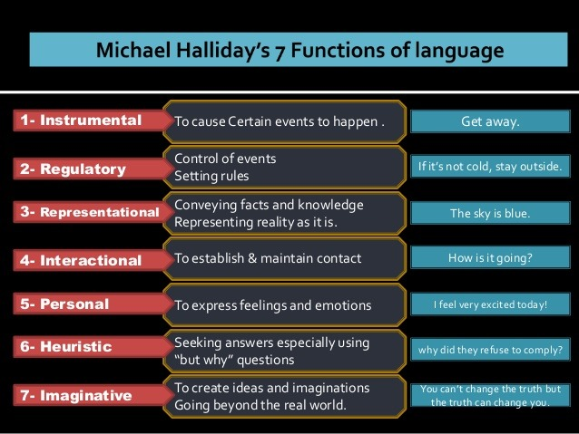

Slide 9
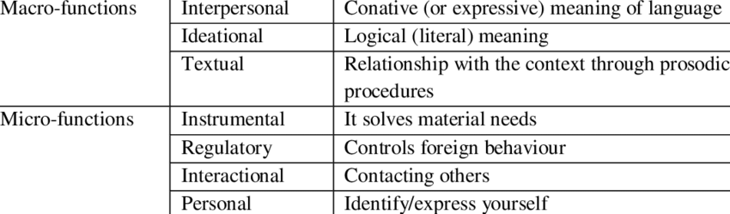
Contd..

Slide 10
Elements of Human Communication
Initiation: Communication starts when a source initiates a statement to convey a thought, need, idea, or information. The receiver interprets the statement and decides on a response.
Feedback: The receiver's response, known as feedback, is sent back to the source. This feedback allows the source to adjust future statements and helps determine if the message was received accurately.

Slide 11
Contd..
Channel: The channel is the medium connecting the source (e.g., speaker) and the receiver (e.g., listener). It involves sound waves for spoken language and light waves for facial expressions and body gestures.
Situation: The situation refers to the setting or environment where the communication takes place.
Purpose: The purpose is the speaker's intention or communicative goal.

Slide 12
Contd..
Attitudes: Both the speaker and listener bring their ideologies, beliefs, likes, dislikes, and emotional states to the communication, influencing their attitudes during the interaction.
Knowledge: The speaker must have sufficient knowledge of the message, derived from observation, study, and experience, to communicate effectively.
Expression: Effective communication relies on clear, fluent, and intelligible expression. Proper expression ensures smooth communication, while faulty expression can lead to misunderstandings.

Slide 13
Contd..
Language: Language is a key element of communication, involving the careful selection of words and sentence patterns. Supported by facial and body gestures, language facilitates effective communication.
Intellectualism: Effective communication requires an intellectual environment where the speaker and listener express and understand views calmly, rationally, and precisely. Without intellectualism, communication may be ineffective.

Slide 14
Few Definitions
Keith (1993) defines communication as "the transfer of information and understanding from one person to another person. It is a way of reaching others with facts, ideas, thoughts and values. It is a bridge of meaning among people so that they can share what they feel and know. By using this bridge a person can cross safely the river of misunderstanding that sometimes separates people"

Slide 15
Miller (1951) puts it this way:
"communication takes place when there is information at one place or person, and we want to get it to another place or person"

Slide 16
Verdman (1970) describes a design for effective communication and says, "effective communication is purposive symbolic interchange resulting in workable understanding and agreement between the sender and the receiver"

Slide 17
Mehrabian Model
7% of meaning is in the words that are spoken
38% of meaning is paralinguistic
55% of meaning is conveyed through facial expression

Slide 18
Interpersonal Communication:
Knowledge of Interpersonal Relations: Having a deep understanding of interpersonal dynamics and achieving a balance in communication is crucial for effective interaction.
Appropriate Communication: It's important to discern what to communicate, to whom, when, and how. For example, it's inappropriate to complain to a new colleague about the boss or to a partner about a nagging spouse.

Slide 19
Levels of Communication
Communication is categorized into five levels based on the nature, scope, and depth of interaction:
Passing Communication: Involves everyday greetings like "hello" or "good morning," meant to acknowledge someone's presence without expecting or giving a detailed response.
Factual Communication: Focuses on exchanging factual information, such as giving instructions or passing on concise details. This type of communication carries minimal emotional risk and is common in organizational settings.
Thoughts and Ideas: Involves sharing ideas and engaging in more involved communication. This level carries a higher risk of rejection, as it involves deeper interaction.

Slide 20
Contd..
Feelings: Entails sharing emotions and sentiments, making the communicator vulnerable to rejection. This level of communication involves a greater emotional risk.
Peak Communication: Represents the highest level of communication, characterized by perfect understanding between individuals or within a group. This level relies on creativity and a harmonious work culture.

